Slide 1
Introduction to Linux
Linux User Group at UTA
Rohit Rawat

Slide 2
Goals of Linux User Group
promote the use of the Linux operating system and other open source software.
provide a venue for students to gain experience giving technical presentations.
provide a forum for students to learn about new aspects of Linux and open source software.
promote fellowship among students who participate in the group.

Slide 3
What is Linux
Linux is an Operating System (OS) – the software that manages its processor, memory and devices and lets you run different programs on it.
It is free and open source.
It has been developed collaboratively by many developers across the globe making it extremely robust and transparent.
It is the number one OS running on the Internet^{[1]} – Google and Facebook's sites run on Linux OS.

Slide 4
The world of Operating Systems
In early days, computers were large multi-user mainframes running some flavor of the Unix operating system. (1969-current)
Personal Computers (PC) started using MSDOS (1981-2000), transitioning to Windows later (1990-current).
Mac-OS competed with Windows on Mac-PCs but Microsoft always dominated.^{[2]} (1984-current)
Linux rose as a free Unix-”like” operating system now completely dominating the server market and becoming a popular PC OS.^{[1]} (1991-current)

Slide 5
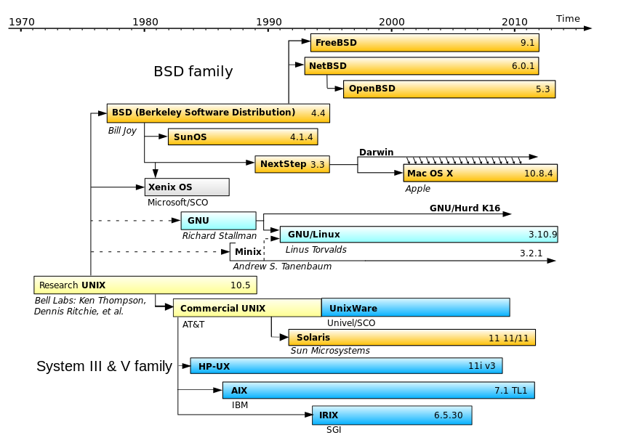
"Unix history" by Guillem, Wereon, Hotmocha (copied from old version's history)Christoph S. (redrew the image with Inkscape) - Original image: Image:Unix.png. Licensed under Public domain via Wikimedia Commons - http://commons.wikimedia.org/wiki/File:Unix_history.svg#mediaviewer/File:Unix_history.svg

Slide 6
Why you might need Linux
Software Engineers & System Administrators
  Large websites like Google/Facebook run on Linux^{[3]}
  Most hardware (smartphones, TVs..) runs on Linux
  Prevalent programming environment
Robotics and Control Engineers
  ROS based on Linux
Mechanical/Aerospace/Physics Engineers
  Run simulations on high performance clusters which run on Linux

Slide 7
Free Open Source
“Free as in freedom”
Software with source code available that you are free to study, change and distribute for any purpose. Examples GPL, BSD licenses.
“Standing on the shoulders of giants”
Imagine:
  Having to pay ridiculous amounts of money to start working on a new idea
  Not being unable to customize software to your needs
  = stifled innovation!

Slide 8
Open Source in Your Life^{[1,4]}
Major websites:
  Google, Facebook, Amazon, Twitter, Dropbox
Software you use:
  Mozilla Firefox, Oracle Java, VLC, LibreOffice
Android smartphones
Embedded Linux devices:
  Smart TVs & DVRs, ATM machines, Wireless routers

Slide 9
LUG-UTA Goals this Semester
Introduce you to the Linux shell and desktop
Guide you to setting up a web server
Set up your programming environment in Linux
Show off exciting applications of Linux like Rasberry-Pi and Robot Operating System
Plus, we will have many presentation on advanced topics like Latex authoring, version control, Linux security, networking and many new topics

Slide 10
Getting started with Linux
Install Linux on a virtual machine (VM)
Read some good Linux tutorials on the web
Watch some Linux introductory videos on the internet
Try your new skills on your Linux VM
Attend LUG meetings

Slide 11
Installation on a Virtual Machine
Download and install Oracle VirtualBox (shown in this guide) https://www.virtualbox.org/wiki/Downloads
  VirtualBox 4.x.x for Windows hosts x86/amd64
  VirtualBox 4.x.x for OS X hosts x86/amd64
Download the ISO image of a Linux distribution (Ubuntu Linux will be used for this demo)
  Ubuntu 64-bit http://releases.ubuntu.com/14.04.1/ubuntu-14.04.1-desktop-amd64.iso
  Ubuntu 32-bit http://releases.ubuntu.com/14.04.1/ubuntu-14.04.1-desktop-i386.iso

Slide 12
Installation
Refer to this video for help in the install: https://www.youtube.com/watch?v=0WiiswmOH1Q

Slide 13
Homework :)
Register for this free, self paced Linux course on EdX:
  https://www.edx.org/course/linuxfoundationx/linuxfoundationx-lfs101x-introduction-1621
  There are no deadlines to meet, take your time reading the material
Watch these introductory videos on YouTube:
  A detailed guide to installing Ubuntu inside VirtualBox on a Windows computer (it applies to Ubuntu 14.04 as well): https://www.youtube.com/watch?v=0WiiswmOH1Q
  A dummies introduction to Ubuntu: https://www.youtube.com/watch?v=Do5npazUXpM
  An introduction to command line: https://www.youtube.com/watch?v=IVquJh3DXUA

Slide 14
Upcoming events
Computer Security Club meeting at 6:00pm in ERB 414
HP Event on September 22 at 6:00pm
LUG meetings:
  Linux commands!
  Robot OS and demos!

Slide 15
Contact Info
Website: www.luguta.org
Join us on MavOrgs: https://mavorgs.collegiatelink.net/
Join our mailing list (see web page)
Email:
  Rohit Rawat rohitrawat@gmail.com
  Clayton Dorsey claytondorsey@gmail.com
Next meeting tentatively in two weeks.

Slide 16
References
[1] http://en.wikipedia.org/wiki/Linux_adoption
[2] http://en.wikipedia.org/wiki/Microsoft_Windows
[3] http://en.wikipedia.org/wiki/Google_platform
[4] http://en.wikipedia.org/wiki/Linux

