Slide 1
Linux User Group at UTA
www.luguta.org
Introduction to Markdown
Rohit Rawat

Slide 2

Introduction to Markdown
Quick and easy way to create documentation with basic formatting
Easy to write as most formatting commands are intuitive and chosen to look like what they mean
Markdown plain text is easy to read and visually corresponds to the rendered HTML
Popularly used in creating README documents and in web forums
Available on all platforms and major websites

Slide 3
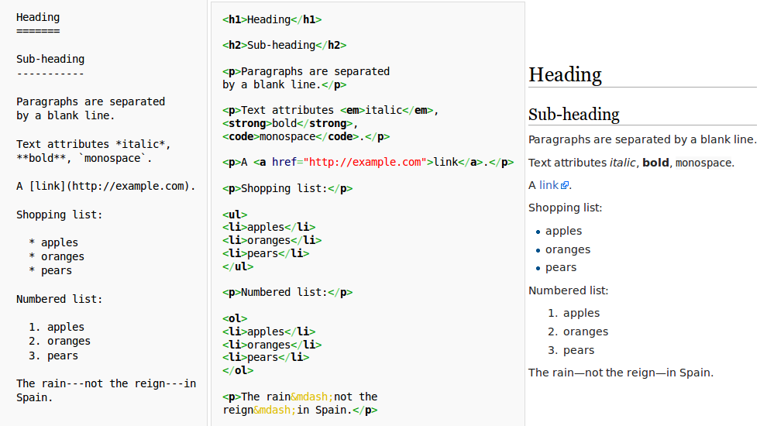
Example
Markdown:
HTML:
Results in a web browser:

Slide 4

Syntax
Headings (<H1>Text</H1> etc.):
# H1
## H2
### H3
#### H4
##### H5
###### H6
Alternatively, for H1 and H2, you can use underlines:
Alt-H1
=====
Alt-H2
--------

Slide 5
Syntax
Italics:
*italic text* or _italic text_
Bold:
**bold text** or __bold text__
Note: The _ for emphasis can be a headache with
variable_names etc. Try escaping with \_.

Slide 6
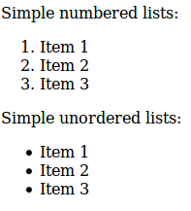
Syntax
Simple numbered lists:
1. Item 1
2. Item 2
3. Item 3
Simple unordered lists:
* Item 1
* Item 2
* Item 3
Can use *, or -, or + for unordered lists

Slide 7
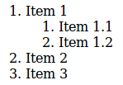
Syntax
Nested lists:
1. Item 1
1. Item 1.1
2. Item 1.2
2. Item 2
3. Item 3
Use two spaces for each level of nesting

Slide 8

Syntax
Inline links:
[Link text](link url)
I love the [LUG website](http://www.luguta.org/)
Results:
I love the <a href="http://www.luguta.org/">LUG website</a>
Note: Omitting the http:// from the link makes it a relative link.
So be sure to keep it when linking to another website.

Slide 9
Syntax
Bibliography style links (for listing longer URLs at the end):
[Link text][id]
[id]: the link's URL
Example:
Visit the [LUG website][lug] and also sign up on our [mailing list][list].
...
[lug]: http://www.luguta.org/
[list]: https://listserv.uta.edu/cgi-bin/wa.exe?SUBED1=LUGUTA&A=1

Slide 10

Syntax
Images – similar to links but with an exclamation mark
Inline-style:
![alt text](image address)
Reference-style:
![alt text][id]
[id]: link
Example:
![A cat eating a cupcake][cat]
[cat]: http://catsoncupcakes.com/catsoncupcakes.jpg

Slide 11
Syntax
Paragraph and line breaks:
- An empty line signifies a new paragraph.
- Two spaces at the end of a line signify a forced line break.
Line breaks are useful around images.
Code:
Inline code can be put in backticks `my_variable_name`.
It appears in monospace and ignores any other formatting.
For a block of code, use a tab at the start of each line.

Slide 12
Use Cases
If you host a project on Github, it's and Markdown files are automatically rendered in HTML. Like:
https://github.com/jquery/jquery/blob/master/README.md
If you don't like WYSIWYG HTML editors and don't want to learn HTML syntax, you can use Markdown to author web pages.
Forums like stackoverflow.com support Markdown syntax in questions and answers.

Slide 13
Links
Original Markdown page:
http://daringfireball.net/projects/markdown/basics
Python markdown module:
https://pythonhosted.org/Markdown/
Markdown help for
  Github - https://help.github.com/articles/github-flavored-markdown
  Stackoverflow - http://stackoverflow.com/editing-help

