Slide 1
PDF Cracker

Slide 2
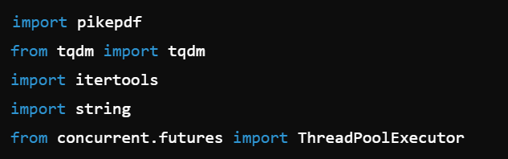
import pikepdf: Imports the pikepdf library, which is used to work with PDF files, including opening password-protected PDFs.
from tqdm import tqdm: Imports the tqdm library, which is used to display progress bars.
import itertools: Imports the itertools module, which provides functions for creating iterators for efficient looping.
import string: Imports the string module, which contains a collection of string constants (e.g., ASCII letters, digits, punctuation).
from concurrent.futures import ThreadPoolExecutor: Imports ThreadPoolExecutor from the concurrent.futures module, allowing concurrent execution of functions using a pool of threads.

Slide 3
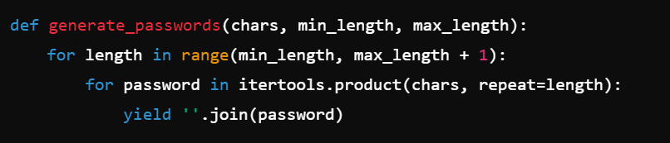
def generate_passwords(chars, min_length, max_length):: Defines a generator function that yields passwords of varying lengths.
for length in range(min_length, max_length + 1):: Loops through each length from min_length to max_length.
for password in itertools.product(chars, repeat=length):: Generates all possible combinations of the given characters for the current length.
yield ''.join(password): Yields each generated password as a string.

Slide 4
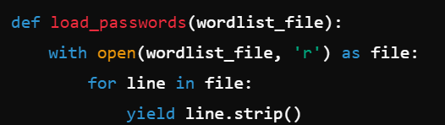
def load_passwords(wordlist_file):: Defines a generator function that yields passwords from a wordlist file.
with open(wordlist_file, 'r') as file:: Opens the wordlist file in read mode.
for line in file:: Iterates over each line in the file.
yield line.strip(): Yields each line stripped of leading and trailing whitespace.

Slide 5
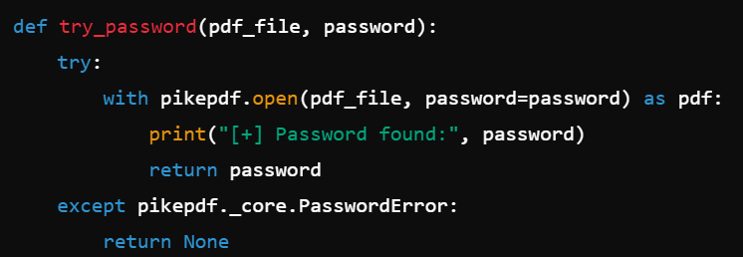
def try_password(pdf_file, password):: Defines a function that attempts to open a PDF file with a given password.
try:: Starts a try block to handle potential exceptions.
with pikepdf.open(pdf_file, password=password) as pdf:: Attempts to open the PDF file with the given password.
print("[+] Password found:", password): Prints a success message if the password is correct.
return password: Returns the found password.
except pikepdf._core.PasswordError:: Catches the exception if the password is incorrect.
return None: Returns None if the password is incorrect.

Slide 6
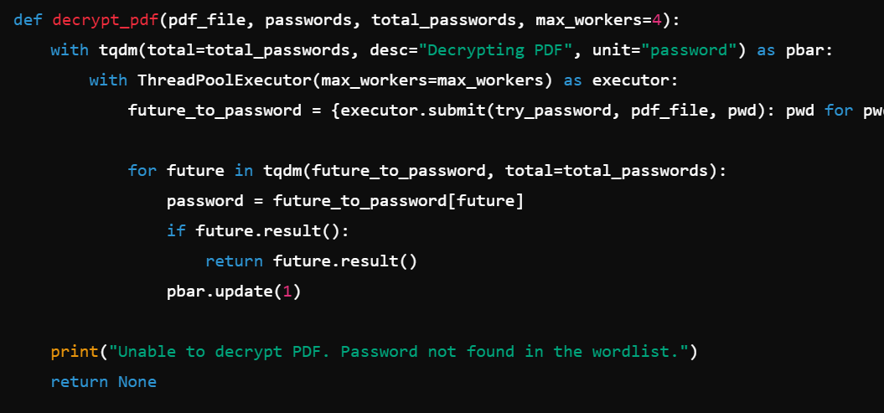
def decrypt_pdf(pdf_file, passwords, total_passwords, max_workers=4):: Defines the main function for decrypting the PDF.
with tqdm(total=total_passwords, desc="Decrypting PDF", unit="password") as pbar:: Creates a progress bar for the password attempts.
with ThreadPoolExecutor(max_workers=max_workers) as executor:: Creates a thread pool executor to handle concurrent tasks.
future_to_password = {executor.submit(try_password, pdf_file, pwd): pwd for pwd in passwords}: Submits tasks to try each password on the PDF file.
for future in tqdm(future_to_password, total=total_passwords):: Iterates over the future results with a progress bar.
password = future_to_password[future]: Retrieves the password associated with the current future.
if future.result():: Checks if the password was correct.
return future.result(): Returns the found password if correct.
pbar.update(1): Updates the progress bar.
print("Unable to decrypt PDF. Password not found in the wordlist."): Prints a failure message if no password was found.
return None: Returns None if no password was found.

Slide 7
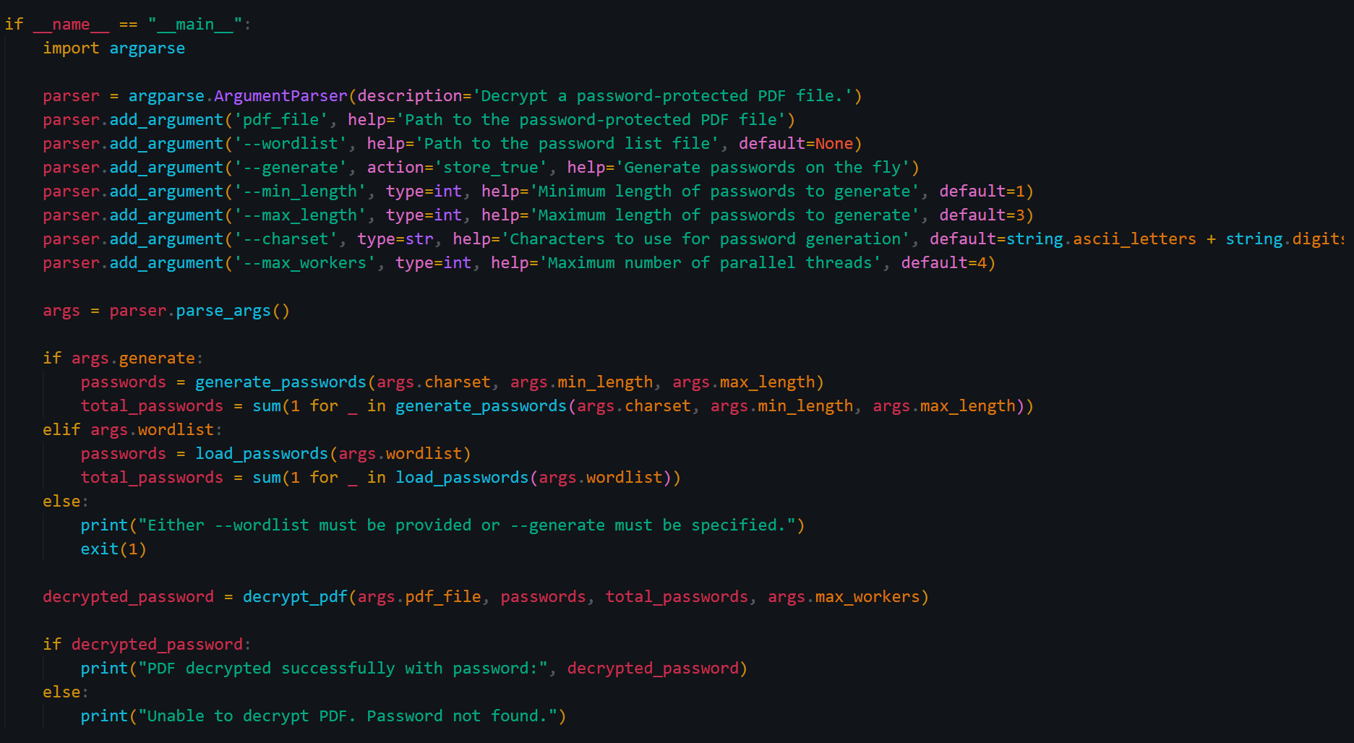

Slide 8
if __name__ == "__main__":: Ensures that the following code block runs only if the script is executed directly.
import argparse: Imports the argparse module for parsing command-line arguments.
parser = argparse.ArgumentParser(description='Decrypt a password-protected PDF file.'): Creates an argument parser.
parser.add_argument('pdf_file', help='Path to the password-protected PDF file'): Adds a required positional argument for the PDF file path.
parser.add_argument('--wordlist', help='Path to the password list file', default=None): Adds an optional argument for the wordlist file path.
parser.add_argument('--generate', action='store_true', help='Generate passwords on the fly'): Adds an optional flag to generate passwords on the fly.
parser.add_argument('--min_length', type=int, help='Minimum length of passwords to generate', default=1): Adds an optional argument for the minimum password length.
parser.add_argument('--max_length', type=int, help='Maximum length of passwords to generate', default=3): Adds an optional argument for the maximum password length.
parser.add_argument('--charset', type=str, help='Characters to use for password generation', default=string.ascii_letters + string.digits + string.punctuation): Adds an optional argument for the character set used in password generation.
parser.add_argument('--max_workers', type=int, help='Maximum number of parallel threads', default=4): Adds an optional argument for the maximum number of parallel threads.
args = parser.parse_args(): Parses the command-line arguments.
if args.generate:: Checks if the --generate flag is specified.
passwords = generate_passwords(args.charset, args.min_length, args.max_length): Generates passwords using the specified character set and lengths.
total_passwords = sum(1 for _ in generate_passwords(args.charset, args.min_length, args.max_length)): Calculates the total number of generated passwords.
elif args.wordlist:: Checks if a wordlist file is provided.
passwords = load_passwords(args.wordlist): Loads passwords from the wordlist file.
total_passwords = sum(1 for _ in load_passwords(args.wordlist)): Calculates the total number of passwords in the wordlist.
else:: If neither --generate nor --wordlist is specified.
print("Either --wordlist must be provided or --generate must be specified."): Prints an error message.
exit(1): Exits the script with an error code.
decrypted_password = decrypt_pdf(args.pdf_file, passwords, total_passwords, args.max_workers): Calls the decrypt_pdf function with the provided arguments.
if decrypted_password:: Checks if a password was found.
print("PDF decrypted successfully with password:", decrypted_password): Prints a success message with the found password.
else:: If no password was found.
print("Unable to decrypt PDF. Password not found."): Prints a failure message.

