Slide 1
Port Scanner

Slide 2
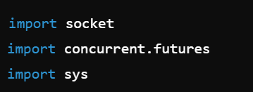
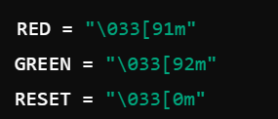
import socket: Imports the socket library, which provides low-level networking interfaces.
import concurrent.futures: Imports the concurrent.futures module, which provides a high-level interface for asynchronously executing callables.
import sys: Imports the sys module, which provides access to some variables used or maintained by the Python interpreter and to functions that interact strongly with the interpreter.
These constants define color codes for red and green text, and reset the color to default. These will be used to color-code the output.

Slide 3
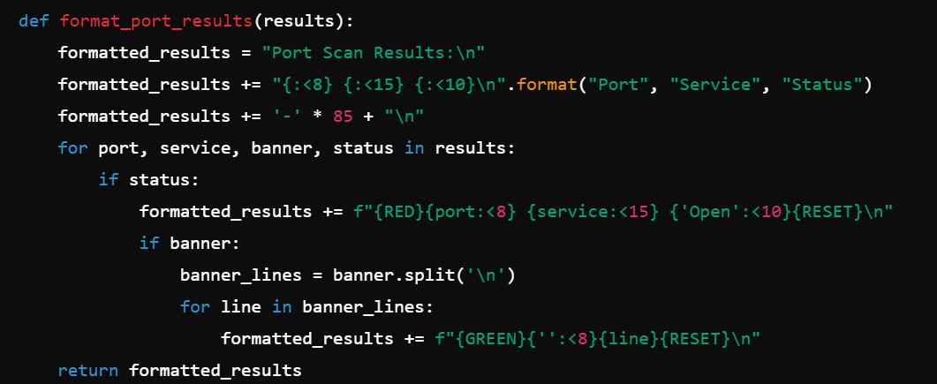
def format_port_results(results):: Defines a function to format the results of the port scan.​
formatted_results = "Port Scan Results:\n": Initializes a string to hold the formatted results.​
formatted_results += "{:<8} {:<15} {:<10}\n".format("Port", "Service", "Status"): Adds a header line with columns for Port, Service, and Status.​
formatted_results += '-' * 85 + "\n": Adds a separator line.​
for port, service, banner, status in results:: Iterates over the scan results.
if status:: Checks if the port is open.
formatted_results += f"{RED}{port:<8} {service:<15} {'Open':<10}{RESET}\n": Adds the port, service, and status to the results string, colored red for open ports.
if banner:: Checks if a banner was retrieved.
banner_lines = banner.split('\n'): Splits the banner into lines.
for line in banner_lines:: Iterates over the banner lines.
formatted_results += f"{GREEN}{'':<8}{line}{RESET}\n": Adds each line of the banner to the results string, colored green.
return formatted_results: Returns the formatted results string.

Slide 4
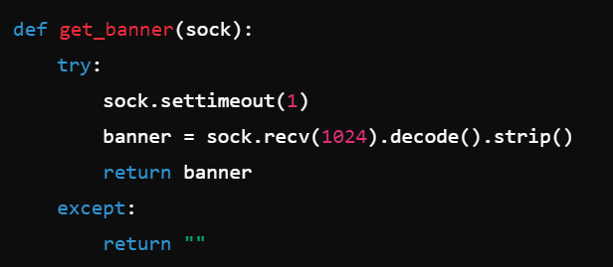
def get_banner(sock):: Defines a function to retrieve the banner from a socket.
try:: Starts a try block to handle potential errors.
sock.settimeout(1): Sets a 1-second timeout for the socket.
banner = sock.recv(1024).decode().strip(): Receives up to 1024 bytes from the socket, decodes the bytes to a string, and removes any leading or trailing whitespace.
return banner: Returns the banner.
except:: Catches any exceptions that occur.
return "": Returns an empty string if an exception occurs.

Slide 5
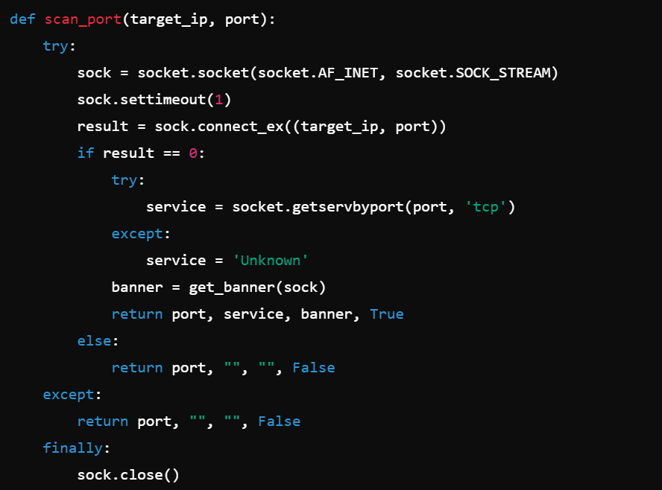
def scan_port(target_ip, port):: Defines a function to scan a single port on the target IP.
try:: Starts a try block to handle potential errors.
sock = socket.socket(socket.AF_INET, socket.SOCK_STREAM): Creates a new TCP socket.
sock.settimeout(1): Sets a 1-second timeout for the socket.
result = sock.connect_ex((target_ip, port)): Attempts to connect to the target IP and port. Returns 0 if the connection is successful.
if result == 0:: Checks if the connection was successful.
try:: Starts a try block to handle potential errors.
service = socket.getservbyport(port, 'tcp'): Attempts to get the service name for the port.
except:: Catches any exceptions that occur.
service = 'Unknown': Sets the service name to 'Unknown' if an exception occurs.
banner = get_banner(sock): Retrieves the banner from the socket.
return port, service, banner, True: Returns the port, service name, banner, and a status indicating the port is open.
else:: If the connection was not successful.
return port, "", "", False: Returns the port, empty strings for the service and banner, and a status indicating the port is closed.
except:: Catches any exceptions that occur.
return port, "", "", False: Returns the port, empty strings for the service and banner, and a status indicating the port is closed.
finally:: Ensures the following block always executes.
sock.close(): Closes the socket.

Slide 6
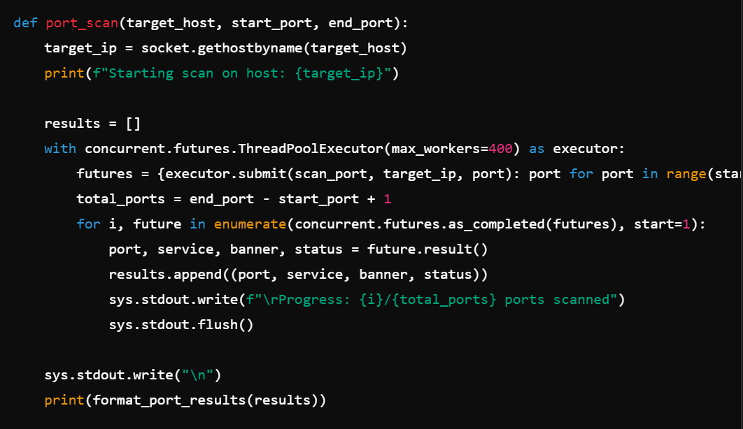
def port_scan(target_host, start_port, end_port):: Defines a function to scan a range of ports on the target host.
target_ip = socket.gethostbyname(target_host): Resolves the target host to an IP address.
print(f"Starting scan on host: {target_ip}"): Prints a message indicating the start of the scan.
results = []: Initializes an empty list to store the scan results.
with concurrent.futures.ThreadPoolExecutor(max_workers=400) as executor:: Creates a thread pool executor with a maximum of 400 threads.
futures = {executor.submit(scan_port, target_ip, port): port for port in range(start_port, end_port + 1)}: Submits tasks to scan each port in the specified range and stores the futures in a dictionary.
total_ports = end_port - start_port + 1: Calculates the total number of ports to scan.
for i, future in enumerate(concurrent.futures.as_completed(futures), start=1):: Iterates over the completed futures.
port, service, banner, status = future.result(): Retrieves the result from the future.
results.append((port, service, banner, status)): Appends the result to the results list.
sys.stdout.write(f"\rProgress: {i}/{total_ports} ports scanned"): Updates the progress on the same line.
sys.stdout.flush(): Flushes the output buffer to ensure the progress message is displayed.
sys.stdout.write("\n"): Writes a newline to move to the next line.
print(format_port_results(results)): Prints the formatted scan results.

Slide 7
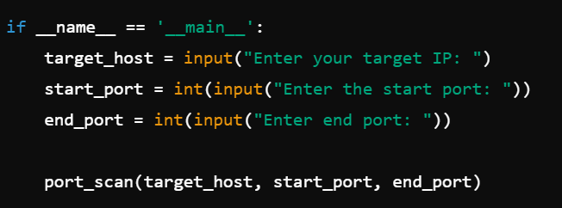
if __name__ == '__main__':: Ensures that the following code block runs only if the script is executed directly.
target_host = input("Enter your target IP: "): Prompts the user to enter the target IP address or hostname.
start_port = int(input("Enter the start port: ")): Prompts the user to enter the starting port number.
end_port = int(input("Enter end port: ")): Prompts the user to enter the ending port number.
port_scan(target_host, start_port, end_port): Calls the port_scan function with the provided arguments.

