Slide 1
Password cracker

Slide 2
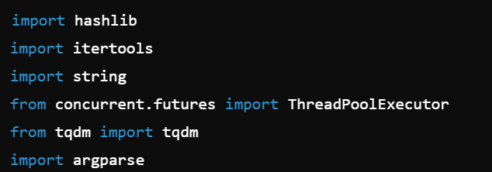
import hashlib: Imports the hashlib module, which provides tools for secure hash and message digest algorithms (e.g., MD5, SHA-1, SHA-256).
import itertools: Imports the itertools module, which provides functions for creating iterators for efficient looping.
import string: Imports the string module, which contains a collection of string constants (e.g., ASCII letters, digits).
from concurrent.futures import ThreadPoolExecutor: Imports ThreadPoolExecutor from the concurrent.futures module, allowing concurrent execution of functions using a pool of threads.
from tqdm import tqdm: Imports tqdm, a module used to display progress bars for loops.
import argparse: Imports the argparse module, which is used for parsing command-line arguments.

Slide 3
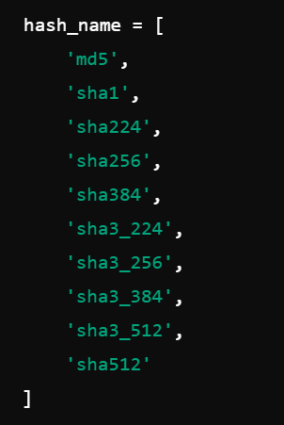
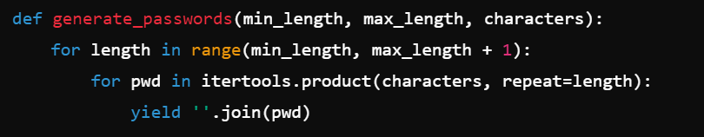
hash_name: A list of supported hash algorithm names that the script can use for cracking.
def generate_passwords(min_length, max_length, characters):: Defines a generator function that yields passwords of varying lengths.
for length in range(min_length, max_length + 1):: Loops through each length from min_length to max_length.
for pwd in itertools.product(characters, repeat=length):: Generates all possible combinations of the given characters for the current length.
yield ''.join(pwd): Yields each generated password as a string.

Slide 4

def check_hash(hash_fn, password, target_hash):: Defines a function that checks if the given password matches the target hash.
return hash_fn(password.encode()).hexdigest() == target_hash: Hashes the password using the specified hash function, compares it to the target hash, and returns True if they match.

Slide 5
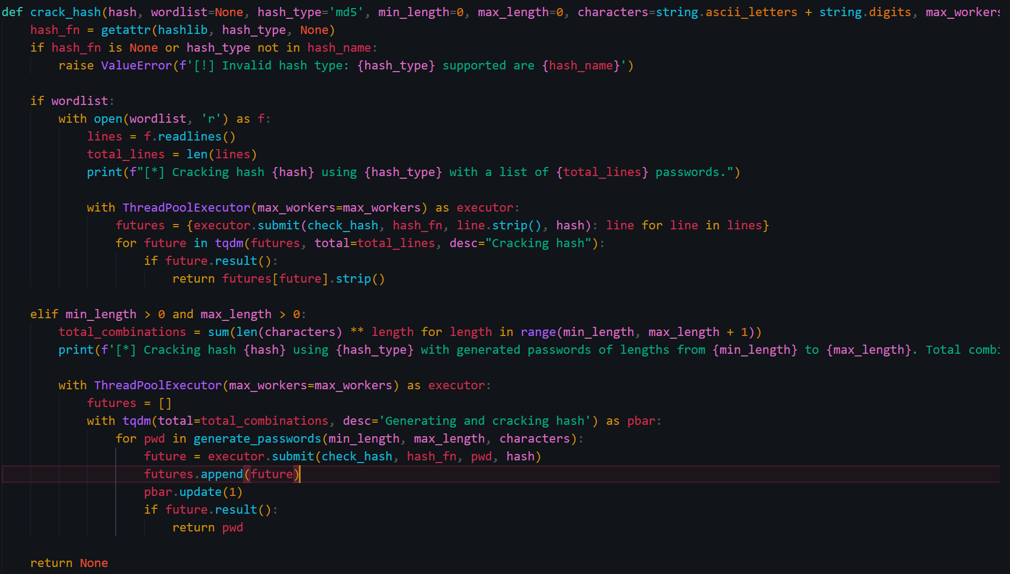
def crack_hash(hash, wordlist=None, hash_type='md5', min_length=0, max_length=0, characters=string.ascii_letters + string.digits, max_workers=4):: Defines the main function for cracking the hash.
hash_fn = getattr(hashlib, hash_type, None): Retrieves the hash function from the hashlib module based on the specified hash_type.
if hash_fn is None or hash_type not in hash_name:: Checks if the hash function is valid and supported.
raise ValueError(f'[!] Invalid hash type: {hash_type} supported are {hash_name}'): Raises an error if the hash type is invalid.

Slide 6
if wordlist:: Checks if a wordlist is provided.
with open(wordlist, 'r') as f:: Opens the wordlist file.
lines = f.readlines(): Reads all lines (passwords) from the wordlist.
total_lines = len(lines): Gets the total number of passwords in the wordlist.
print(f"[*] Cracking hash {hash} using {hash_type} with a list of {total_lines} passwords."): Prints the information about the cracking process.
with ThreadPoolExecutor(max_workers=max_workers) as executor:: Creates a thread pool executor to handle concurrent tasks.
futures = {executor.submit(check_hash, hash_fn, line.strip(), hash): line for line in lines}: Submits tasks to check each password from the wordlist.
for future in tqdm(futures, total=total_lines, desc="Cracking hash"):: Iterates over the future results with a progress bar.
if future.result():: Checks if the result matches the target hash.
return futures[future].strip(): Returns the cracked password.
elif min_length > 0 and max_length > 0:: Checks if password generation parameters are provided.
total_combinations = sum(len(characters) ** length for length in range(min_length, max_length + 1)): Calculates the total number of password combinations.
print(f'[*] Cracking hash {hash} using {hash_type} with generated passwords of lengths from {min_length} to {max_length}. Total combinations: {total_combinations}.'): Prints the information about the cracking process.
with ThreadPoolExecutor(max_workers=max_workers) as executor:: Creates a thread pool executor to handle concurrent tasks.
futures = []: Initializes a list to store future tasks.
with tqdm(total=total_combinations, desc='Generating and cracking hash') as pbar:: Creates a progress bar for the password generation and cracking process.
for pwd in generate_passwords(min_length, max_length, characters):: Iterates over the generated passwords.
future = executor.submit(check_hash, hash_fn, pwd, hash): Submits a task to check the current password.
futures.append(future): Adds the future task to the list.
pbar.update(1): Updates the progress bar.
if future.result():: Checks if the result matches the target hash.
return pwd: Returns the cracked password.

Slide 7
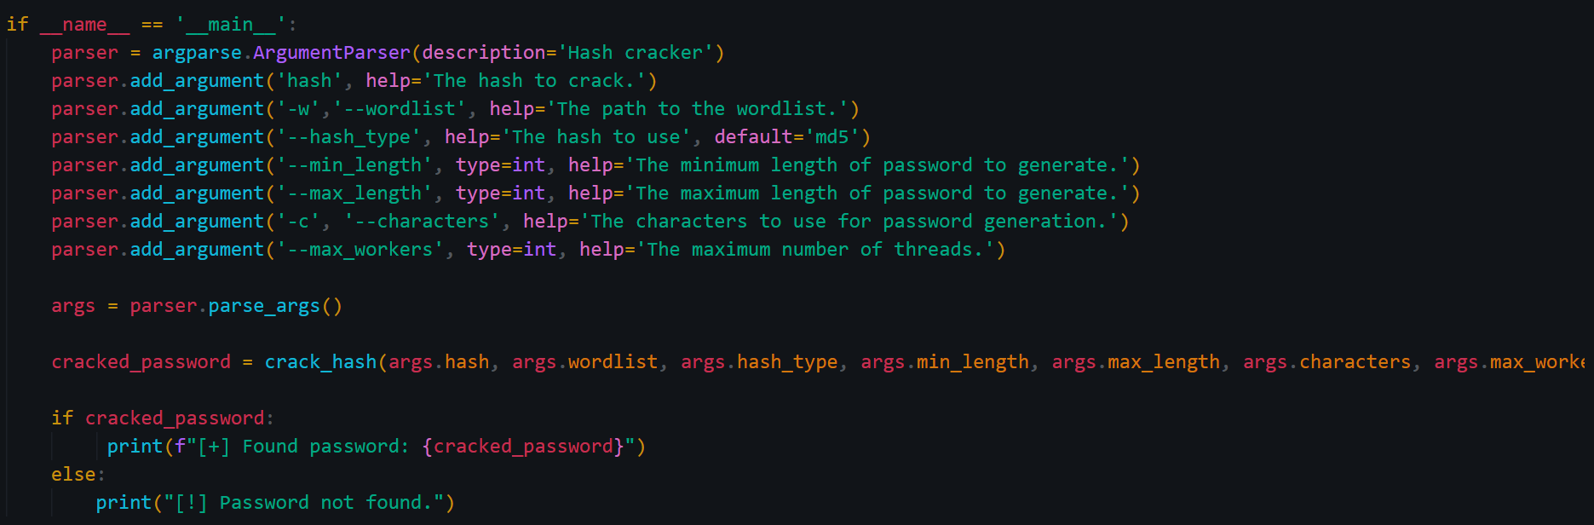
if __name__ == '__main__':: Ensures that the following code block runs only if the script is executed directly.
parser = argparse.ArgumentParser(description='Hash cracker'): Creates an argument parser for command-line arguments.
parser.add_argument('hash', help='The hash to crack.'): Adds a required positional argument for the hash to crack.

Slide 8
parser.add_argument('-w','--wordlist', help='The path to the wordlist.'): Adds an optional argument for the path to the wordlist.
parser.add_argument('--hash_type', help='The hash to use', default='md5'): Adds an optional argument for the hash type, defaulting to md5.
parser.add_argument('--min_length', type=int, help='The minimum length of password to generate.'): Adds an optional argument for the minimum length of generated passwords.
parser.add_argument('--max_length', type=int, help='The maximum length of password to generate.'): Adds an optional argument for the maximum length of generated passwords.
parser.add_argument('-c', '--characters', help='The characters to use for password generation.'): Adds an optional argument for the characters to use in password generation.
parser.add_argument('--max_workers', type=int, help='The maximum number of threads.'): Adds an optional argument for the maximum number of threads to use.
args = parser.parse_args(): Parses the command-line arguments.
cracked_password = crack_hash(args.hash, args.wordlist, args.hash_type, args.min_length, args.max_length, args.characters, args.max_workers): Calls the crack_hash function with the parsed arguments.
if cracked_password:: Checks if a password was found.
print(f"[+] Found password: {cracked_password}"): Prints the found password.
else:: If no password was found.
print("[!] Password not found."): Prints a message indicating the password was not found.

