Slide 1
Deep Reinforcement Learning with Actor-Critic

Slide 2
Outline:
Background
Experiments
Results
Video
Questions

Slide 3
Outline:
Background
Experiments
Results
Video
Questions

Slide 4
Problem Definition:
Markov Decision Process
Q-Learning
Policy Estimation
Credit Assignment
State-of-the-art
Rainbow
Actor-Critic
Notes:
Most recent work in Deep RL can be categorized into advancements in value function methods, policy search, or a hybrid mix of the two.

Slide 5
Outline:
Background
Experiments
Results
Video
Questions

Slide 6
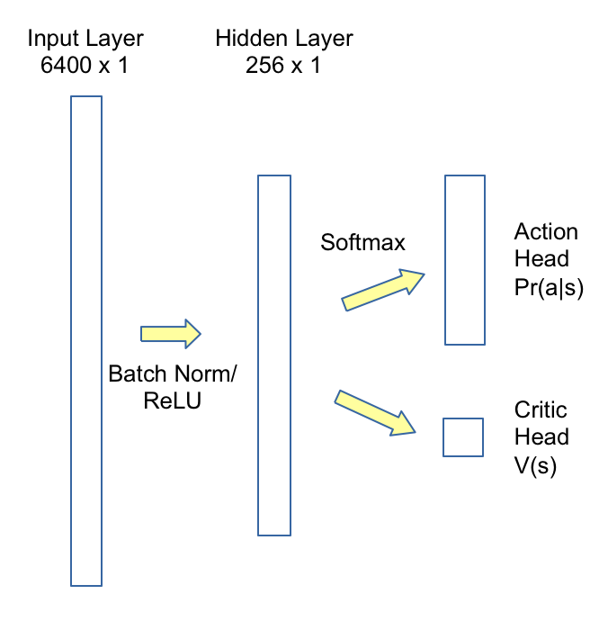
Experiment 1: Linear + Actor/Critic
Notes:
This is a feedforward, fully-connect with 256 hidden units in 1 hidden layer.
The output from the hidden layer is split into two learned function.
The first samples from a softmax distribution to approximate a policy – which learns which action to take, given a state.
The second is a linear combination from the output layer, and is used to approximate a value function, which estimates sum of the expected rewards from a state, using a policy. TODO
Results
When we tried the Karpathy method of diffing consecutive frames, it fails on breakout because it erases the static blocks.
When we tried to use 4 consecutive frames, the model had huge memory demands, with over1.3M parameters per game step.
So we abandon further work with linear models.

Slide 7
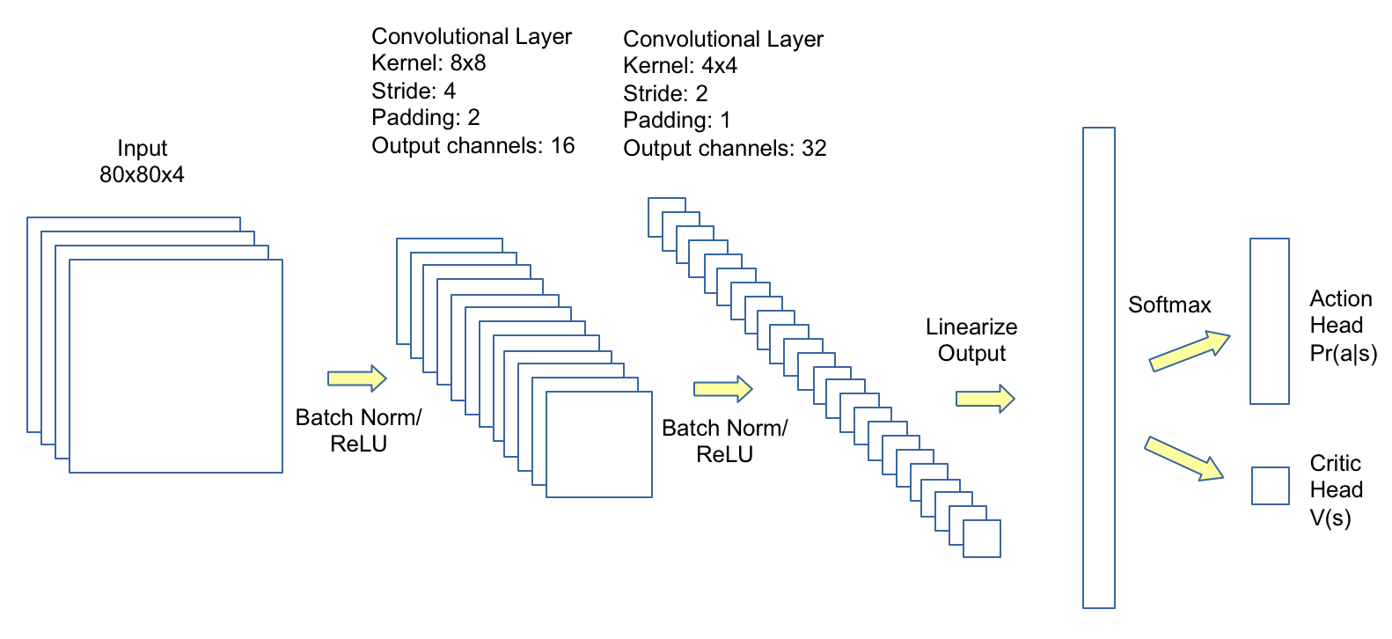
Experiment 2: CNN + Actor/Critic
Notes:
This model is a two layer convolutional neural network, and we use RMSprop as the optimizer.
Preprocessing: ??
Achieves 106% human expert performance on pong, and 154% of human expert performance on breakout.
Both games achieve human level 80K episodes of game play.

Slide 8
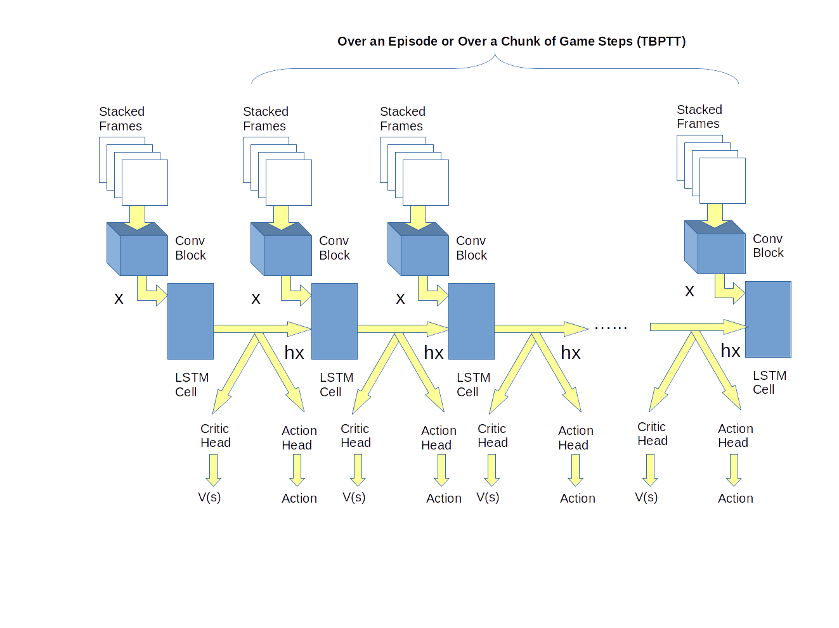
Experiment 3: CNN + LSTM + Actor/Critic
Notes:
The problem in DeepRL is credit assignment. In recent DeepRL work on Atari games, researches have introduced many “hacks” for “experience replay” which samples past state/action pairs, during credit assignment, without violating statistical learning assumptions about independence of game states. This motivates an experiment with LSTM units because we surmise that the network can learn which state/action pairs influenced the final reward. This intuition may have been correct, it is hard to tell, because we stopped before the model converged.
This approach was the best of all our experiments.

Slide 9
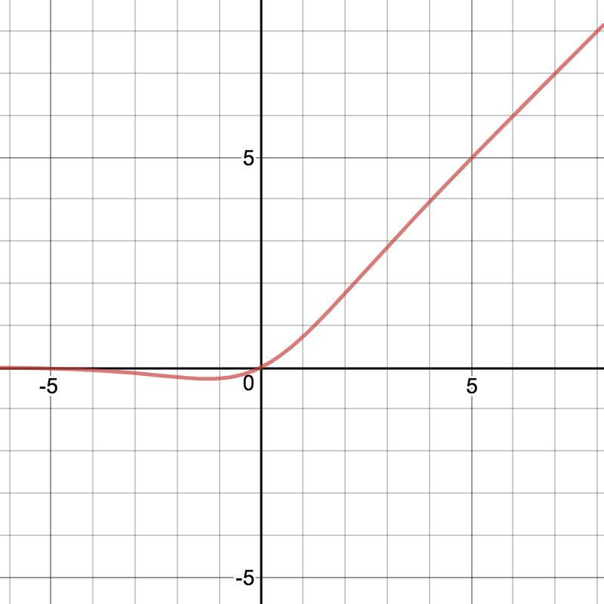
Experiment 3: CNN + LSTM + Actor/Critic
Notes:
In this experiment we also played with activation functions. We really like SiLU/Swish because of the gradient minimum, which ReLU doesn’t have.
However, it seems to do comparably well to ReLU.

Slide 10
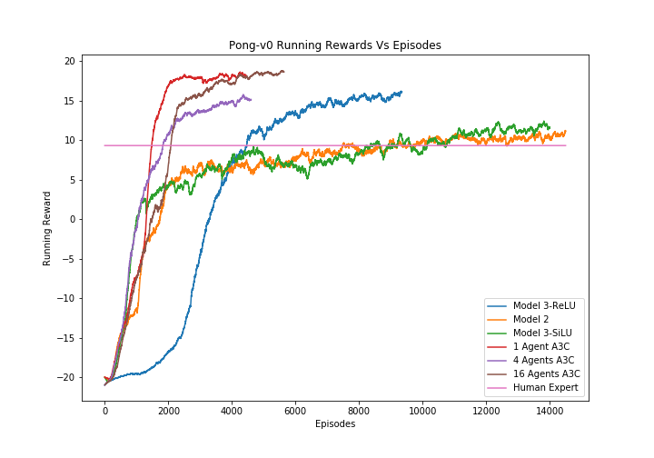
Pong Performance:
Notes:
Benchmarks are Red(1 agent A3C), Purple(4 agent A3c), Brown (16 agent A3c)
Best model is Blue(Model 3, ReLU)
Green (Model 3, SiLU) also does well.
Takes 4500 episodes to beat human expert level.
Is still climbing as of today, and may outperform all benchmarks YAY

Slide 11
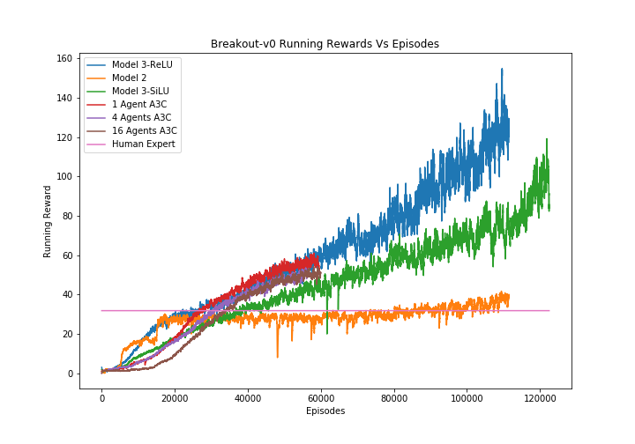
Breakout Performance:
Notes:
Benchmarks are Red(1 agent A3C), Purple(4 agent A3c), Brown (16 agent A3c).
Superimposed and doing worse than us!
Best model is Blue(Model 3, ReLU)
Green (Model 3, SiLU) also does well.
Takes 25K episodes to beat human expert level (faster than A3C).
Is still climbing as of today, and may break world-records!

Slide 12
Outline:
Background
Experiments
Results
Video
Questions

Slide 13
Video:

Slide 14
Thank You

