Slide 1
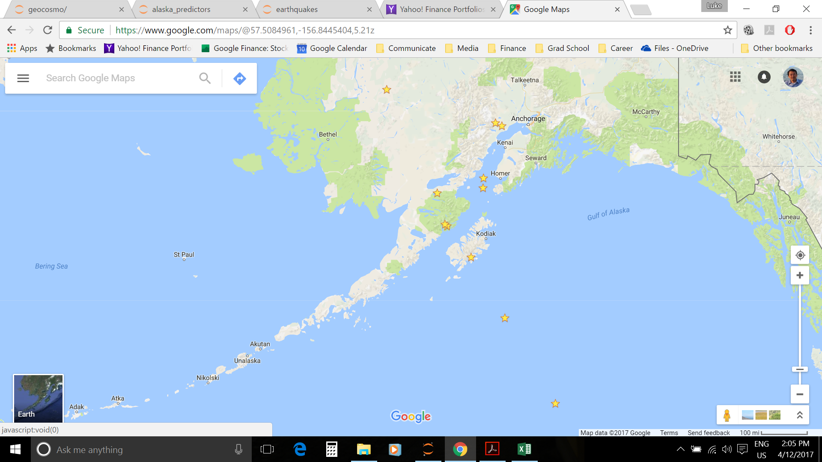
Mag 5.4
2015-12-17
Mag 5.5
2015-12-10
Mag 7.1
2016-01-24
Mag 5.2
2015-11-18
Mag 5.1
2016-01-30
Mag 5.5
2015-12-10
Wider Long/Lat
Window around
Kodiak Station 7
Station 7
Original Long/Lat
Window around
Kodiak Station 7

Slide 2
Mag 5.4
2015-12-17
Stress Line
Mag 5.5
2015-12-10
Mag 7.1
2016-01-24
Mag 5.2
2015-11-18
Mag 5.1
2016-01-30
Mag 5.5
2015-12-10
Wider Long/Lat
Window around
Kodiak Station 7
Station 7
Original Long/Lat
Window around
Kodiak Station 7

Slide 3

Sea level
Magnetic field generated by +ve current
(Right hand rule)
Station 7
Mag Field – Z
Pointing toward ground
And perpendicular to
the current source.
Positive Holes moving
away from Stress Line
+

Slide 4
Sea level
Station 9
Station 8
Magnetic field generated by +ve current
(Right hand rule)
Station 7
Mag Field – Z
Pointing toward ground
And perpendicular to
the current source.
Positive Holes moving
away from Stress Line
+

Slide 5
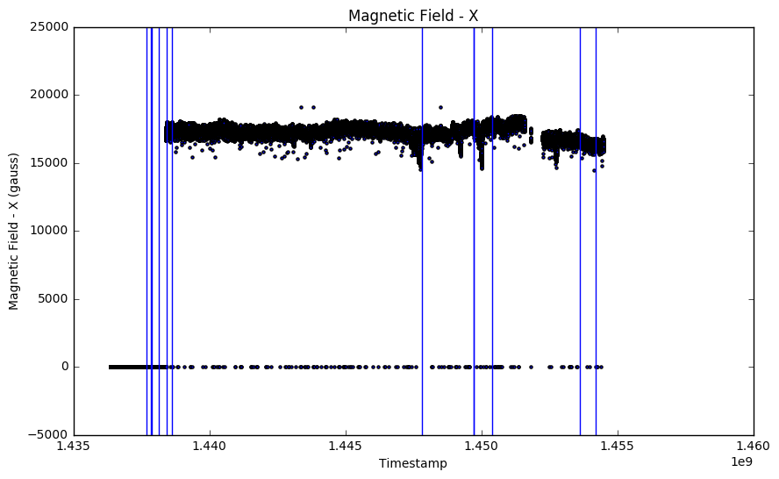

Slide 6
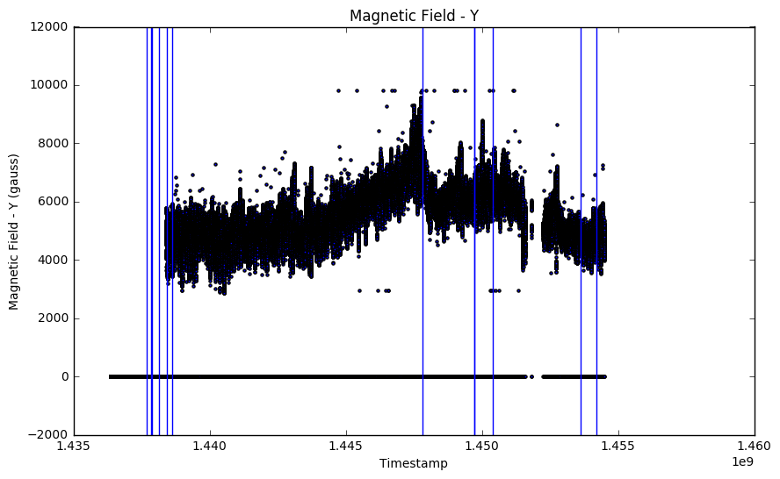

Slide 7
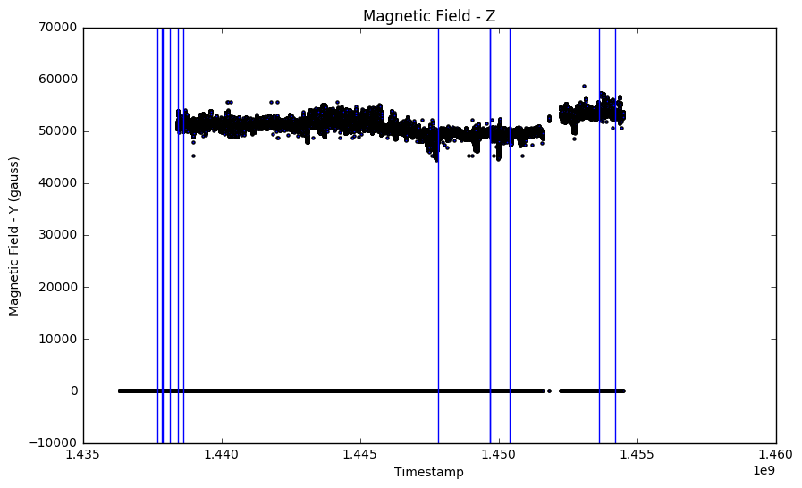

Slide 8
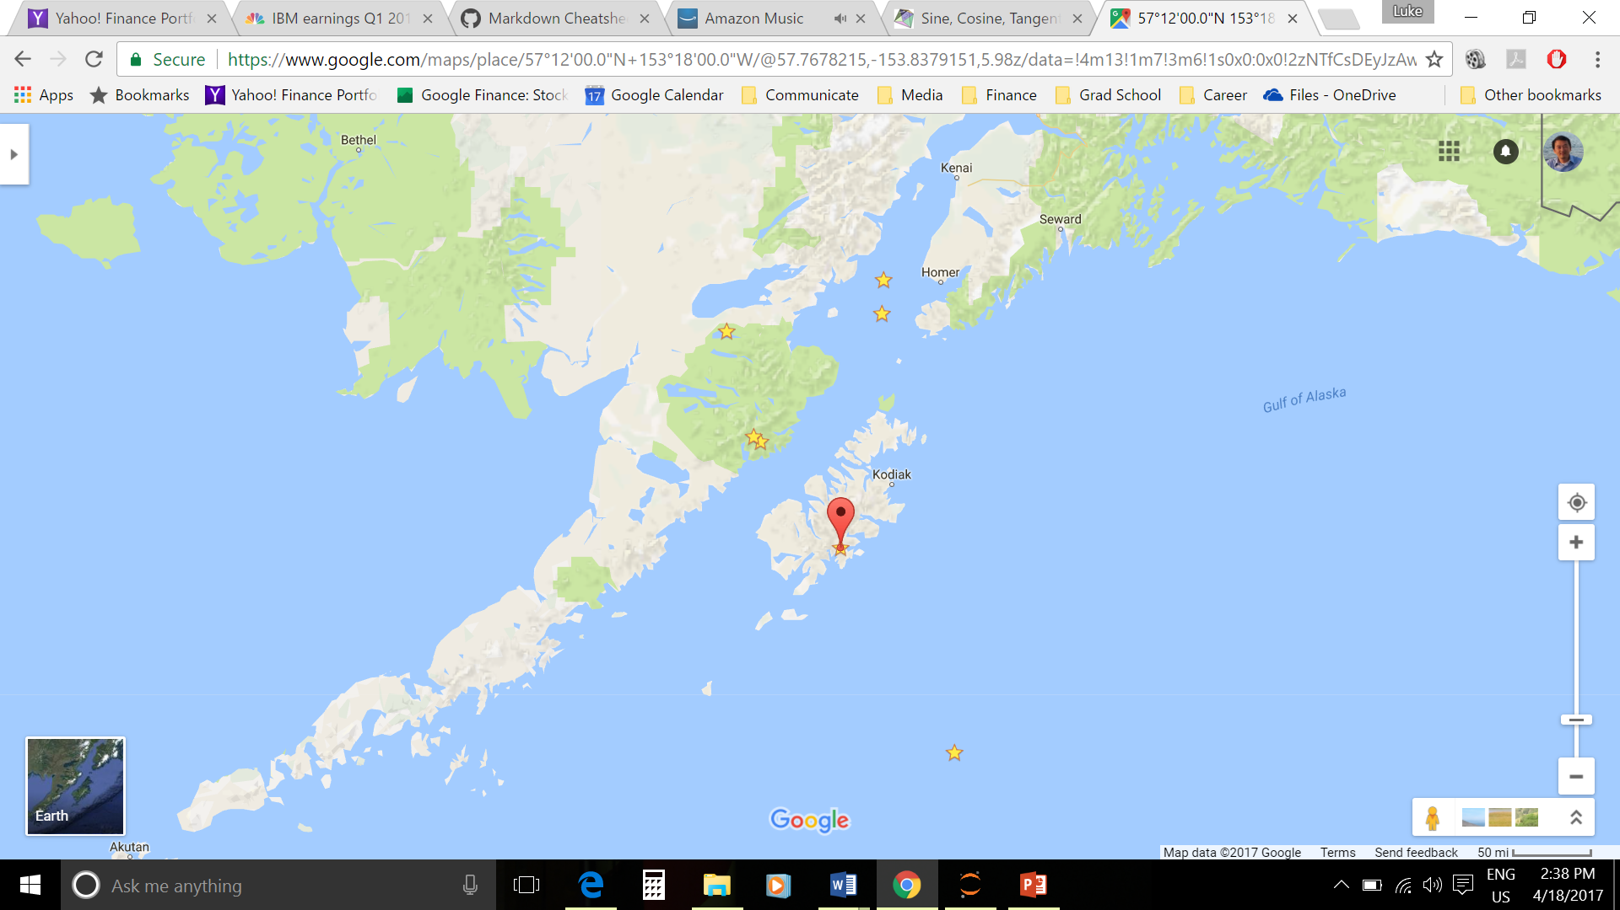
Magnetic
North is 14.72° E
of True North
X Field of 17000nT
17°
Y Field of 5200nT

