Slide 1
Modeling MDs questions
1. Predictors of deterioration (patient profile – disease trajectory)
2. Predictors of underlying mechanism (disease stage)

Slide 2
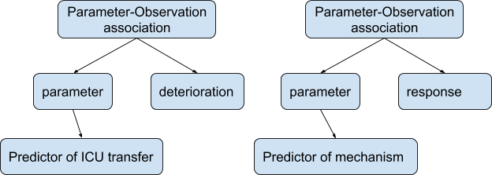

Slide 3
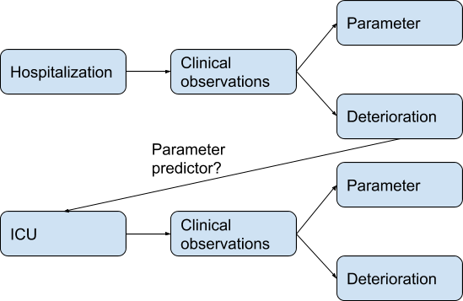

Slide 4
Cohort
Patient
Disease trajectory
Hospitalization
intervention
ICU transfer
organ
Disease state 1 or relapse 1
Medication
Mecanico-ventilation
Deterioration or symptom
Association?
parameter
predictor
Medication
Mechanism
variant
response
gene
Association?
GO
parameter
predictor
cell
organ

Slide 5
Modeling lab & metavision terms for the Dashboard
Temporarily lab model:
- track essential parameters (cytokines)
- datestamp -> disease stage

Slide 6
Modeling lab measurements
Existing models

Slide 7
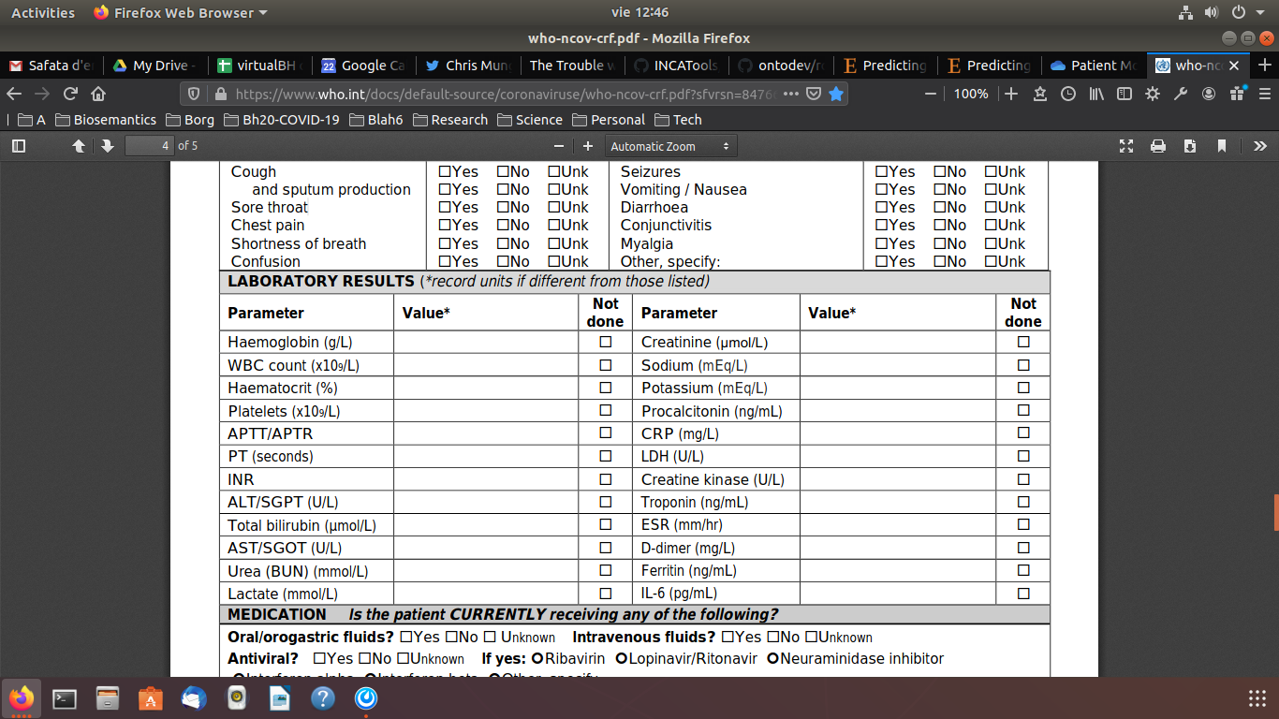
ISMB Quantitative traits
"37.5"^^xsd:float
sio:has-value
sio:has-unit
qt:instance
uo:celsius
iao:measurement-unit-label
bao:bioassay
obi:temperature-measurement-assay
rdf:type
cmo:body-temperature
obi:assay
iao:measurement-datum
https://github.com/NuriaQueralt/BioHackathon/tree/master/bh20-ontology-qt
WHO CRF RAPID 23MAR2020 VERSION: https://www.who.int/docs/default-source/coronaviruse/who-ncov-crf.pdf?sfvrsn=84766e69_2

Slide 8
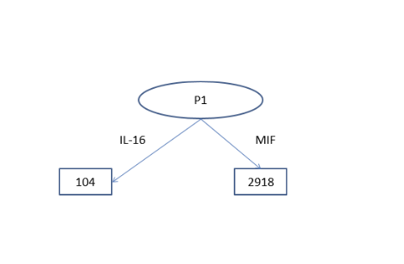
Qinqin model

Slide 9
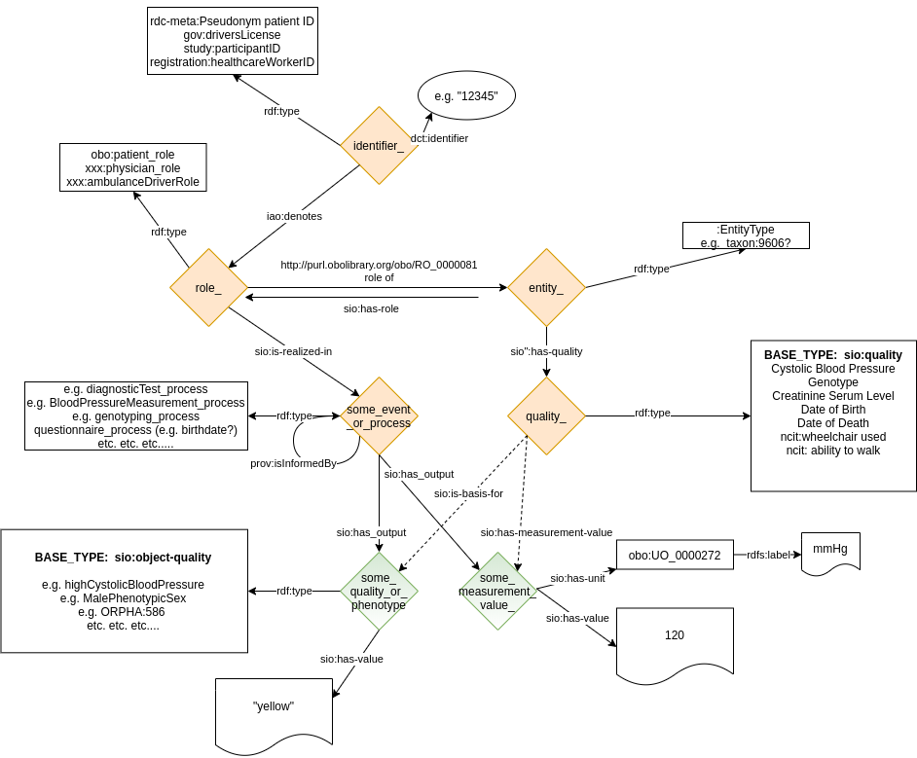
EJP CDE process-based pattern model

Slide 10
Linking to patient model and datestamp
Temporal factor

Slide 11
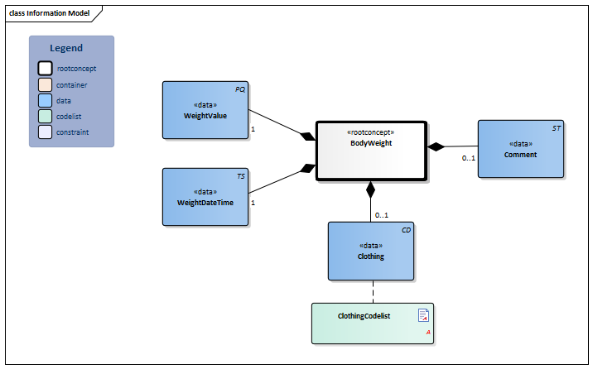
HCIM: https://zibs.nl/wiki/BodyWeight-v3.1(2019EN)

Slide 12
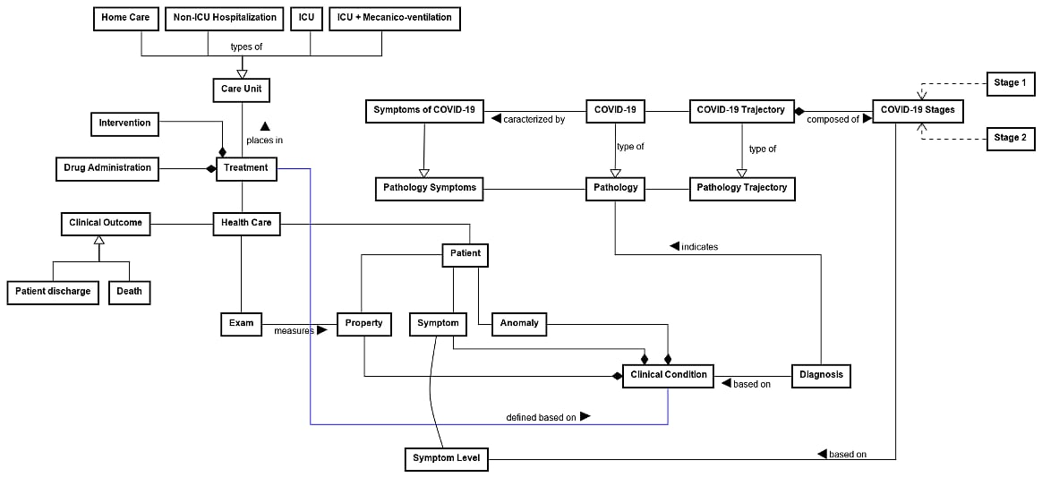
Cesar model

Slide 13
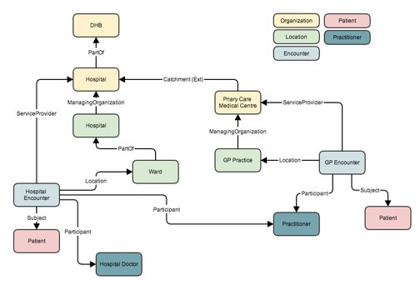
HL7-FHIR: this is an example https://fhirblog.com/2014/01/24/modelling-encounters-with-fhir/
Ronald Cornet pointed at during EJP CDE hackathon: https://www.hl7.org/fhir/observation-vitalsigns.html

