Slide 1
MESSAGEix-Pakistan 1
August 5, 2025

Slide 2
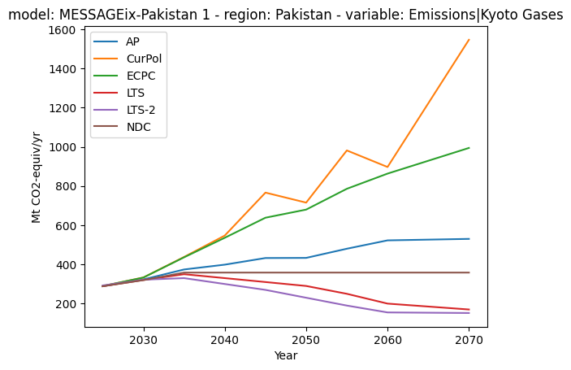
Emissions MtCO2-eq

Slide 3
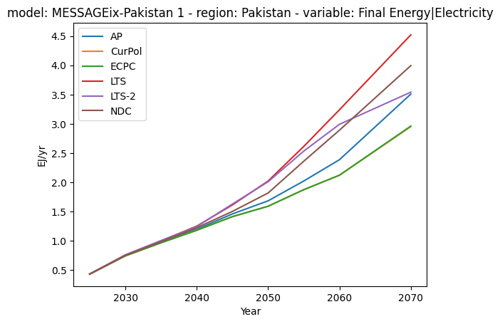
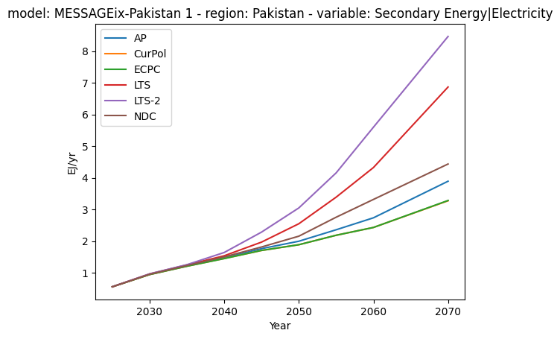
Electricity at Final and Secondary
Final
Secondary

Slide 4
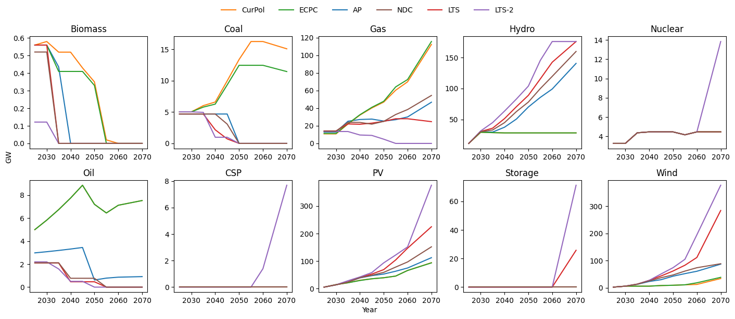
Capacity | Electricity

Slide 5
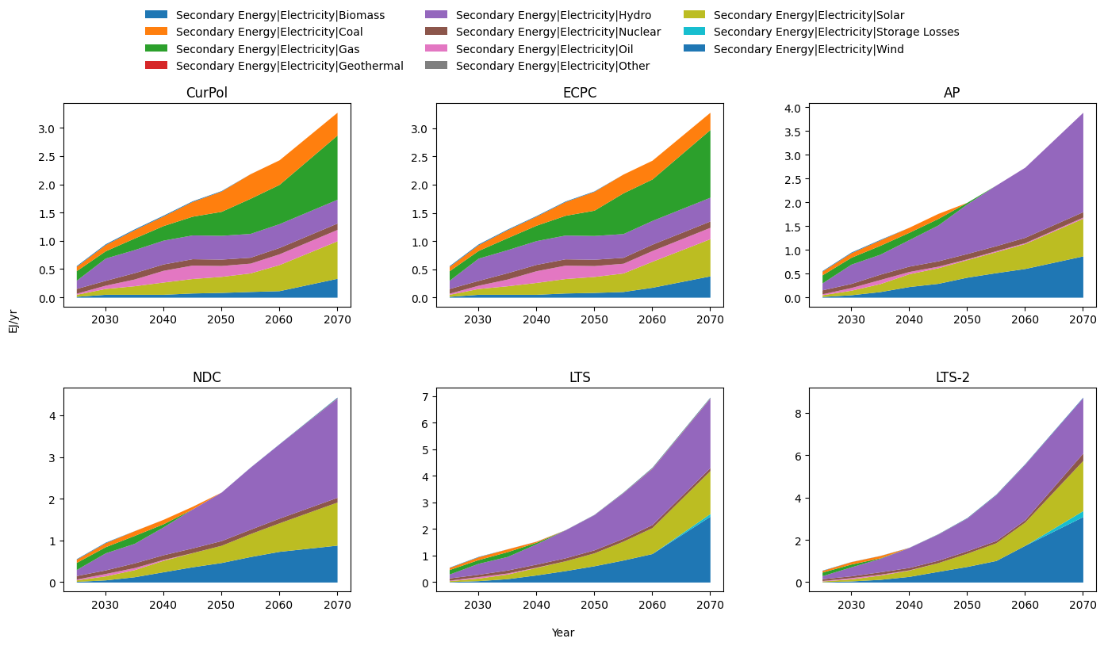
Secondary Energy | Electricity

Slide 6
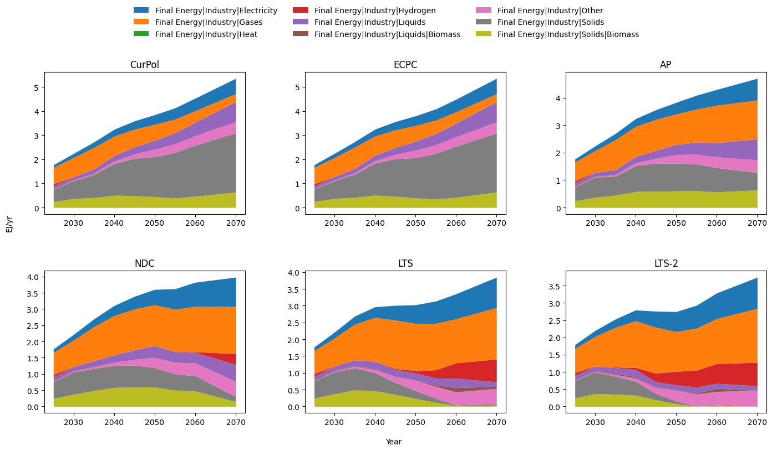
Final Energy | Industry

Slide 7
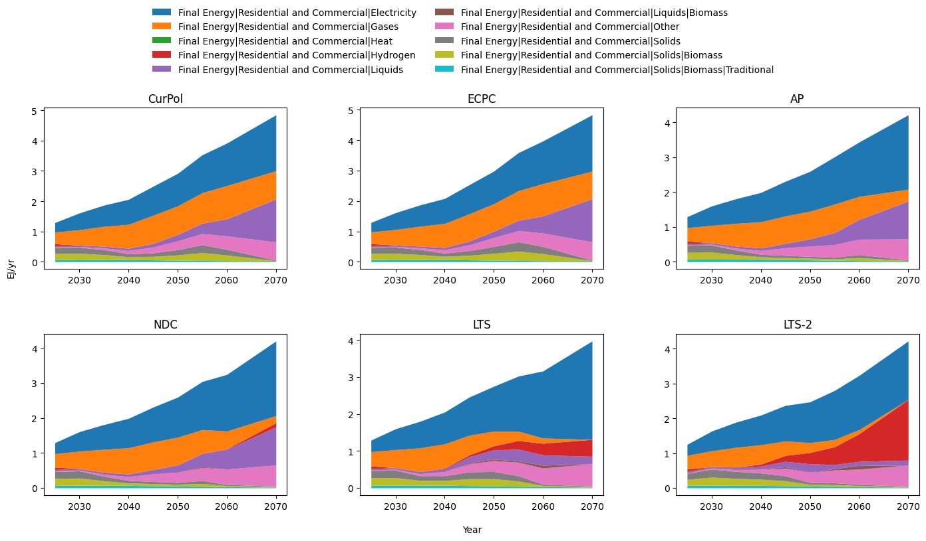
Final Energy | Residential/Commercial

Slide 8
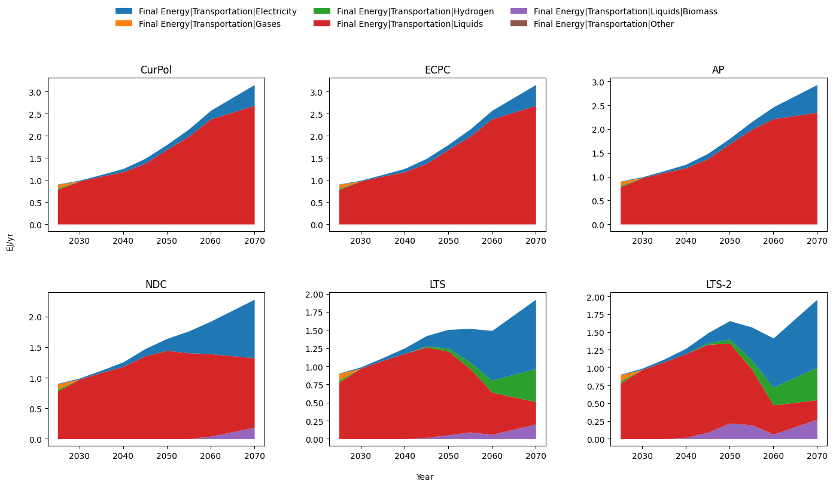
Final Energy | Transport

