Slide 1




PYTHON: THE START
Python Basics
University of Iloilo

Slide 2

WHY PYTHON?
Python is created by Guido Van Rossum. It is a high-level language sought for its easy-to-read syntax.
Well supported and a huge community of users.
With the given ease of learning Python, those who tend to study the language enables learners to become productive quickly.

Slide 3
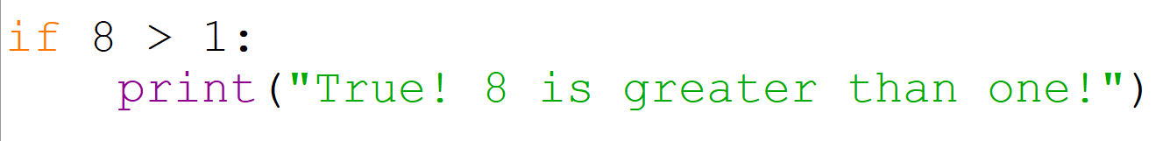
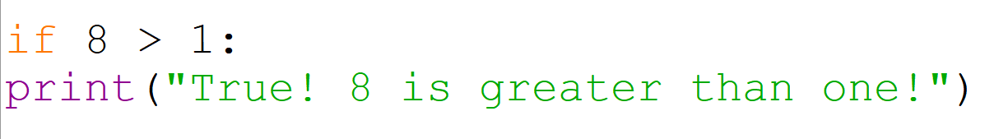
PYTHON INDENTATION
Indentation in Python is very important, this is what signifies a block of code in Python.
The code above is going to be accepted whilst the code below will throw an error.
NOTE: In keyboards, pressing TAB will indent your text

Slide 4
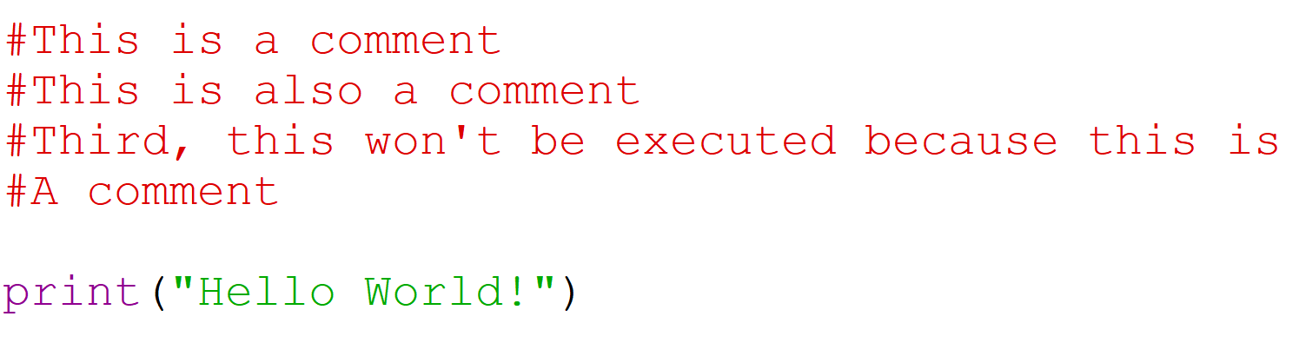
COMMENTS
This hashtag symbol on the start of a statement signifies a comment.

Slide 5
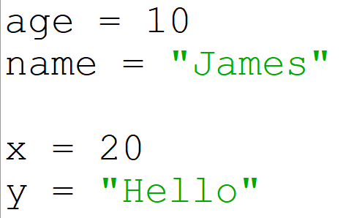
VARIABLES
Variables are temporary containers for storing data, Python's variable is dynamic in regards to its data type. A variable is created when you assign a value to it and whatever the value is, the data type of the variable will adjust accordingly.
The variable age is given the value of a number 10, thus it becomes an integer. Python once again, has dynamic data typing.

Slide 6
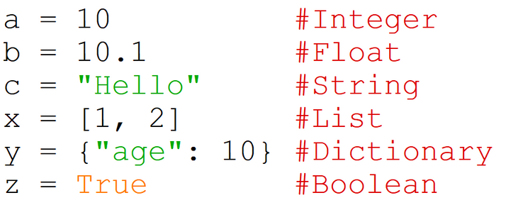
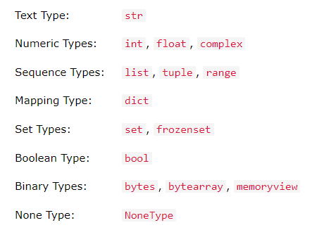
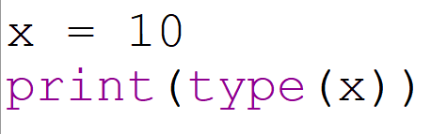
DATA TYPES
Data types define what operations can you do to your values or data. Here are some of the most used built-in data types in Python:
Complete list of built-in Data Types:
To get the data type:

Slide 7
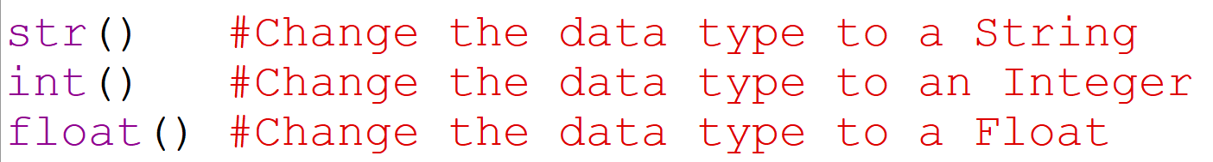
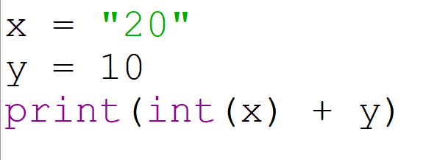
CASTING
Casting is done when you want to specify or change the data type of a particular value.
Adding a string and an integer will result to an error, you have to change the data type first.
NOTE: Strings are always enclosed in double quotations or quotations: "HelloWorld"

Slide 8

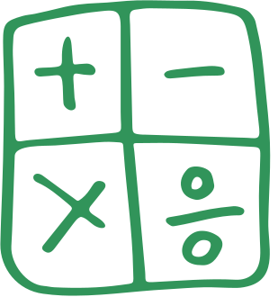

OPERATORS
Operators are the ones responsible for manipulating our data. Adding two numbers is not possible without operators. As for the operators, we will discuss:
Arithmetic Operators
Assignment Operators
Comparison Operators
Logical Operators

Slide 9
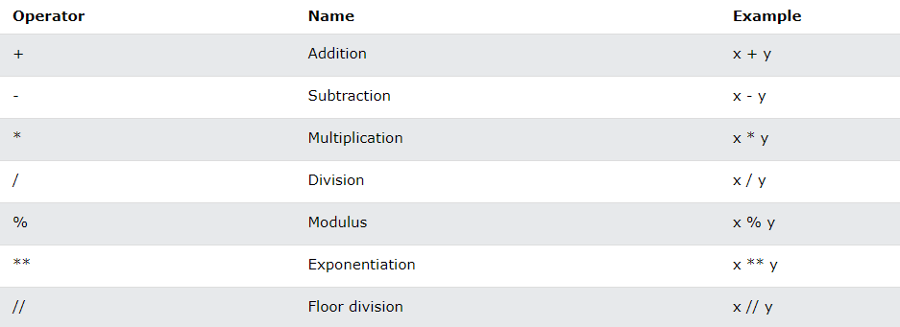
ARITHMETIC OPERATORS
Arithmetic operators are used for common mathematical operations

Slide 10
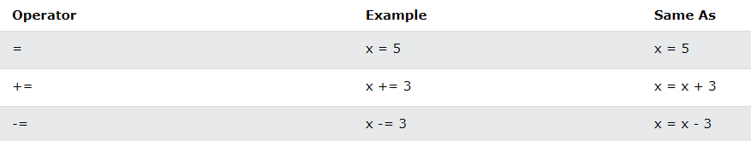
ASSIGNMENT OPERATORS
Assignment operators are used to assign a value to our variables.

Slide 11
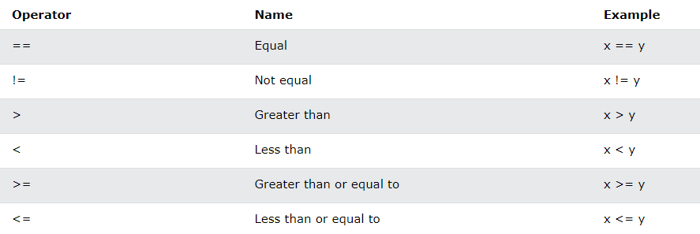
COMPARISON OPERATORS
Comparison operators are used to compare two values:

Slide 12
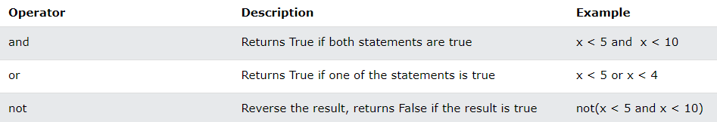
LOGICAL OPERATORS
Logical operators are used to combine conditional statements:

Slide 13
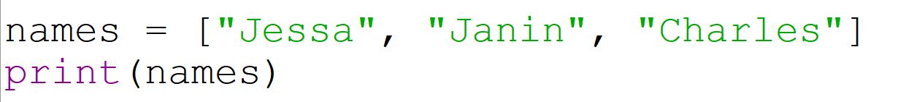
LIST
List is a way for us to store multiple values to a single variable.
Python list is declared by using square brackets [ ]. Inside this list, we have 3 elements. Let us print our list.
OUTPUT:

Slide 14
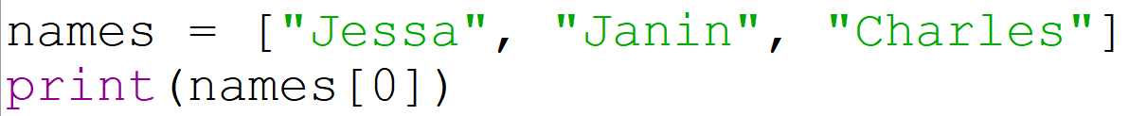
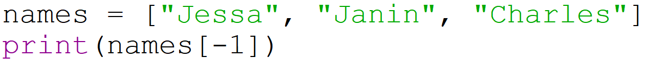
ACCESS LIST
The values of our list are called elements. Each element has its own corresponding indexes. "Jessa" for example has the index of 0.
Putting a negative number will get the elements at reversed order. The code below will output: Charles

Slide 15
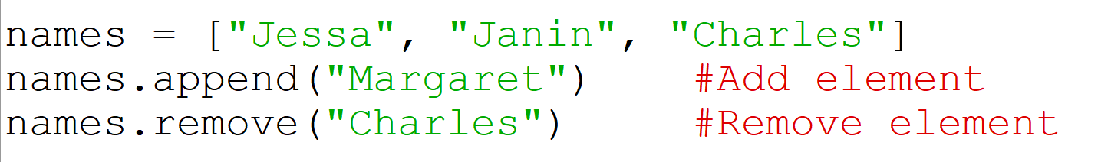
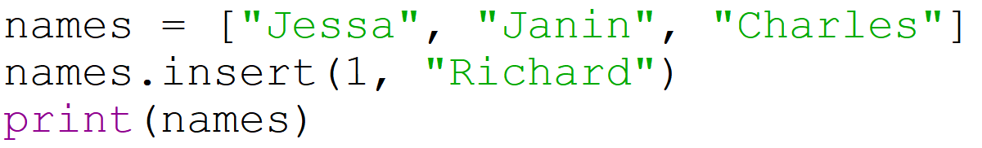
ELEMENTS: ADD, REMOVE
We can also add or remove elements from our list.
To add an element to a specific index, we use the insert() method.
OUTPUT:

Slide 16
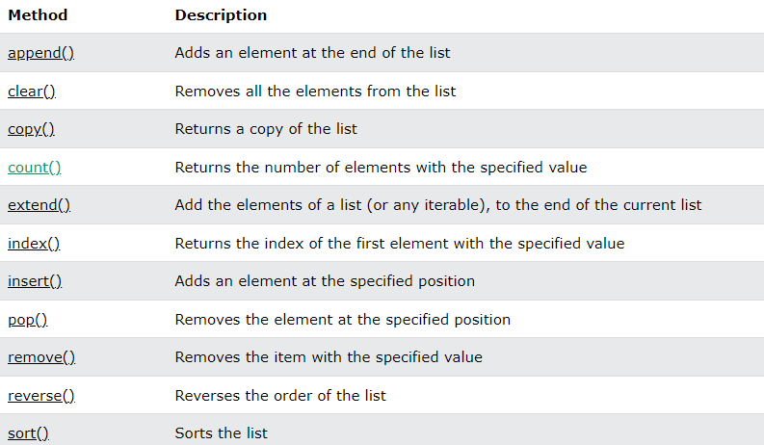
LIST METHODS
Here is the complete list of methods that you may use on your list.

Slide 17
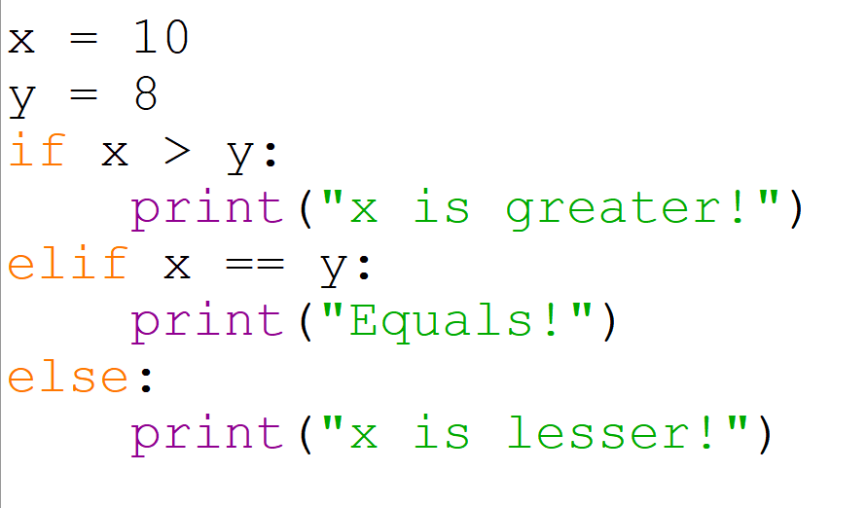

IF, ELIF AND ELSE
Conditional statements are the heart of logical problem-solving. Here is an example of declaring an if...else statement wherein the answer varies upon the condition:
OUTPUT:

Slide 18
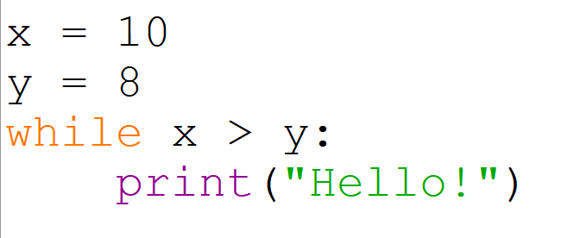
WHILE LOOP
While loop will keep on executing the statements on its block as long as the condition remains true.
This will execute endlessly since the condition remains true endlessly.

Slide 19
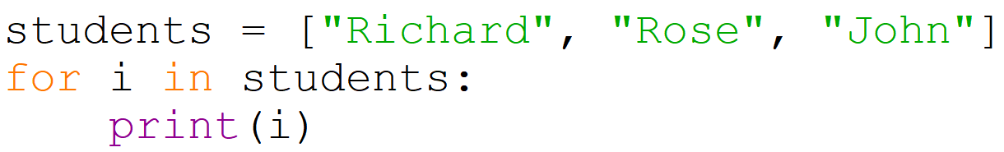
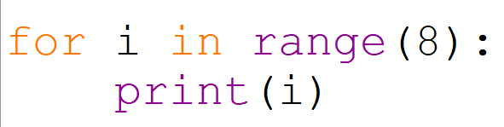
FOR LOOP
A for loop is used for iterating a sequence such as a list. In other words, it is used to loop through a sequence.
Using the range() function, allows us to execute line of codes by number of specified times.

Slide 20
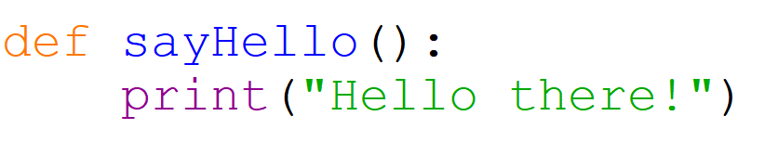

FUNCTIONS
A function is a block of code that runs only when called. To create a function, we use the keyword def().
To call a function, use the name of the function with parentheses.
This will activate the function and execute whatever is inside the block of this function. Remember, a block of code in Python can be defined by indentation.

Slide 21
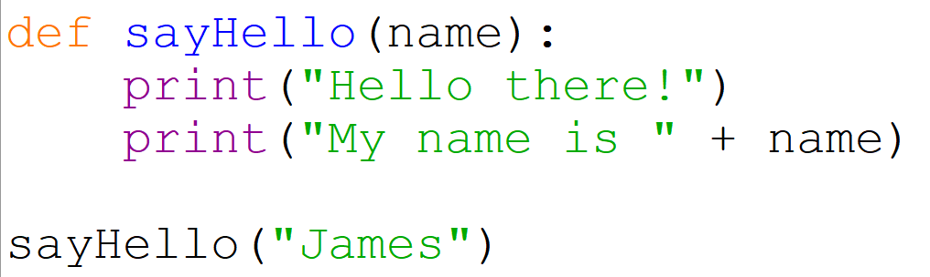


PARAMETER AND ARGUMENTS
Data can be passed inside a function as well. You can pass an arguments to parameters.
The (name) is the parameter and this parameter is accessible only inside the function. The value of name is called the argument.
"James" is a value, it is an argument for the parameter -- name.

Slide 22
Always remember, programming is a skill...
And skills can be learned.
THANK YOU
Attribution to W3Schools or some screenshots.
University of Iloilo

