Slide 1
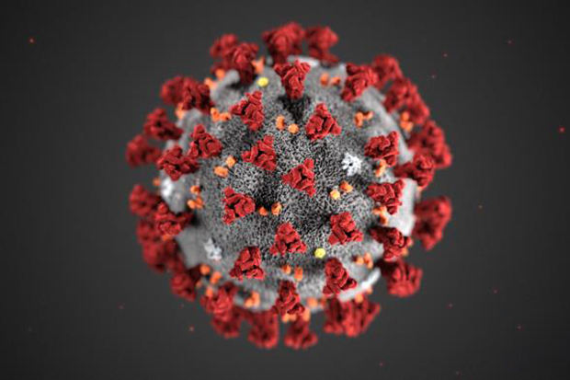
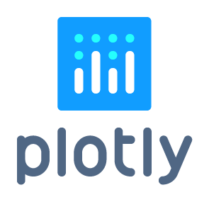
Visualizing the Covid-19 pandemic with Plotly and Python
April 2020
Rachel Lund

Slide 2

Who am I ?
https://www.linkedin.com/in/rachel-lund-3500972b/
https://github.com/LUNDR

Slide 3
"A picture is worth a thousand words"

Slide 4
Today’s Agenda
Aims:
An introduction to Plotly
Make some nice interactive charts with the COVID-19 data
Data read-in and wrangling (with pandas)
The basics of plotting with Plotly
More involved charting : fine-tuning layout and animation
Deploying charts

Slide 5

Following along
You can git clone the repo and follow along, or play with the code afterwards
https://github.com/LUNDR/covid-19
WARNING! There’s quite a lot of installing to set up Plotly to work with jupyter. Make sure you read the Readme

Slide 6
What is plotly?
Plotly is an open source graphing library; which:
Allows you to Make high quality interactive charts easily
Integrate your charts into a webpage
Is free!
Is available as library for python, but also R and Javascript as well.
Has a good manual and gallery which can be found here: https://plotly.com/python/

Slide 7
So let’s get started…

Slide 8
Many thanks for listening!

