Slide 1
Can a QPSK link reliably carry image traffic over fading channels?
Communication Monte Carlo experiment · theory validation · Rician fading · coding gain
BITS
QPSK
CHANNEL
RX
source bits
2 bits / symbol
h·s + n
BER / image
MAIN QUESTION
COMMUNICATION
APPLICATION
First prove the link simulator is trustworthy
Channel effects + coding gain
CV only allocates source bits
Open the presentation with this sentence

Slide 2
Explain the experiment in 30 seconds
MAKE THE VERIFICATION TARGET EXPLICIT
INPUT
LINK
EVIDENCE
Random information BITS
or an image. CV only decides which 8×8 blocks use 4 or 8 bits.
QPSK modulation
AWGN, Rayleigh and Rician channels. The RX estimates h, equalizes, hard-demaps and runs Viterbi when coded.
BER curves with theory
95% confidence intervals, coding gain, constellation, spectrum and image-layer PSNR.
One sentence: validate the link with theory first, then show coding and CV payload trade-offs.
02

Slide 3
What is inside the link?
EVERY BOX MAPS TO A CODE BLOCK
TX
CHANNEL
RX
FEC
METRICS
bits → parity
→ QPSK mapper
h·s + n
AWGN / Rayleigh / Rician
pilot estimate
→ equalizer → hard decision
Viterbi
→ information bits
BER · CI95
PSNR · rate
APPLICATION ENTRY
Fixed 6-bit image source ↔ CV adaptive 4/8-bit source
03

Slide 4
Why use Eb/N0 on the x-axis?
PUT MODULATION AND CODING ON THE SAME SCALE
QPSK: 2 bits / symbol
E_s = 1
N0 = R / (2 · 10^(Eb/N0 / 10))
R = 1 uncoded
R = 1/2 convolutional code
PROBLEM
Using Es/N0 mixes the 2 bits/symbol factor into the comparison.
FIX
Use information-bit Eb/N0. AWGN BPSK and Gray-QPSK then share the same per-bit theory curve.
DEFENSE LINE
Normalize information-bit energy first, then compare channel and coding effects.
04

Slide 5
What changes in a Rician channel?
K IS THE LOS-TO-SCATTER POWER RATIO
K = 10^(K_dB / 10)
h = √(K/(K+1))
+ √(1/(K+1)) · g
g ~ CN(0,1)
K = 0
No LOS term. This becomes Rayleigh.
K = 10 dB
LOS power is ten times diffuse power.
K → ∞
Fading vanishes as the channel approaches AWGN.
The previous zero-mean complex Gaussian model was Rayleigh. The new code fixes this.
05

Slide 6
How is Monte Carlo made credible?
SAMPLE COUNT, FIXED SEED AND CONFIDENCE INTERVALS
SWEEP
SAMPLES
UNCERTAINTY
Eb/N0 = 0:2:16 dB
AWGN / Rayleigh / Rician
uncoded / coded
28 independent trials
12,000 information bits / trial
336,000 information bits / point
p̂ = errors / bits
CI95 = 1.96 × √[p̂(1−p̂)/N]
fixed rng seed
At high SNR, report the confidence interval when zero errors are observed.
06

Slide 7
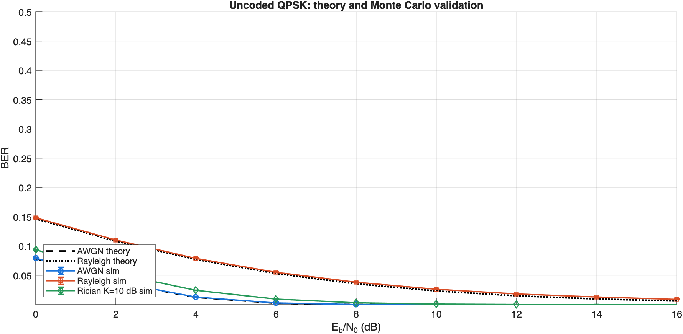
Core result 1: theory and simulation agree
THIS VALIDATES THE SIMULATOR BEFORE DISCUSSING CODING GAIN
AWGN
Markers follow Q(sqrt(2γ)).
Rayleigh
Markers follow the Rayleigh theory expression.
Rician
K=10 dB adds LOS power, so BER is lower than Rayleigh.
07

Slide 8
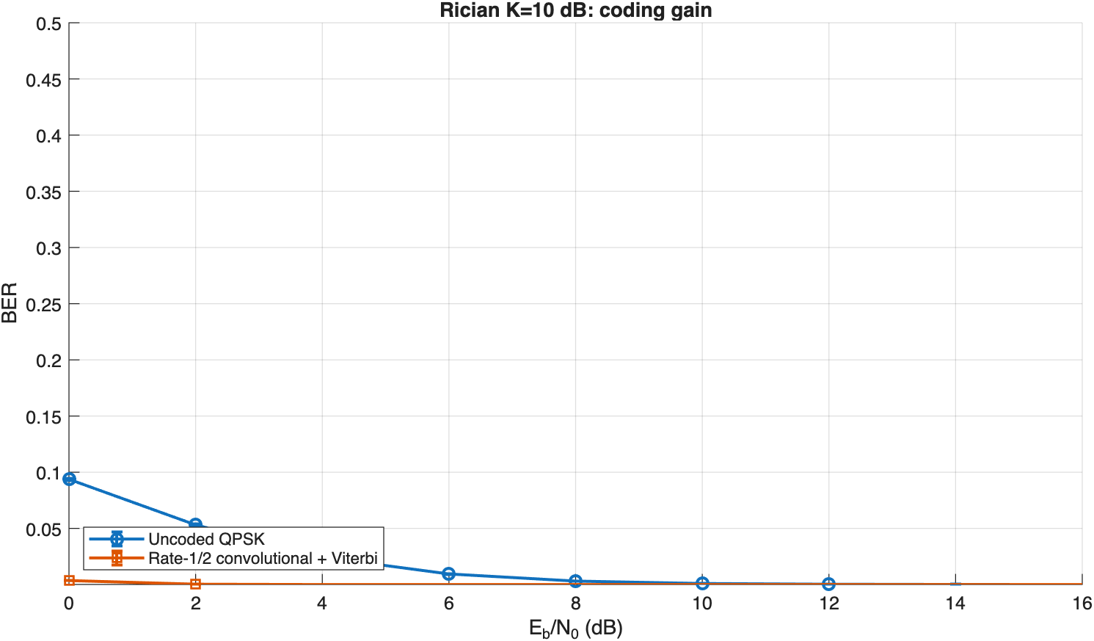
Core result 2: how much gain does coding buy?
RATE-1/2 CONVOLUTIONAL CODE + VITERBI
g1 = 111₂
g2 = 101₂
4 states · hard Viterbi
RESULT
At Rician 8 dB, uncoded BER≈3.1×10⁻³. The coded run has zero observed errors in 336,000 information bits.
08

Slide 9
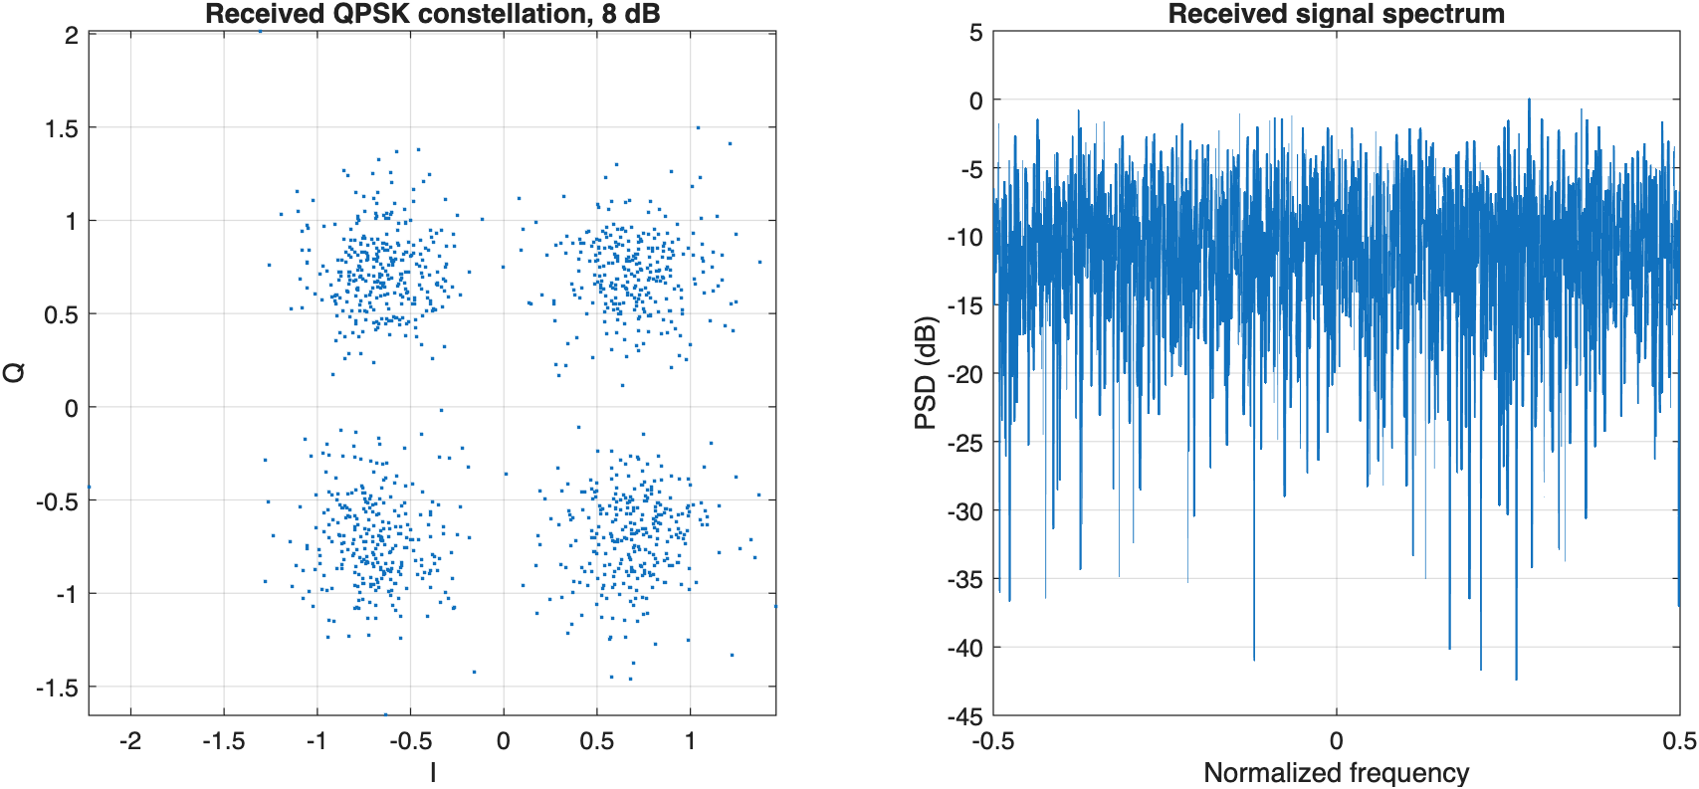
Waveform evidence: the link really carries QPSK
CONSTELLATION AND SPECTRUM MAKE THE SIGNALING WAVEFORM VISIBLE
CONSTELLATION
Rician fading spreads the four ideal points before equalization.
SPECTRUM
The FFT shows signal energy over normalized frequency.
RECEIVER
A small h-estimation error models imperfect pilots.
09

Slide 10
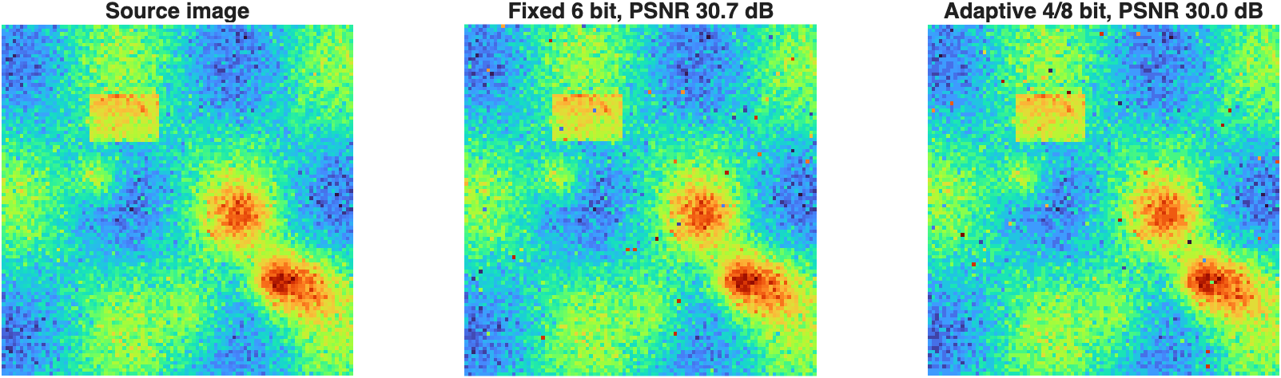
Where does CV fit?
IT IS A PAYLOAD POLICY INSIDE THE TRUSTED LINK
FIXED PAYLOAD
6 bits per pixel.
ADAPTIVE PAYLOAD
Gradient complexity selects 4 or 8 bits per 8×8 block.
SAME LINK
Both payloads use the same QPSK, Rician channel and Eb/N0.
Fixed PSNR≈30.7 dB. Adaptive PSNR≈30.0 dB, with target-region PSNR≈32.3 dB.
10

Slide 11
How do you read the code?
TRACE FROM THE ENTRY POINT TO BER
run_project_v3.m
1 link budget
2 BER Monte Carlo loop
3 qpskChannel()
4 convEncode()
5 viterbiDecode()
6 waveform figures
7 transmitImage()
8 write CSV + MAT
START HERE
qpskChannel() maps QPSK, adds noise and h, estimates h_hat, equalizes and hard-demaps.
NEXT
viterbiDecode() is a four-state dynamic program with path metrics and traceback.
OUTPUT FILES
ber_validation.csv feeds the theory plot. link_budget.csv stores the link budget. application_layer.csv stores the CV payload results.
11

Slide 12
Remember three sentences
CLOSE THE PROJECT WITH ONE STORY
1
2
3
I validate the QPSK simulator with AWGN and Rayleigh theory before discussing Rician.
I measure coding gain with a rate-1/2 convolutional code and Viterbi.
I connect a CV-adaptive image source to the same trusted link.
QPSK is the main character. Rician fading and coding provide depth. CV is the application layer.
Q&A
12

