Slide 1
Communication-first Monte Carlo design
QPSK link validation, Rician fading and coding gain
Keep AI / CV at the application layer
Put link validity, theory and coding gain first
LINK
EVIDENCE
APPLICATION
TX · channel · RX
theory · CI95 · Monte Carlo
adaptive image source
MATLAB R2025b · reproducible seed · communication course project

Slide 2
What the experiment must prove
GRADING RUBRIC TRANSLATED INTO EVIDENCE
1 · COMPLETE LINK
2 · THEORY CHECK
3 · CORRECT MODEL
4 · TRUSTED MC
Transmitter, channel, receiver and measured outputs are explicit.
AWGN and Rayleigh theory lines are plotted beside simulation.
Rician has a LOS component and K is reported in dB.
Total bits, fixed seed and 95% confidence intervals are saved.
The CV policy is a business-layer extension. It is not allowed to hide communication errors.
02

Slide 3
End-to-end chain
ONE QPSK LINK, TWO PAYLOAD POLICIES
TX
CHANNEL
RX
METRICS
source bits
CRC / parity
QPSK mapper
pilot-aided h estimate
AWGN / Rayleigh / Rician
K = 10 dB
equalizer
hard demapper
Viterbi decoder
BER + CI95
PSNR / target PSNR
rate / retries
CONTROLLED COMPARISON
All modulation comparisons use the same QPSK and the same Eb/N0 axis.
03

Slide 4
Link budget sets the operating range
A SIMPLE LEO TELEMETRY SANITY CHECK
FSPL = 92.45 + 20log10(f_GHz)
+ 20log10(d_km)
P_r = P_t + G_t + G_r − FSPL − L
N = −174 + 10log10(BW)
+ 10log10(Tn / 290)
ASSUMPTIONS
LOSSES
2.2 GHz · 600 km
30 dBm · 8/8 dBi
2 dB implementation loss
1 MHz bandwidth
OUTPUT
FSPL = 154.86 dB
Received power = −110.86 dBm
Noise power = −111.63 dBm
Link SNR ≈ 0.77 dB
The simulated Eb/N0 sweep extends above this nominal point so the coding waterfall is visible.
04

Slide 5
Signal model uses Eb/N0
NORMALIZE BEFORE COMPARING MODULATION OR CODING
QPSK: s = [(2b1−1) + j(2b2−1)] / √2
E_s = 1, k = 2 bits/symbol
N0 = R / (k · 10^(Eb/N0 / 10))
y = h·s + n
z = conj(h_hat)·y / |h_hat|²
WHY THIS AXIS?
For Gray-coded QPSK, uncoded BER in AWGN is the same function of Eb/N0 as BPSK.
CODING RATE
Rate-1/2 coding changes the noise calibration through R = 1/2, while the x-axis remains information-bit Eb/N0.
MEASUREMENT
BER counts information bits after decoding.
05

Slide 6
The channel model is actually Rician
LOS POWER IS CONTROLLED BY K
K = 10^(K_dB/10)
h = √(K/(K+1))
+ √(1/(K+1))·g
g ~ CN(0, 1)
K = 0
No LOS term. Rayleigh fading.
K = 10 dB
LOS power is ten times diffuse power.
K → ∞
Fading disappears. The channel approaches AWGN.
The previous version used zero-mean complex Gaussian h. That was Rayleigh, not Rician.
06

Slide 7
Monte Carlo protocol
HOW MANY BITS MAKE ONE POINT BELIEVABLE
SWEEP
SAMPLES
UNCERTAINTY
Eb/N0 = 0:2:16 dB
3 channel models
2 coding states
28 independent trials
12,000 information bits / trial
336,000 info bits / point
p̂ = errors / bits
CI95 ≈ 1.96·√[p̂(1−p̂)/N]
Saved per curve point
At high SNR, zero observed errors does not mean BER is exactly zero. The confidence interval is still reported.
07

Slide 8
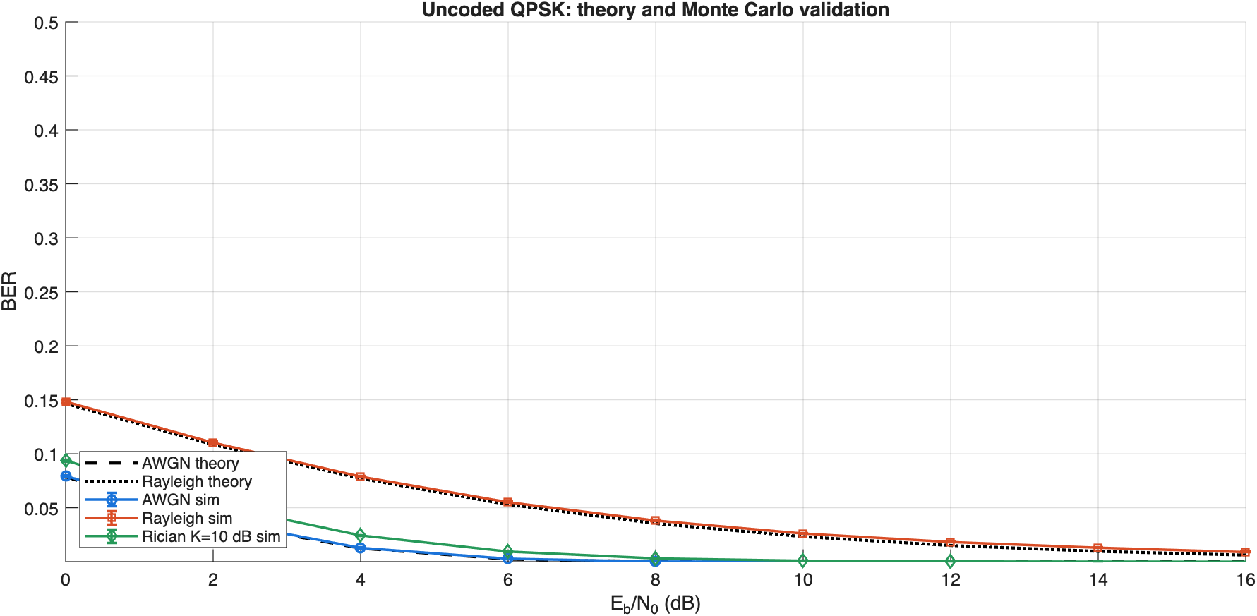
Theory validation comes first
UNCODED QPSK, SIMULATION MARKERS AND THEORY LINES
AWGN
Blue markers overlap the AWGN theory curve.
RAYLEIGH
Orange markers overlap the Rayleigh theory curve.
RICIAN
K=10 dB keeps a strong LOS path, so BER is lower than Rayleigh.
08

Slide 9
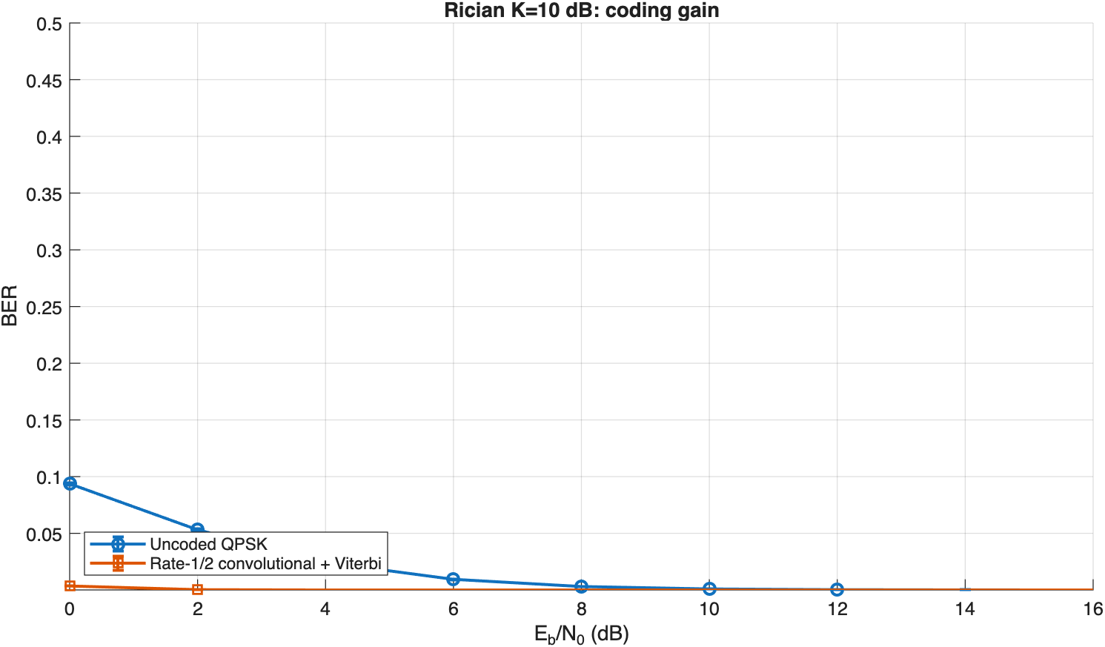
Coding gain is the communication contribution
RATE-1/2 CONVOLUTIONAL CODE + HARD VITERBI
g1 = 111₂
g2 = 101₂
state: (s1, s2)
output: [b⊕s1⊕s2, b⊕s2]
RESULT
At 8 dB, the coded Rician curve reaches zero observed BER in 336k information bits.
09

Slide 10
What the decoder is doing
VITERBI IS A FOUR-STATE DYNAMIC PROGRAM
STATE
BRANCH METRIC
TRACEBACK
Each state stores the previous two encoder bits.
There are 4 states and 2 candidate inputs per time step.
For each received pair, compute Hamming distance to the two possible output pairs.
Keep the lowest path metric entering each state.
After all symbols, select the lowest-metric final state and trace predecessor pointers backward.
This is why the code is inspectable. No Communications Toolbox decoder is hiding the mechanism.
10

Slide 11
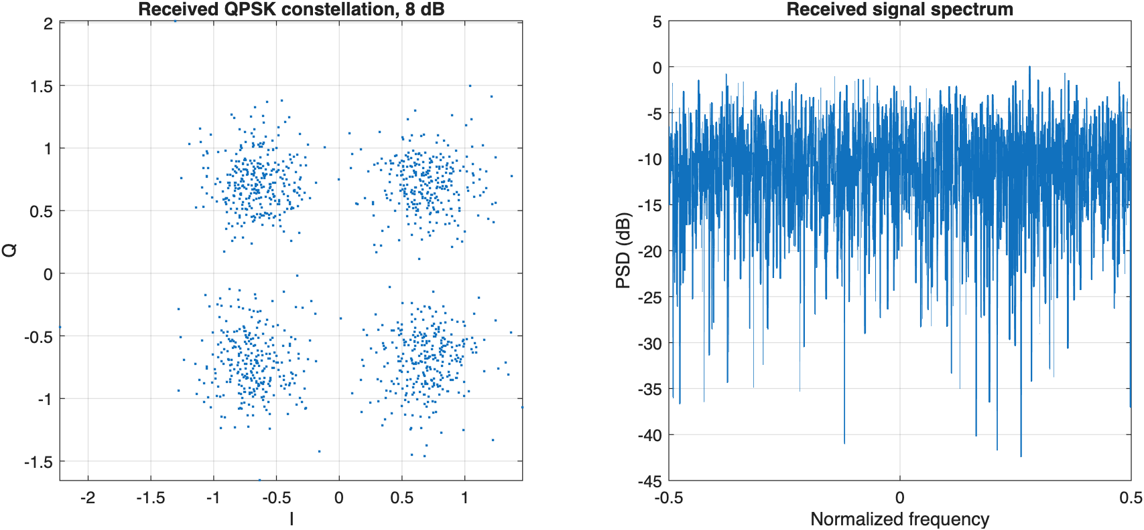
Waveform evidence
CONSTELLATION AND SPECTRUM ARE PART OF THE LINK STORY
CONSTELLATION
Fading spreads the four ideal QPSK points before equalization.
SPECTRUM
The FFT panel makes the signaling waveform visible instead of treating it as an invisible function call.
RECEIVER
Pilot-aided h estimate is intentionally imperfect.
11

Slide 12
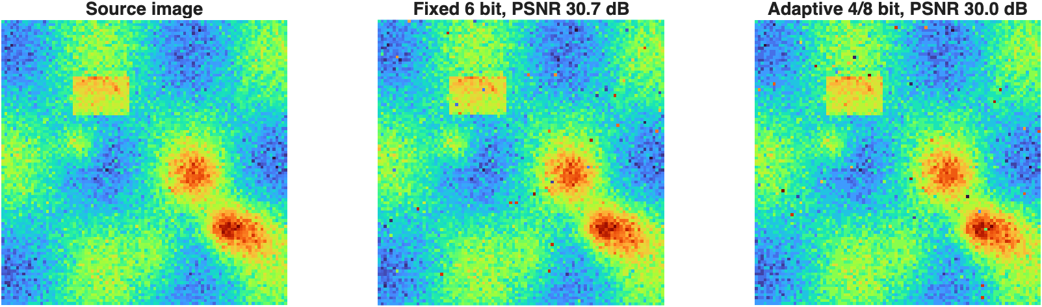
CV stays at the business layer
SAME QPSK LINK, DIFFERENT IMAGE PAYLOAD
FIXED
6 bit/pixel, same QPSK and Eb/N0.
ADAPTIVE
4/8 bit blocks from gradient score. Average source rate is lower.
ROLE
CV changes the payload. It does not replace the channel experiment.
12

Slide 13
Fair application-layer comparison
WHAT CHANGES AND WHAT STAYS FIXED
FIXED 6-BIT
CV ADAPTIVE
INTERPRETATION
Source policy: uniform
Modulation: QPSK
Channel: Rician K=10 dB
Eb/N0: 8 dB
PSNR: 30.7 dB
Source policy: 4/8 bit blocks
Modulation: QPSK
Channel: Rician K=10 dB
Eb/N0: 8 dB
PSNR: 30.0 dB
Adaptive source reduces transmitted load and improves target-region PSNR.
The communication link is held constant, so the difference is attributable to the source policy.
13

Slide 14
How to explain the curves
THREE MECHANISMS, THREE VISUAL SIGNATURES
MODULATION
FADING
CODING
Moving from Es/N0 to Eb/N0 removes the artificial 3 dB QPSK shift.
The AWGN BPSK and QPSK theory functions become the same per bit.
Rayleigh has deep fades and a BER floor relative to AWGN.
Rician adds a LOS component, so increasing K moves the curve toward AWGN.
The convolutional code uses extra channel bits to reduce information-bit errors.
The gain is visible as a horizontal shift in required Eb/N0.
14

Slide 15
Deliverables and reproducibility
EVERYTHING REQUIRED TO RERUN THE EXPERIMENT
run_project_v3.m
├── link_budget.csv
├── ber_validation.csv
├── project_v3.mat
└── figures/
├── theory_validation.png
├── coding_gain.png
├── waveform.png
└── application_reconstruction.png
RUN COMMAND
MATLAB R2025b
run_project_v3
FIXED SEED
rng(20261109, twister)
Same curves on every run.
PRIMARY CLAIM
The simulator is validated against theory before it is used for the image payload.
15

Slide 16
Conclusion
COMMUNICATION FIRST, CV SECOND
The project is now a communication experiment with an image application.
1
2
3
True Rician model and Eb/N0-normalized BER curves are validated against theory.
Convolutional coding and Viterbi decoding provide a measurable coding-gain story.
CV-aware source adaptation is evaluated only after the link is trusted.
Q&A prompt Where does the 25% source-rate saving go in a real telemetry system?
Thank you
16

