Slide 1

Business Strategy and Accounting Research: A Text-Analysis Approach
Rajiv Banker
with Xinjie Ma
October 2018
Convergence of Financial and Managerial Accounting

Slide 2
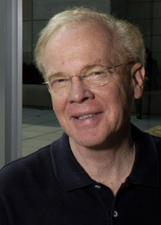

Motivation
Many prior studies present evidence in support of earnings management based on earnings properties and invoke agency costs theory as the explanation; but few studies directly examine how firm fundamentals affect earnings properties under the null hypothesis of no earnings management -Ball (AH 2013)
Earnings properties are jointly determined by the nature of the business and accounting choices -Dechow et al. (JAE 2010)
The nature of business operations matters!
Strategy is an essential descriptor of business!
Ray Ball
Patricia Dechow
Notes:
Why do we look at time-series earnings: it is important because many researchers have studied its consequences. Especially, using time-series properties as a measure of earnings quality, such as in this textual analysis paper Li 2008. He documents managers’ obfuscation using earnings persistence as a measure for earnings quality.
However, as this review paper on earnings quality point out that these earnings properties are joint determined by many variables. It reflects dividend policy, the nature of the firm’s operations, and the accounting system.

Slide 3
Objectives
Develop and validate text-based measures of strategy
Generic strategies (Porter HBR 1980)
Value propositions (Treacy and Wiersema HBR 1993)
Document relation between strategy and earnings properties
Earnings persistence
Earnings volatility
Document relation between strategy and financial accounting policies
Income-statement conservatism
Matching of revenue and expenses
Abnormal accruals
Explore relation between strategy and research in management accounting, auditing and tax accounting

Slide 4
Generic strategies and value propositions
Cost leadership
Differentiation
Porter
(1980)
Operational excellence
Customer intimacy
Product leadership
Treacy and Wiersema (1993)
Kaplan and Norton
(2000)
Generic strategies are examined at a high level to compare common structural features across firms rather than to examine details of individual operating strategies as they are executed

Slide 5
Correlation between alternative strategy measures
 | Product leadership | Customer intimacy | Operational excellence | Differentiation | Cost leadership
Product leadership | 1
Customer intimacy | 0.01 | 1
Operational excellence | 0.06 | 0.05 | 1
Differentiation | 0.65 | 0.61 | 0.04 | 1
Cost leadership | 0.03 | 0.26 | 0.69 | 0.17 | 1

Slide 6
Overview of empirical results on earnings properties
Does generic strategy affect earnings persistence?
Yes: product-leadership firms have more persistent earnings than customer-intimacy and operational-excellence firms
Sustainability of competitive advantage
Does generic strategy affect earnings volatility?
Yes: product-leadership firms have more volatile earnings than customer-intimacy and operational-excellence firms
Differences in outcome uncertainty
Observe the difference between our results and the influential results in Dichev and Tang (JAE 2009) and Frankel and Litov (JAE 2009)
Notes:
Specifically, we ask two questions: does generic strategy affect earnings persistence and does it affect earnings volatility?
We find Yes and Yes.
Firms with product leadership will have more persistent earnings than customer-intimacy and operational-excellence firms because they have different levels of ability to sustain the competitive advantage
Also firms with product leadership will have more volatile earnings than the other two because of the differences in outcome uncertainty and accounting treatment

Slide 7
Overview of empirical results on accounting policies
Is generic strategy associated with conservatism?
Yes; product-leadership firms appear to have more balance-sheet and less income-statement conservatism than customer-intimacy and operational-excellence firms when we use traditional approaches to measure them
Unrecognized intangible assets and growth potential
Is generic strategy associated with revenue-expense matching?
Yes; product-leadership firms appear to have weaker contemporaneous revenue-expense matching than customer-intimacy and operational-excellence firms
More expenses recognized before revenue realization
Is generic strategy associated with abnormal accruals?
Yes; product-leadership firms appear to have less abnormal accruals measured using traditional models than customer-intimacy and operational-excellence firms
Different business operations

Slide 8






Generic strategies and nature of business operations
 | Operational excellence | Customer intimacy | Product leadership
Positioning | Low-cost | Greater customer value | Greater customer value
Focus | Lean and efficient operations | Meet customer needs | Constantly launch new products
Investment | Capital expenditure | Marketing | R&D
Examples
Profit Margin | Low | High | High
Operational Efficiency | High | High | Low
Notes:
1. To sum up, these generic strategies outline some main options of how firms can strategically position themselves in the industry.
2. the chosen strategic positioning guide firms in further decision-making processes concerning the focus and investments. Operational-excellence firms will try to operate in a lean and efficient fashion. To do that, they can invest in new machines and equipment to leverage modern technology. Customer-intimacy firms try to understand target market, meet customers’ needs, and cultivate loyalty. Therefore, they spend more on marketing. And finally, product-leadership firms operate more proactively. They try to constantly launch new products to render existing products obsolete. Therefore, they value flexibility in the operations, change constantly, and spend more on R&D.
3. If firms develop a congruent strategy and implement it consistently, then we can observe diverging patterns in financial outcomes. For example, customer-intimacy and product leadership firms will have a higher profit margin because they can deliver greater customer value. On the other hand, operational-excellence firms operate efficiently. Customer-intimacy firms can also operate efficiently because their target customers tend to be homogenous and they can leverage the economies of scale.

Slide 9
Strategy and earnings persistence
Sustained competitive advantage leads to persistent earnings
Sustainability of competitive advantage
Barriers to entry
Barriers to imitation
Barriers to substitution
Product leadership strategy
Earnings persistence
Notes:
How does it affect earnings persistence?
Although firms who obtain the competitive advantages will earn above-average profits, it does not last forever.
We argue that firms with different generic strategies have different levels of ability to sustain their competitive advantage.
Only those who are able to sustain their advantage have persistent earnings.

Slide 10
Sustainability of competitive advantage
Barriers to imitation
Information or resource-based advantage over competitors (Barney JMgt 1991; Porter HBR 2001) :
Don’t know
Open market vs. internal generation
Causal ambiguity (Krasnikov and Jayachandran JMkt 2008; Reed and Defillippi AMR 1990) :
Don’t understand
Stable and narrow vs. flexible and complex
Barriers to substitution (Treacy and Wiersema HBR 1993)
Render the existing products obsolete
Notes:
1. Why do they have different abilities then? Two things: barrier to imitation and barrier to substitution
2. First, Competitors’ informational disadvantages about a focal firm’s resources and capabilities make it hard for them to imitate.
Asymmetric information:
Operational excellence: through modern technology bought from suppliers
Customer intimacy: through publicly observable communications with customers
Product leadership: through internal R&D activities
3. Causal ambiguity: The basic ambiguity concerning the nature of the causal connections between actions and results. Even if competitors have full information, they may not be able to immediately and fully understand how an advantage arises.
Operational excellence: stable and narrow process due to the emphasis on efficiency:
Product leadership: The innovation process is complex. In addition, don’t have a long record of implementing unchanging police; hardly rely on historical precedents
Customer intimacy stays in the middle: stable yet complex market knowledge
4. Even if imitation is not a credible threat, firms still may be subject to substitution from rivals. Firms pursuing operational excellence or customer intimacy are particularly vulnerable to this as they both rely on existing products or services and not necessarily quickly adapt to changes in the environment. Firms pursuing product leadership, on the contrary, act proactively and initiative new products continuously that can render existing products obsolete

Slide 11
Predictions on earnings persistence
 | Operational excellence | Customer intimacy | Product leadership
Barriers to imitation
Information advantage | Low | Low | High
Causal ambiguity | Low | Middle | High
Barriers to substitution | Low | Low | High
Overall | Low | Middle | High
H1: Product-leadership firms have more persistent earnings than operational-excellence and customer-intimacy firms.
Notes:
To sum up, product-leadership firms clearly have high barrier to imitation and substitution.
Operational excellence clearly have low barrier to imitation and substitution.
Customer-intimacy firms stay in the middle and lean toward the lower bound. The comparison between operational excellence and customer intimacy is an empirical question. Because, ex ante, we don’t know whether the gap in the causal ambiguity will make a difference when we look at annual earnings persistence.

Slide 12
Strategy and earnings volatility
Outcome uncertainty: (Govindarajan and Gupta AOS 1985; Higgins et al. CAR 2015)
Product leadership: Through exploratory organizational learning
Customer intimacy: Through exploratory yet less risky learning
Operational excellence: Through exploitative organizational learning
H2: Product-leadership firms have more volatile earnings than operational-excellence and customer-intimacy firms.
Notes:
1. Now, we move on to earnings volatility
2. First, product-leadership firms have the highest level of outcome uncertainty because they focus on exploratory innovative activities while operational-excellence firms have the lowest because they improve efficiency mainly through internal-oriented learning from past experience. Expectedly, customer-intimacy firms stay in the middle since their activities to build a loyal customer base, though also exploratory in nature, is less risky. Once you know your customers, you know how to treat them. For example, prior literature documents that benefits from advertising are about as uncertain as those from tangible investments. 3. Another more mechanical reason is the accounting treatments. Because firms with different strategies have different investment activities. Investments on machines will be capitalized while investments on marketing or R&D will be expensed. This different treatment for intangible assets will result in the difference in the matching between concurrent revenue and expenses. The unmatched part of the expenses will act as an extra layer to the earnings volatility.

Slide 13
Strategy and conservatism
Product-leadership firms invest heavily in innovation activities that accumulate intangible assets and enhance growth potential
Most intangible assets are not recognized on the balance sheet due to lower verifiability
Bad news related to unrecognized intangible assets do not trigger asset write-downs, and thus there is less observable income-statement evidence on asymmetry for unrecognized assets (Lafond and Roychowdhury JAR 2008; Roychowdhury and Watts JAE 2007)
RQ1: Is generic strategy associated with (a) balance-sheet conservatism and (b) income-statement conservatism as measured using traditional models?

Slide 14
Strategy and revenue-expense matching
Product-leadership firms are more likely to have
less expenses (e.g., COGS) that are recognized with revenue realization
more expenses (e.g., R&D, intangibles) that are recognized before revenue realization
less expenses (e.g., depreciation of tangible assets) that are recognized systematically through useful life
RQ2: Is generic strategy associated with revenue-expense matching?

Slide 15
Strategy and abnormal accruals
Business strategy drives business operations
Diverging business operations may lead to differences in accruals-generating processes under the null hypothesis of no earnings management
RQ3: Is generic strategy associated with abnormal accruals?

Slide 16
Prior research on strategy measures
Self typing
Executive responses to surveys or proprietary databases
Private databases hinder subsequent replications or extensions
E.g., Dess and Davis (AMJ 1984); Shinkle, Kriauciunas and Hundley (SMJ 2013)
External assessment
Outside experts as raters
Private data and subjective standards limit comparability across research studies
E.g. Zott and Amit (SMJ 2008)
Financial outcomes
Publicly available financial data such as R&D/Sales
More suited for measuring realized strategy: ex post in nature
E.g. Ittner, Larcker and Rajan (TAR 1997); Bentley, Omer and Sharp (CAR 2013); Banker, Hu and Pavlou (MISQ 2011)
Source: Snow and Hambrick. 1980. Measuring organizational strategies : Some theoretical and methodological problems. Academy of Management Review 5(4): 527–538.

Slide 17
Strategy measures using financial outcomes
 | Ittner et al. 1997. TAR | Bentley et al. 2013. CAR | Banker et al. 2011. MISQ
Profit margin |  |  | $$√$$
Asset turnover |  |  | $$√$$
R&D/Sales | $$√$$ | $$√$$
SG&A/Sales |  | $$√$$
Book-to-Market | $$√$$
∆Sales |  | $$√$$
Employees/Sales | $$√$$ | $$√$$
σ(Employees) |  | $$√$$
PPE/Sales |  | $$√$$
New products /Sales | $$√$$
Sales/COGS

Slide 18
Our research design
Textual measure of strategy
Leverage public data
Analyze 10-K filings released on Edgar database
Measure intended strategy (Mintzberg CalMgtRev 1987)
Use managerial disclosure of business strategy
Measure reliably for a large sample, cross-sectional and over time
(Shadish et al. 2002)
Conduct a battery of validity checks
Earnings properties variables from Compustat
Control variables from Compustat: Size, Lev, Loss, MTB, Big4, cash flow
Notes:
(Mintzberg CMR 1987): California management review
(Shadish et al. 2002): a book

Slide 19
Step 1: Identify the source of textual data
A measure based on 10-K filings Item 1 “Business”
“Item 1 “Business” requires a description of the company’s business, including its main products and services, what subsidiaries it owns, and what markets it operates in. This section may also include information about recent events, competition the company faces, regulations that apply to it, labor issues, special operating costs, or seasonal factors. This is a good place to start to understand how the company operates.”
-- U.S. Securities and Exchange Commission

Slide 20
Example of Item 1
“The Company is committed to bringing the best user experience to its customers through its innovative hardware, software and services.”
“…its unique ability to design and develop its own operating systems, hardware, application software and services to provide its customers products and solutions with innovative design, superior ease-of-use and seamless integration.”
“The Company believes a high-quality buying experience with knowledgeable salespersons who can convey the value of the Company’s products and services greatly enhances its ability to attract and retain customers.”
-- Apple Inc. 2016 10-K form

Slide 21
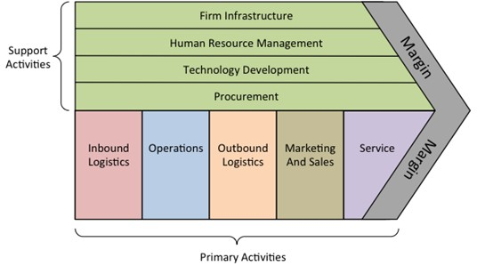
Step 2: Develop keyword list
To capture both overall strategic position and detailed functional activities
Source: Porter. 1985. Competitive Advantage: Creating and Sustaining Superior Performance. Free Press: New York, NY.

Slide 22
Examples of keywords
Strategic positioning: differenti*, unique*, superior, high* end*, cost leader*, low* pric*, low* cost*, etc.
Operations: efficien*, asset* utilization*, scale*, large* volume*, economy* of scale, quality*, reliab*, durable*, new* product*, etc.
Marketing: marketing*, advertis*, brand*, reputation*, trademark*, etc.
Service: customer* service*, customer* need*, customer* preference*, customiz*, tailor*, responsive*, etc.
Infrastructure: control* cost*, minimiz* cost*, reduce* cost*, cut* cost*, decreas* cost*, sav* cost*, cost* control*, cost* minimization*, cost* reduction*, cost* saving*, etc.
Human resources management: talent*, train*, skill*, human capital*, etc.
Technology: innovate*, creativ*, research and development, R&D, techni*, technolog*, patent*, proprietar*

Slide 23
Step 3: Count keyword frequency
Count with flexibility
Use stemmer
E.g. “low* cost*”
Two-word terms
E.g. “high end” or “high-end”
Phrases with a verb form and its object
E.g. “minimize cost”
77 variables in total

Slide 24
Step 4: Factor analysis
Advantages:
Identify latent factors based on data correlation structure rather than human judgment or intervention
Weigh factors based on factor loading rather than simply equal weighting
Interpret and label the factors using factor loading

Slide 25
Three dimensions of strategy measures
Product leadership | Customer intimacy | Operational excellence
technolog* | brand | reduc* cost
proprietary | quality | efficien*
R&D | marketing | low cost
intellect* propert* | customer service | improv* cost
patent | innovat*
techni* | trademark
reliab*
new product

Slide 26
Validation of textual measures
Content validity
Represents all facets of a given construct?
Reliability
Test-retest reliability?
Intra-class Correlation Coefficient (0<ICC<1)
0.99
0.98
0.97
Construct validity
Measures the intended construct?
Regression tests
Investment activities
Financial ratios
Source: Shadish, Cook, Campbell. 2002. Experimental and Quasi-Experimental Designs for Generalized Causal Inference. Wadsworth Cengage learning: Boston, MA.

Slide 27
Time trends for balanced panel of firms

Slide 28
Construct validity – Investment activities
 | R&D_{t} | R&D_{t+1} | Adv_{t} | Adv_{t+1} | CAPEX_{t} | CAPEX_{t+1}
Product leadership_{t} | 0.034*** | 0.003*** | -0.002*** | -0.000 | -0.002** | -0.002***
Customer intimacy_{t} | -0.013*** | -0.001*** | 0.009*** | 0.001*** | -0.002* | -0.000
Operational excellence_{t} | -0.010*** | -0.001*** | -0.005*** | -0.000*** | 0.004*** | 0.001***
R&D_{t} |  | 0.886***
Adv_{t} |  |  |  | 0.923***
CAPEX_{t} |  |  |  |  |  | 0.665***
Controls | Yes | Yes | Yes | Yes | Yes | Yes
Ind & Year FE | Yes | Yes | Yes | Yes | Yes | Yes
Adj R-squared | 0.444 | 0.882 | 0.238 | 0.906 | 0.284 | 0.629
#Obs | 47,908 | 39,590 | 47,908 | 39,590 | 47,908 | 39,590

Slide 29
Construct validity – Financial ratios
 | Gross margin_{t} | Gross margin_{t+1} | ATO_{t} | ATO_{t+1}
Product leadership_{t} | 0.012 | 0.004 | -0.153*** | -0.008***
Customer intimacy_{t} | 0.088*** | 0.007*** | 0.119*** | 0.006**
Operational excellence_{t} | -0.016** | -0.003* | 0.140*** | 0.011***
Gross margin_{t} |  | 0.912***
ATO_{t} |  |  |  | 0.930***
Controls | Yes | Yes | Yes | Yes
Ind & Year FE | Yes | Yes | Yes | Yes
Adj R-squared | 0.152 | 0.806 | 0.374 | 0.936
#Obs | 47,908 | 39,590 | 47,908 | 39,590
Controls: Age & Size

Slide 30
Correlation between alternative strategy measures
 | Product leadership | Customer intimacy | Operational excellence | BOSmeasure | HPmeasure
Product leadership | 1
Customer intimacy | 0.01 | 1
Operational excellence | 0.06 | 0.05 | 1
BOSmeasure | 0.25 | -0.02 | -0.07 | 1
HPmeasure | 0.09 | -0.21 | -0.18 | 0.12 | 1
BOSmeasure: one-dimensional strategy score based on financial outcomes used in Bentley et al. (CAR 2013);
HPmeasure: total similarity score based on text analysis developed in Hoberg and Phillips (JPE 2016)

Slide 31
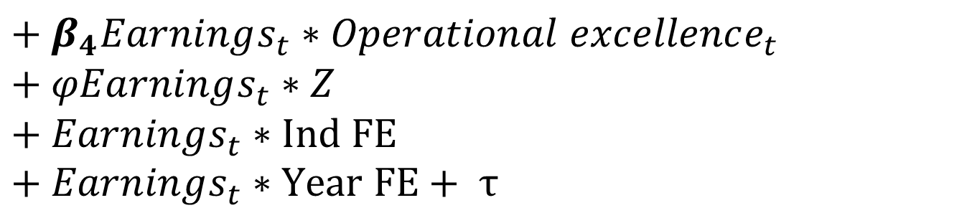
Empirical model: Earnings persistence
$$Earnings_{t+1}=β_{0}+β_{1}Earnings_{t}$$
$${+ β}_{2}Earnings_{t}∗Product leadership_{t}$$
$${+ β}_{3}Earnings_{t}∗Customer intimacy_{t}$$
$${+ β}_{4}Earnings_{t}∗Operational excellence_{t}$$
$$+ φEarnings_{t}∗Z$$
$$+ Earnings_{t}∗Ind FE$$
$+ Earnings_{t}∗Year FE+ τ$
$Earnings_{t}$ = income before extraordinary items scaled by average total assets
Z: controls of Size, Lev, Loss, MTB, Big4, and CF
Notes:
1. With the factors, let me briefly talk about the empirical model.
2. We use AR1 model to test the earnings persistence and assume that the AR1 coefficient is influenced by strategy and other controls. So here is the model with all the interaction terms. For robustness, we also estimate the model with the interaction terms and the main effects. And we test whether betas are different.

Slide 32
Results for H1: Earnings persistence
 | Earnings_{t+1} | Earnings_{t+1}
Earnings_{t} * Product leadership_{t} | 0.034** | 0.043**
Earnings_{t} * Customer intimacy_{t} | -0.033** | -0.043***
Earnings_{t} * Operational excellence_{t} | -0.039*** | -0.049***
Stand-alone terms | No | Yes
Earnings*Controls | Yes | Yes
Earnings*Industry FE | Yes | Yes
Earnings*Year FE | Yes | Yes
Adj R-squared | 0.523 | 0.533
#Obs | 36,159 | 36,159

Slide 33
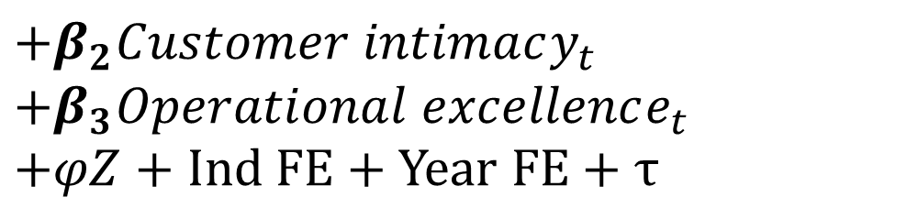
Empirical model: Earnings volatility
$$Vol\left(Earnings_{t}\right)=β_{0}+β_{1}Product leadership_{t}$$
$$+β_{2}Customer intimacy_{t}$$
$${+β}_{3}Operational excellence_{t}$$
$+φZ+Ind FE+Year FE+$ $τ$
$Vol(Earnings_{t})$ = five-year rolling standard deviation of $Earnings_{t}$ in periods t-4 through year t
Z: controls of Size, Lev, Loss, MTB, Big4, and CF
Notes:
.

Slide 34
Results for H2: Earnings volatility
 | Vol(Earnings)_{t}
Product leadership_{t} | 0.011***
Customer intimacy_{t} | -0.004***
Operational excellence_{t} | -0.005***
Controls | Yes
Industry & Year FE | Yes
Adj R-squared | 0.295
#Obs | 43,610

Slide 35
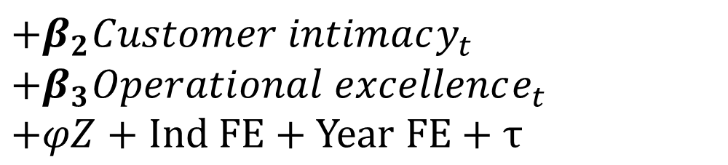
Empirical model: Balance-sheet conservatism
$$BTM_{t}=β_{0}+β_{1}Product leadership_{t}$$
$$+β_{2}Customer intimacy_{t}$$
$${+β}_{3}Operational excellence_{t}$$
$+φZ+Ind FE+Year FE+$ $τ$
$BTM_{t}$= Book-to-market ratio of equity valuation
Z: controls of Size, Lev, Loss, Big4, and CF

Slide 36
Results for RQ1a: Balance-sheet conservatism
 | BTM_{t}
Product leadership_{t} | -0.095***
Customer intimacy_{t} | 0.002
Operational excellence_{t} | 0.049***
Controls | Yes
Industry & Year FE | Yes
Adj R-squared | 0.155
#Obs | 43,610

Slide 37
Empirical model: Income-statement conservatism
$E_{t}/P_{t−1}$= $β_{0}+β_{1}DR_{t}+β_{2}RET_{t}+ β_{3}DR_{t}∗RET_{t}$
$$+ β_{4}DR_{t}∗RET_{t}∗Product leadership+β_{5}DR_{t}∗RET_{t}∗Customer intermacy+β_{6}DR_{t}∗RET_{t}∗Operational exellence+φDR_{t}∗RET_{t}∗Z$$
$$+DR_{t}∗RET_{t}∗Ind FE+ DR_{t}∗RET_{t}∗Year FE+ τ_{t}$$
$E_{t}/P_{t−1}$ = earnings per share scaled by stock price at the beginning of the fiscal year
$RET_{t}$ = annual stock return
$DR_{t}$ = an indicator variable for negative return
Z: controls of Size, Lev, Loss, MTB, Big4, and CF

Slide 38
Results for RQ1b: Income-statement conservatism
 | E/P | E/P
DR * RET * Product leadership | -0.025*** | -0.033***
DR * RET * Customer intimacy | -0.002 | -0.006
DR * RET * Operational excellence | 0.009 | 0.006
Stand-alone terms | No | Yes
DR * RET * Controls | Yes | Yes
DR * RET * Industry FE | Yes | Yes
DR * RET * Year FE | Yes | Yes
Adj R-squared | 0.190 | 0.487
#Obs | 43,610 | 43,610

Slide 39
Empirical model: Revenue-Expense matching
$${Revenue}_{t}=β_{0}+β_{1}{Expense}_{t−1}+β_{2}{Expense}_{t}+ β_{3}{Expense}_{t+1}$$
$$+β_{4}{Expense}_{t−1}∗Product leadership+β_{5}{Expense}_{t−1}∗Customer intimacy+β_{6}{Expense}_{t−1}∗Operational excellence$$
$$+β_{7}Expense_{t}∗Product leadership+β_{8}Expense_{t}∗Customer intimacy+β_{9}Expense_{t}∗Operational excellence$$
$$+β_{10}{Expense}_{t+1}∗Product leadership+β_{11}{Expense}_{t+1}∗Customer intimacy+β_{12}{Expense}_{t+1}∗Operational excellence$$
$$+φ_{1}{Expense}_{t−1}∗Z+φ_{2}Expense_{t}∗Z+φ_{3}{Expense}_{t+1}∗Z$$
$$+{Expense}_{t−1}∗Ind FE+{Expense}_{t−1}∗Year FE+Expense_{t}∗Ind FE$$
$+Expense_{t}∗Year FE+{Expense}_{t+1}∗Ind FE+{Expense}_{t+1}∗Year FE+τ_{t}$
Z: controls of Size, Lev, Loss, MTB, Big4, and CF

Slide 40
Results for RQ2: Revenue-Expense matching
 | Revenue_{t} | Revenue_{t}
Expense_{t-1} * Product leadership_{t} | 0.058** | 0.050**
Expense_{t-1} * Customer intimacy_{t} | -0.008 | -0.005
Expense_{t-1} * Operational excellence_{t} | -0.033** | -0.028**
Expense_{t} * Product leadership_{t} | -0.087*** | -0.085***
Expense_{t} * Customer intimacy_{t} | 0.044* | 0.044*
Expense_{t} * Operational excellence_{t} | 0.041** | 0.040**
Expense_{t+1} * Product leadership_{t} | 0.018 | 0.020
Expense_{t+1} * Customer intimacy_{t} | -0.024* | -0.026**
Expense_{t+1} * Operational excellence_{t} | -0.016 | -0.017
Stand-alone terms | No | Yes
Expense * Controls | Yes | Yes
Expense * Industry FE | Yes | Yes
Expense * Year FE | Yes | Yes
Adj R-squared | 0.988 | 0.990
#Obs | 43,610 | 43,610

Slide 41
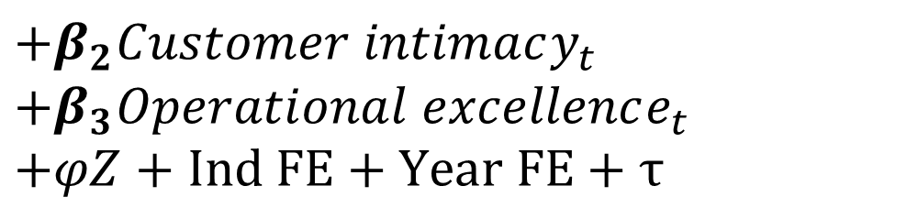
Empirical model: Abnormal accruals
$$AbnAcc=β_{0}+β_{1}Product leadership_{t}$$
$$+β_{2}Customer intimacy_{t}$$
$${+β}_{3}Operational excellence_{t}$$
$+φZ+Ind FE+Year FE+$ $τ$
$AbnAcc$= abnormal accruals estimated using the Jones model, modified Jones model, modified Jones model with ROA, and performance-matched model
Z: controls of Size, Lev, Loss, MTB, Big4, and CF

Slide 42
Results for RQ3: Abnormal accruals
 | Jones Model AbnAcc_{t} | Modif Jones AbnAcc_{t} | With ROA AbnAcc_{t} | Perf Matched AbnAcc_{t}
Product leadership_{t} | -0.002** | -0.002** | -0.002** | -0.004***
Customer intimacy_{t} | 0.002** | 0.002** | 0.002*** | 0.003**
Operational excellence_{t} | 0.000 | 0.000 | 0.000 | 0.000
Controls | Yes | Yes | Yes | Yes
Industry & Year FE | Yes | Yes | Yes | Yes
Adj R-squared | 0.117 | 0.121 | 0.131 | 0.053
#Obs | 43,610 | 43,610 | 43,610 | 43,610

Slide 43
Other implications of strategy
Management accounting
Strategy determines performance measures in CEO compensation contracts
Strategy determines reliance on equity pay in CEO compensation contracts
Strategy influences pay-performance-sensitivity in CEO compensation contracts
Strategy influences cost stickiness
Auditing
Strategy affects propensity for restatements
Tax accounting
Strategy moderates implications of book-tax differences
Mergers and acquisitions
Strategy synergy

Slide 44

Strategy matters!
Accounting research must consider, model and control for business strategy

