Slide 1


Title - Glucose Monitoring System using IOT
Software Engineering In Practice
Under the Guidance of,
Dr. Yashashwini
Associate Professor
Department of Computer Science & Engineering,
Cambridge Institute of Technology.
PRESENTED BY
LUWINA P (1CD23SCS05)
SHIRINITHYA R (1CD23SCS14)
Notes:
Is the notion of software architecture really important?

Slide 2
Introduction
Glucose is a simple sugar molecule. The sugar molecule is chemically symbolized as C6H12O6. This means that glucose molecule contains 6 Carbon (C) atoms, 12 Hydrogen (H) atoms, and 6 Oxygen (O) atoms. In human’s blood, glucose molecule circulates as blood sugar. Normally after eating food or drinking, our body breaks down sugars from food and uses them for energy in our cells. To perform this, our pancreas produces a hormone called insulin. Insulin pulls sugar from the blood and puts it in the cells for use.

Slide 3
Components Used
Microcontroller ESP32 - The ESP32 is a powerful microcontroller with built-in Wi-Fi and Bluetooth, ideal for IoT applications. It features dual-core processing and multiple analog/digital I/O pins for sensor integration. It collects data from sensors (like a pulse oximeter) and transmits it wirelessly to cloud platforms or mobile apps.
Pulse Oximeter Sensor - This sensor measures blood oxygen saturation (SpO₂) and heart rate using light-based technology. It uses infrared and red LEDs along with a photodetector to detect oxygen levels in the blood. The sensor sends real-time biometric data to the microcontroller for monitoring and alerts.
LCD 16x 2 display – The 16x2 LCD can display two lines of text with 16 characters per line. It is used to show live readings such as heart rate and SpO₂ directly on the device. It connects to the ESP32 via parallel pins or through an I2C adapter to save GPIO pins.
Power Supply - The power supply provides the necessary voltage (typically 5V) to run the ESP32 and connected components. It can be a rechargeable Li-ion battery, USB power bank, or regulated adapter. Reliable power ensures uninterrupted data collection and wireless transmission in portable applications.

Slide 4
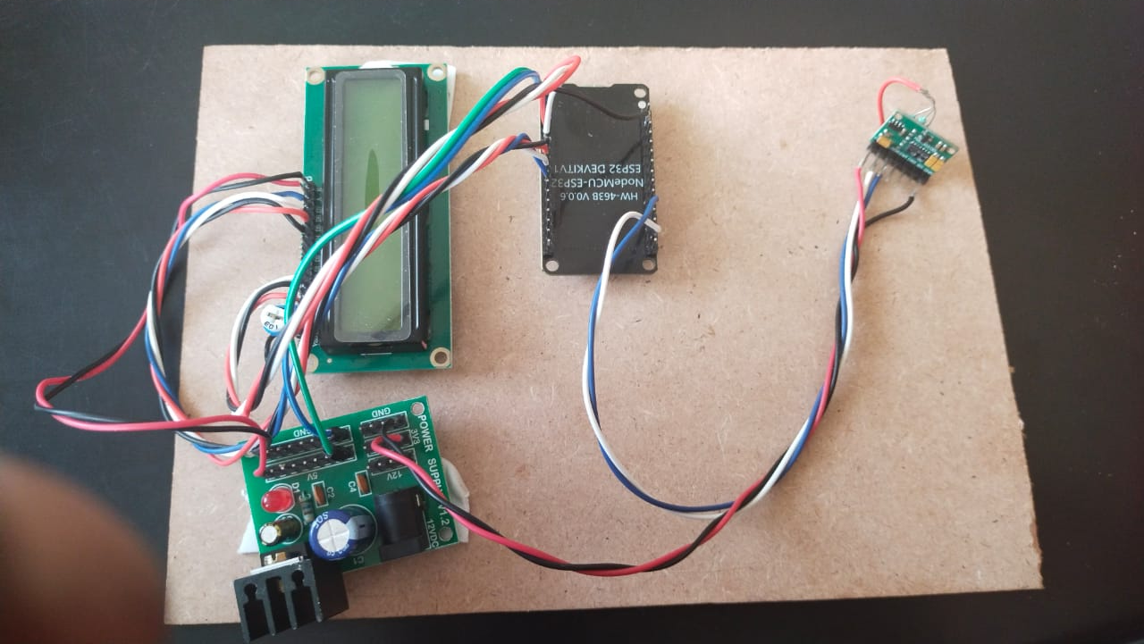
Flow chart
[ Glucose Sensor ]
│
(Analog Signal)
↓
[ ESP32 Microcontroller ]
│
(Processes & Sends Data)
↓
[ LCD display ]

Slide 5
Work Flow
In this project the blood glucose meter that can provide glucose measurements painlessly, without a blood sample or finger pricks, within a few seconds.
The device checks the heartbeat and it is displayed on the lcd. The primary task is to identify the hardware components which are suitable for this project.
Block diagram consist of hardware components which are interconnected with each other to perform specific task. When a light ray passes through biological tissues, it is both absorbed and scattered by the tissues. Light scattering occurs in biological tissues due to the mismatch between the refraction index of extracellular fluid and the membranes of the cells.
Variation in glucose level in blood affects the intensity of light scattered from the tissue.
Beer- Lambert Law plays a major role in absorbance measurement which states that absorbance of light through any solution is in proportion with the concentration of the solution and the length path travelled by the light ray.

Slide 6
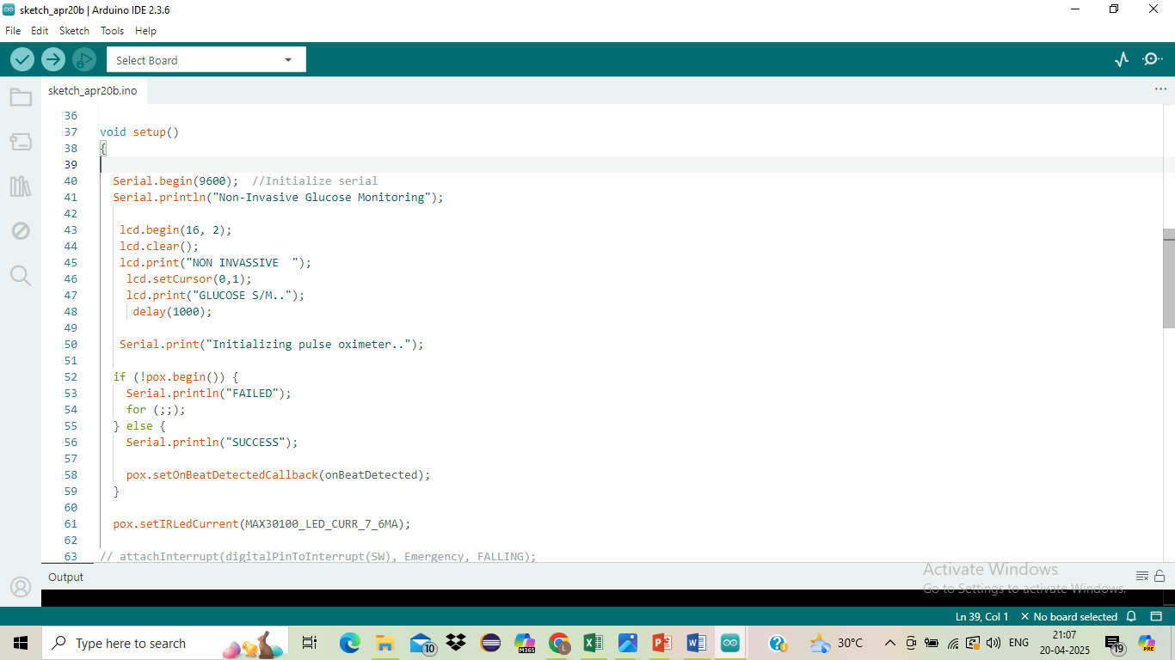
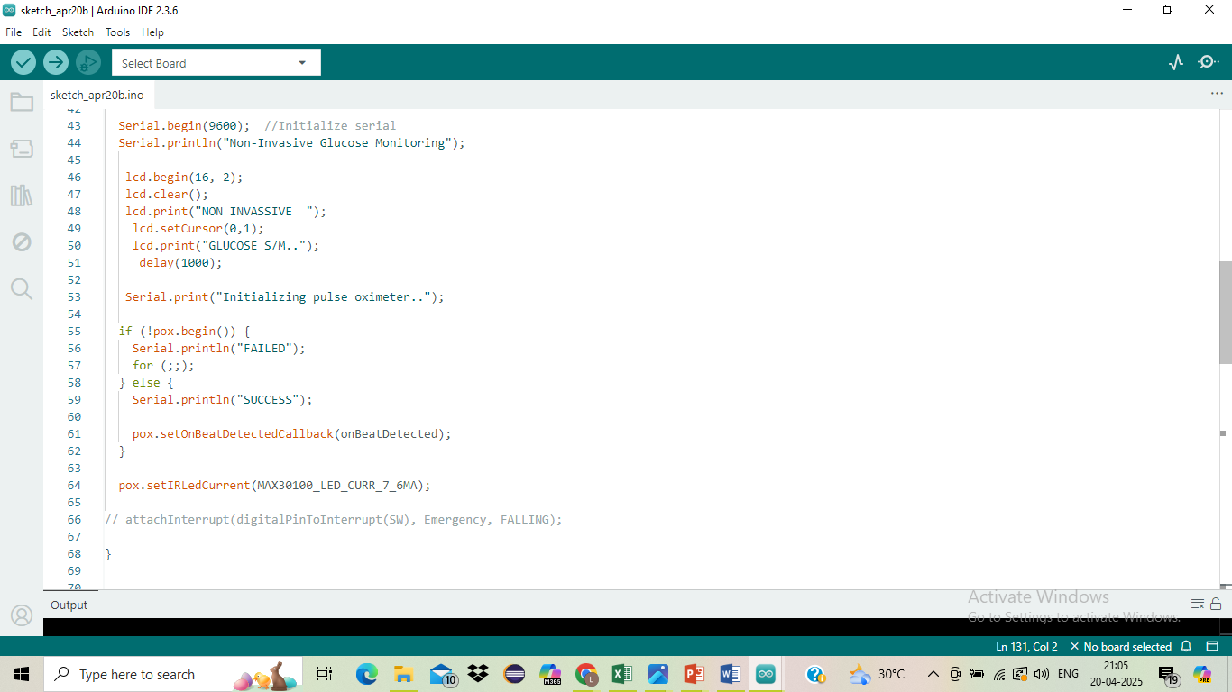
Code snippet

Slide 7
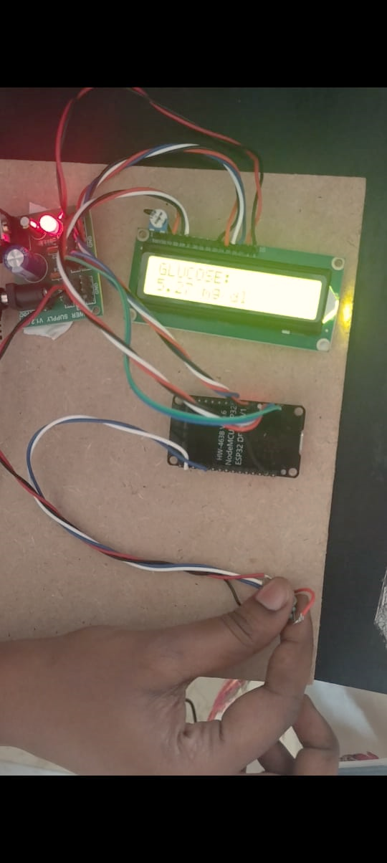
Result

Slide 8
Thank You ☺

