Slide 1
Lab 1
Li Zhao
lizhaomri@zju.edu.cn

Slide 2
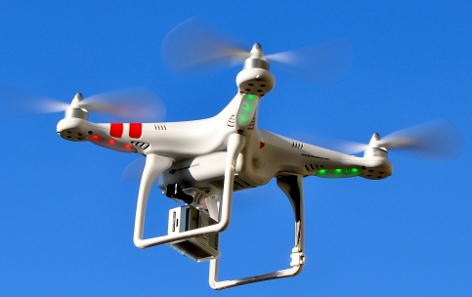
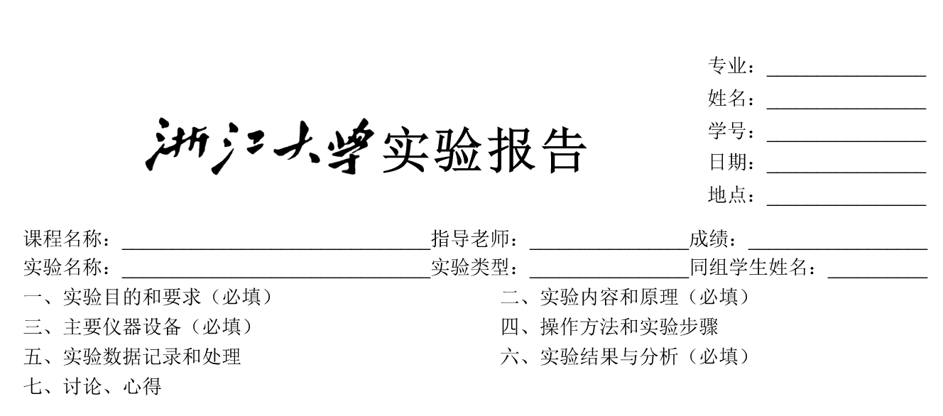
Lab Report: for yourself
Purpose
How it is related to the primary goal
Step
Parameters
If wrong, Go back and check
Result
Conclusion/Expectation
Todo

Slide 3
IDE
Matlab live editor
https://ww2.mathworks.cn/campaigns/offers/matlab-live-editor.html
Jupyter notebook
https://jupyter.org/
VS code
https://code.visualstudio.com/

Slide 4
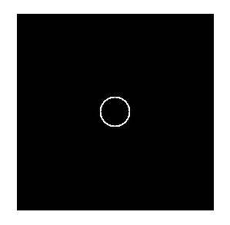

Project 1 Grey Image
Generate an image
Generate a 256x256 image with a circle in the center
Generate a grey image with the two vertices 0 and linearly increases to 255 at the diagonal

Slide 5
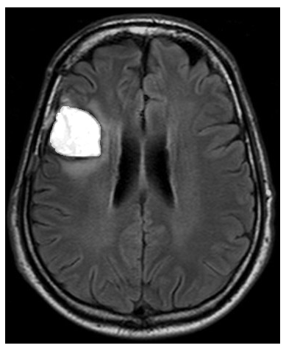
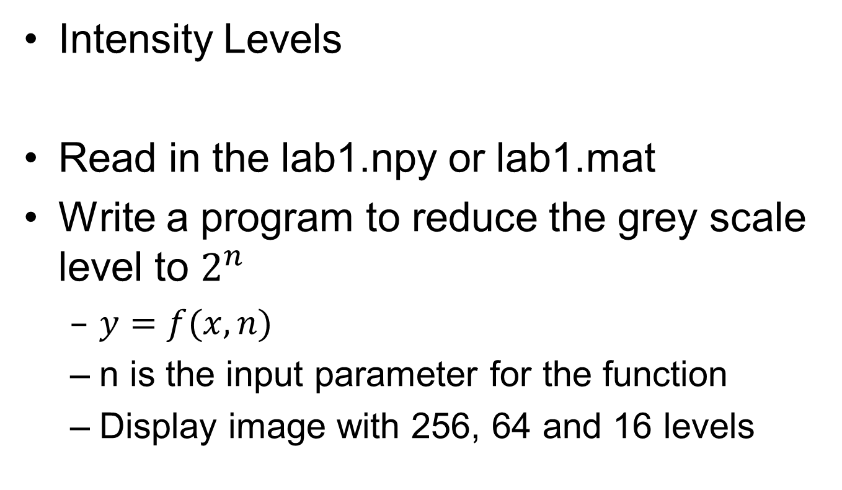
Project 2 Grey Image
Intensity Levels
Read in the lab1.npy or lab1.mat
Write a program to reduce the grey scale level to $2^{n}$
$y=f(x,n)$
n is the input parameter for the function
Display image with 256, 64 and 16 levels

Slide 6
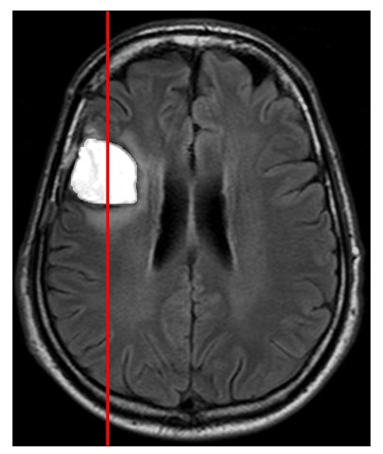
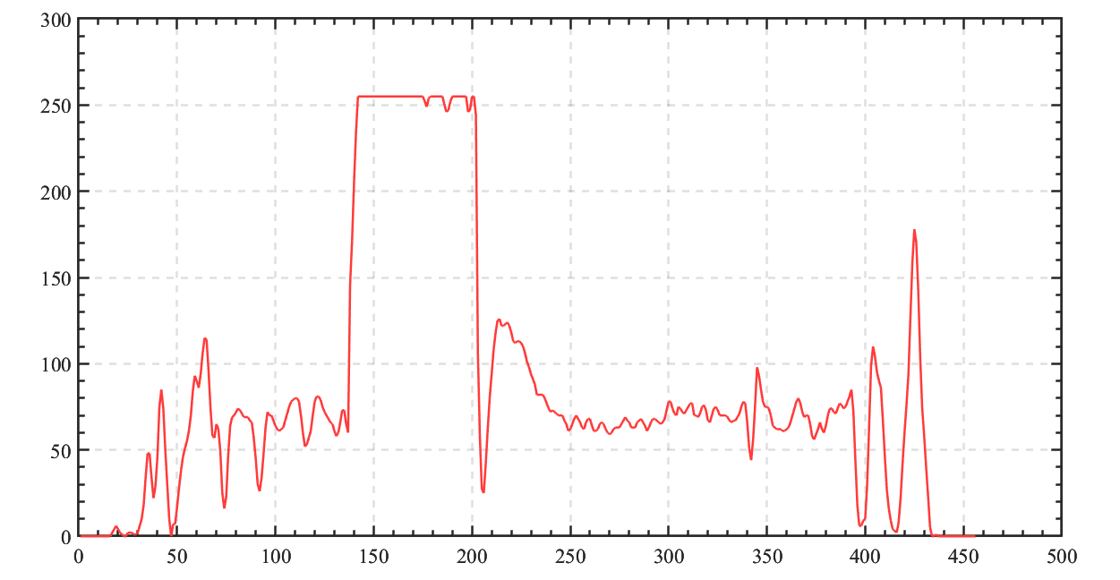
Project 3 Grey Image
Zooming and Shrinking Images
Plot a line through the image and compare the details for
Original image
Reduce the image size to 1/N
Increase the reduced image size to N

Slide 7
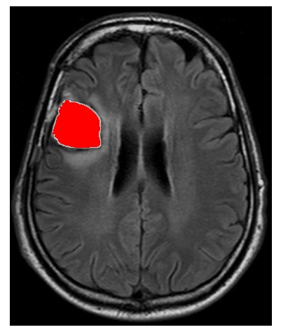
Project 4 Color Image
Color overlay
Generate the mask by I>threshold
Put the mask in the red channel to generate a color overlay image

Slide 8
Lab 1

