Slide 1
Lab 2
Li Zhao
lizhaomri@zju.edu.cn

Slide 2
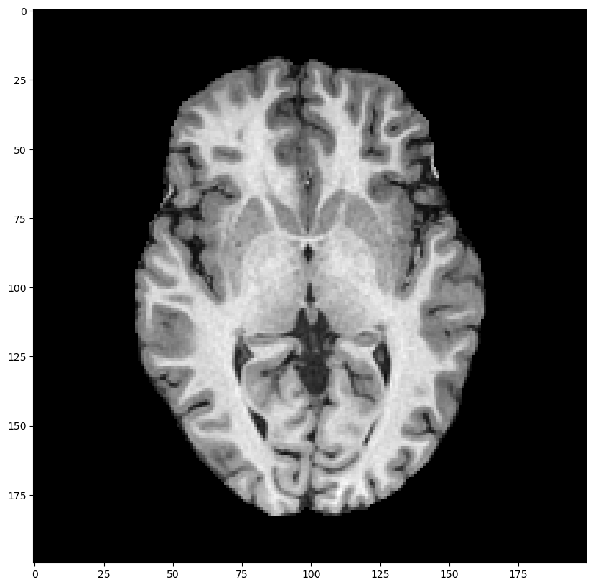
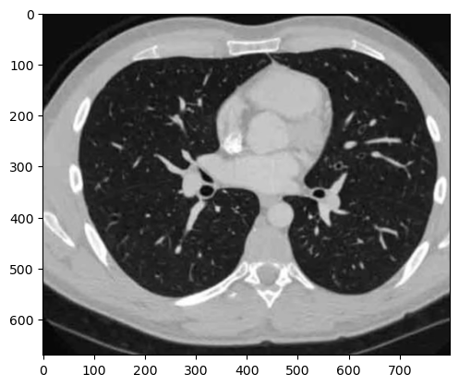
Pre Lab
Load data lab2_CT/MRI into arrays
Displace the image with a proper view window
Lab2_CT
Lab2_MRI

Slide 3
Project 1 Spatial Transform
Affine transformation:lab2_MRI.mat/npy
Use the provided data of brain MRI
Design and implement the following transforms
Translation along vertical direction
Rescale to size M/2,N/2
Flip： along x axis or y axis
Rotation: Rotate around the origin (pi/4)
Design composite transformations above

Slide 4
Project 2: Intensity Transform
Intensity transform: lab2_CT .mat/npy
Write your code for: Log transform，Power transform
Adjust the parameters to show the best visual effect
Explain the major differences between the methods
Expalin how the parameters were selected

Slide 5
Project 3: Histogram Equalization
Write your code for (lab2_CT.mat/npy)
Computer and show the histogram
Histogram equalization
Check the histogram of the enhanced images in Project 3
Explain the enhancement regarding the histogram

