Slide 1
Algorithm Analysis & Design Introduction to Algorithm
T&R Team of Algorithm Design
College of Computer Science and Engineering, CQU
Notes:
本人是国际视觉电生理学会(ISCEV)的会员。

Slide 2
GREEDY ALGORITHM
16
Locally optimal choice

Slide 3
Overview
Like dynamic programming, used to solve optimization problems.
Dynamic programming can be overkill; greedy algorithms tend to be easier to code
Problems exhibit optimal substructure (like DP).
Problems also exhibit the greedy-choice property.
When we have a choice to make, make the one that looks best right now.
Make a locally optimal choice in hope of getting a globally optimal solution.

Slide 4
Greedy Strategy
The choice that seems best at the moment is the one we go with.
Prove that when there is a choice to make, one of the optimal choices is the greedy choice. Therefore, it’s always safe to make the greedy choice.
Show that all but one of the subproblems resulting from the greedy choice are empty.

Slide 5
Activity-Selection Problem
Problem: get your money’s worth out of a festival
Buy a wristband that lets you onto any ride
Lots of rides, each starting and ending at different times
Your goal: ride as many rides as possible
Another, alternative goal that we don’t solve here: maximize time spent on rides
Welcome to the activity selection problem

Slide 6
Activity-selection Problem
Input: Set S of n activities, a₁, a₂, …, a_{n}.
s_{i} = start time of activity i.
f_{i} = finish time of activity i.
Output: Subset A of maximum number of compatible activities.
Two activities are compatible, if their intervals don’t overlap.
Example:
Activities in each line
are compatible.
2
5
3
6
1
4
7

Slide 7
Optimal Substructure
Assume activities are sorted by finishing times.
f₁ ≤ f₂ ≤ … ≤ f_{n}.
Suppose an optimal solution includes activity a_{k}.
This generates two subproblems.
Selecting from a₁, …, a_{k-1}, activities compatible with one another, and that finish before a_{k} starts (compatible with a_{k}).
Selecting from a_{k+1}, …, a_{n}, activities compatible with one another, and that start after a_{k} finishes.
The solutions to the two subproblems must be optimal.
Prove using the cut-and-paste approach.

Slide 8
Optimal Substructure
Assume activities are sorted by finishing times.
f₁ ≤ f₂ ≤ … ≤ f_{n}.
Suppose an optimal solution includes activity a_{k}.
This generates two subproblems.
Selecting from a₁, …, a_{k-1}, activities compatible with one another, and that finish before a_{k} starts (compatible with a_{k}).
Selecting from a_{k+1}, …, a_{n}, activities compatible with one another, and that start after a_{k} finishes.
The solutions to the two subproblems must be optimal.
Prove using the cut-and-paste approach.

Slide 9
Activity Selection: Repeated Subproblems
Consider a recursive algorithm that tries all possible compatible subsets to find a maximal set, and notice repeated subproblems:
S 1∈A?
yes
no
S’ 2∈A?
S-{1} 2∈A?
yes
no
yes
no
S’’
S’-{2}
S’’
S-{1,2}

Slide 10
Recursive Solution
Let S_{ij} = subset of activities in S that start after a_{i} finishes and finish before a_{j} starts.
Subproblems: Selecting maximum number of mutually compatible activities from S_{ij}.
Let c[i, j] = size of maximum-size subset of mutually compatible activities in S_{ij}.
Recursive
Solution:

Slide 11
Greedy Choice Property
Dynamic programming? Memoize? Yes, but…
Activity selection problem also exhibits the greedy choice property:
Locally optimal choice ⇒ globally optimal sol’n
Them 16.1: if S is an activity selection problem sorted by finish time, then ∃ optimal solution A ⊆ S such that {1} ∈ A
Sketch of proof: if ∃ optimal solution B that does not contain {1}, can always replace first activity in B with {1} (Why?). Same number of activities, thus optimal.

Slide 12
Greedy-choice Property
The problem also exhibits the greedy-choice property.
There is an optimal solution to the subproblem S_{ij}, that includes the activity with the smallest finish time in set S_{ij}.
Can be proved easily.
Hence, there is an optimal solution to S that includes a₁.
Therefore, make this greedy choice without solving subproblems first and evaluating them.
Solve the subproblem that ensues as a result of making this greedy choice.
Combine the greedy choice and the solution to the subproblem.

Slide 13
Recursive Algorithm
Recursive-Activity-Selector (s, f, i, j)
m ← i+1
while m < j and s_{m} < f_{i}
do m ← m+1
if m < j
then return {a_{m}} ∪
Recursive-Activity-Selector(s, f, m, j)
else return φ
Initial Call: Recursive-Activity-Selector (s, f, 0, n+1)
Complexity: Θ(n)
Straightforward to convert the algorithm to an iterative one.

Slide 14
Typical Steps
Cast the optimization problem as one in which we make a choice and are left with one subproblem to solve.
Prove that there’s always an optimal solution that makes the greedy choice, so that the greedy choice is always safe.
Show that greedy choice and optimal solution to subproblem ⇒ optimal solution to the problem.
Make the greedy choice and solve top-down.
May have to preprocess input to put it into greedy order.
Example: Sorting activities by finish time.

Slide 15
Activity Selection: A Greedy Algorithm
So actual algorithm is simple:
Sort the activities by finish time
Schedule the first activity
Then schedule the next activity in sorted list which starts after previous activity finishes
Repeat until no more activities
Intuition is even more simple:
Always pick the shortest ride available at the time

Slide 16
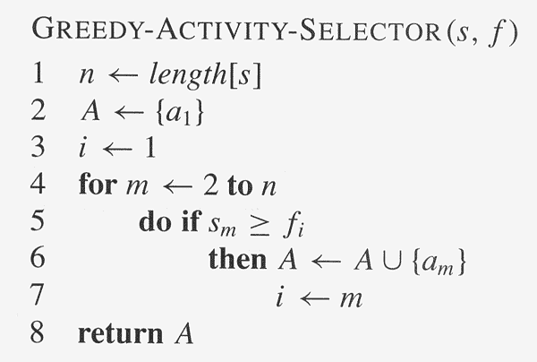
Copyright © The McGraw-Hill Companies, Inc. Permission required for reproduction or display.

Slide 17
Elements of Greedy Algorithms
Greedy-choice Property.
A globally optimal solution can be arrived at by making a locally optimal (greedy) choice.
Optimal Substructure.

Slide 18
Change-Making Problem

Slide 19
Change-Making Problem
Finding the number of ways of making changes
for a particular amount of cents, n, using a given
set of denominations C={c1…cd} (e.g, the US
coin system: {1, 5, 10, 25, 50, 100})
– An example: n = 4,C = {1,2,3}, solutions: {1,1,1,1},
{1,1,2},{2,2},{1,3}.
▪ Minimizing the number of coins returned for a
particular quantity of change (available coins
{1, 5, 10, 25})
– 30 Cents (solution: 25 + 5, two coins)
– 67 Cents ?
▪ 17 cents given denominations = {1, 2, 3, 4}?

Slide 20
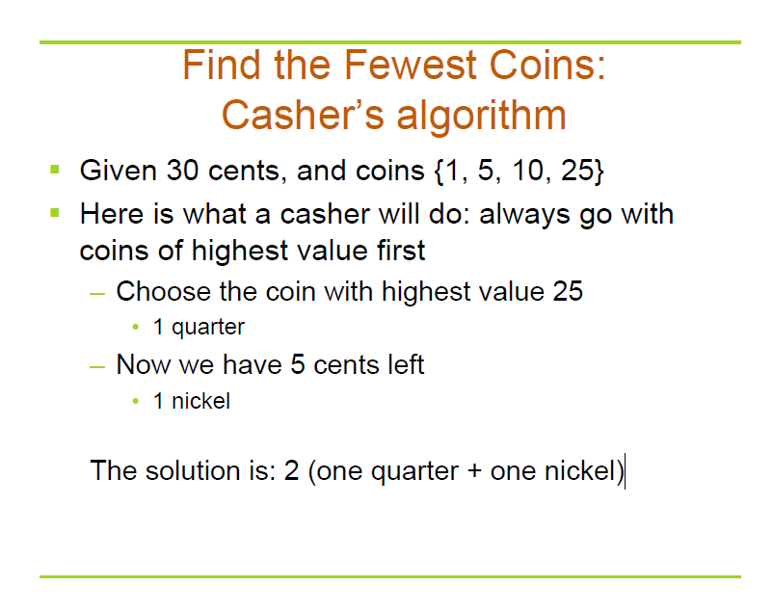

Slide 21
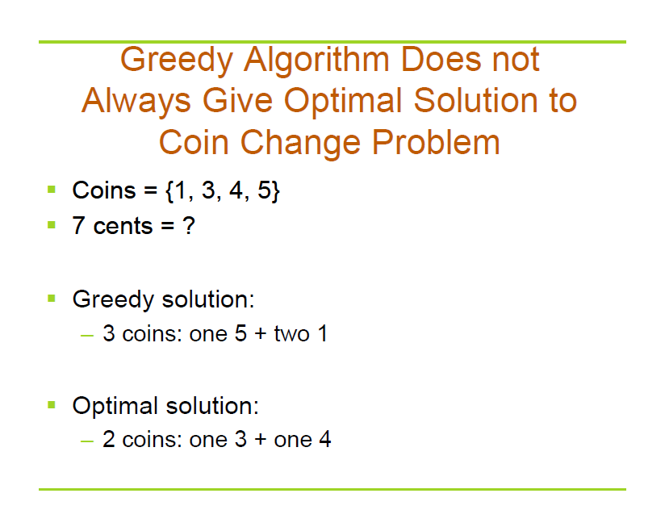

Slide 22
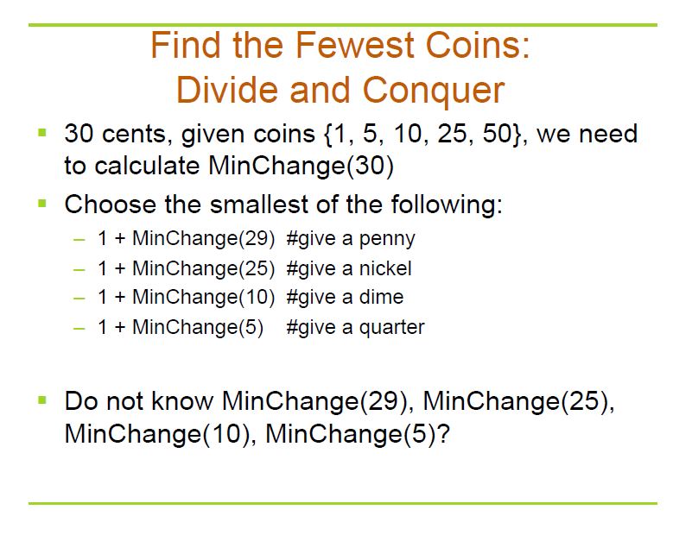

Slide 23
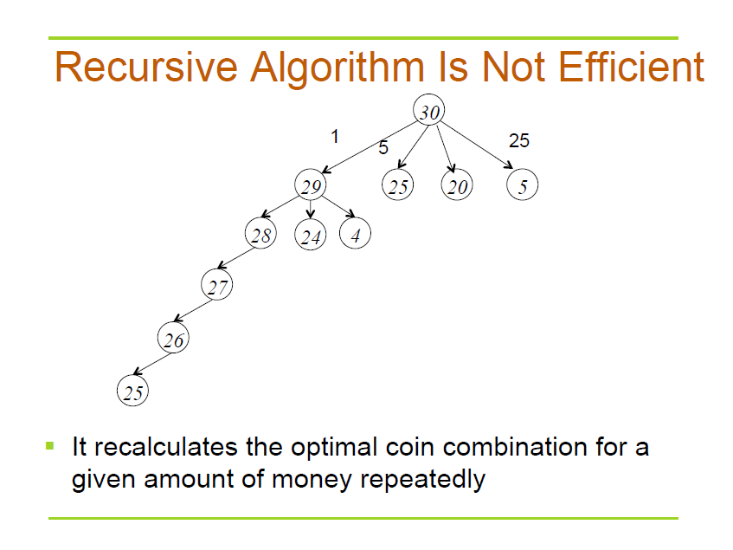

Slide 24
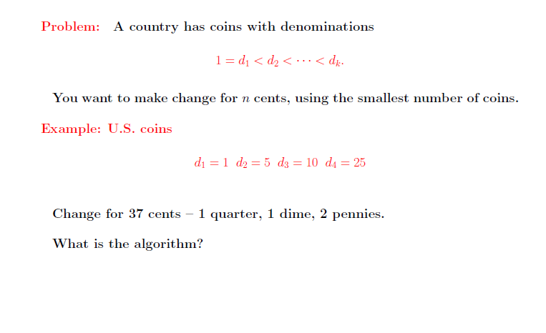
Dynamic Programming

Slide 25
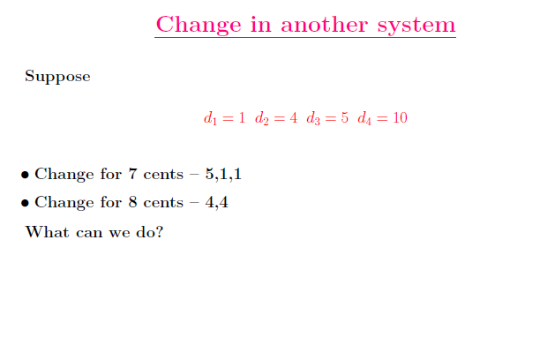
Dynamic Programming

Slide 26
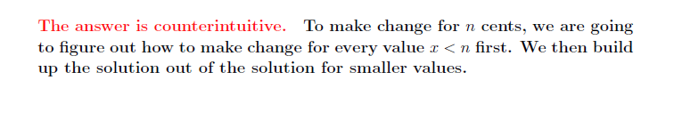
Dynamic Programming

Slide 27
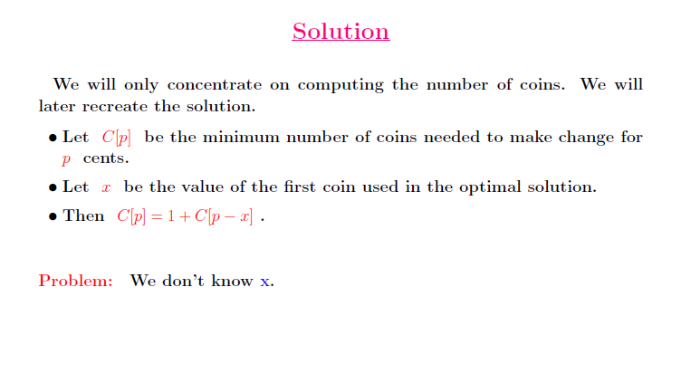
Dynamic Programming

Slide 28
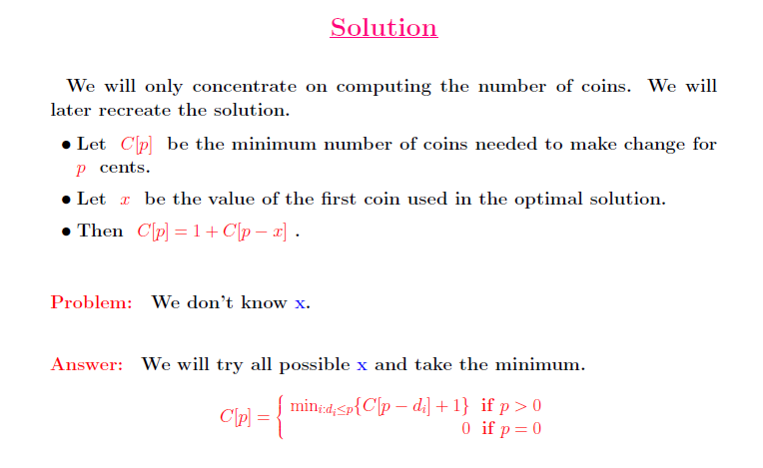
Dynamic Programming

Slide 29
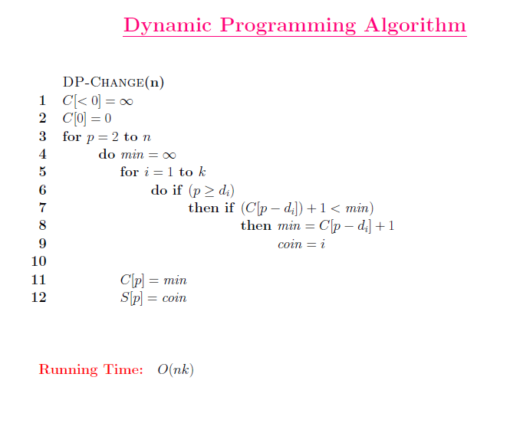

Slide 30
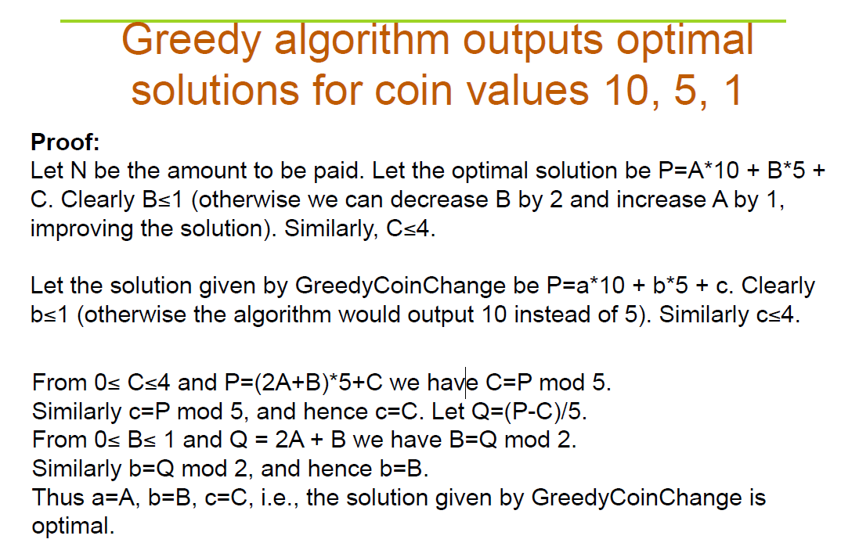

Slide 31
Homework
CLRS 16.1-2
CLRS 16.1-5
CLRS 16.2-7

Slide 32
Exercise in Class
Prove that Greedy algorithm outputs optimal solution for coin values 18,6,3,1

Slide 33
练习题
礼品分组
N个礼品，每个礼品的价格不一样。现要把所有礼品分组，每组的礼品数量不超过2个，且礼品总价格不超过C (C>0)，求分组的数目最少的分法。

Slide 34
练习题
堆积木
老师给每个小朋友分了些积木块，但每个小朋友手上的积木都不足以堆成想要的形状。现在你手上有一些积木，你可以全部交给某个小朋友让他有足够的积木堆成形状，堆完后再收回所有的积木。你最多可以让多少小朋友堆成积木。

Slide 35
练习题
PK赛
土木专业男生寝室A和煤矿专业寝室B的人数都是N，为了争夺和文艺系女生寝室的“联谊”权，决定举行一场摔跤PK赛。比赛要进行N轮，每轮由双方寝室各派出一位男生参加，但每人只能比赛一次。假设寝室B的室长知道双方学生的实力，他如何安排寝室B学生的比赛顺序才能取得最多的胜利。

Slide 36
练习题
整数值
3元，2元，1元的硬币各有K₃,K₂,K₁枚，问总共有多少种不需要返回零钱的支付方法。

Slide 37
练习题
正整数序列取值
0,a₁,a₂,…,a_{n},0中依次取出正整数值，取出a_{i}后，之后的整数值都会向前移一位，并获得min{a_{i-1},a_{i+1}}的奖励，问总奖励最多的抽取方法。

Slide 38
Huffman Codes

Slide 39
Data Compression
Q. Given a text that uses 32 symbols (26 different letters, space, and
some punctuation characters), how can we encode this text in bits?
Q. Some symbols (e, t, a, o, i, n) are used far more often than others.
How can we use this to reduce our encoding?
Q. How do we know when the next symbol begins?
Ex. c(a) = 01 What is 0101?
c(b) = 010
c(e) = 1

Slide 40
Data Compression
Q. Given a text that uses 32 symbols (26 different letters, space, and some punctuation characters), how can we encode this text in bits?
A. We can encode 32 different symbols using a fixed length of 5 bits per symbol. This is called fixed length encoding.
Q. Some symbols (e, t, a, o, i, n) are used far more often than others.
How can we use this to reduce our encoding?
A. Encode these characters with fewer bits, and the others with more bits.
Q. How do we know when the next symbol begins?
A. Use a separation symbol (like the pause in Morse), or make sure that there is no ambiguity by ensuring that no code is a prefix of another one.
Ex. c(a) = 01 What is 0101?
c(b) = 010
c(e) = 1

Slide 41
Prefix Codes
Definition. A prefix code for a set S is a function c that maps each x∈S to 1s and 0s in such a way that for x,y∈S, x≠y, c(x) is not a prefix of c(y).
Ex. c(a) = 11
c(e) = 01
c(k) = 001
c(l) = 10
c(u) = 000
Q. What is the meaning of 1001000001 ?
A. “leuk”
Suppose frequencies are known in a text of 1G:
fa=0.4, fe=0.2, fk=0.2, fl=0.1, fu=0.1
Q. What is the size of the encoded text?
A. 2*fa + 2*fe + 3*fk + 2*fl + 4*fu = 2.4G

Slide 42
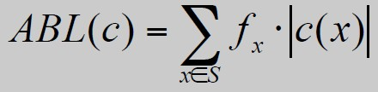
Optimal Prefix Codes
Definition. The average bits per letter of a prefix code c is the sum
over all symbols of its frequency times the number of bits of its
encoding:
We would like to find a prefix code that is has the lowest possible
average bits per letter.
Suppose we model a code in a binary tree…

Slide 43
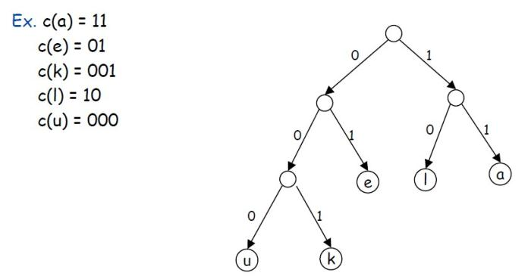
Representing Prefix Codes using Binary Trees
Q. How does the tree of a prefix code look?
A. Only the leaves have a label.
Pf. An encoding of x is a prefix of an encoding of y if and only if the
path of x is a prefix of the path of y.

Slide 44
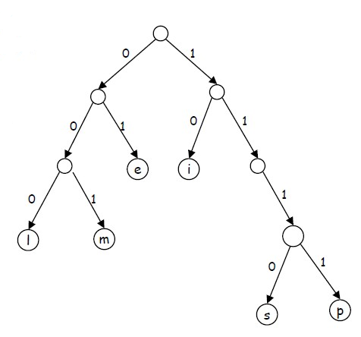

Representing Prefix Codes using Binary Trees
Q. What is the meaning of
111010001111101000 ?
A. “simpel”
Q. How can this prefix code be made more efficient?
A. Change encoding of p and s to a shorter one.
This tree is now full.

Slide 45
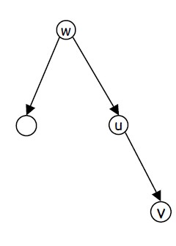
Representing Prefix Codes using Binary Trees
Definition. A tree is full if every node that is not a leaf has two
children.
Claim. The binary tree corresponding to the optimal prefix code is full.
Pf. (by contradiction)
Suppose T is binary tree of optimal prefix code and is not full.
This means there is a node u with only one child v.
Case 1: u is the root; delete u and use v as the root
Case 2: u is not the root
– let w be the parent of u
– delete u and make v be a child of w in place of u
In both cases the number of bits needed to encode any leaf in the
subtree of v is decreased. The rest of the tree is not affected.
Clearly this new tree T’ has a smaller ABL than T. Contradiction.

Slide 46
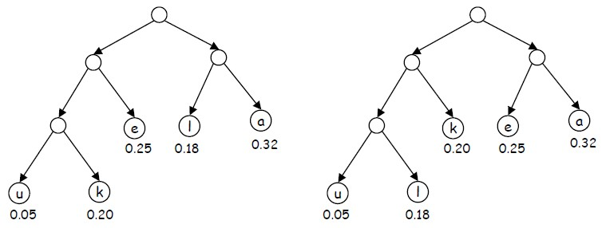
Optimal Prefix Codes: False Start
Q. Where in the tree of an optimal prefix code should letters be placed
with a high frequency?
A. Near the top.
Greedy template. Create tree top-down, split S into two sets S1 and S2
with (almost) equal frequencies. Recursively build tree for S1 and S2.
[Shannon-Fano, 1949] f_{a}=0.32, f_{e}=0.25, f_{k}=0.20, f_{l}=0.18, f_{u}=0.05

Slide 47
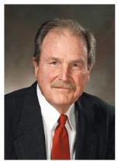
Optimal Prefix Codes: Huffman Encoding
Observation. Lowest frequency items should be at the lowest level in
tree of optimal prefix code.
Observation. For n > 1, the lowest level always contains at least two
leaves.
Observation. The order in which items appear in a level does not
matter.
Claim. There is an optimal prefix code with tree T* where the two
lowest-frequency letters are assigned to leaves that are siblings in T*.
Greedy template. [Huffman, 1952] Create tree bottom-up.
Make two leaves for two lowest-frequency letters y and z.
Recursively build tree for the rest using a meta-letter for yz.

Slide 48
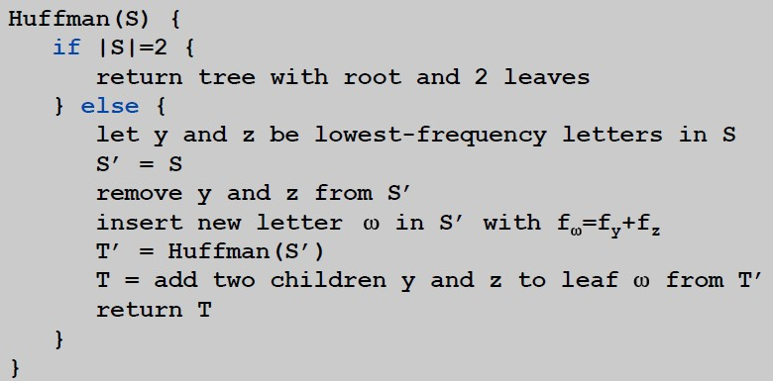
Optimal Prefix Codes: Huffman Encoding
Q. What is the time complexity?
A. T(n) = T(n-1) + O(n) so O(n²)
Q. How to implement finding lowest-frequency letters efficiently?
A. Use priority queue for S: T(n) = T(n-1) + O(log n) so O(n log n)

Slide 49
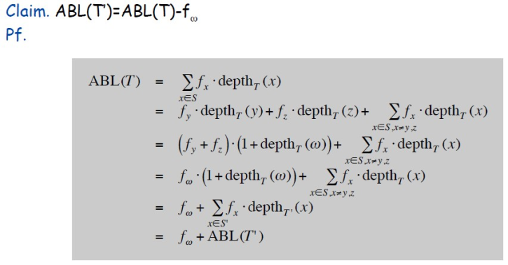
Huffman Encoding: Greedy Analysis
Claim. Huffman code for S achieves the minimum ABL of any prefix code.
Pf. by induction, based on optimality of T’ (y and z removed, ω added)

Slide 50
Huffman Encoding: Greedy Analysis
Claim. Huffman code for S achieves the minimum ABL of any prefix
code.
Pf. (by induction)
Base: For n=2 there is no shorter code than root and two leaves.
Hypothesis: Suppose Huffman tree T’ for S’ of size n-1 with ω instead of y and z is optimal. (IH)
Step: (by contradiction)
Idea of proof:
– Suppose other tree Z of size n is better.
– Delete lowest frequency items y and z from Z creating Z’
– Z’ cannot be better than T’ by IH.

Slide 51
Huffman Encoding: Greedy Analysis
Claim. Huffman code for S achieves the minimum ABL of any prefix
code.
Pf. (by induction)
Base: For n=2 there is no shorter code than root and two leaves.
Hypothesis: Suppose Huffman tree T’ for S’ with ω instead of y and z is optimal. (IH)
Step: (by contradiction)
Suppose Huffman tree T for S is not optimal.
So there is some tree Z such that ABL(Z) < ABL(T).
Then there is also a tree Z for which leaves y and z exist that are
siblings and have the lowest frequency (see observation).
Let Z’ be Z with y and z deleted, and their former parent labeled ω.
Similar T’ is derived from S’ in our algorithm.
We know that ABL(Z’)=ABL(Z)-fω, as well as ABL(T’)=ABL(T)-fω.
But also ABL(Z) < ABL(T), so ABL(Z’) < ABL(T’).
Contradiction with IH.

