Slide 1
Algorithm Analysis & Design Introduction to Algorithm
T&R Team of Algorithm Design
College of Computer Science and Engineering, CQU
Notes:
本人是国际视觉电生理学会(ISCEV)的会员。

Slide 2
Chapter 25: All-Pairs Shortest Paths

Slide 3
Outlines
All-pairs shortest paths
First solution: using Dijkstra’s algorithm
Second solution: dynamical programming
1. matrix manipulation
2. Floyd-warshall algorithm

Slide 4
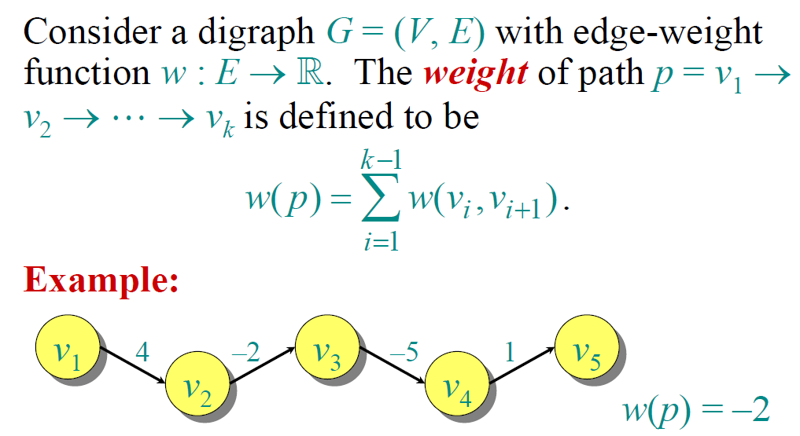
Paths in Graphs

Slide 5
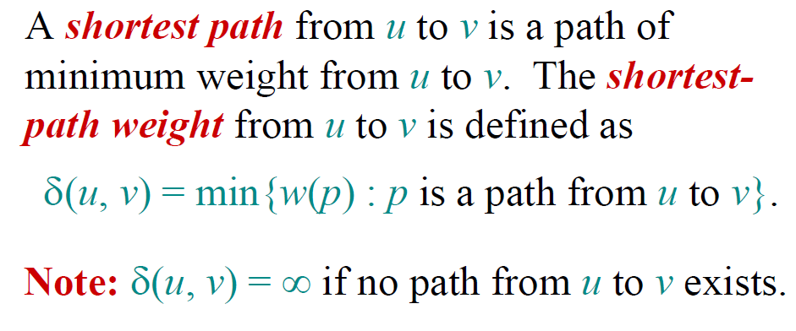
Shortest Paths

Slide 6
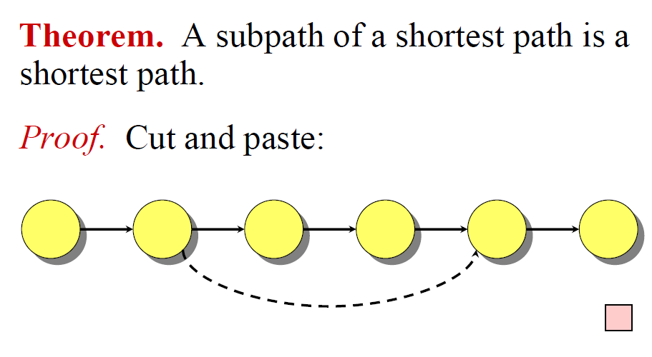
Optimal Sub-Structure

Slide 7
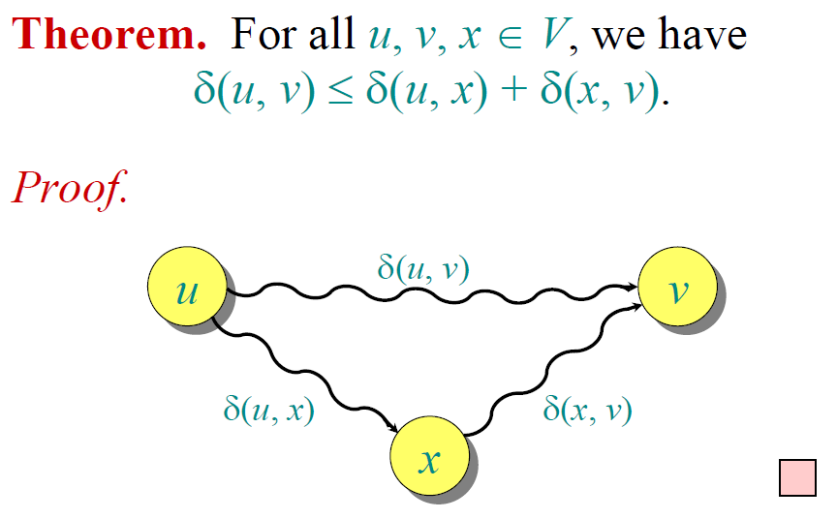
Triangle Inequality

Slide 8
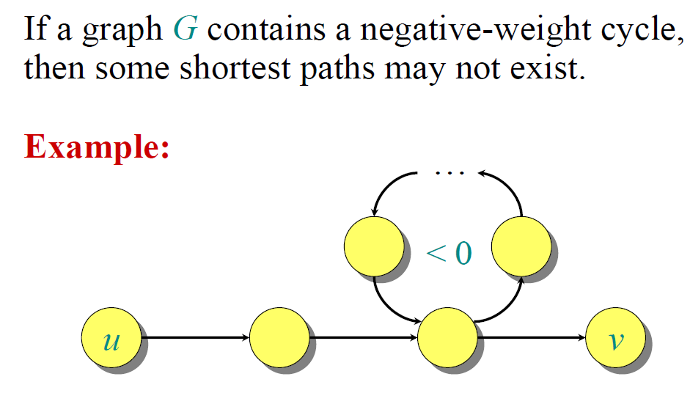
Well-Definedness of SP

Slide 9
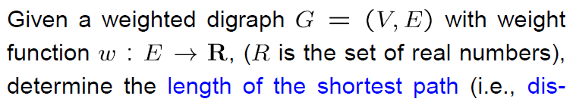
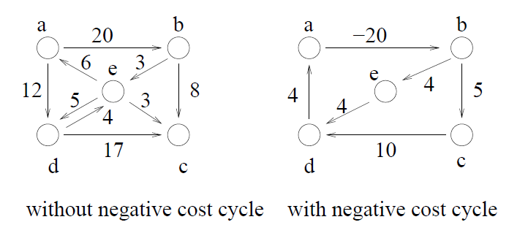
All-Pairs Shortest Paths

Slide 10
Dijkstra’s Algorithm

Slide 11
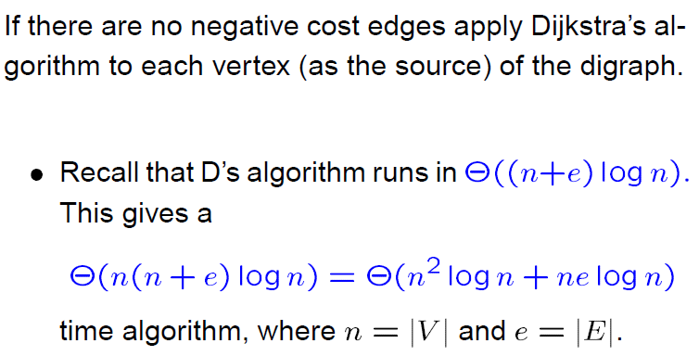
Solution 1: Dijkstra’s Algorithm

Slide 12
Dynamical Programming

Slide 13
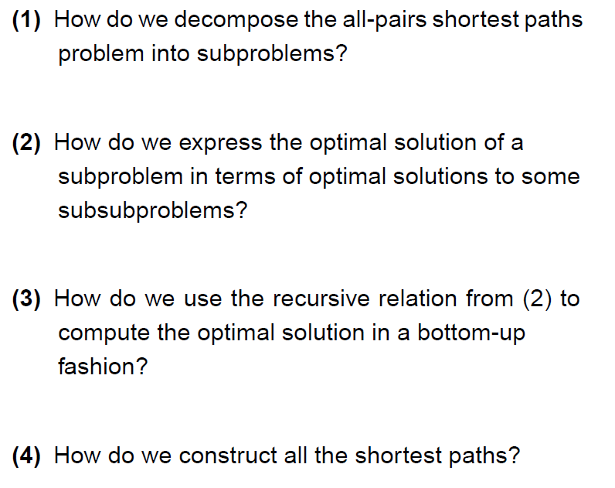
To make DP work:

Slide 14
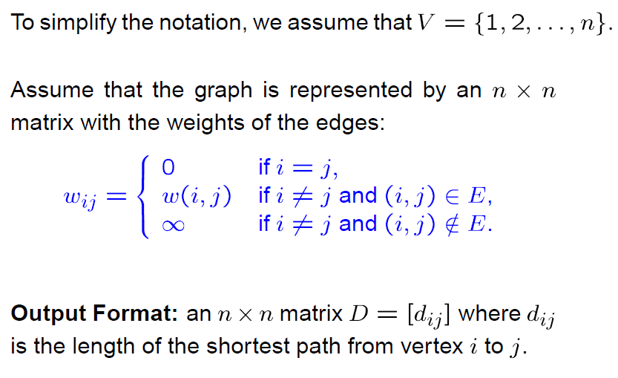
Matrix multiplication

Slide 15
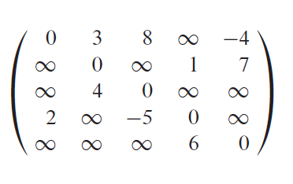
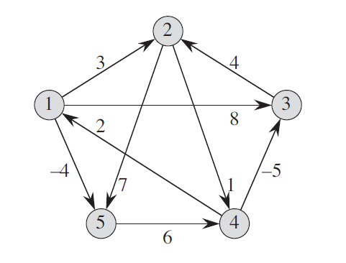
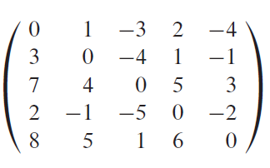
Example
Input
Without negative circle
Output

Slide 16
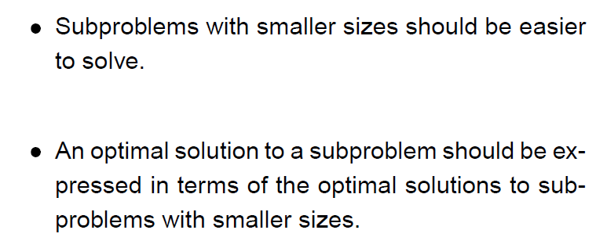

How to decompose the problem

Slide 17
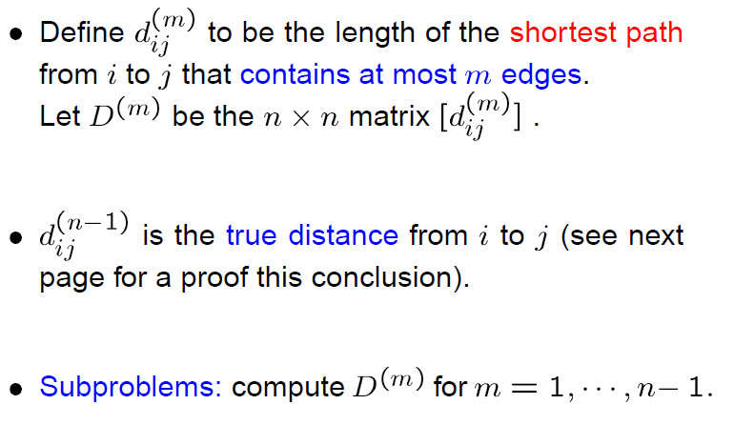

Step 1: Decompose in a Natural Way

Slide 18

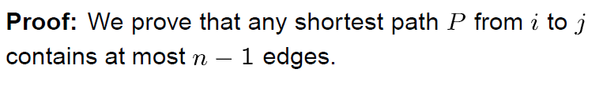
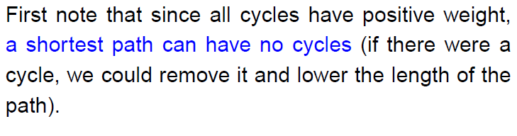
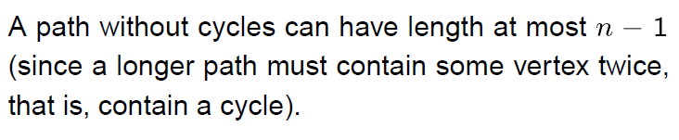

Slide 19

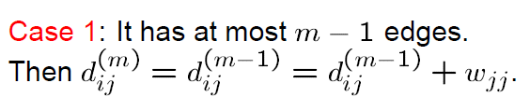
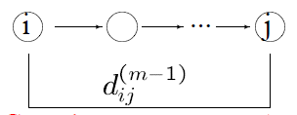
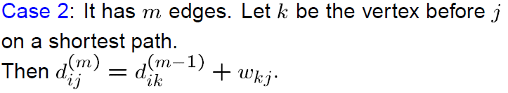
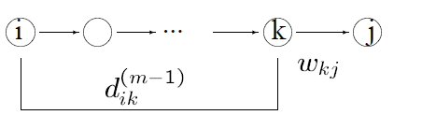
Step 2：Recursive Formula

Slide 20
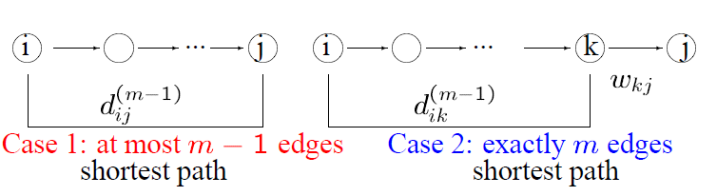
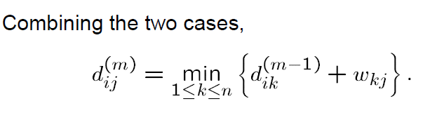
Step 2: Recursive Formula

Slide 21
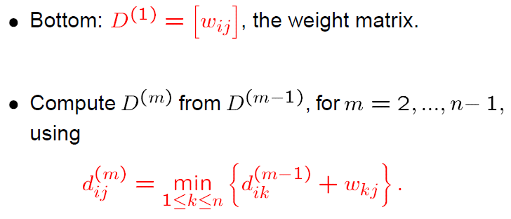
Step 3: Bottom-Up Computation

Slide 22
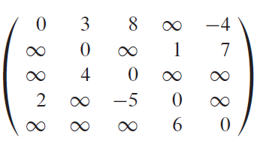

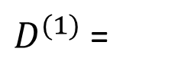
Example
$D^{(1)}$ =

Slide 23

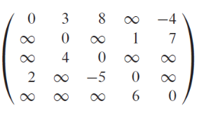
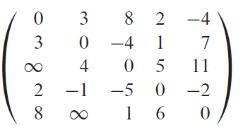

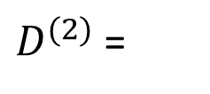

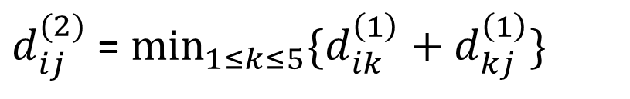
Example
$$D^{(1)}$$
$$D^{(1)}$$
X
$d_{ij}^{(2)}$ = $\min_{1≤k≤5}{\{d_{ik}^{\left(1\right)}+d_{kj}^{\left(1\right)}\}}$
$D^{(2)}$ =

Slide 24
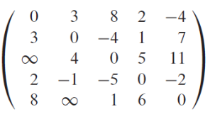
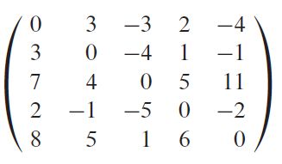

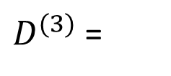
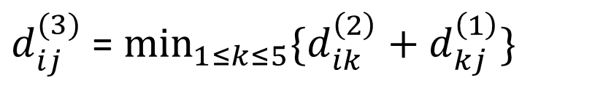
Example
$$D^{(2)}$$
$$D^{(1)}$$
0
X
$d_{ij}^{(3)}$ = $\min_{1≤k≤5}{\{d_{ik}^{\left(2\right)}+d_{kj}^{\left(1\right)}\}}$
$D^{(3)}$ =
0

Slide 25
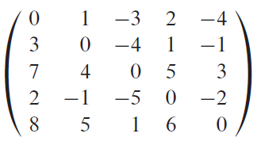
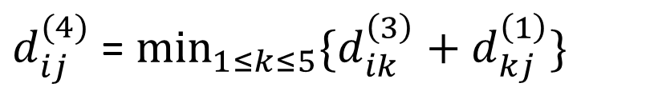
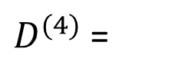

Example
$$D^{(3)}$$
$$D^{(1)}$$
X
$d_{ij}^{(4)}$ = $\min_{1≤k≤5}{\{d_{ik}^{\left(3\right)}+d_{kj}^{\left(1\right)}\}}$
$D^{(4)}$ =
The shortest distances between any pair of vertices

Slide 26
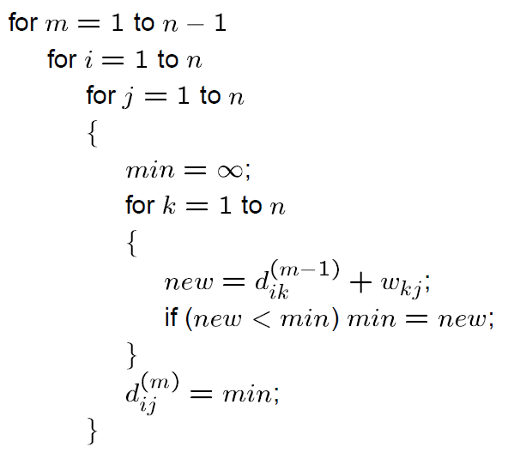
Algorithm

Slide 27
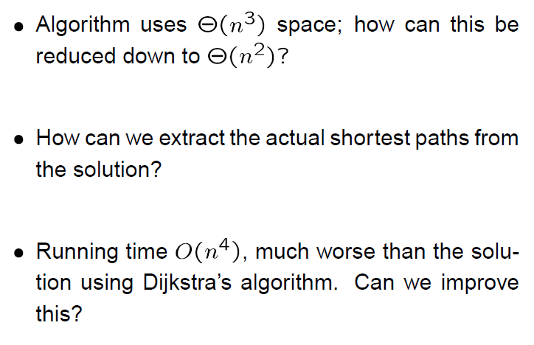
Comments

Slide 28

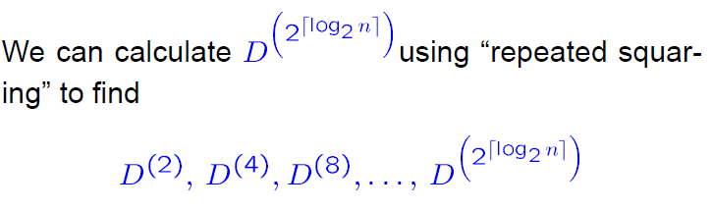
Improvement: Repeated Squaring

Slide 29
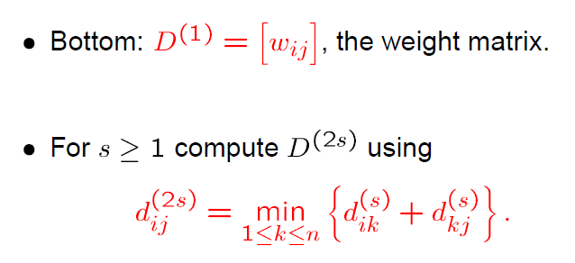
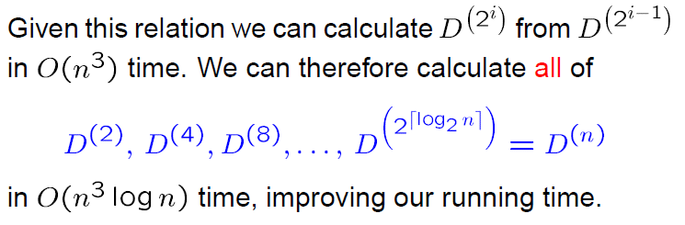
Improvement: Repeated Squaring

Slide 30
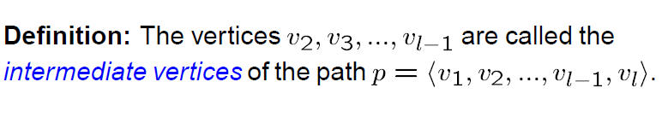
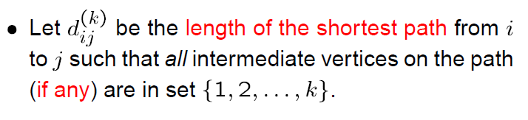
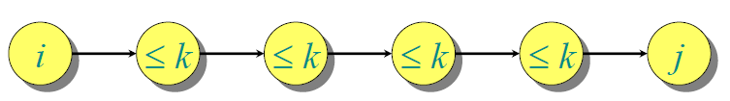
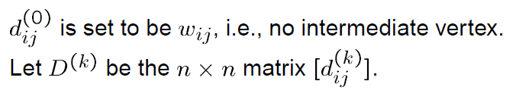
Floyd-Warshell Algorithm

Slide 31
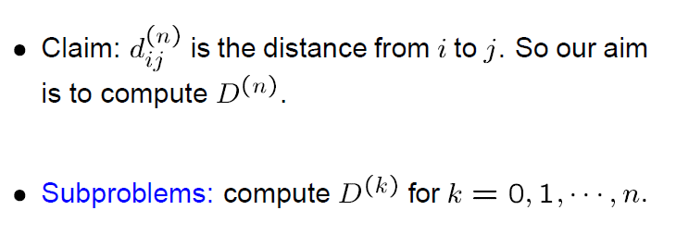
Floyd-Warshell Algorithm

Slide 32

The Structure of Shortest Paths
Non-negative circle!

Slide 33
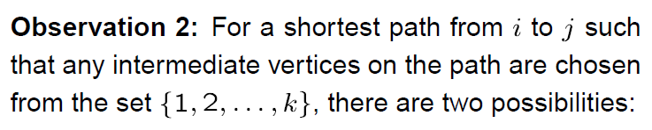

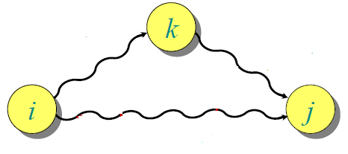





Step 2： The Structure of Shortest Paths

Slide 34

Step 3：Bottom-Up Computation

Slide 35
Step 3：Bottom-Up Computation

Slide 36

Example
$D^{(0)}$ =

Slide 37




Example
$$D^{(0)}$$
$d_{ij}^{(1)}$ = $\min{\{d_{ij}^{(0)}{, d}_{i1}^{\left(0\right)}+d_{1j}^{(0)}\}}$
$D^{(1)}$ =

Slide 38



Example
$$D^{(1)}$$
$d_{ij}^{(2)}$ = $\min{\{d_{ij}^{(1)}{, d}_{i2}^{\left(1\right)}+d_{2j}^{(1)}\}}$
$D^{(2)}$ =

Slide 39



Example
$$D^{(2)}$$
$d_{ij}^{(3)}$ = $\min{\{d_{ij}^{(2)}{, d}_{i3}^{\left(2\right)}+d_{3j}^{(2)}\}}$
$D^{(3)}$ =

Slide 40



Example
$d_{ij}^{(5)}$ = $\min{\{d_{ij}^{(4)}{, d}_{i5}^{\left(4\right)}+d_{5j}^{(4)}\}}$
$D^{(5)}$ =
The shortest distances between any pair of vertices

Slide 41

Algorithm

Slide 42

Comments

Slide 43

Extracting The Shortest Paths

Slide 44
Exercises
25.1-1
24.1-7
25.2-1
25.2-4

Slide 45


Short Test in Class
Give $D^{(1)}$, $D^{(2)}$, $D^{(3)}$ with matrix multiplication algorithm, or $D^{(0)}$, $D^{(1)}$, $D^{(2)}$ by Floyd-Warshell algorithm.

Slide 46
End of Section.
算法分析课程组
重庆大学计算机学院
Notes:
本人是国际视觉电生理学会(ISCEV)的会员。

