Slide 1
Algorithm Analysis & Design Introduction to Algorithm
T&R Team of Algorithm Design
College of Computer Science and Engineering, CQU
Notes:
本人是国际视觉电生理学会(ISCEV)的会员。

Slide 2
Chapter 26: Maximum Flow

Slide 3
Outlines
Flow networks
Ford-Fulkerson method
Edmonds & Karp Algorithm
Applications

Slide 4
Flow Networks

Slide 5
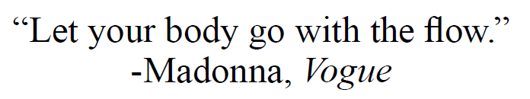
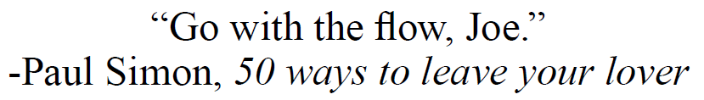
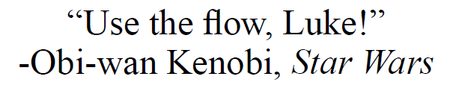
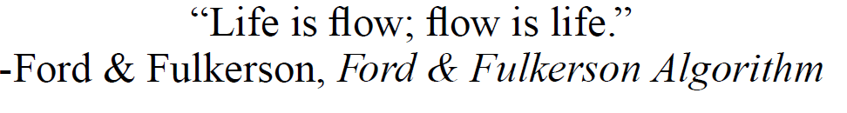

The Tao of Flow

Slide 6
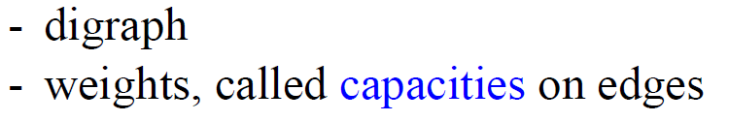




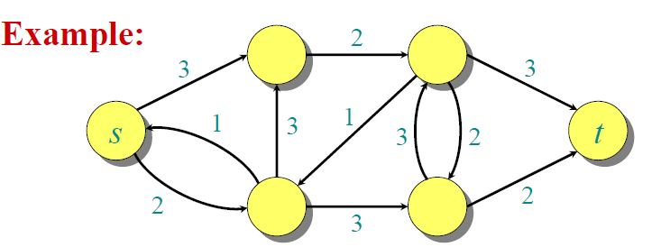
Flow Network
- two distinct vertices
- each vertex on some path from source to sink

Slide 7
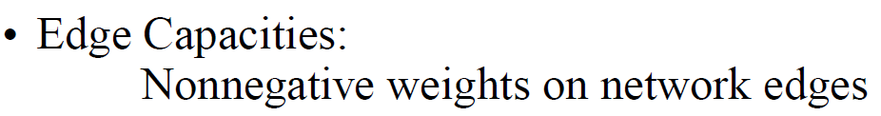






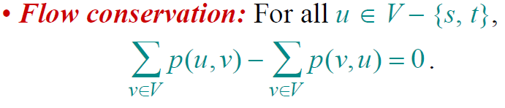
Capacity and Flow

Slide 8
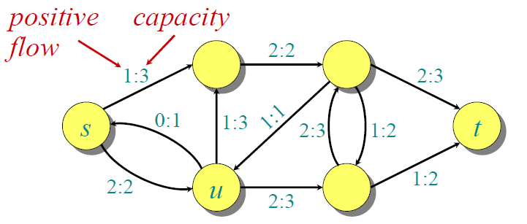
Capacity and Flow

Slide 9
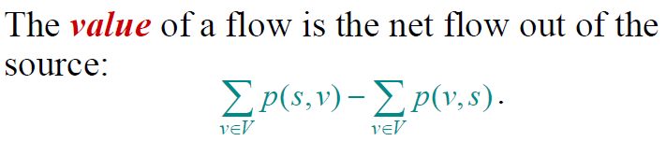
Flow Value

Slide 10
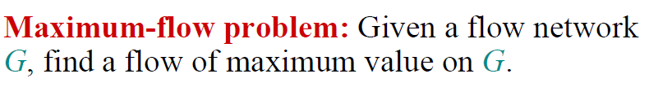
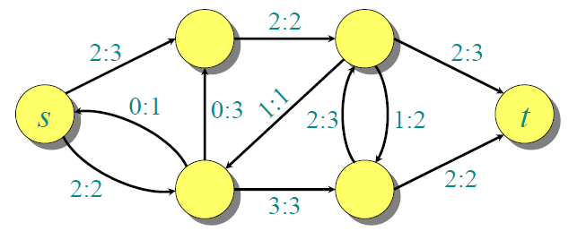

The Maximum-Flow Problem

Slide 11
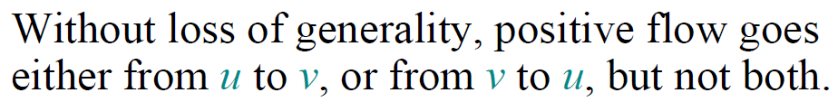
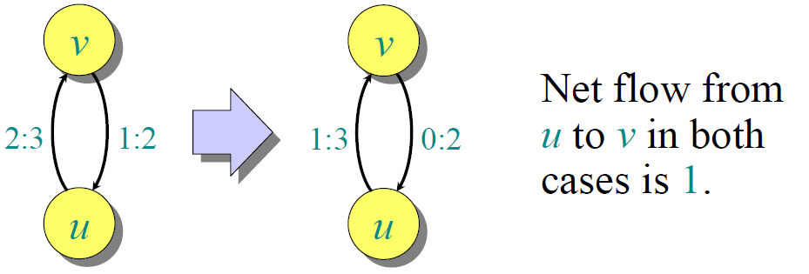
Flow Cancellation

Slide 12

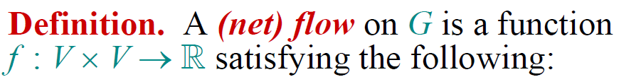
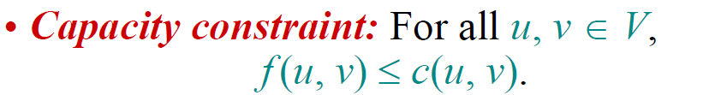
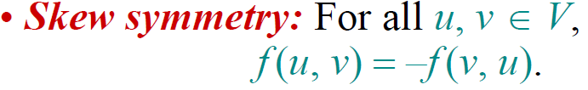
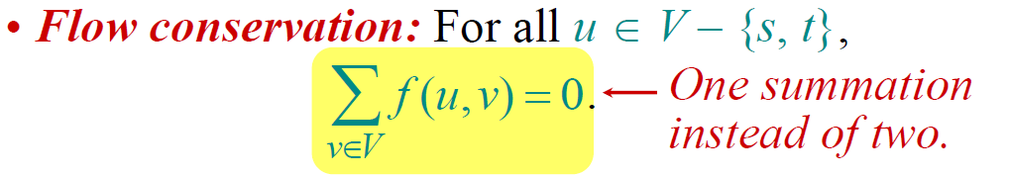
Net Flow Definitions

Slide 13
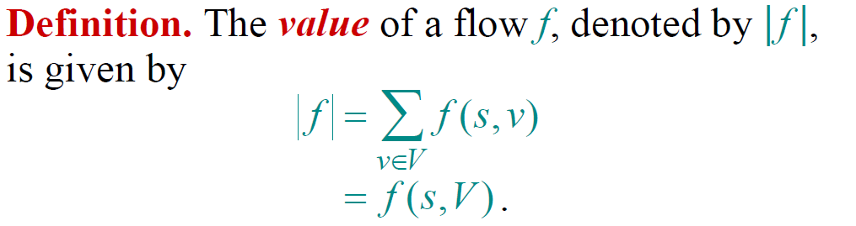
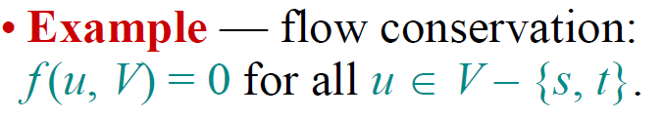
Net Flow Value

Slide 14

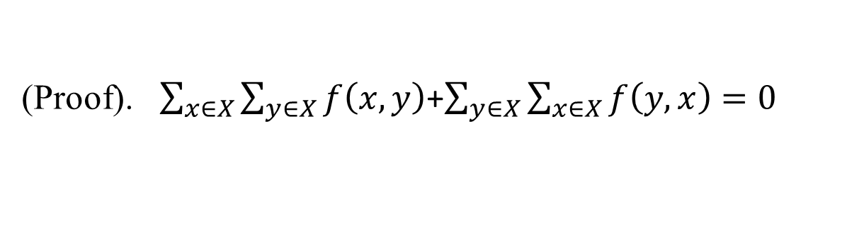

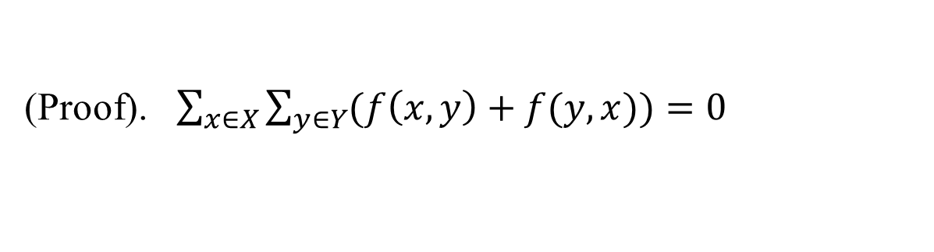
Simple Properties of Net Flow

Slide 15

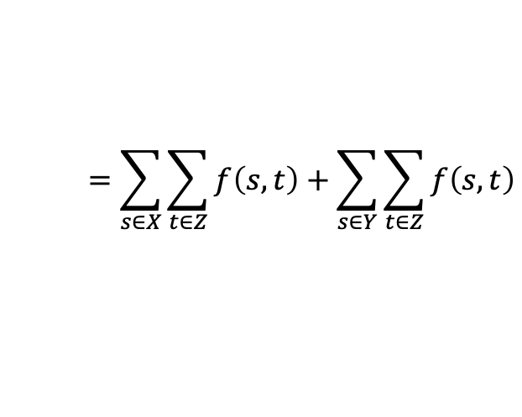

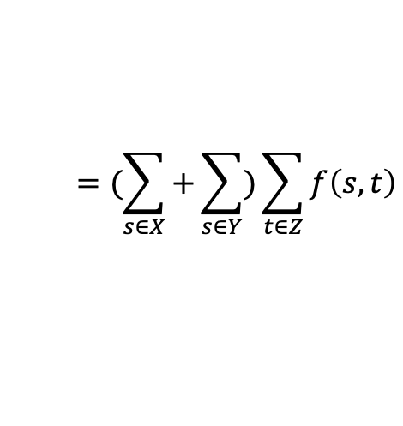
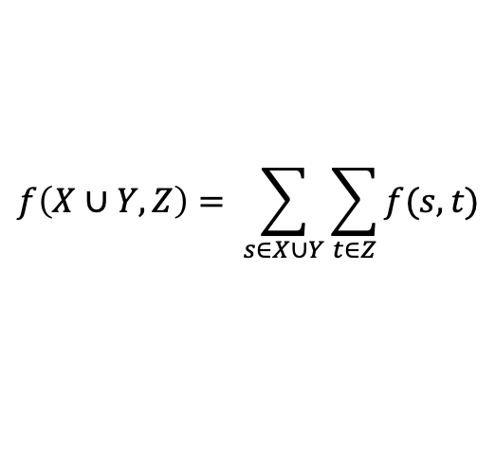
Simple Properties of Net Flow
(Proof).
$$f\left(X∪Y, Z\right)= \sum_{s∈X∪Y}{\sum_{t∈Z}{f(s,t)}}$$
$$=(\sum_{s∈X}{+\sum_{s∈Y}{)\sum_{t∈Z}{f\left(s,t\right)}}}$$
$$∵X∩Y=∅$$
$$=\sum_{s∈X}{\sum_{t∈Z}{f\left(s,t\right)}+\sum_{s∈Y}{\sum_{t∈Z}{f\left(s,t\right)}}}$$
$$=f\left(X,Z\right)+f(Y,Z)$$

Slide 16







Simple Properties of Net Flow
$$=−f\left(V−s, V\right)=f(V,V−s)$$

Slide 17
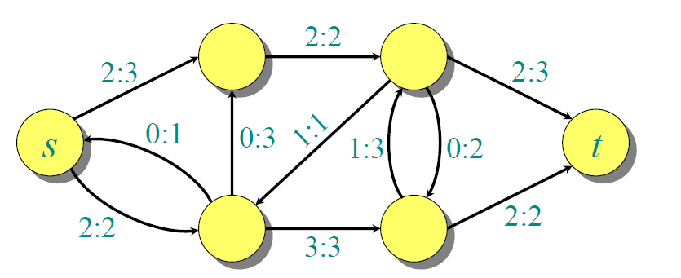

Net Flow into Sink

Slide 18





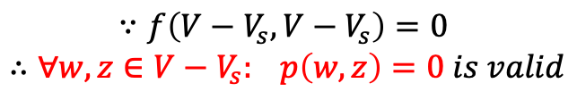

思考题
可删除
如果流量图中有节点v，从源节点s到达该节点的路径不存在，则有最大流，
从节点v流向其它节点的流为零，且从其它节点流向v的流也为零。
s
v
$$∀u∈V: p\left(u,v\right)=0∧p\left(v,u\right)=0$$
设s能够到达的节点集合为 $V_{s}$， 显然$v∉V_{s} and ∀v^{′}∈{V−V_{s}}_{}:s↛v^{′}$
$$V_{s}$$
$$f\left(V−V_{s}, V\right)=0$$
子图
s
t
$$f\left(V−V_{s}, V_{s}\right)=0$$
$$∀x∈V−V_{s }∀y∈V_{s}: p\left(x,y\right)=0$$
$$V−V_{s}$$
子图
v
$$∵f\left(V−V_{s}, V−V_{s}\right)=0$$
$$∴∀w,z∈V−V_{s}: p\left(w,z\right)=0 is valid$$

Slide 19
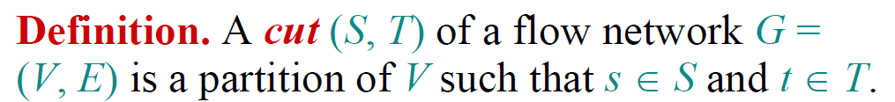
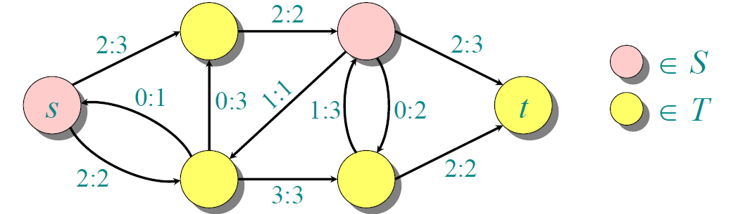

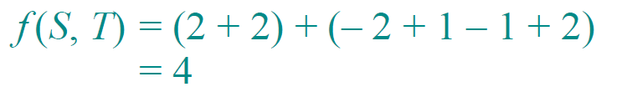
Cut

Slide 20






Flow of A Cut

Slide 21
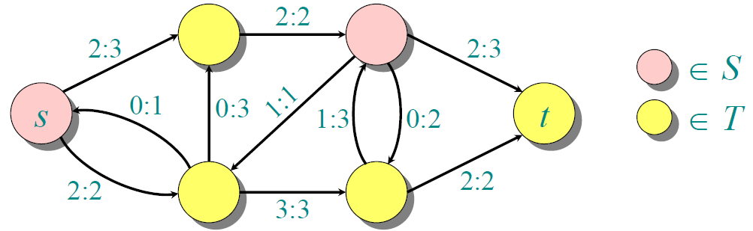
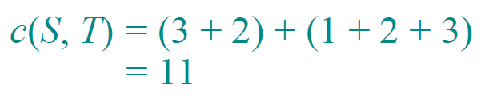
Capacity of A Cut

Slide 22




Upper Bound on Flow Value

Slide 23
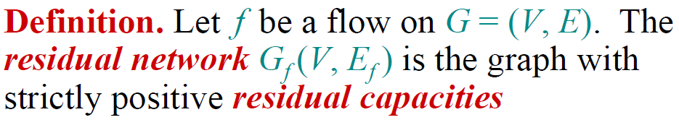
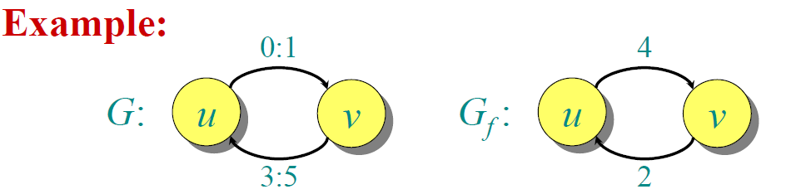

Residual Network

Slide 24

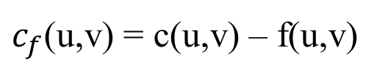
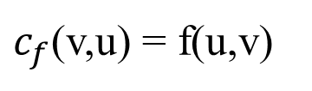
Residual Network
f(u,v) > 0
u
v
u
v
c(u,v)

Slide 25
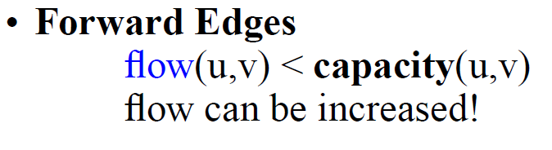
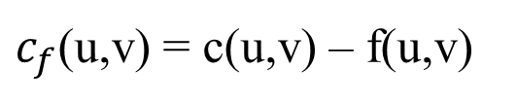
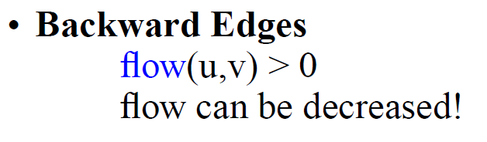
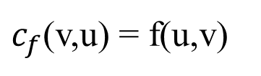
Residual Network
f(u,v) > 0
u
v
c(u,v)
u
v

Slide 26

Residual Network Example

Slide 27
Short Test in Class
Give the residual network of the next graph
12/12
v₁
v₃
11/16
15/20
s
1/4
7/7
t
0/10
4/9
8/13
v₂
v₄
4/4
11/14

Slide 28
Exercises
26.1-1
26.1-3

Slide 29
Augmenting Path
An augmenting path p is a simple path from s to t in the residual network Gf of a flow network G.
residual capacity of p
the maximum flow | f | can increased by increasing the flow on each edge in p

Slide 30
Augmenting Path Example
v₁
12/12
v₃
11/16
15/20
s
1/4
t
augmenting path p
0/10
4/9
7/7
8/13
v₂
v₄
4/4
12
5
v₁
v₃
11/14
5
11
4
s
11
3
7
15
t
5
5
3
4
8
v₂
v₄
11
v₁
v₃
4
11/16
19/20
s
0/10
1/4
7/7
t
0/9
12/13
v₂
v₄
4/4
Maximum flow increased by 4!
11/14

Slide 31
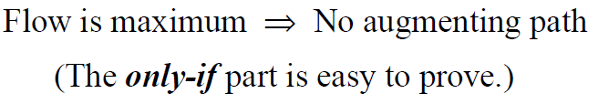
Maximum Flow Theorem

Slide 32

Max-Flow, Min-Cut Theorem

Slide 33
Max-Flow, Min-Cut Theorem

Slide 34
Max-Flow, Min-Cut Theorem

Slide 35
Max-Flow, Min-Cut Theorem
(S,T) is a cut! Why?

Slide 36
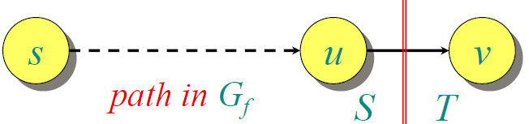
Max-Flow, Min-Cut Theorem
Maximum flow!

Slide 37
Ford-Fulkerson Algorithm

Slide 38
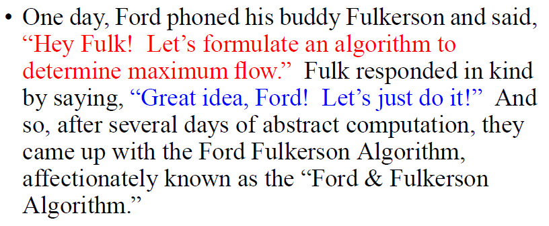
A Story

Slide 39

Rough Idea

Slide 40
Algorithm

Slide 41
Example—Basic Implementation
0/12
v₁
v₃
0/20
0/16
s
0/10
0/4
0/7
t
0/9
0/13
v₂
v₄
0/4
0/14
Flow initialization
v₁
12
v₃
16
20
s
10
4
7
t
9
13
v₂
v₄
4
14
Residual network

Slide 42
Example
Residual Networks
Flows
v₁
12
v₃
v₁
4/12
v₃
16
20
4/16
0/20
s
10
4
7
t
s
0/10
0/4
0/7
t
9
4/9
13
v₂
v₄
4
0/13
v₂
v₄
4/4
14
4/14
8
4/12
v₁
v₃
v₁
v₃
7/20
12
4
20
11/16
s
4
4
t
s
0/4
t
10
4
7
7/10
4/9
7/7
5
13
10
v₄
4
0/13
v₂
v₄
4/4
v₂
11/14

Slide 43
Example
Residual Networks
Flows
8
12/12
v₁
v₃
v₁
v₃
15/20
5
4
13
11/16
11
4
s
3
11
7
7
t
s
0/10
1/4
7/7
t
5
4/9
13
3
4
4/4
v₂
v₄
8/13
v₂
v₄
11
11/14
12
12/12
v₁
v₃
v₁
v₃
19/20
5
5
11/16
11
4
s
11
3
7
15
t
s
0/10
1/4
7/7
t
5
5
0/9
3
4
4/4
8
v₂
v₄
12/13
v₂
v₄
11
11/14

Slide 44
Example
Residual Networks
Flows
12/12
v₁
v₃
19/20
11/16
s
0/10
1/4
7/7
t
0/9
12/13
v₂
v₄
4/4
11/14
12
5
v₁
v₃
Maximum flow |f| = 11+12 = 23
1
s
11
19
t
11
3
9
7
1
3
4
12
v₂
v₄
11
No augmenting path

Slide 45
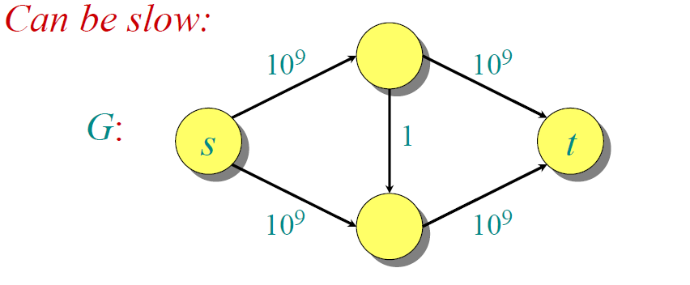
Problem：Time Complexity

Slide 46
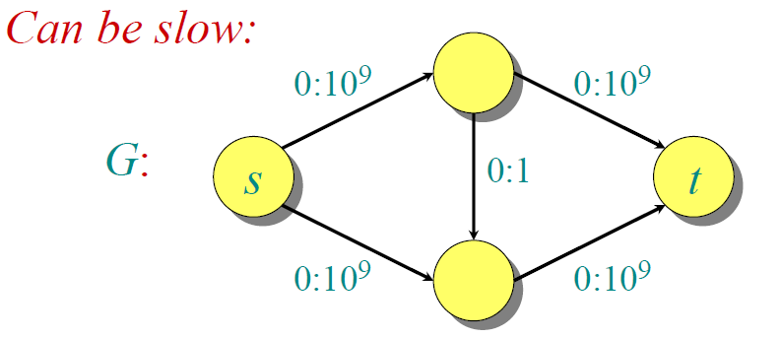
Problem：Time Complexity

Slide 47
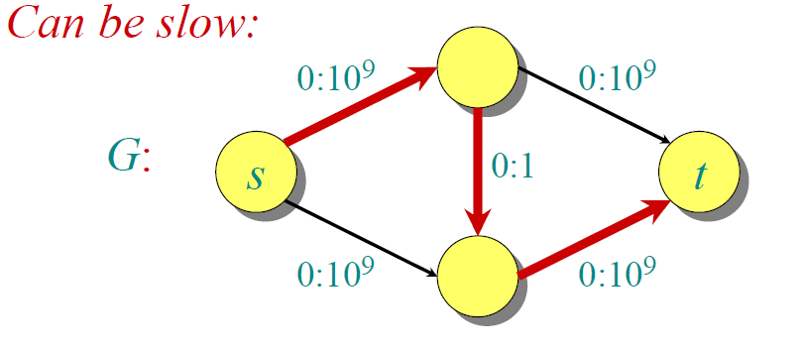
Problem：Time Complexity

Slide 48
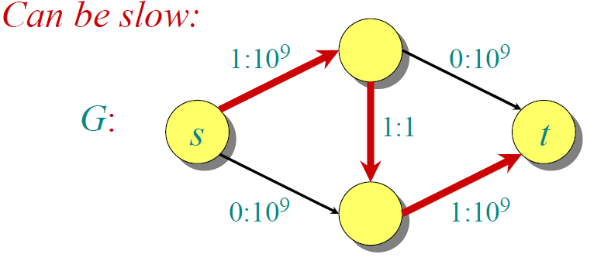
Problem：Time Complexity

Slide 49
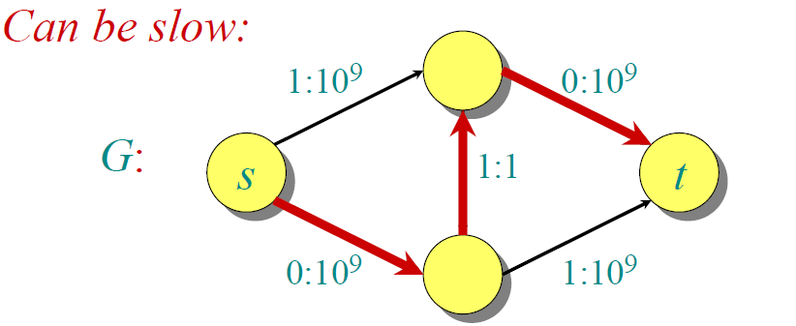
Problem：Time Complexity

Slide 50
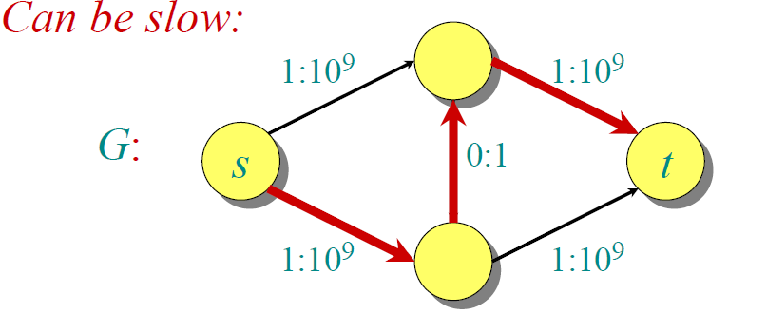
Problem：Time Complexity

Slide 51
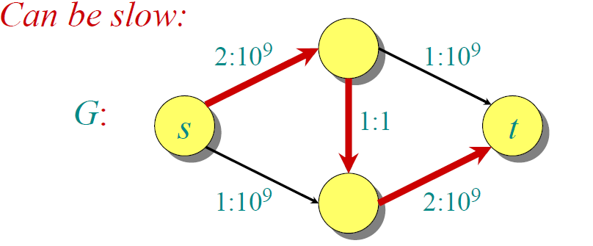
Problem：Time Complexity

Slide 52




Time Complexity

Slide 53
Edmonds & Karp Algorithm

Slide 54
Breadth-First Search
Input:
- Graph G = (V, E), either directed or undirected, - source vertex s ∈ V.
Output: for all v ∈ V
d[v] = length of shortest path from s to v
(d[v] = ∞ if v is not reachable from s).
π[v] = u if (u, v) is last edge on shortest path s v.
u is v’s predecessor.
breadth-first tree = a tree with root s that contains all reachable vertices.

Slide 55
Definitions on BSF
Path between vertices u and v:
vertices (v₁, v₂, …, v_{k}) such that
u=v₁ and v =v_{k},
(v_{i},v_{i+1}) ∈ E, for all 1≤ i ≤ k-1.
Length of the path: Number of edges in the path.
Path is simple if no vertex is repeated.

Slide 56
Principle of Breadth-First Search
Expands the frontier between discovered and undiscovered vertices uniformly
across the breadth of the frontier.
A vertex is “discovered” the first time it is encountered during the search.
A vertex is “finished” if all vertices adjacent to it have been discovered.

Slide 57
BFS for Shortest Paths
Colors the vertices to keep track of progress.
Undiscovered
Discovered
S
Finished
2
3
3
2
2
3
1
S
S
S
2
1
1
2
2
3
3

Slide 58
BFS(G,s)
1. for each vertex u in V[G] – {s}
2 do color[u] ← white
3 d[u] ← ∝
4 π[u] ← nil
5 color[s] ← gray
6 d[s] ← 0
7 π[s] ← nil
8 Q ← Φ
9 enqueue(Q,s)
10 while Q ≠ Φ
11 do u ← dequeue(Q)
12 for each v in Adj[u]
13 do if color[v] = white
14 then color[v] ← gray
15 d[v] ← d[u] + 1
16 π[v] ← u
17 enqueue(Q,v)
18 color[u] ← black
white: undiscovered
gray: discovered
black: finished
Q: a queue of discovered vertices
color[v]: color of v
d[v]: distance from s to v
π[u]: predecessor of v

Slide 59
Example (BFS)
r
s
t
u
∞
0
∞
∞
∞
∞
∞
∞
v
w
x
y
Q: s
0
frontier

Slide 60
Example (BFS)
r
s
t
u
∞
0
∞
∞
∞
∞
∞
∞
v
w
x
y
Q: s
0
frontier

Slide 61
Example (BFS)
r
s
t
u
1
0
∞
∞
∞
1
∞
∞
v
w
x
y
Q: w r
1 1

Slide 62
Example (BFS)
r
s
t
u
1
0
2
∞
∞
1
2
∞
v
w
x
y
Q: r t x
1 2 2

Slide 63
Example (BFS)
r
s
t
u
1
0
2
∞
2
1
2
∞
v
w
x
y
Q: t x v
2 2 2

Slide 64
Example (BFS)
r
s
t
u
1
0
2
3
2
1
2
∞
v
w
x
y
Q: x v u
2 2 3

Slide 65
Example (BFS)
r
s
t
u
1
0
2
3
2
1
2
3
v
w
x
y
Q: v u y
2 3 3

Slide 66
Example (BFS)
r
s
t
u
1
0
2
3
2
1
2
3
v
w
x
y
Q: u y
3 3

Slide 67
Example (BFS)
r
s
t
u
1
0
2
3
2
1
2
3
v
w
x
y
Q: y
3

Slide 68
Example (BFS)
r
s
t
u
1
0
2
3
2
1
2
3
v
w
x
y
Q: ∅

Slide 69
Example (BFS)
r
s
t
u
1
0
2
3
2
1
2
3
v
w
x
y
BF Tree

Slide 70
Breadth-First Tree
Predecessor sub-graph of G = (V, E) with source s is
G_{π} = (V_{π} , E_{π}) where
V_{π} ={v∈V : π[v] ≠ NIL} + {s}
E_{π} ={(π[v],v)∈E : v ∈ V_{π} - {s}}
G_{π} is a breadth-first tree if:
V_{π} consists of the vertices reachable from s
for all v∈V_{π} , there is a unique simple path from s to v in G_{π}
the path is also a shortest path from s to v in G.
The edges in E_{π} are called tree edges. |E_{π} | = |V_{π} | - 1.

Slide 71
Analysis of BFS
Initialization takes O(|V|).
Traversal Loop
Each vertex is enqueued and dequeued at most once, so the total time for queuing is O(|V|).
The adjacency list of each vertex is scanned at most once.
The sum of lengths of all adjacency lists is Θ(|E|).
Total running time of BFS is O(|V|+|E|)
Correctness of BFS (see Dijkstra later)

Slide 72
Edmonds & Karp Algorithm
Find the augmenting path using breadth-first search.
Breadth-first search gives the shortest path for graphs (Assuming the length of each edge is 1.)
Time complexity of Edmonds-Karp algorithm is O(|V||E|²).
The proof is very hard!.

Slide 73
Example
Flows
0/12
v₁
v₃
Residual Networks
0/16
0/20
BFS
s
0/10
0/4
0/7
t
0/9
0/13
0/4
1
12
2
v₂
v₄
20
0/14
16
0
10
4
7
3
9
13
1
2
4
14

Slide 74
Example
Flows
12/12
v₁
v₃
Residual Networks
12/16
12/20
BFS
s
0/10
0/4
0/7
t
0/9
0/13
v₂
v₄
0/4
0/14
12
4
1
3
8
0
12
12
3
10
4
9
7
14
4
13
1
2

Slide 75
Example
Flows
12/12
v₁
v₃
Residual Networks
12/16
12/20
BFS
s
0/10
0/4
0/7
t
0/9
4/13
v₂
v₄
4/4
4/14
12
3
4
1
8
0
12
12
4
10
4
9
7
9
10
4
4
1
2
4

Slide 76
Example
Flows
12/12
v₁
v₃
Residual Networks
12/16
19/20
BFS
s
0/10
0/4
7/7
t
0/9
11/13
v₂
v₄
4/4
11/14
12
∞
4
1
1
Maximum!
0
12
19
∞
10
4
9
7
2
3
4
11
1
2
11
No path to sink

Slide 77
Edmonds & Karp Algorithm
The proof is very hard!.
命题1： 随着流量的递增，剩余流量图中任何顶点v的d[v]值（BFS)不会减少，只会增加或保持不变。
命题2：每次增加流量，增广路径中至少有一条边会从剩余流量图中删除（只剩反方向的边）。这条边在后序的增流中可能会再次出现，然后再被删除。。。但任何被反复删除的次数不超过结点数量的一半。

Slide 78
Applications
比赛淘汰问题
Teams | Wins | Losses | To play | ATL | PHI | NY | MON
Atlanta | 82 | 71 | 8 | -- | 4 | 3 | 1
Philly | 81 | 75 | 6 | 4 | -- | 1 | 1
New York | 78 | 78 | 6 | 3 | 1 | -- | 2
Montreal | 74 | 84 | 4 | 1 | 1 | 2 | --
美国职业棒球的例行赛，每个球队都要打 162 场比赛，所胜场数最多者为该分区的冠军
根据目前各球队的得分情况和剩余的场次安排，判断New York队是否有夺冠的可能？

Slide 79
Applications
解题思路
New York队能够夺得冠军的最低条件，剩下的比赛都赢即赢6场胜利，且其他队伍最终赢的场数不超过84。
剩下比赛中各队的胜利场数
4
ATL
各队的获胜场数的上限
A-P
4
比赛场数
1
4
3
A-N
1
PHI
2
3
t
1
A-M
6
s
1
1
1
P-N
NY
9
1
1
P-M
2
MON
2
1
如果最大流等于剩下的比赛场数之和（12），则NY有夺冠的可能，否则不能夺冠。
N-M
NY全胜
剩下的比赛
球队

Slide 80
Applications
最大匹配问题
有5个背包和5件货品ABCDE，由于包的形状、大少、载重量的限制，每个包可装的货品不同：
第1个包可装A B C
第2个包可装A B D E
第3个包只能装C
第4个包可装A C
第5个包可装D E
如果每个包只能装一件货品，如何分配货品，使装上货品的包数量最多？

Slide 81
Applications
解题思路： （流量图中所有边的容量为1）
包1
A
包2
B
t
s
包3
C
包4
D
包5
E

Slide 82
Applications
线（点）覆盖问题
平面上有n个点(x₁,y₁), (x₂,y₂),…..,(x_{n},y_{n})。通过在平面划横线或竖线把一个或多个点覆盖，如图。若要覆盖所有的点，最少可以划多少条线？
最少划两条线

Slide 83
Applications
解题思路：用蓝色点和红色点分别表示横线和竖线，用红蓝两点之间的边表示两条线可同时覆盖的平面上的点。
求覆盖所有边（原来平面上的点）的最少点（原题中的横线或竖线）的问题，可转换为求蓝色的点集与红色点集之间的最大比配问题
最少划两条线

Slide 84
Exercises
26.2-3
26.2-8
No path to sink

Slide 85
End of Section.
算法分析课程组
重庆大学计算机学院
Notes:
本人是国际视觉电生理学会(ISCEV)的会员。

