Slide 1
Algorithm Analysis & Design Introduction to Algorithm
T&R Team of Algorithm Design
College of Computer Science and Engineering, CQU
Notes:
本人是国际视觉电生理学会(ISCEV)的会员。

Slide 2
Chapter 7: Quick Sort

Slide 3
Outline
6.1 Basic Quick Sort
6.2 Improving Quick Sort with Medians
6.3 Quick Search

Slide 4
7.1 Basic Quick Sort

Slide 5
QUICK SORT
We have seen two O(n log n) sorting algorithms:
Merge sort which is faster but requires more memory
Heap sort which allows in-place sorting
We will now look at a recursive algorithm which may be done almost in place and usually faster than heap sort
Use an object in the array (a pivot) to divide the two
Average case: O(n log n) time and O(log n) memory
Worst case: O(n²) time and O(n) memory

Slide 6
QUICK SORT
Merge sort splits the array sub-lists and sorts them
The larger problem is split into two sub-problems based on location in the array
Consider the following alternative:
Chose an object in the array and partition the remaining objects into two groups relative to the chosen entry

Slide 7
QUICK SORT
For example, given an unsorted array:
We can select the last entry, 4, and sort the remaining entries into two groups, those less than 4 and those greater than 4:
Note that 4 is now in the correct location once the list is sorted
Proceed by applying the algorithm to the first 3 and last 4 entries
2 | 8 | 7 | 1 | 3 | 5 | 6 | 4
2 | 1 | 3 | 4 | 7 | 5 | 6 | 8

Slide 8
A Simple Implementation – PARTITION
PARTITION (A, p, r)
x ← A[r]
i ← p-1
FOR j ← p TO r-1
IF A[ j] ≤ x
THEN i ← i + 1
exchange A[i] ↔ A[ j]
exchange A[i+1] ↔ A[r]
RETURN i+1

Slide 9
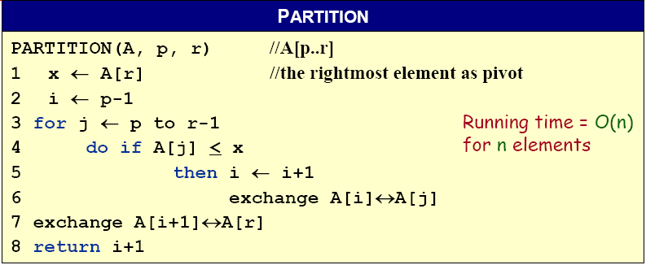
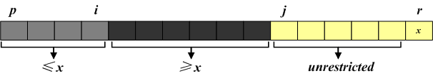
A Simple Implementation – PARTITION
A[p, … , i]: known to be ≤ pivot
A[j … r-1]: not yet examined
A[i+1, … , j-1]: known to be > pivot
A[r]: pivot

Slide 10










A Simple Implementation – PARTITION
The operation of Partition on the sample array. Lightly shaded array elements are all with values no greater than x (the pivot). Heavily shaded array elements are all with values greater than x.

Slide 11
A Simple Implementation – QUICKSORT
QUICKSORT (A, p, r)
IF p < r
THEN q ← PARTITION (A, p, r)
QUICKSORT (A, p, q–1)
QUICKSORT (A, q+1, r)
Initial call: QUICKSORT(A, 1, n)

Slide 12
Run-time Analysis
In the best case, the list will be split into two approximately equal sub-lists, and thus, the run time could be very similar to that of merge sort: Θ(n log n)

Slide 13
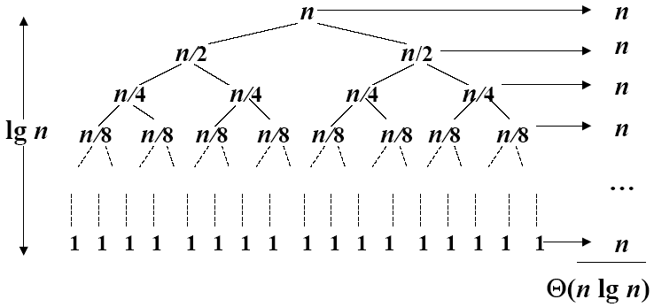
Recursive Tree of the Best Case
A recursion tree for quick sort in which the partition always balances the two sides of the partition equally. The resulting running time is Θ(n log n)
The question is: WHAT happens if we don’t get that lucky?

Slide 14
Worst-case Scenario
Suppose we choose the smallest element as our pivot and we try ordering a sorted list:
Using 2, we partition the original list into
We still have to sort a list of size n – 1
The run time is T(n) = T(n – 1) + Θ(n) = Θ(n²)
Thus, the run time drops from Θ(n log n) to Θ(n²)
80 | 38 | 95 | 84 | 66 | 10 | 79 | 2 | 26 | 87 | 96 | 12 | 43 | 81 | 3
2 | 80 | 38 | 95 | 84 | 66 | 10 | 79 | 26 | 87 | 96 | 12 | 43 | 81 | 3

Slide 15
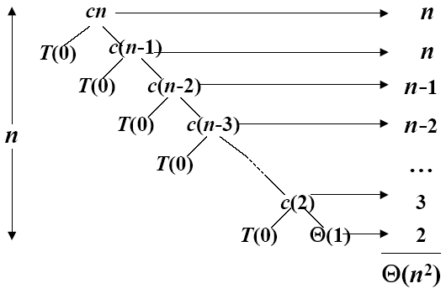
Recursive Tree of the Worst Case
A recursion tree for quick sort in which the partition always puts only a single element on one side of the partition. The resulting running time is Θ(n²)

Slide 16
Recursive Tree of the Balanced Case
What if the split is always 1:9?
T(n) = T(9n/10) + T(n/10) + Θ(n)
What is the solution to this recurrence?

Slide 17
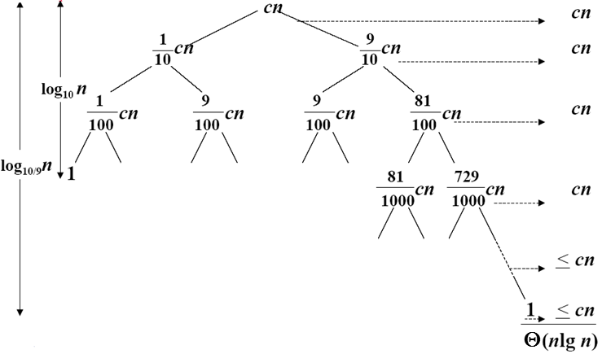
Recursive Tree of the Balanced Case
A recursion tree for quick sort in which partition always produces a 9-to-1 split, yielding a running time of Θ(n log n)

Slide 18
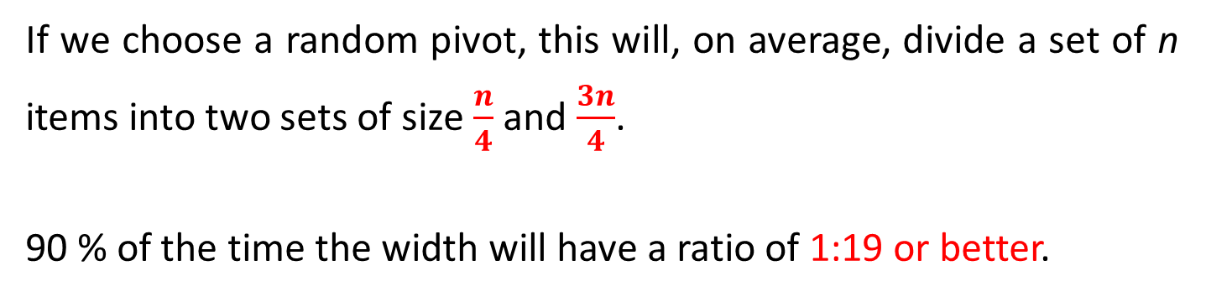
Average-case Senario
A recursion tree for quick sort in which partition always produces a 9-to-1 split, yielding a running time of Θ(n log n)
If we choose a random pivot, this will, on average, divide a set of n items into two sets of size $\frac{n}{4}$ and $\frac{3n}{4}$.
90 % of the time the width will have a ratio of 1:19 or better.

Slide 19
7.2 Improving Quick Sort with Medians

Slide 20
Alternate Strategy
Our goal is to choose the median element in the list as our pivot:
Unfortunately, it’s DIFFICULT to find
Alternate strategy: take the median of a subset of entries
For example, take the median of the first, middle, and last entries
80 | 38 | 95 | 84 | 66 | 10 | 79 | 2 | 26 | 87 | 96 | 12 | 43 | 81 | 3

Slide 21
Choose the Median-of-Three
It is difficult to find the median so consider another strategy:
Choose the median of the first, middle, and last entries in the list
This will usually give a much better approximation of the actual median

Slide 22
Choose the Median-of-Three
Sorting the elements based on 44 results in two sub-lists, each of which must be sorted (again, using quicksort)
We select the 26 to partition the first sub-list:
and 81 to partition the second sub-list:

Slide 23
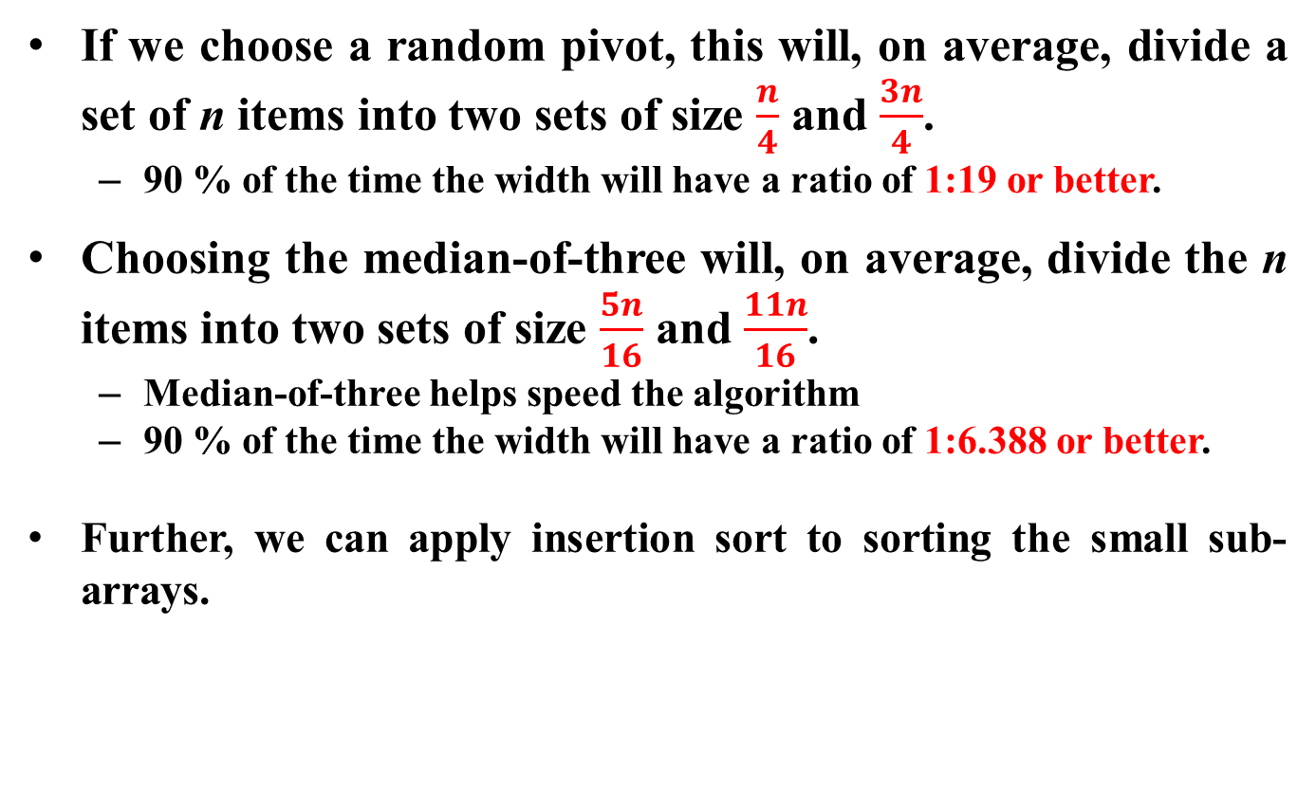
Choose the Median-of-Three
If we choose a random pivot, this will, on average, divide a set of n items into two sets of size $\frac{n}{4}$ and $\frac{3n}{4}$.
90 % of the time the width will have a ratio of 1:19 or better.
Choosing the median-of-three will, on average, divide the n items into two sets of size $\frac{5n}{16}$ and $\frac{11n}{16}$.
Median-of-three helps speed the algorithm
90 % of the time the width will have a ratio of 1:6.388 or better.
Further, we can apply insertion sort to sorting the small sub-arrays.

Slide 24
Improved Quick Sort Example
First, we examine the first, middle, and last entries of the full list
The span below will indicate which list we are currently sorting

Slide 25

Improved Quick Sort Example
We select 57 to be our pivot
We move 24 into the first location

Slide 26
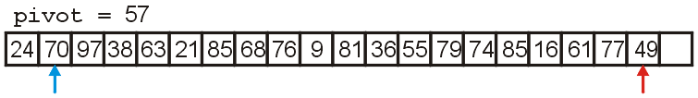
Improved Quick Sort Example
Starting at the 2nd and 2nd-last locations:
we search forward till we find 70 > 57
we search backward till we find 49 < 57

Slide 27
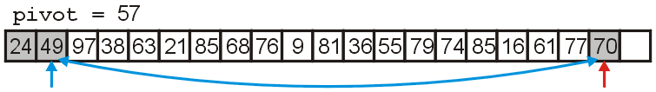
Improved Quick Sort Example
We swap 70 and 49, placing them in order with respect to each other

Slide 28
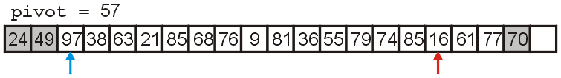
Improved Quick Sort Example
We search forward until we find 97 > 57
We search backward until we find 16 < 57

Slide 29
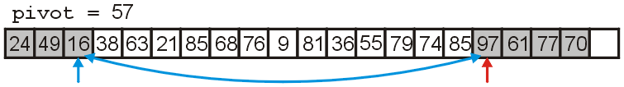
Improved Quick Sort Example
We swap 16 and 97 which are now in order with respect to each other

Slide 30
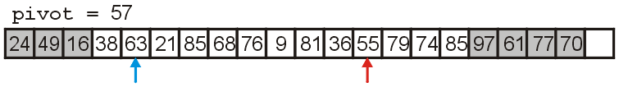
Improved Quick Sort Example
We search forward till we find 63 > 57
We search backward till we find 55 < 57

Slide 31
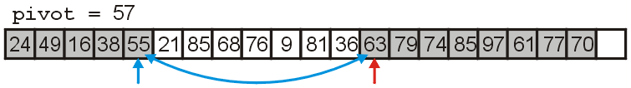
Improved Quick Sort Example
We swap 63 and 55

Slide 32
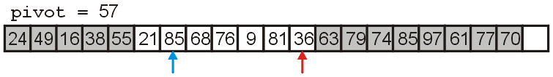
Improved Quick Sort Example
We search forward till we find 85 > 57
We search backward till we find 36 < 57

Slide 33
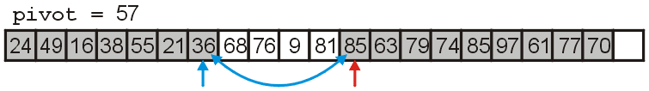
Improved Quick Sort Example
We swap 85 and 36, placing them in order with respect to each other

Slide 34
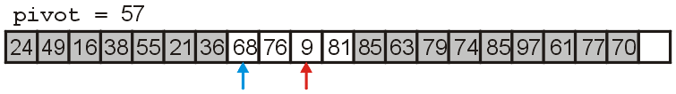
Improved Quick Sort Example
We search forward until we find 68 > 57
We search backward until we find 9 < 57

Slide 35
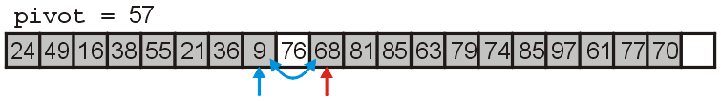
Improved Quick Sort Example
We swap 68 and 9

Slide 36
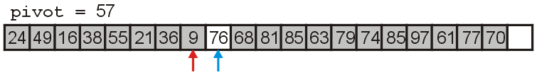
Improved Quick Sort Example
We search forward until we find 76 > 57
We search backward until we find 9 < 57
The indices are out of order, so we stop

Slide 37
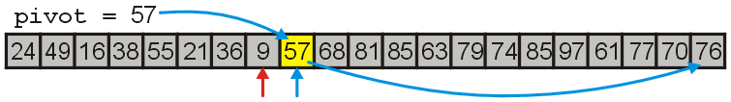
Improved Quick Sort Example
We move the larger indexed item to the vacancy at the end of the array
We fill the empty location with the pivot, 57
The pivot is now in the correct location

Slide 38
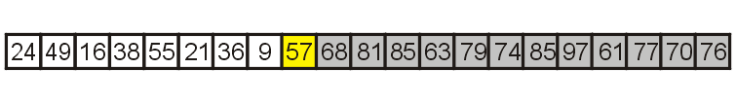
Improved Quick Sort Example
We will now recursively call quick sort on the first half of the list
When we are finished, all entries < 57 will be sorted

Slide 39
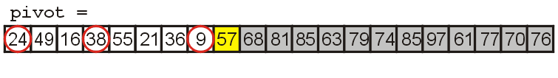
Improved Quick Sort Example
We examine the first, middle, and last elements of this sub list

Slide 40
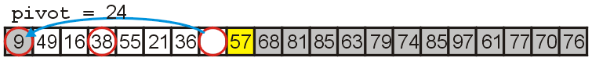
Improved Quick Sort Example
We choose 24 to be our pivot
We move 9 into the first location in this sub-list

Slide 41
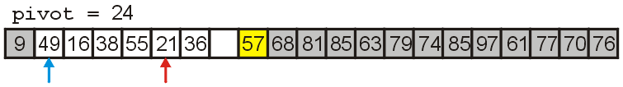
Improved Quick Sort Example
We search forward till we find 49 > 24
We search backward till we find 21 < 24

Slide 42
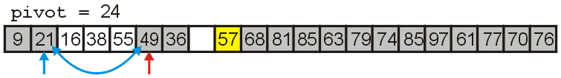
Improved Quick Sort Example
We swap 49 and 21, placing them in order with respect to each other

Slide 43
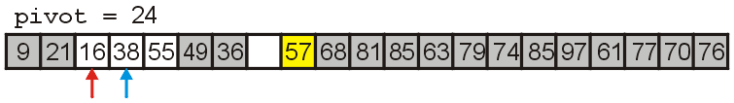
Improved Quick Sort Example
We search forward till we find 38 > 24
We search backward till we find 16 < 24
The indices are reversed, so we stop

Slide 44
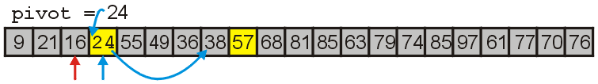
Improved Quick Sort Example
We move 38 to the vacant location and move the pivot 24 into the previous location of 38
24 is now in the correct location

Slide 45
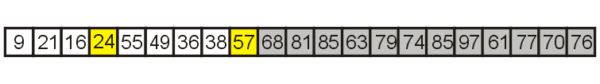
Improved Quick Sort Example
We will now recursively call quick sort on the left and right halves of those entries which are < 57

Slide 46
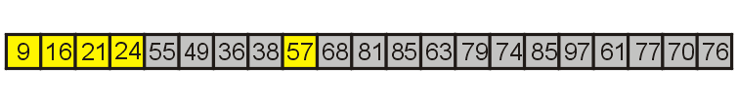
Improved Quick Sort Example
The first partition has three entries, so we sort it using insertion sort

Slide 47
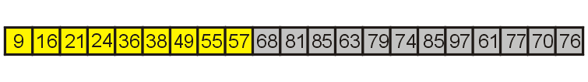
Improved Quick Sort Example
The second partition also has only four entries, so again, we use insertion sort

Slide 48
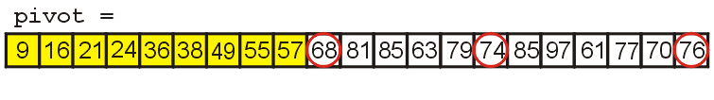
Improved Quick Sort Example
First we examine the first, middle, and last entries of the sub-list

Slide 49
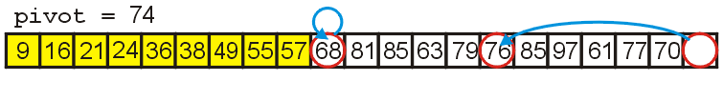
Improved Quick Sort Example
We choose 74 to be our pivot
We move 76 to the vacancy left by 74

Slide 50
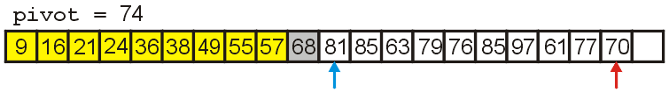
Improved Quick Sort Example
We search forward till we find 81 > 74
We search backward till we find 70 < 74

Slide 51
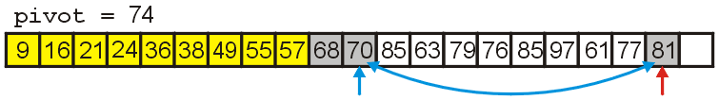
Improved Quick Sort Example
We swap 70 and 84 placing them in order

Slide 52
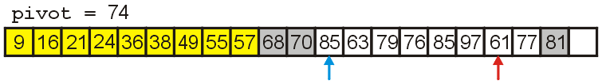
Improved Quick Sort Example
We search forward till we find 85 > 74
We search backward till we find 61 < 74

Slide 53
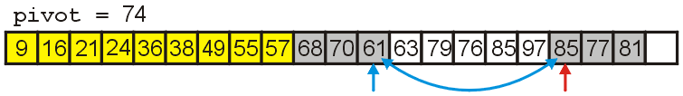
Improved Quick Sort Example
We swap 85 and 61 placing them in order

Slide 54
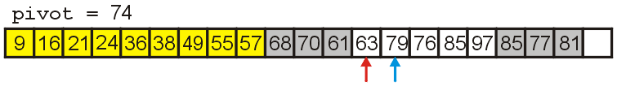
Improved Quick Sort Example
We search forward till we find 79 > 74
We search backward till we find 63 < 74
The indices are reversed, so we stop

Slide 55
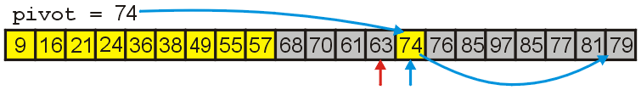
Improved Quick Sort Example
We move 79 to the vacant location and move the pivot 74 into previous location of 79
74 is now in the correct location

Slide 56
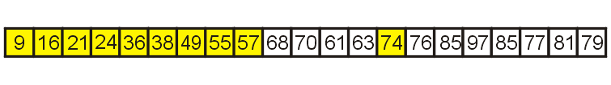
Improved Quick Sort Example
We sort the left sub-list first
It has 4 elements, so we simply use insertion sort

Slide 57
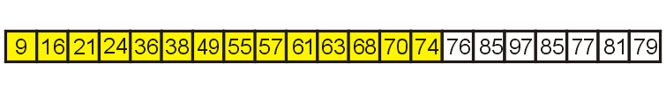
Improved Quick Sort Example
Having sorted the four elements, we focus on the remaining sub-list of seven entries

Slide 58
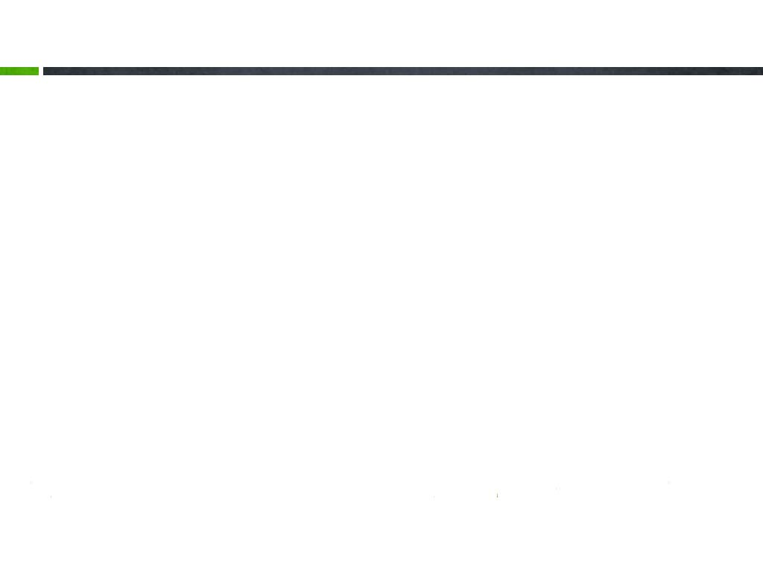
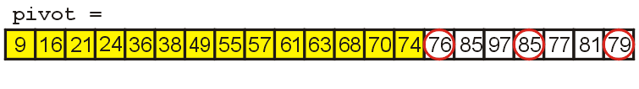
Improved Quick Sort Example
To sort the next sub-list, we examine the first, middle, and last entries

Slide 59
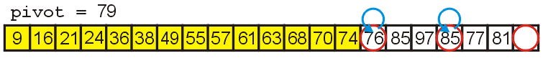
Improved Quick Sort Example
We select 79 as our pivot and move:
76 into the lowest position
85 into the highest position

Slide 60
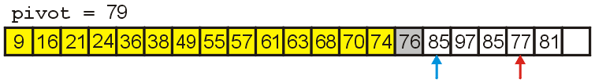
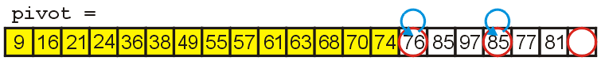
Improved Quick Sort Example
We search forward till we find 85 > 79
We search backward till we find 77 < 79

Slide 61
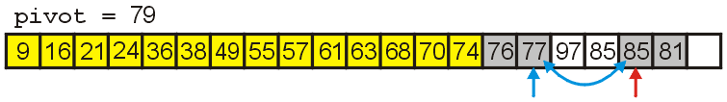
Improved Quick Sort Example
We swap 85 and 77, placing them in order

Slide 62
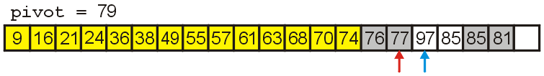
Improved Quick Sort Example
We search forward till we find 97 > 79
We search backward till we find 77 < 79
The indices are reversed, so we stop

Slide 63
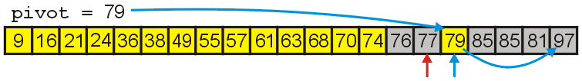
Improved Quick Sort Example
Finally, we move 97 to the vacant location and copy 79 into the appropriate location
79 is now in the correct location

Slide 64
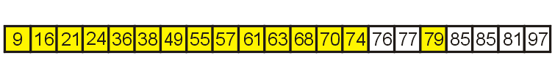
Improved Quick Sort Example
This splits the sub-list into two sub-lists of size 2 and 4
We use insertion sort for the first sub-list

Slide 65
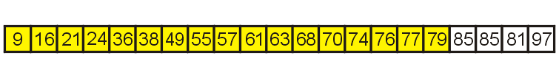
Improved Quick Sort Example
We are left with one sub-list with four entries, so again, we use insertion sort

Slide 66
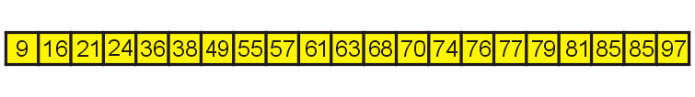
Improved Quick Sort Example
Sorting the last sub-list, we arrive at an ordered list

Slide 67
Searching k-th smallest element
Input: A[1…n] unsorted array
Output: index of the k-th smallest element
(1≦k ≦n)
Algorithm 1:
Sorting A
Time complexity: O(nlog n)
Algorithm 2:
Sequential selection
Time complexity: O(kn)
Algorithm 3:
Quick Search

Slide 68
Quick Search
QuickSearch(A, p, r, k)
if(p = r) return p //p=r=k
t ← Partition(A, p, r)
if(t = k) return t
if( k < t)
QuickSearch(A, p, t-1, k)
// find k-th smallest element in A[p..t-1]
else
QuickSearch(A, t+1, r, k)
// find k-th smallest element in A[t+1..r]

Slide 69

Quick Search
QuickSearch(A, p, r, k)
if(p = r) return p //p=r=k
t ← Partition(A, p, r)
if(t = k) return l
if( k < l)
QuickSearch(A, p, t-1, k)
// find k-th smallest element in A[p..t-1]
else
QuickSearch(A, t+1, r, k)
// find k-th smallest element in A[t+1..r]
Time complexity
Worst case: O(n²)
Best case: O(1)
Average case: O(n) ?

Slide 70
The Memory Requirement
The additional memory required is O(log n)
Each recursive function call places its local variables, parameters, etc., on a stack
The depth of the recursion tree is O(log n)
Unfortunately, if the run time is O(n²), the memory use is O(n)

Slide 71
Run Time Summery
To summarize all three O(n log n) algorithms
 | Average Run Time | Worst-case Run Time | Average Memory | Worst-case Memory
Heap Sort | O(n log n) |  | O(1)
Merge Sort | O(n log n) |  | O(n)
Quick Sort | O(n log n) | O(n²) | O(log n) | O(n)

Slide 72
End of Section.
算法分析课程组
重庆大学计算机学院
Notes:
本人是国际视觉电生理学会(ISCEV)的会员。

