Slide 1
Computer Architecture (Fall 2022)
Lecture10
Pipelining
Dr. Duo Liu (刘铎)
Office: Main Building 0626
Email: liuduo@cqu.edu.cn

Slide 2

Stalling
The easiest solution is to stall the pipeline.
We could delay the AND instruction by introducing a one-cycle delay into the pipeline, sometimes called a bubble.
Notice that we’re still using forwarding in cycle 5, to get data from the MEM/WB pipeline register to the ALU.
Clock cycle
1 2 3 4 5 6 7
lw $2, 20($3)
and $12, $2, $5
IM
Reg
DM
Reg
IM
Reg
DM
Reg

Slide 3
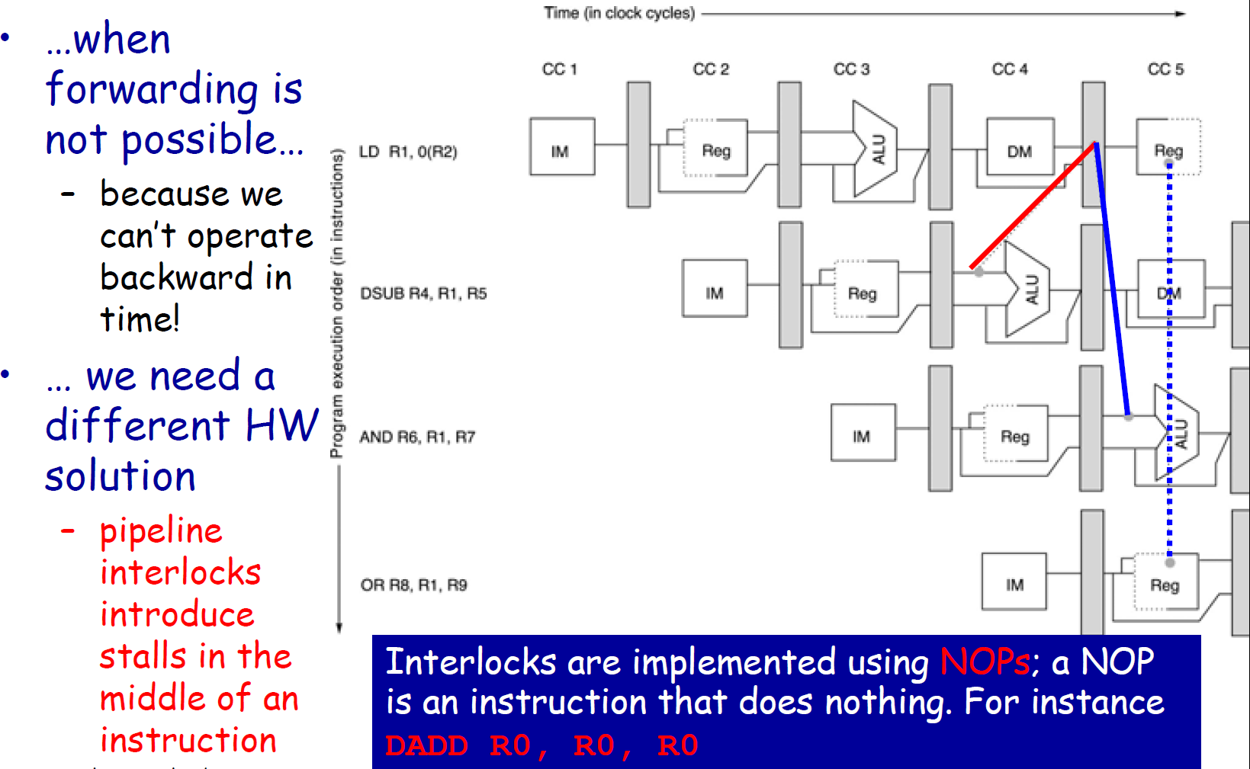
Dealing with Data Hazards: Pipeline Interlocks

Slide 4
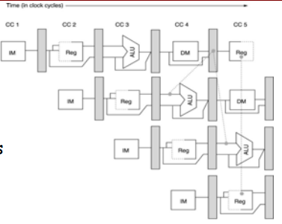
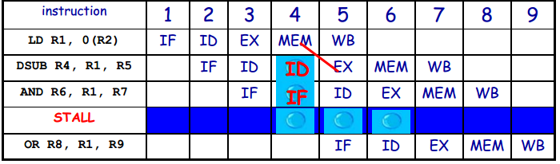
Pipeline Stalls due to Interlocks
At Cycle 4 the
progression of DSUB
(and all the following
instructions) is
halted
– no new instruction
is fetched
– a NOP instruction is
inserted into the
EX stage and will
exit the pipe at
Cycle 6
A NOP Instruction (a
bubble) that is
generated by one
interlock activation
increases the CPI of
the stalled instruction
by the length of one
clock cycle

Slide 5
Branches
Most of the work for a branch computation is done in the EX stage.
The branch target address is computed.
The source registers are compared by the ALU, and the Zero flag is set or cleared accordingly.
Thus, the branch decision cannot be made until the end of the EX stage.
But we need to know which instruction to fetch next, in order to keep the pipeline running!
This leads to what’s called a control hazard.
Clock cycle
1 2 3 4 5 6 7 8
beq $2, $3, Label
? ? ?
IM
Reg
DM
Reg
IM

Slide 6
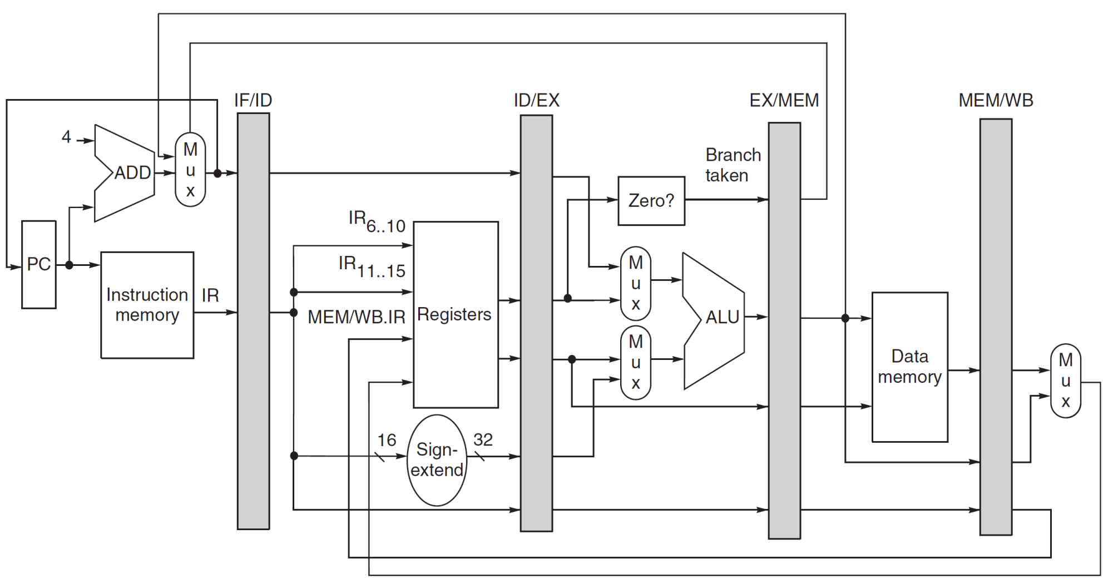
MIPS Pipeline Implementation

Slide 7
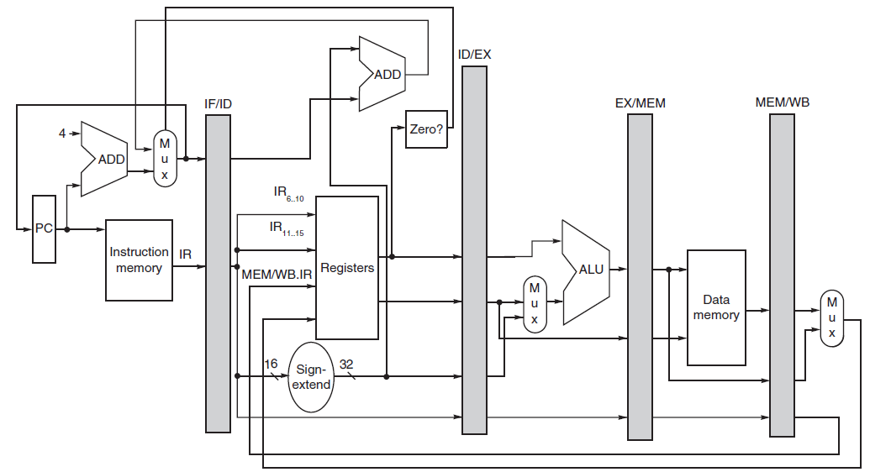
MIPS Pipeline Implementation (revised)
1 clock stall
with branch
Solved in ID

Slide 8
Branch (Control) Hazards and Their Impact on the Pipeline Performance
Control hazards can cause a greater performance loss for a pipelined implementation than data hazards. In first approximation:
– performance loss can vary between 10% and 30%
depending on the branch frequency
– generally, the deeper the pipeline, the worse the branch penalty
(measured in clock cycles)
• Various strategies to reduce the branch penalty
– static (compile time) schemes
• they are fixed for each branch during the entire execution
– dynamic
• hardware and software techniques
• more sophisticated branch prediction schemes

Slide 9
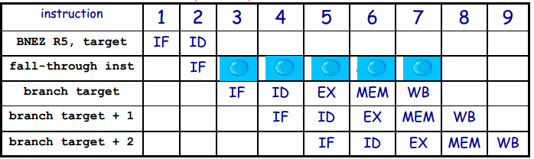
Reducing Pipeline Branch Penalties - I: Freezing (Flushing) the Pipeline
• Assuming now that the target address calculation
and the comparison are performed during the ID
stage, then, in case of “branch taken”, the PC is
changed at the end of the ID stage
– simplest strategy: freezing the pipeline as soon as the
instruction is detected as a branch and regardless of its
outcome (branch penalty is fixed, SW cannot reduce it)

Slide 10
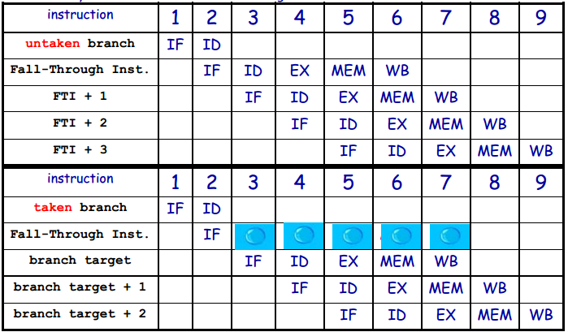
Reducing Pipeline Branch Penalties - II: Predicting “Non-Taken”
If the branch is taken, all the fetched instruction must be turned into NOPs and it is necessary to restart the fetch at the target address. The state must be unaffected!!

Slide 11
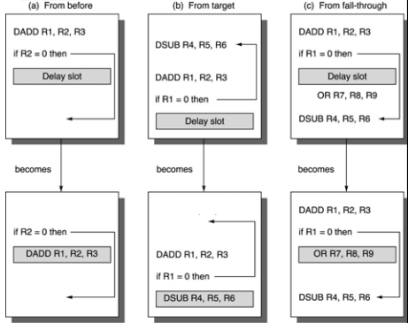
Reducing Pipeline Branch Penalties – III: Branch Delaying
The instruction in
the delay slot is
executed whether
or not the branch is
taken
Scheduling problem
for the compiler
Three strategies to
fill the delay slot
a) always best choice if
possible
b) preferred when
branch is taken with
high probability
– e.g., loop branches
c) dual case as (b)
Strategies (b) and (c) can be applied only if it is ok to execute the moved instruction if the prediction is wrong (i.e. the processor state is not affected)

Slide 12
Summary
Three kinds of hazards conspire to make pipelining difficult.
Structural hazards result from not having enough hardware available to execute multiple instructions simultaneously.
These are avoided by adding more functional units (e.g., more adders or memories) or by redesigning the pipeline stages.
Data hazards can occur when instructions need to access registers that haven’t been updated yet.
Hazards from R-type instructions can be avoided with forwarding.
Loads can result in a “true” hazard, which must stall the pipeline.
Control hazards arise when the CPU cannot determine which instruction to fetch next.
We can minimize delays by doing branch tests earlier in the pipeline.
We can also take a chance and predict the branch direction, to make the most of a bad situation.

Slide 13
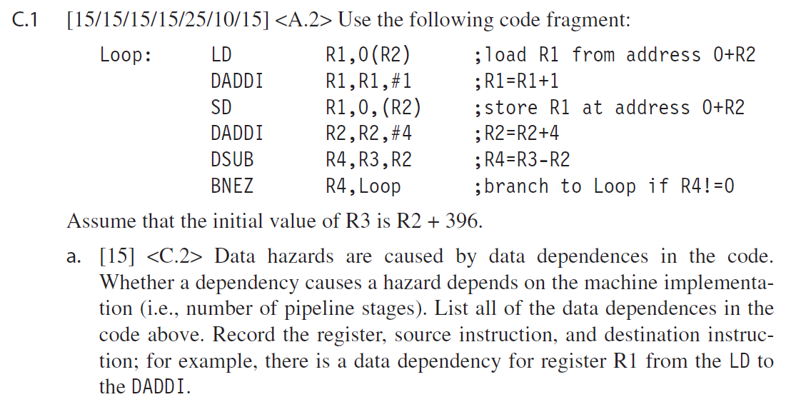
Example

Slide 14
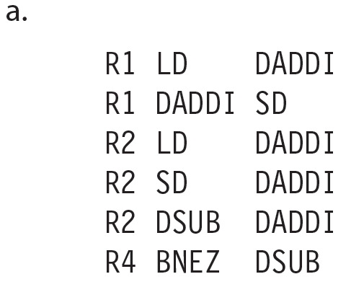
Example

Slide 15
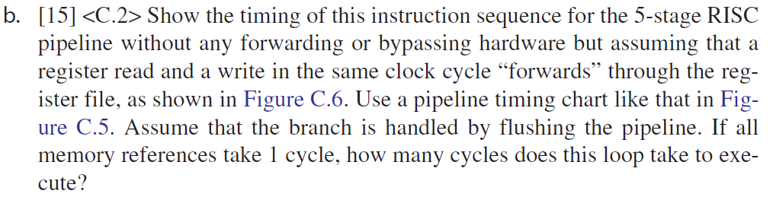
Example
 | 1 | 2 | 3 | 4 | 5 | 6 | 7 | 8 | 9 | 10 | 11 | 12 | 13 | 14 | 15 | 16 | 17 | 18
LD R1, 0(R2)
DADDI R1, R1, #1
SD R1, 0(R2)
DADDI R2, R2, #4
DSUB R4, R3, R2
BNEZ R4, Loop
LD R1, 0(R2)

Slide 16
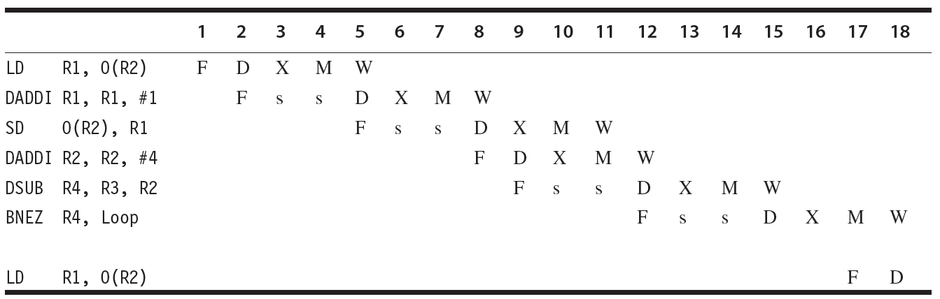
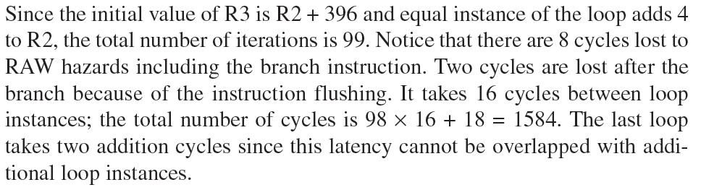
Example

Slide 17
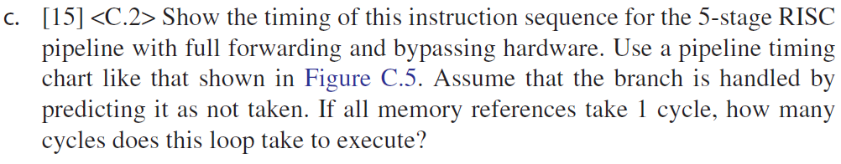
Example
 | 1 | 2 | 3 | 4 | 5 | 6 | 7 | 8 | 9 | 10 | 11 | 12 | 13 | 14 | 15 | 16 | 17 | 18
LD R1, 0(R2)
DADDI R1, R1, #1
SD R1, 0(R2)
DADDI R2, R2, #4
DSUB R4, R3, R2
BNEZ R4, Loop
LD R1, 0(R2)

Slide 18
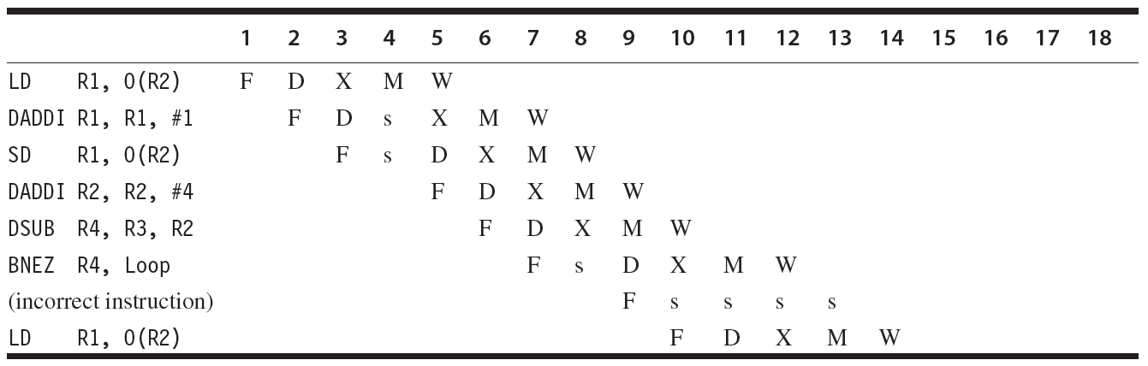
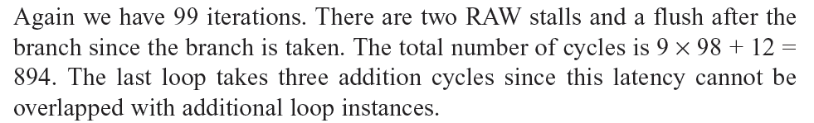
Example

Slide 19
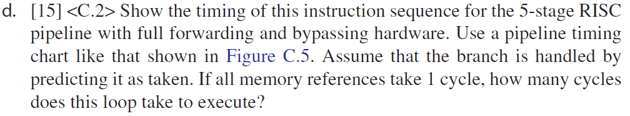
Example
 | 1 | 2 | 3 | 4 | 5 | 6 | 7 | 8 | 9 | 10 | 11 | 12 | 13 | 14 | 15 | 16 | 17 | 18
LD R1, 0(R2)
DADDI R1, R1, #1
SD R1, 0(R2)
DADDI R2, R2, #4
DSUB R4, R3, R2
BNEZ R4, Loop
LD R1, 0(R2)

Slide 20
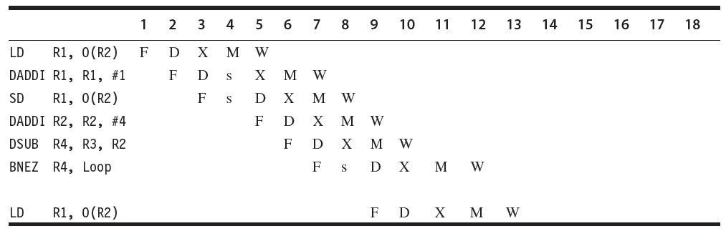

Example

Slide 21
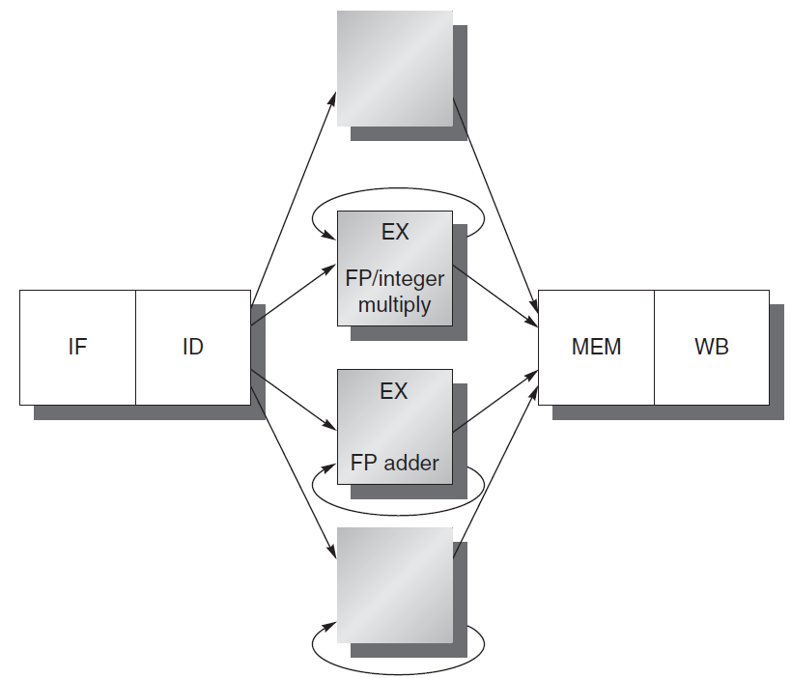
Handling Multi-Cycle Operations in Pipelined Implementations
• Motivation: Impractical to require that all FP operations complete in 1 or 2 clock cycles
CCT would become too large
it would require huge design costs
• For higher clock rates
put fewer logic levels in each pipeline stage
• more pipe stages for complex operations
• more pipeline registers necessary
• tradeoff lower CCT vs. higher CPI

Slide 22
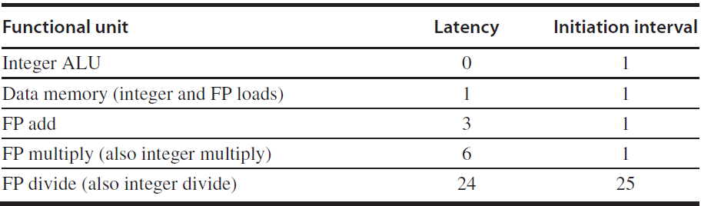
Latency and Initiation Interval
Two important terms of pipelined operations
Latency: the number of intervening cycles between an instruction that produces a result and an instruction that uses the result.
Initiation interval: The number of cycles that must elapse between issuing two operations of a given type.
Since most operations consume their operands at the beginning of EX, the latency is usually the # of stages after EX that an instruction produces a result
Integer ALU operations are all 0;
Loads are 1, since their results can be used after one intervening cycle.
Stores, which consume the value being stored 1 cycle later, are little different. The latency for the value being stored will be 1 cycle less.
Pipeline latency is essentially equal to 1 cycle less than the depth of the execution pipeline, which is the number of stages from the EX stage to the stage that produces the result.

Slide 23
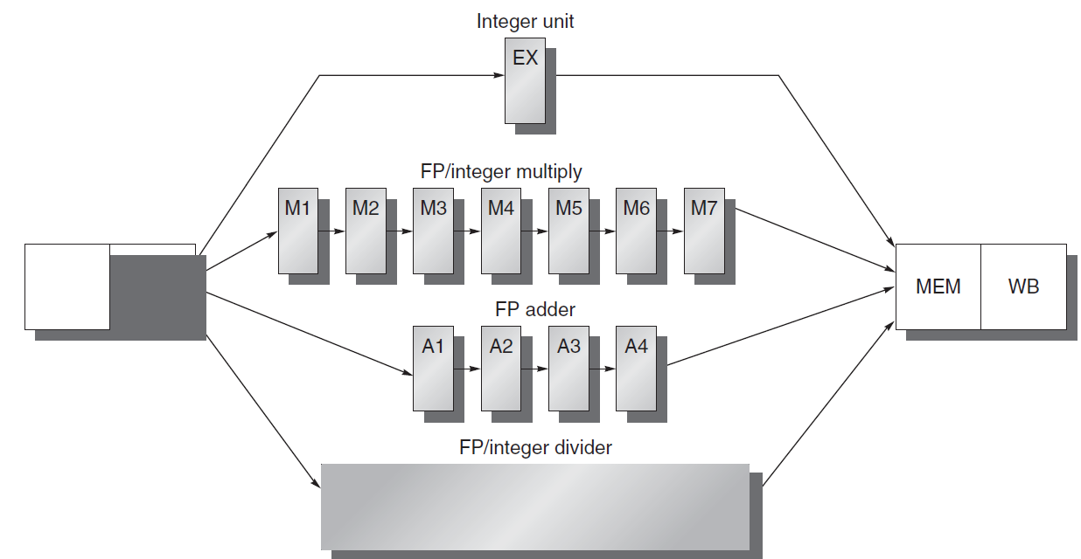
Multi-Stage” vs. “Multi-Cycle” Operations: i.e. Pipelined Stages vs. Sequential Stages
FunctionalUnit | (Additional)Latency | Initiation Interval
IntegerALU | 0 | 1
Data Memory(Int&FP Loads) | 1 | 1
FP Add | 3 | 1
Int&FP Multiply | 6 | 1
Int&FP Divide (SEQUENTIAL!) | 24 | 25
Notes:
CA历史分为两个部分，发展的过程与总结

Slide 24
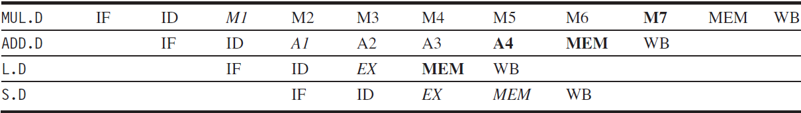
A pipeline supporting multiple outstanding FP operations.
The FP multiplier and adder are pipelined and have a depth of 7 and 4 stages.
The FP divider is not pipelined, but requires 24 cycles to complete.
For example, the 4th instruction after an FP add can use its result without being stalled. Similarly, 7th after an FP multiplier can use its result without being stalled.
Results are ready
Data are needed
Notes:
CA历史分为两个部分，发展的过程与总结

Slide 25
Hazards due to Multiple Outstanding Operations
• Structural Hazards
sequential (non-pipelined) function units
• e.g., two “close” DIV operations require stalling
number of register writes per cycle may be larger than 1
• More Frequent RAW Data Hazards
• “instruction y (which follows instruction x in the program order) tries
to read a source register before x writes it”
longer latency of operations produce more stalls
• Two New Classes of Data Hazards
WAW
• “instruction y tries to write a destination register before x writes it”
WAR
• “instruction y tries to write a destination register before x reads it”
• Out-of-order completion
makes exception handling more complex
Notes:
CA历史分为两个部分，发展的过程与总结

Slide 26
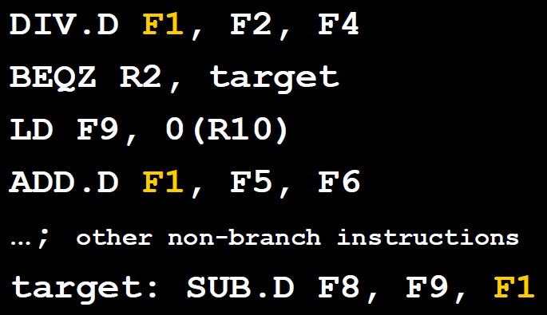
Hazards due to Multiple Outstanding Operations – Example of WAW Hazard
WAW
• “instruction y tries to write a destination register before x writes it”
One may wonder how can WAW hazards occur since it may seem that a compiler would never generate two writes to the same register without anintervening read
However such sequences do occur,
e.g., a program may take a path that the compiler cannot predict, e.g. due to an intervening branch
Also, in the case of multiple-issue pipelines, an intervening read may be present (and stalled) while the second write could progress
• In this example if the branch is not taken a WAW if possible when the DIV completes its execution after the BEQZ, LD, and ADD complete theirs
Notes:
CA历史分为两个部分，发展的过程与总结

Slide 27
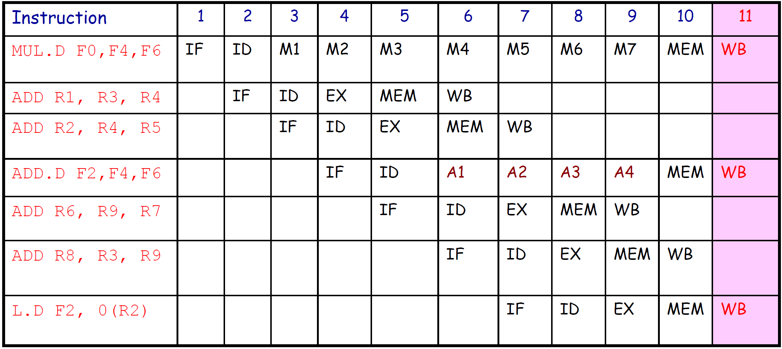
Hazards due to Multiple Outstanding Operations – Example of Structural Hazard
With Only 1 write port in register file, the processor must serialize the 3 WB instructions
Option 1: Tracking port access during ID and (pre)-stalling corresponding instructions (same logic as for interlock detection)
Option 2: Stall the conflicting instructions with smaller latency (“least-waited”) just before MEM or WB
Notice that there is no structural hazard at MEM because, among the 3 instructions, only L.D really needs to access memory. However, this assumes that there is separate HW to make the other two instructions progress into WB as they need
Notes:
CA历史分为两个部分，发展的过程与总结

Slide 28
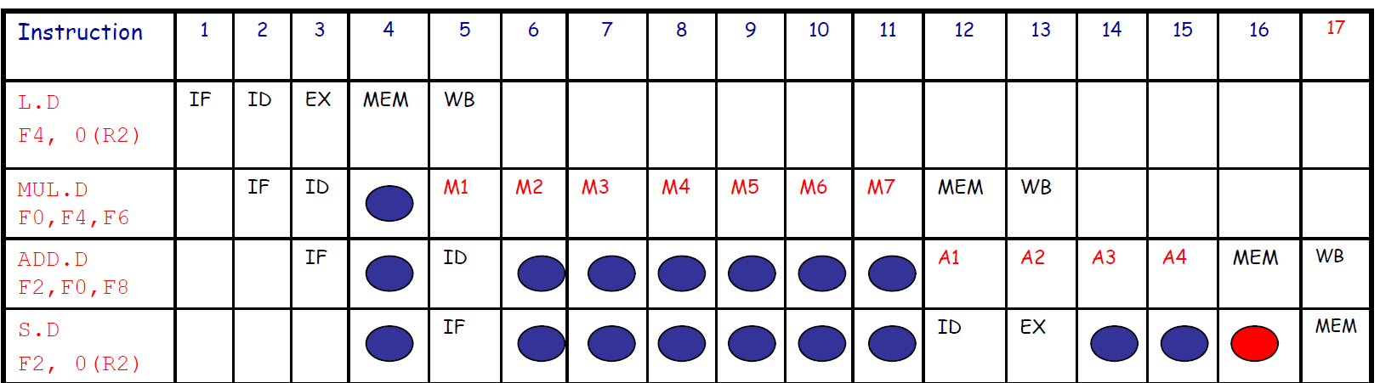
Hazards due to Multiple Outstanding Operations – Example of RAW Hazard
Deeper pipelines increase the stall frequencies
Each instruction in the example depends on the previous one
Each instruction proceeds as soon as the awaited data become available (optimal forwarding)
To avoid a RAW hazard the S.D must wait for the ADD.D to provide the new value of F2 (via bypassing) before entering MEM
NB: Fig. C.37 is not consistent with C.38 since it implies that there is a structural hazard on MEM because ADD.D does not really need the MEM stage (but only to progress execution)
Notes:
CA历史分为两个部分，发展的过程与总结

Slide 29
Hazards due to Multiple Outstanding Operations – Control Implementation
• Assuming that all hazard detections are done in
ID, before issuing an instruction x we must
– check for structural hazards
• the required function unit must be available (e.g., FP Divisor)
• no future conflicts on the register write port
– check for RAW data hazards
• no conflict between x source register and previous
instruction destination registers
– e.g. if x is a FP operation on F2, check that F2 is not a
destination in ID/A1, A1/A2, A2/A3
– check for WAW data hazards
• no instruction in A1,…,A4, D, M1,…M7 can have the same
register destination as x
• Logic implementation is similar as for the MIPS
integer pipeline
Notes:
CA历史分为两个部分，发展的过程与总结

