Slide 1
MIPS Assembly Programming
CST31101
Computer Origanization and Design
Yufeng Lv

Slide 2

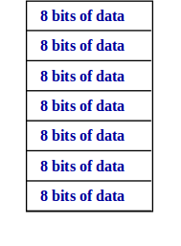
Review: Memory Organization
Large single-dimension array
A memory address is an index into the array
Memory stores 8 bits in each address
Registers store 32 bits of information
For example:
Li $t0, 0
lw $t0, 0($t1)
Then $t0 will contain the data of the first four memory locations

Slide 3
Review: Registers
MIPS has 32 registers, each containing 32 bits
Some registers are listed below
register | function
$zero | constant 0
$at | reserved for the assembler
$v0 - $v1 | function results
$a0 - $a3 | function arguments
$t0 - $t9 | temporary
$s0 - $s7 | temporary

Slide 4
Outline
Assembly Language Statements
Assembly Language Program Template
Defining Data
Memory Alignment
System Calls
Procedures
Parameter Passing and Runtime Stack

Slide 5
Outline
Assembly Language Statements
Assembly Language Program Template
Defining Data
Memory Alignment
System Calls
Procedures
Parameter Passing and Runtime Stack

Slide 6
Assembly Language Statements
Executable Instructions
Generate machine code for the processor to execute at runtime
Instructions tell the processor what to do
Pseudo-instruction and Macros
Translated by the assembler into real instructions
Simplify the programmer task
Assembler Directives
Provide information to the assembler while translating a program
Used to define segments, allocate memory variables, etc.
Non-executable: directives are not part of the instruction set

Slide 7
Instructions
Instruction format
[label:] mnemonic [operands] [#comment]
Label: (optional)
Marks the address of a memory location, must have a colon
Typically appear in data and text segments
Mnemonic
Identifies the operation (e.g. add, sub, etc.)
Operands
Specify the data required by the operation
Operands can be registers, memory variables, or constants
Demo: L1: addiu $t0, $t0, 1 #increment $t0

Slide 8
Comments
Comments are very important!
Explain the program's purpose
When it was written, revised, and by whom
Explain data used in the program, input, and output
Explain instruction sequences and algorithms used
Comments are also required at the beginning of every procedure
Indicate input parameters and results of a procedure
Describe what the procedure does
Single-line comment
Begins with a hash symbol # and terminates at end of line

Slide 9
Outline
Assembly Language Statements
Assembly Language Program Template
Defining Data
Memory Alignment
System Calls
Procedures
Parameter Passing and Runtime Stack

Slide 10
Program Template
# Title: Filename:
# Author: Date:
# Description:
# Input:
# Output:
######### Data segment #############
.data
. . .
######### Code segment #############
.text
.globl main
main: # main program entry
. . .
li $v0, 10 # Exit program
syscall

Slide 11
Directives
.DATA
Defines the data segment of a program containing data
The program's variables should be defined under this directive
Assembler will allocate and initialize the storage of variables
.TEXT
Defines the code segment of a program containing instructions
.GLOBL
Declares a symbol as global
Global symbols can be referenced from other files
We use this directive to declare main procedure of a program

Slide 12
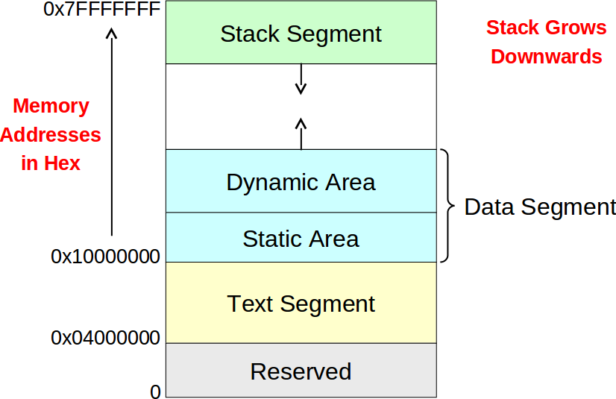
Layout of a Program in Memory

Slide 13
Outline
Assembly Language Statements
Assembly Language Program Template
Defining Data
Memory Alignment
System Calls
Procedures
Parameter Passing and Runtime Stack

Slide 14
Data Definition Statement
Syntax:
[name:] directive initializer [, initializer] . . .
var1: .WORD 10

Slide 15
Data Directives
.BYTE
Stores the list of values as 8-bit bytes
.HALF
Stores the list as 16-bit values aligned on half-word boundary
.WORD
Stores the list as 32-bit values aligned on a word boundary
.WORD w:n
Stores the 32-bit value w into n consecutive words aligned on a word boundary.
.FLOAT
Stores the listed values as single-precision floating point
.DOUBLE
Stores the listed values as double-precision floating point

Slide 16
String Directives
.ASCII
Allocates a sequence of bytes for an ASCII string
.ASCIIZ
Same as .ASCII directive, but adds a NULL char at end of string
Strings are null-terminated, as in the C programming language
.SPACE n
Allocates space of n uninitialized bytes in the data segment
Special characters in strings follow C convention
Newline: \n Tab:\t Quote: \”

Slide 17
Examples of Data Definitions
.DATA
var1: .BYTE 'A', 'E', 127, -1, '\n'
var2: .HALF -10, 0xffff
var3: .WORD 0x12345678
Var4: .WORD 0:10
var5: .FLOAT 12.3, -0.1
var6: .DOUBLE 1.5e-10
str1 : .ASCII "A String\n"
str2 : .ASCIIZ "NULL Terminated String"
array: .SPACE 100

Slide 18
Outline
Assembly Language Statements
Assembly Language Program Template
Defining Data
Memory Alignment
System Calls
Procedures
Parameter Passing and Runtime Stack

Slide 19
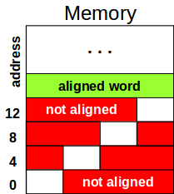
Memory Alignment
.ALIGN n
Aligns the next data definition on a 2n byte boundary
Memory is viewed as an array of bytes with addresses
Byte Addressing: address points to a byte in memory
Words occupy 4 consecutive bytes in memory
MIPS instructions and integers occupy 4 bytes
Alignment: address is a multiple of size
Word address should be a multiple of 4
Least significant 2 bits of address should be 00
Halfword address should be a multiple of 2

Slide 20











Symbol Table
Assembler builds a symbol table for labels (variables)
Assembler computes the address of each label in data segment
Example Symbol Table
.DATA
var1: .BYTE 1, 2,'Z'
str1: .ASCIIZ "My String\n"
var2: .WORD 0x12345678
.ALIGN 3
var3: .HALF 1000
Label | Address

Slide 21
Outline
Assembly Language Statements
Assembly Language Program Template
Defining Data
Memory Alignment
System Calls
Procedures
Parameter Passing and Runtime Stack

Slide 22
System Calls
Programs do input/output through system calls
MIPS provides a special syscall instruction
To obtain services from the operating system
Many services are provided in the SPIM and MARS simulators
Using the syscall system services
Load the service number in register $v0
Load argument values, if any, in registers $a0, $a1, etc.
Issue the syscall instruction
Retrieve return values, if any, from result registers

Slide 23
Syscall Services
Service | $v0 | Arguments / Result
Print Integer | 1 | $a0 = integer value to print
Print Float | 2 | $f12 = float value to print
Print Double | 3 | $f12 = double value to print
Print String | 4 | $a0 = address of null-terminated string
Read Integer | 5 | $v0 = integer read
Read Float | 6 | $f0 = float read
Read Double | 7 | $f0 = double read
Read String | 8 | $a0 = address of input buffer, $a1 = maximum number of characters to read
Exit Program | 10
Print Char | 11 | $a0 = character to print, Supported by MARS
Read Char | 12 | $a0 = character read, Supported by MARS

Slide 24
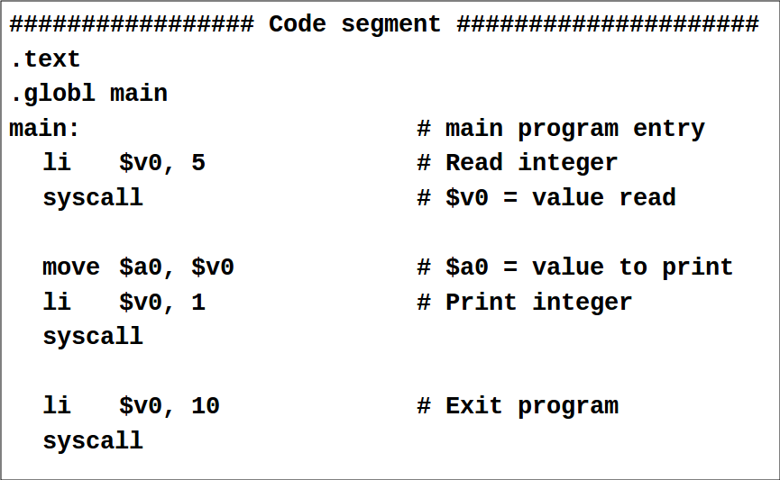
Reading and Printing an Integer

Slide 25
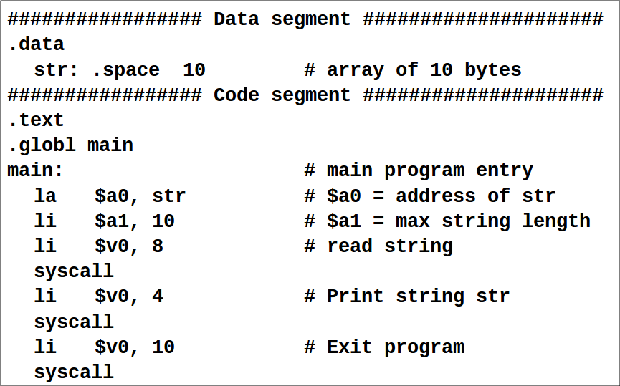
Reading and Printing a String

Slide 26
Outline
Assembly Language Statements
Assembly Language Program Template
Defining Data
Memory Alignment
System Calls
Procedures
Parameter Passing and Runtime Stack

Slide 27
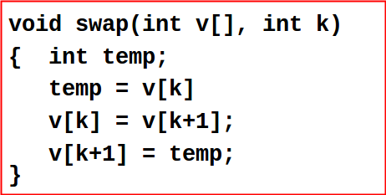
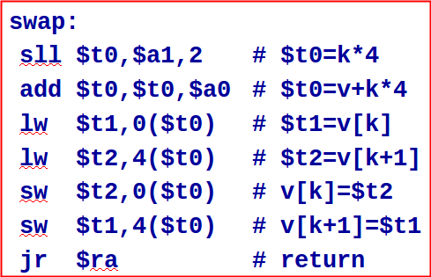
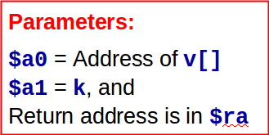
Procedures
Consider the following swap procedure (written in C)
Translate this procedure to MIPS assembly language

Slide 28
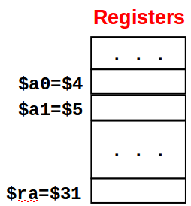

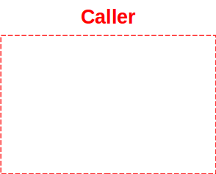
Call / Return Sequence
Suppose we call procedure swap as: swap(a,10)
Pass address of array a and 10 as arguments
Call the procedure swap saving return address in $31 = $ra
Execute procedure swap
Return control to the point of origin (return address)
swap:
sll $t0,$a1,2
add $t0,$t0,$a0
lw $t1,0($t0)
lw $t2,4($t0)
sw $t2,0($t0)
sw $t1,4($t0)
jr $ra
addr a
la $a0, a
10
li $a1, 10
jal swap
# return here
. . .
ret addr

Slide 29

Details of JAL and JR
Address Instructions Assembly Language
00400020 lui $1, 0x1001 la $a0, a
00400024 ori $4, $1, 0
00400028 ori $5, $0, 10 li $a1,10
0040002C jal 0x10000f jal swap
00400030 . . . # return here
swap:
0040003C sll $8, $5, 2 sll $t0,$a1,2
00400040 add $8, $8, $4 add $t0,$t0,$a0
00400044 lw $9, 0($8) lw $t1,0($t0)
00400048 lw $10,4($8) lw $t2,4($t0)
0040004C sw $10,0($8) sw $t2,0($t0)
00400050 sw $9, 4($8) sw $t1,4($t0)
00400054 jr $31 jr $ra
Pseudo-Direct Addressing
PC = imm26 << 2 = 0x10000f << 2 = 0x0040003C
Register $31
is the return address register

Slide 30
Outline
Assembly Language Statements
Assembly Language Program Template
Defining Data
Memory Alignment
System Calls
Procedures
Parameter Passing and Runtime Stack

Slide 31
Parameter Passing
Parameter passing in assembly language is different
More complicated than that used in a high-level language
In assembly language
Place all required parameters in an accessible storage area
Then call the procedure
Two types of storage areas used
Registers: general-purpose registers are used (register method)
Memory: stack is used (stack method)
Two common mechanisms of parameter passing
Pass-by-value: parameter value is passed
Pass-by-reference: address of parameter is passed

Slide 32
Parameter Passing – cont'd
By convention, registers are used for parameter passing
$a0 = $4 .. $a3 = $7 are used for passing arguments
$v0 = $2 .. $v1 = $3 are used for result values
Additional arguments/results can be placed on the stack
Runtime stack is also needed to …
Store variables / data structures when they cannot fit in registers
Save and restore registers across procedure calls
Implement recursion
Runtime stack is implemented via software convention
The stack pointer $sp = $29 (points to top of stack)
The frame pointer $fp = $30 (points to a procedure frame)

Slide 33
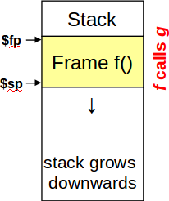
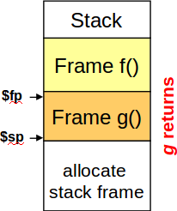
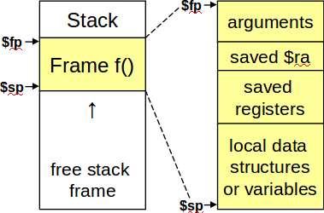
Stack frame is the segment of the stack containing …
Saved arguments, registers, and local data structures (if any)
Called also the activation frame or activation record
Frames are pushed and popped by adjusting …
Stack pointer $sp = $29 and Frame pointer $fp = $30
Decrement $sp to allocate stack frame, and increment to free

Slide 34
Preserving Registers
Need to preserve registers across a procedure call
Stack can be used to preserve register values
Which registers should be saved?
Registers modified by the called procedure, and
Still used by the calling procedure
Who should preserve the registers?
Called Procedure: preferred method for modular code
Register preservation is done inside the called procedure
By convention, registers $s0, $s1, …, $s7 should be preserved
Also, registers $sp, $fp, and $ra should also be preserved

