Slide 1
Pipelined MIPS Processor
Temporal parallelism
Divide single-cycle processor into 5 stages:
  Fetch
  Decode
  Execute
  Memory
  Writeback
Add pipeline registers between stages

Slide 2
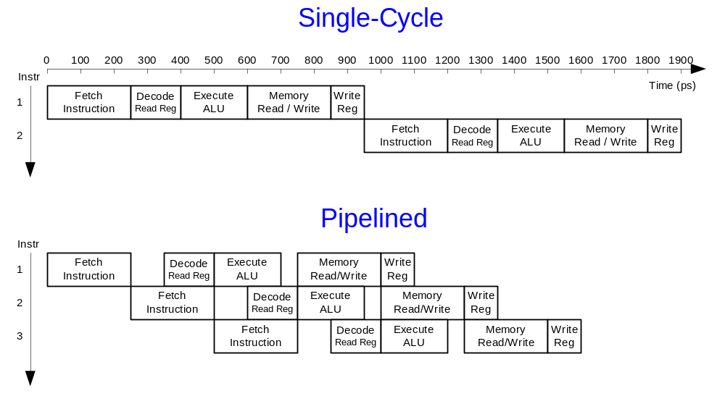
Single-Cycle vs. Pipelined

Slide 3
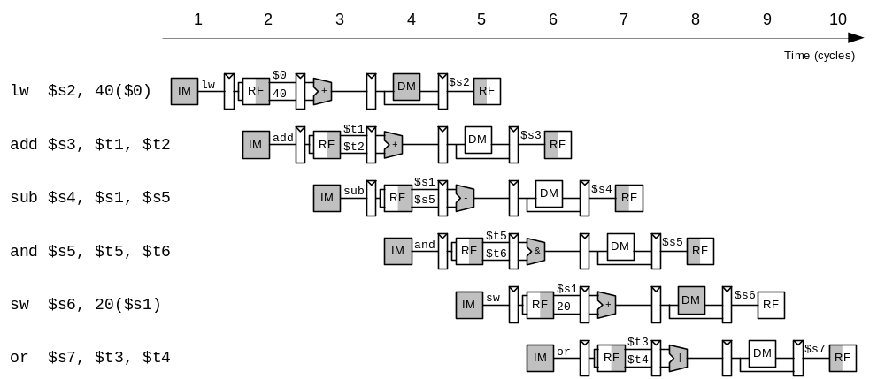
Pipelined Processor Abstraction

Slide 4
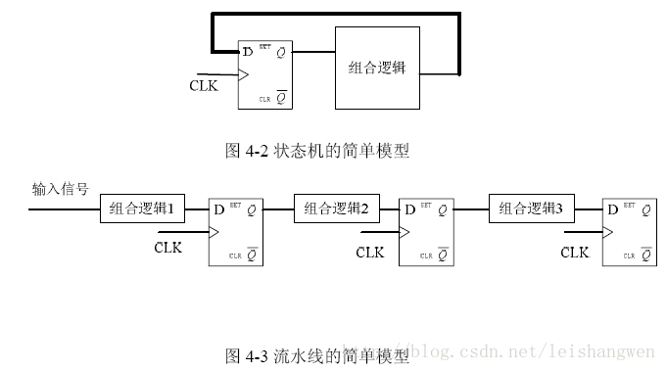
Pipelined & RTL
RTL: Register Transfer Level
The signal translate between registers, and every stage occurs their change for combined logic

Slide 5
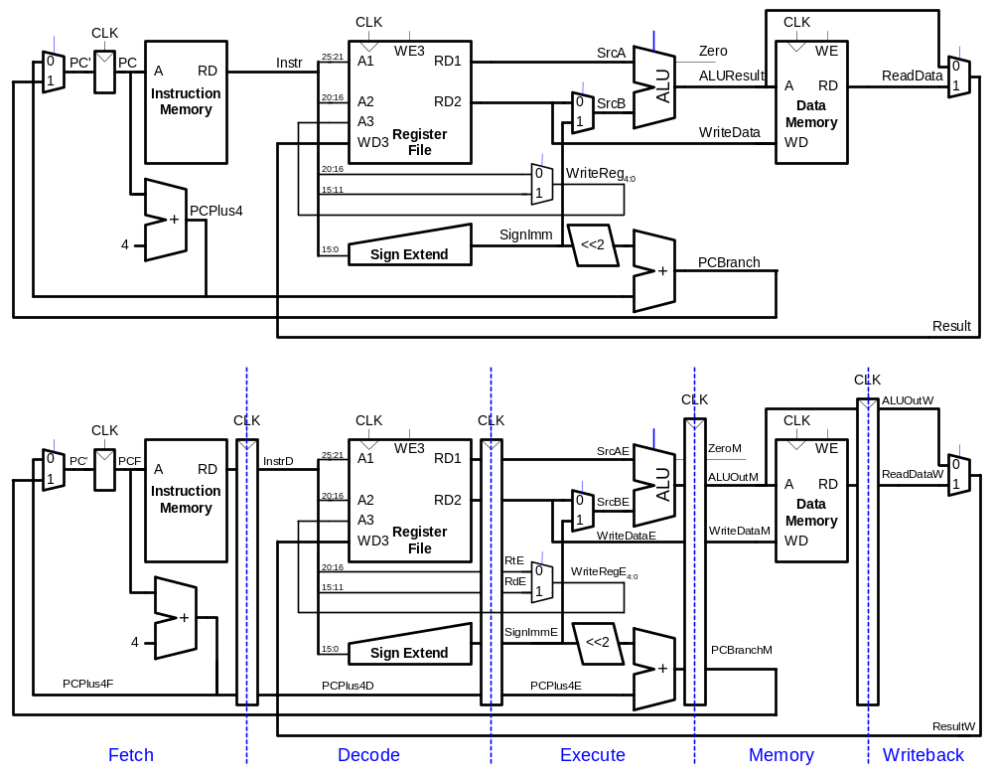
Single-Cycle & Pipelined Datapath

Slide 6
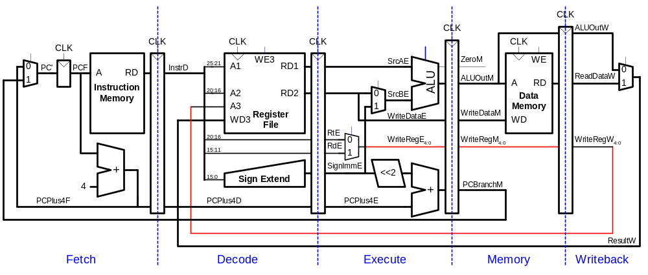
Corrected Pipelined Datapath
WriteReg must arrive at same time as Result

Slide 7
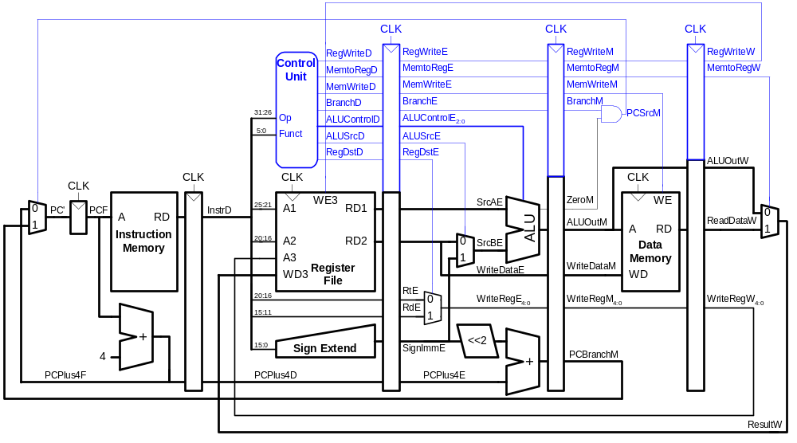
Pipelined Processor Control
Same control unit as single-cycle processor
Control delayed to proper pipeline stage

Slide 8
Pipeline Hazards
When an instruction depends on result from instruction that hasn’t completed
Types:
  Structural hazard: We have already solve it by using Harvard architecture. (depart the instruction memory and data memory into two pieces)
  Data hazard: register value not yet written back to register file
  Control hazard: next instruction not decided yet (caused by branches)

Slide 9
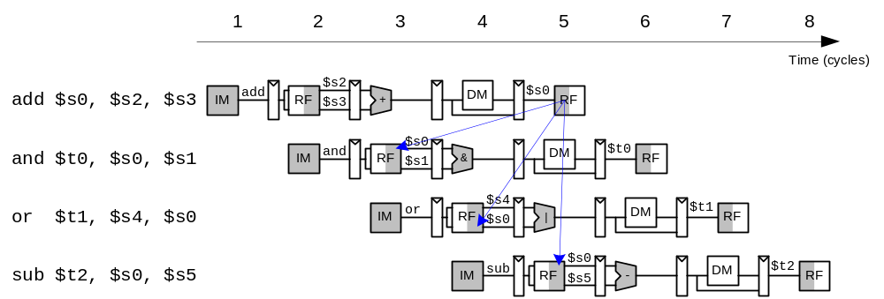
Data Hazard

Slide 10
Handling Data Hazards
Insert nops in code at compile time
Rearrange code at compile time
Forward data at run time
Stall the processor at run time

Slide 11
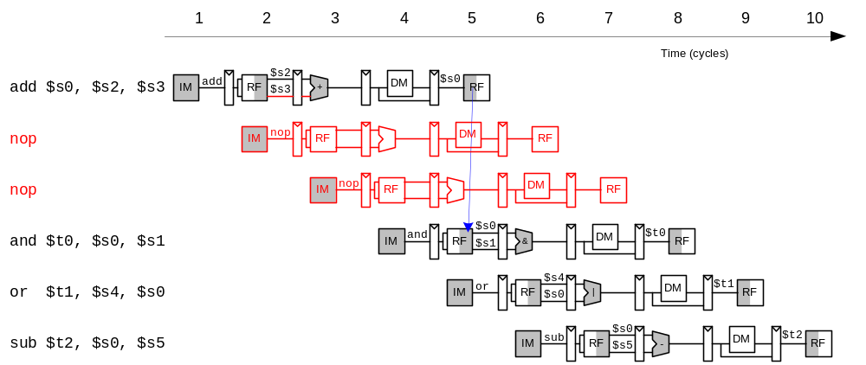
Compile-Time Hazard Elimination
Insert enough nops for result to be ready
Or move independent useful instructions forward

Slide 12
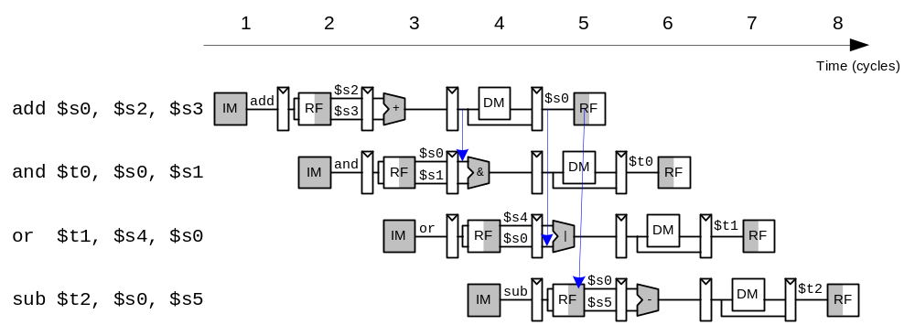
Data Forwarding

Slide 13
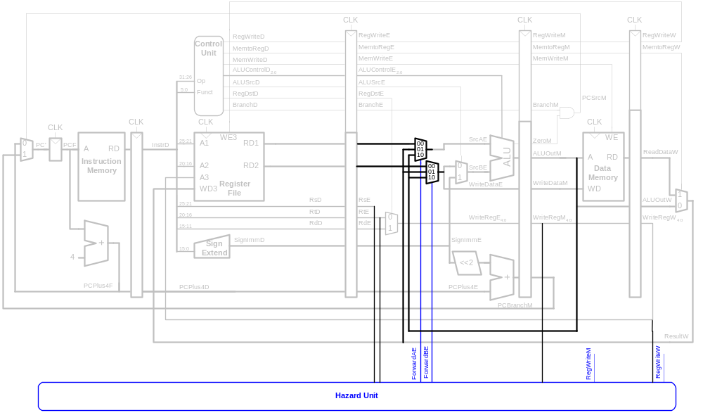
Data Forwarding

Slide 14
Data Forwarding
Forward to Execute stage from either:
  Memory stage or
  Writeback stage
Forwarding logic for ForwardAE:
if ((rsE != 0) AND (rsE == WriteRegM) AND RegWriteM)
then ForwardAE = 10
else if ((rsE != 0) AND (rsE == WriteRegW) AND RegWriteW)
then ForwardAE = 01
else ForwardAE = 00
Forwarding logic for ForwardBE same, but replace rsE with rtE

Slide 15
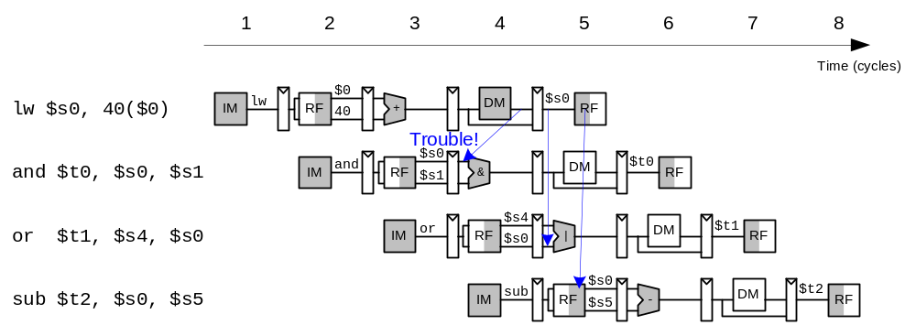
Stalling

Slide 16
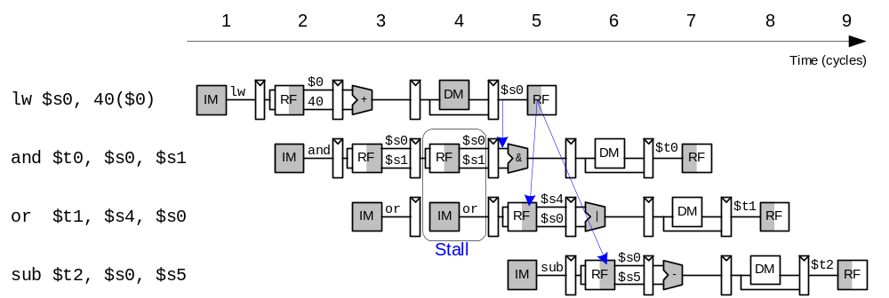
Stalling

Slide 17
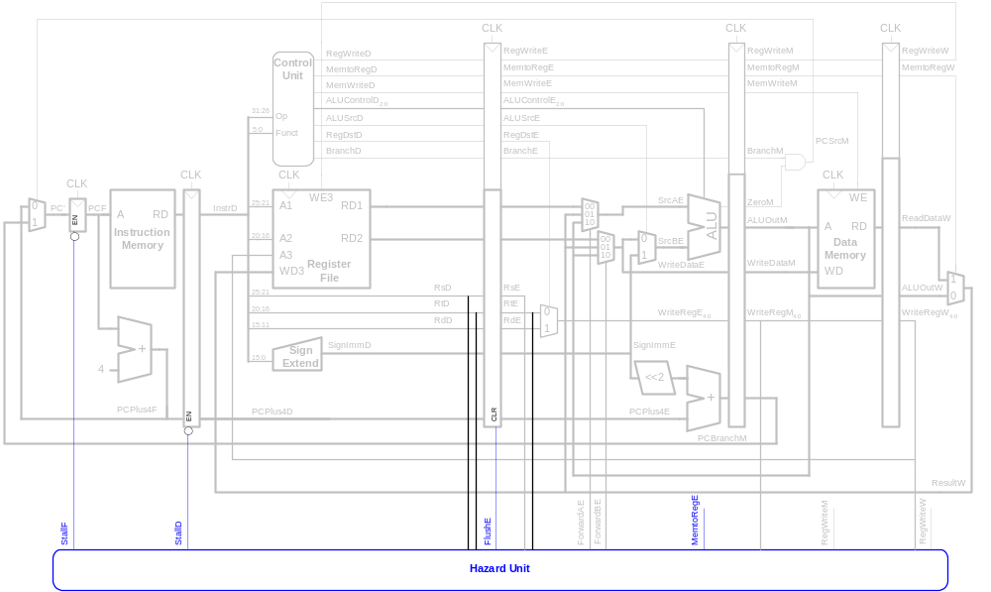
Stalling Hardware

Slide 18
Stalling Logic
lwstall =
((rsD==rtE) OR (rtD==rtE)) AND MemtoRegE
StallF = StallD = FlushE = lwstall

Slide 19
Control Hazards
beq:
  branch not determined until 4th stage of pipeline
  Instructions after branch fetched before branch occurs
  These instructions must be flushed if branch happens
Branch misprediction penalty
  number of instruction flushed when branch is taken
  May be reduced by determining branch earlier

Slide 20
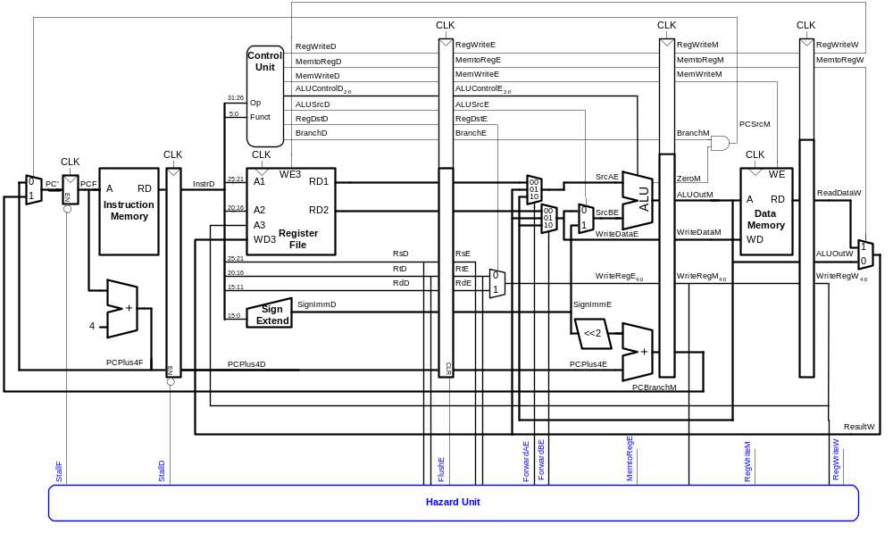
Control Hazards: Original Pipeline

Slide 21
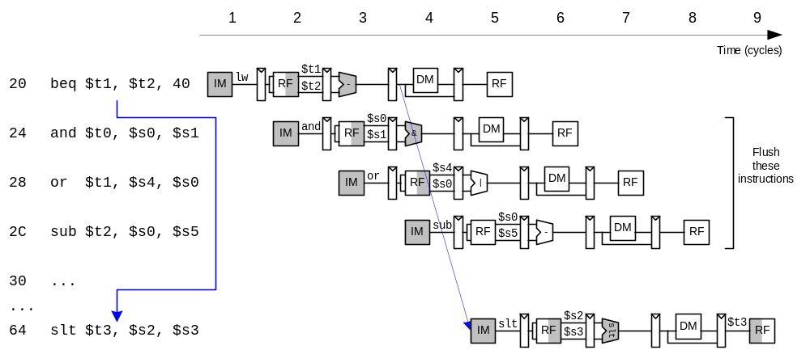
Control Hazards

Slide 22
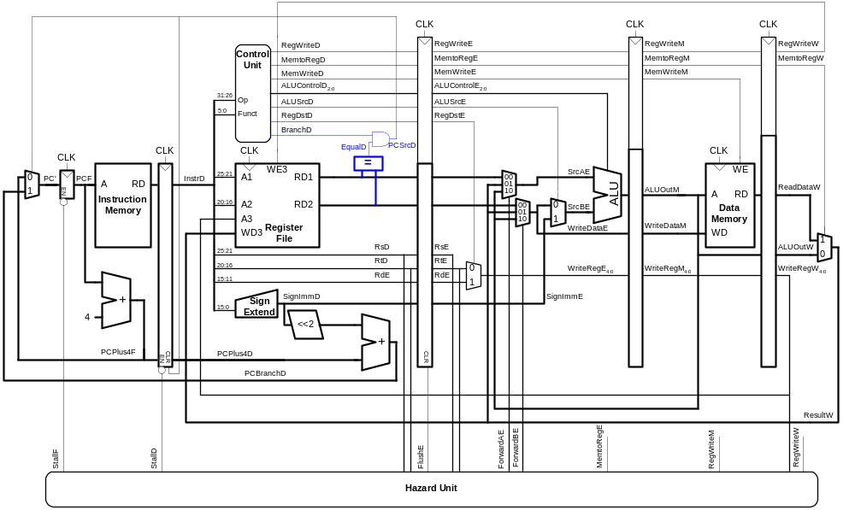
Early Branch Resolution
Introduced another data hazard in Decode stage

Slide 23
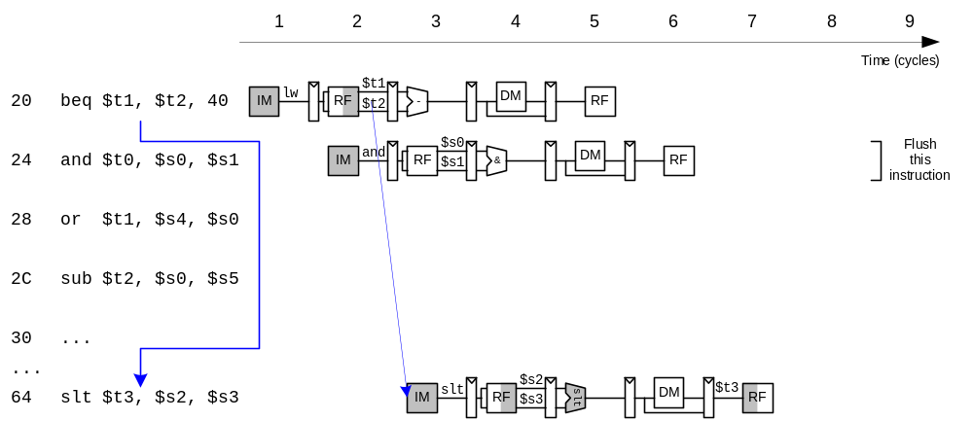
Early Branch Resolution

Slide 24
Branch delay slot
Branch delay slot：The instruction after branch always execute.
In this way, the only left instruction could use effectively, instead of wasting this stage

Slide 25
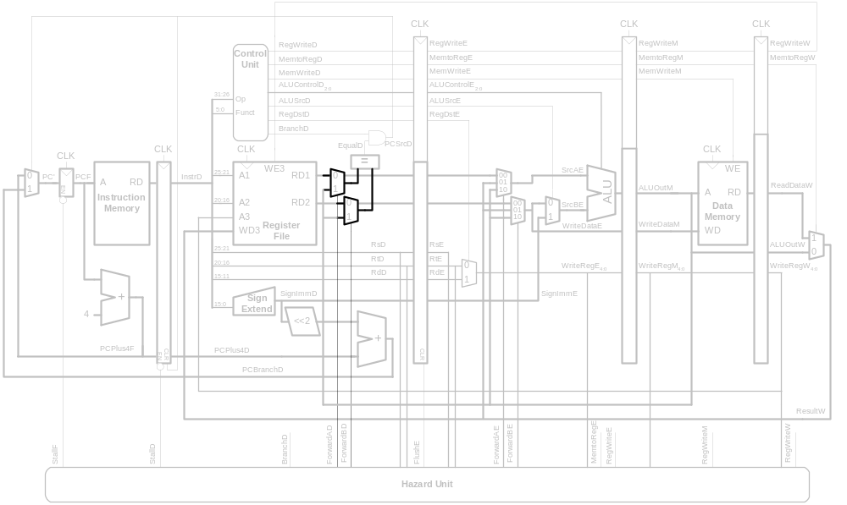
Handling Data & Control Hazards

Slide 26
Control Forwarding & Stalling Logic
Forwarding logic:
ForwardAD = (rsD !=0) AND (rsD == WriteRegM) AND RegWriteM
ForwardBD = (rtD !=0) AND (rtD == WriteRegM) AND RegWriteM
Stalling logic:
branchstall = BranchD AND RegWriteE AND
(WriteRegE == rsD OR WriteRegE == rtD)
OR
BranchD AND MemtoRegM AND
(WriteRegM == rsD OR WriteRegM == rtD)
StallF = StallD = FlushE = lwstall OR branchstall

Slide 27
Branch Prediction
Guess whether branch will be taken
  Backward branches are usually taken (loops)
  Consider history to improve guess
Good prediction reduces fraction of branches requiring a flush

Slide 28
Pipelined Performance Example
SPECINT2000 benchmark:
  25% loads
  10% stores
  11% branches
  2% jumps
  52% R-type
Suppose:
  40% of loads used by next instruction
  25% of branches mispredicted
  All jumps flush next instruction
What is the average CPI?

Slide 29
Pipelined Performance Example
SPECINT2000 benchmark:
  25% loads
  10% stores
  11% branches
  2% jumps
  52% R-type
Suppose:
  40% of loads used by next instruction
  25% of branches mispredicted
  All jumps flush next instruction
What is the average CPI?
  Load/Branch CPI = 1 when no stalling, 2 when stalling
  CPI_{lw} = 1(0.6) + 2(0.4) = 1.4
  CPI_{beq} = 1(0.75) + 2(0.25) = 1.25
  Average CPI = (0.25)(1.4) + (0.1)(1) + (0.11)(1.25) + (0.02)(2) + (0.52)(1)
  = 1.15

Slide 30
Pipelined Performance
Pipelined processor critical path:
T_{c} = max {
t_{pcq} + t_{mem} + t_{setup}
2(t_{RFread} + t_{mux} + t_{eq} + t_{AND} + t_{mux} + t_{setup} )
t_{pcq} + t_{mux} + t_{mux} + t_{ALU} + t_{setup}
t_{pcq} + t_{memwrite} + t_{setup}
2(t_{pcq} + t_{mux} + t_{RFwrite}) }

Slide 31
Pipelined Performance Example
Element | Parameter | Delay (ps)
Register clock-to-Q | t_{pcq_PC} | 30
Register setup | t_{setup} | 20
Multiplexer | t_{mux} | 25
ALU | t_{ALU} | 200
Memory read | t_{mem} | 250
Register file read | t_{RFread} | 150
Register file setup | t_{RFsetup} | 20
Equality comparator | t_{eq} | 40
AND gate | t_{AND} | 15
Memory write | T_{memwrite} | 220
Register file write | t_{RFwrite} | 100 ps
T_{c} = 2(t_{RFread} + t_{mux} + t_{eq} + t_{AND} + t_{mux} + t_{setup} )
= 2[150 + 25 + 40 + 15 + 25 + 20] ps = 550 ps

Slide 32
Pipelined Performance Example
Program with 100 billion instructions
Execution Time = (# instructions) × CPI × T_{c}
= (100 × 10⁹)(1.15)(550 × 10⁻¹²)
= 63 seconds

Slide 33
Processor Performance Comparison
Processor | Execution Time (seconds) | Speedup (single-cycle as baseline)
Single-cycle | 92.5 | 1
Multicycle | 133 | 0.70
Pipelined | 63 | 1.47

