Slide 1
Seminar ：
Fast Matrix Transposing

Slide 2
Fast Matrix Transposing
Discussion: compared with 2-D array representation
  O(columns*elements) vs. O(columns*rows)
  elements --> columns * rows when non-sparse,
  O(columns²*rows)
Problem: Scan the array “columns” times.
  How can we transpose a matrix represented as a sequence of triples in O(columns + elements) time？

Slide 3
Fast Matrix Transposing
Solution:
  First, determine the number of elements in each column of the original matrix.
  Second, determine the starting positions of each row in the transpose matrix.

Slide 4
Fast Matrix Transposing
You are to create programs to transpose a matrix represented as a sequence of triples in O(columns + elements)

Slide 5
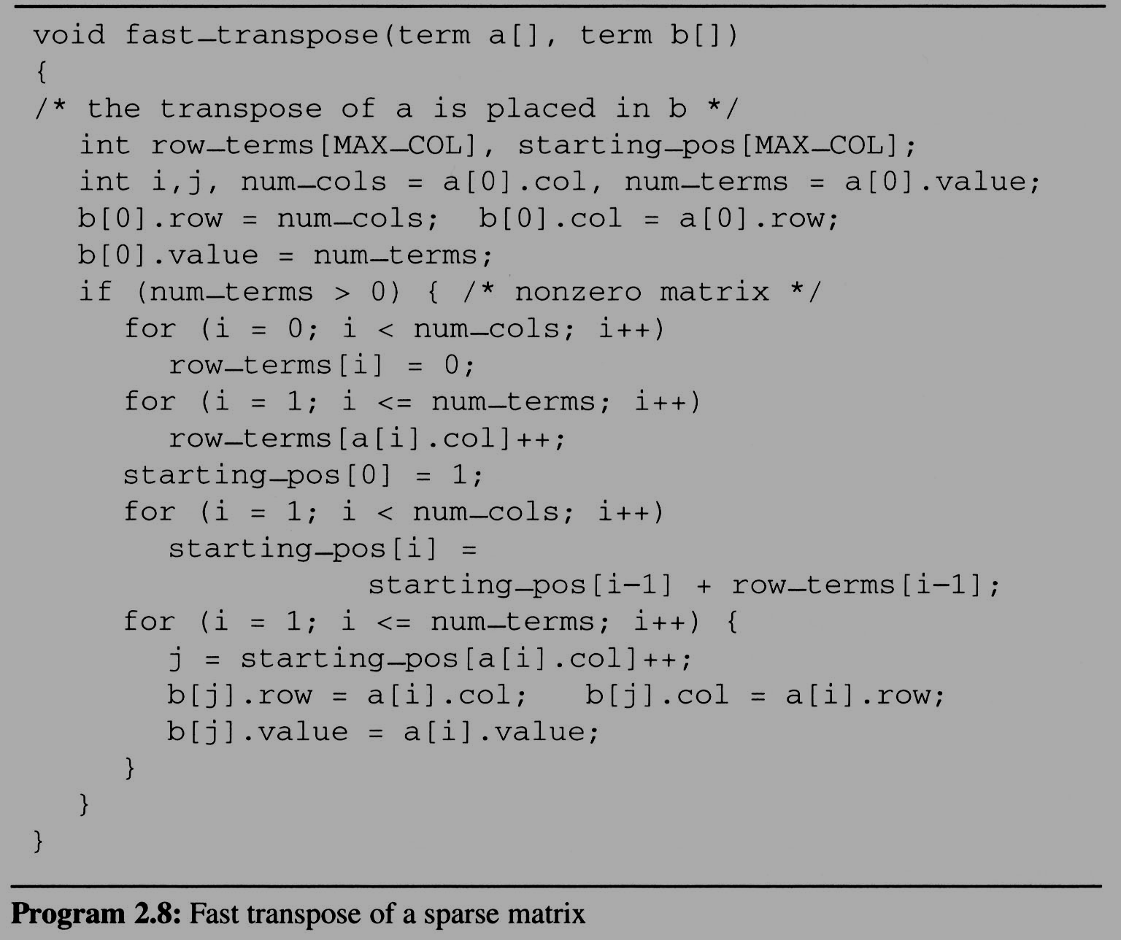

Fast Matrix Transposing
Cost:
Additional row_terms and starting_pos arrays are required.
Let the two arrays row_terms and starting_pos be shared.
For columns
Buildup row_term
& starting_pos
For elements
columns
For columns
transpose
For elements

Slide 6
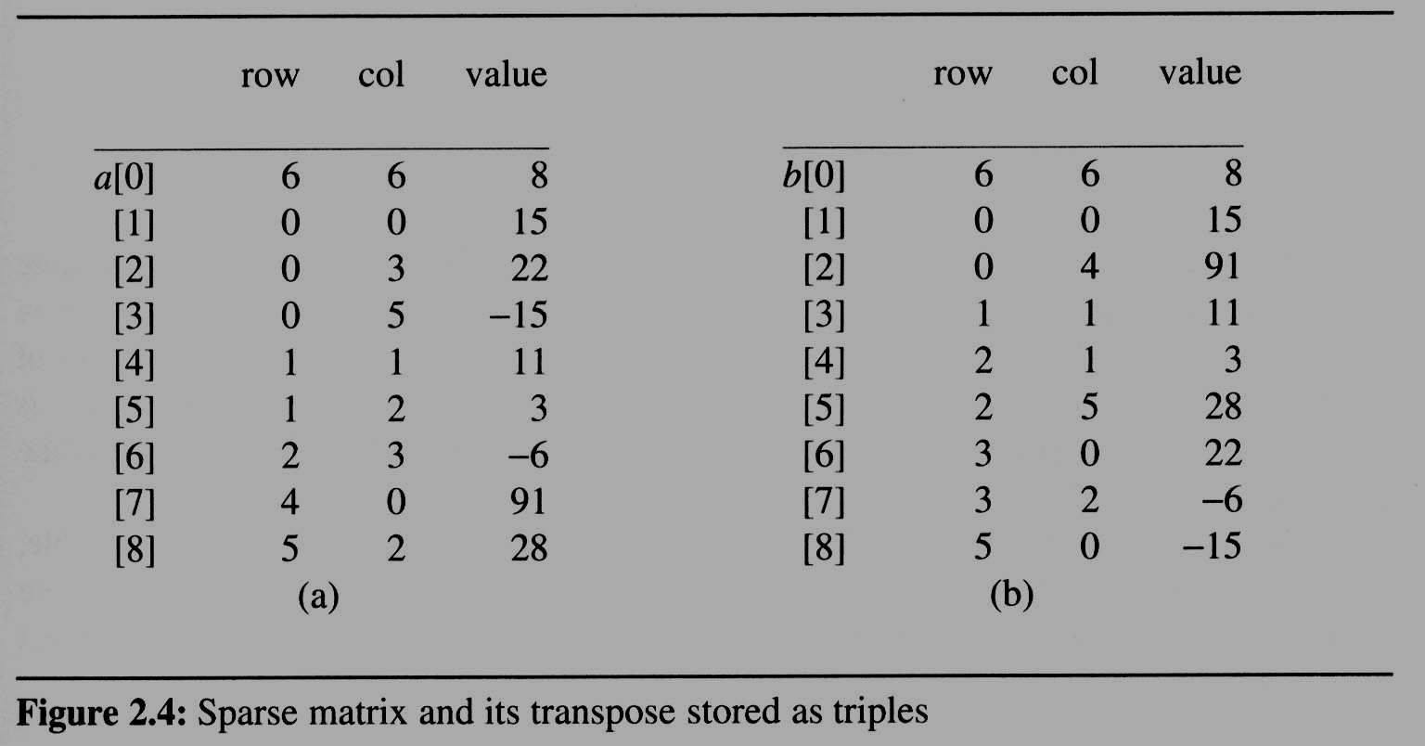
Fast Matrix Transposing
After the execution of the third for loop, the values of row_terms and starting_pos are:
[0] [1] [2] [3] [4] [5]
row_terms = 2 1 2 2 0 1
starting_pos = 1 3 4 6 8 8
transpose

Slide 7
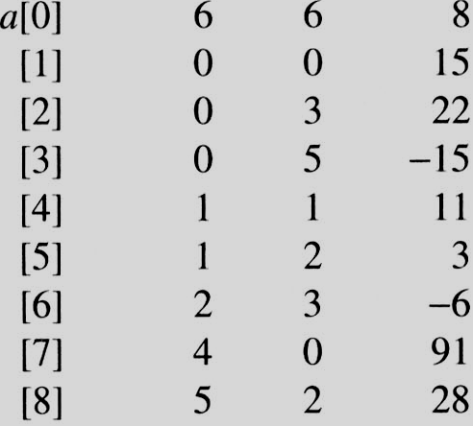
[0] [1] [2] [3] [4] [5]
row_terms
0
1
2
0
1
0
1
2
1
2
0
0
0
1
#col = 6
#term = 6
Matrix A
Row Col Value
starting_pos
1
3
4
6
8
8

Slide 8
[0] [1] [2] [3] [4] [5]
row_terms = 2 1 2 2 0 1
starting_pos = 1 3 4 6 8 8
[0] [1] [2] [3] [4] [5]
row_terms = 2 1 2 2 0 1
starting_pos = 2 3 4 6 8 8
[0] [1] [2] [3] [4] [5]
row_terms = 2 1 2 2 0 1
starting_pos = 2 3 4 7 8 8
[0] [1] [2] [3] [4] [5]
row_terms = 2 1 2 2 0 1
starting_pos = 2 3 4 7 8 9
[0] [1] [2] [3] [4] [5]
row_terms = 2 1 2 2 0 1
starting_pos = 2 4 4 7 8 9
[0] [1] [2] [3] [4] [5]
row_terms = 2 1 2 2 0 1
starting_pos = 2 4 5 7 8 9
[0] [1] [2] [3] [4] [5]
row_terms = 2 1 2 2 0 1
starting_pos = 2 4 5 8 8 9
[0] [1] [2] [3] [4] [5]
row_terms = 2 1 2 2 0 1
starting_pos = 3 4 5 8 8 9
[0] [1] [2] [3] [4] [5]
row_terms = 2 1 2 2 0 1
starting_pos = 3 4 6 8 8 9
I = 1
I = 2
I = 3
I = 4
I = 5
I = 6
I = 7
I = 8
Matrix A
Row Col Value
Row Col Value
0 6 6 8
1 0 0 15
2 0 4 91
3 1 1 11
4 2 1 3
5 2 5 28
6 3 0 22
7 3 2 -6
8 5 0 -15

Slide 9
Reference
《数据结构（ C 语言版）》，严蔚敏，吴伟民编著，清华大学出版社，1997年第1版,P99-100

Slide 10
-END-

