Slide 1
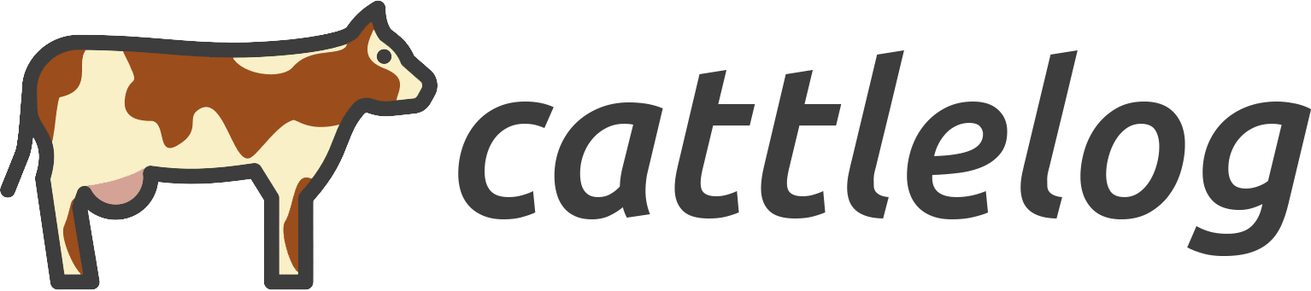

Slide 2
Outline
Intro and Background
The Problem
Our Strategy
Our Solution
Live Demo

Slide 3
Introduction &
Background
Developed a platform to enable real-time traceability of cows and monitoring of diseases
End to end blockchain based technology
Based on Hyperledger Fabric

Slide 4
The Problem
“Industry fragmentation”
Disease outbreaks → Farms shut down & products recalled
Lack real time identification of:
Root of sickness
Correlation factors
Affected samples
“Estimated the total losses from a disease outbreak in the US would exceed $266B” ^{[1]}
^{[1]} Van Eenennaam A, Weber K, Cooprider K, Drake D. 2010. Integrated data-collection system tracks beef cattle from conception to carcass. Calif Agr 64(2):94-100.https://doi.org/10.3733/ca.v064n02p94.
Notes:
No way to analyse objectively the data points associated with sickness in cows
No way to correlate external factors to predict disease outbreaks

Slide 5
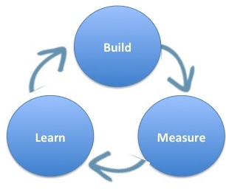
Our Strategy
Our strategy is to deploy a minimum viable product, get feedback from the farmers, transacting entities, and Statistics Canada and make continuous changes.
The transacting entities in our prototype covers transactions between the farmers and the feedlot and the feedlot and distributors
After creating a complete platform for cows, we will create platforms for other livestock
Timeline of full cover: 2 years

Slide 6
Our Solution
Profile for each cow:
Identification number (asset address)
Date of birth
Health records
Test records
...to be expanded at each transaction
Profile for each node (Farmer/Feed Lot/etc.):
License number
Metadata
Different levels of authority
All transactions are private between the farmer and the transacting participant
We provide Stats Canada with a platform to isolate this data according to filters and run statistical programs on them
“A distributed record of lifetime tracking for each cattle using a private blockchain network”
Farmer
Feedlot
Distributor
Consumer
Notes:
A distributed record of all data points tracking a cow from the farm to the end user
Farmers use our app to create profiles for their cows
Profile has unique id, height, weight, feed and health records
Unique id is used to track cow throughout the supply chain
Our algorithms aggregate data from external sources, like weather
All transactions are private between the farmer and his transacting participant
We provide Stats Canada with a platform to isolate this data according to filters and run statistical programs on them

Slide 7
LIVE DEMO
Hyperledger Fabric (prototype)
Excel (data extraction)

Slide 8
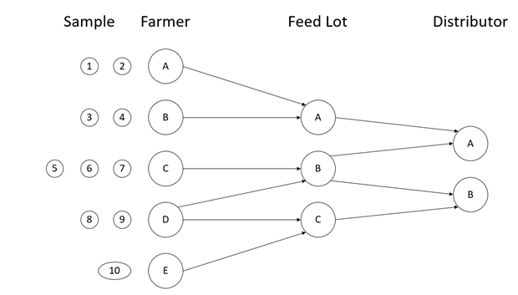
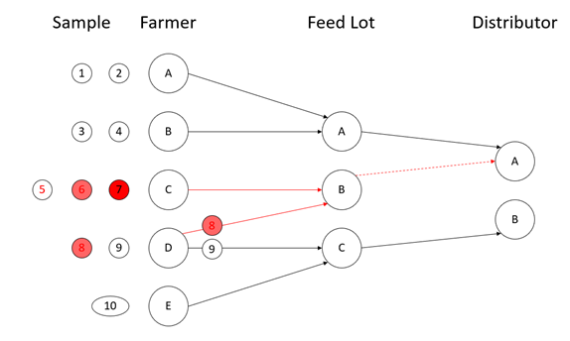
NORMAL
DISEASE OUTBREAK DETECTION

Slide 9

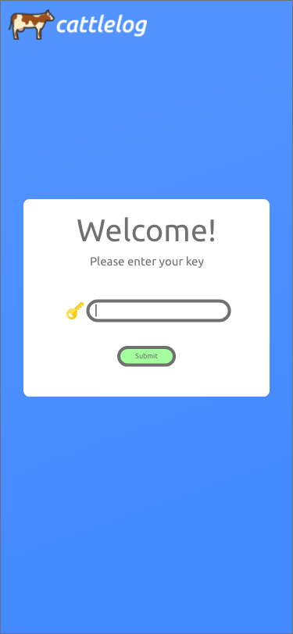
Data Logging
Status quo: RFID tag with mobile input
(minimize OCM for Farmer)

Slide 10
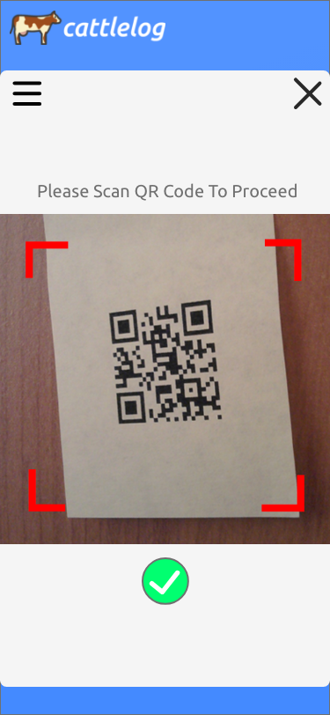
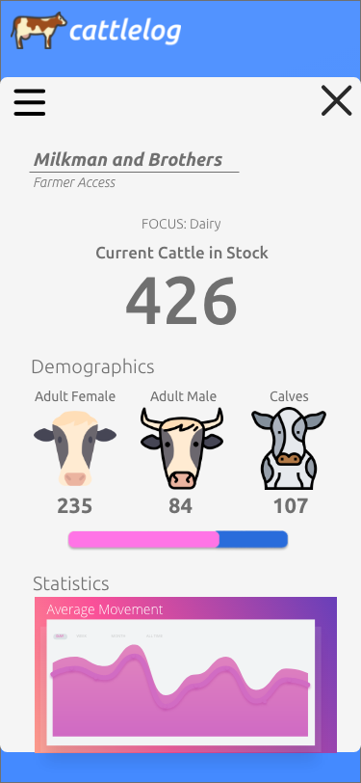
Data Logging
Status quo: RFID tag with mobile input

Slide 11
Thank You
By:
Luis Victoria: luisvictoriajr@gmail.com
Sarhaan Gulati: sarhaangulati737@gmail.com
Ryan Vo: minhvoryan@gmail.com
Avinash Rantnani:
Shiraz Khan: khan.shiraza@gmail.com

