Slide 1
COURSE ONE- EXCEL FUNDAMENTALS
FINAL LAB ASSESSMENT

Slide 2
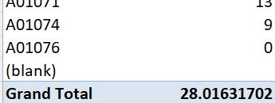
Task-1
Here, the lead time is in form of days and therefore, an average of 28 days is the difference between request date and work date for all the orders.

Slide 3

Task-2
“Northwest” district has the highest number of rush jobs.

Slide 4
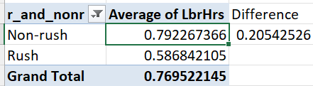
Task-3
A data column containing “Rush” and “Non-rush” data is used here. Upon looking at the average LbrHrs, a difference of 0.2 hours (12 minutes) is seen.

Slide 5
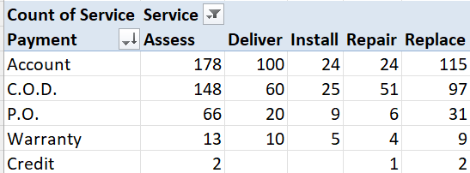
Task-4
For services like Assess, Deliver and Replace, most of the payments are done through “Account” and for services like Install and Repair, payments are majorly done through “C.O.D.”. The same can be seen in the bar chart illustration.

Slide 6
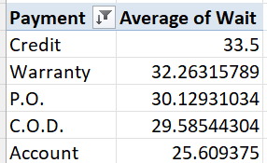
Task-5
Here it can be seen that 5 modes of payment are done for each waiting time. Payment via “Credit” is more common when the waiting period is more and for minimum waiting period of 25 days(approx.), payment is through “Account”.

Slide 7
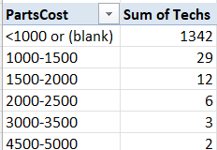
Task-6
Here it can be seen that, as the cost of the parts increases, the number technicians required decreases.

Slide 8
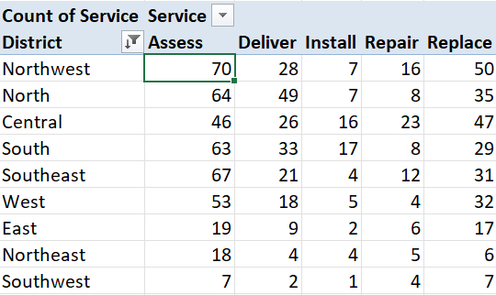
Task-7
The tabular column and the line chart gives a clear picture of the service that is most common in each district. For example, “Assess” service is mostly availed in the Northwest district.

Slide 9

Task-8
Here it is very clear that for every order without warranty label, payment is opted through other modes whereas for orders with warranty label, payment is done only through “Warranty” mode.

Slide 10
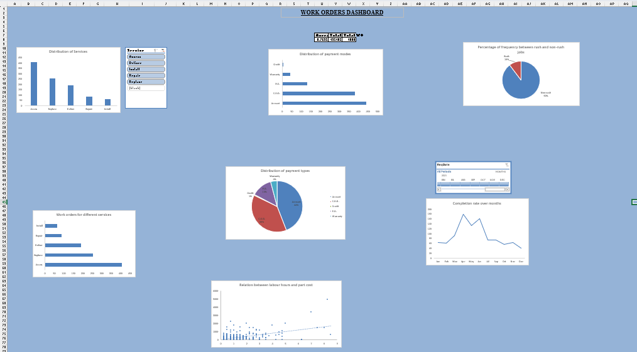
Task-9 Dashboard

Slide 11
