Slide 1
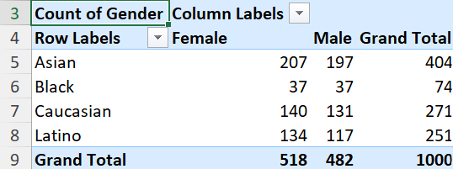
Task 1
This summarizes the distribution of genders from various ethnicities.

Slide 2
Task 2

Slide 3
Task 3
Though the range of difference is less at the start, there is a significant decrease in the average salary of the “IT” department when compared to other departments.

Slide 4

Task 4
Out of 1000 employees in total, United States has the highest number of employees of 643.

Slide 5

Task 5
Here it can be seen that 296 employees are present in the age group of 45 to 54 years

Slide 6
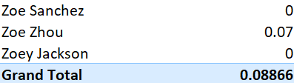
Task 6
In an average, 0.08866 is the bonus % offered.

Slide 7

Task 7
The job title “Director” occurs the most in the dataset

Slide 8
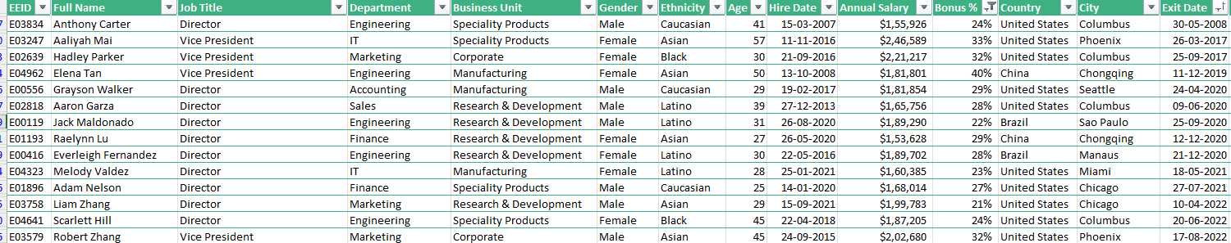
Task 8
The primary reasons are not cited. Totally 14 employees have left. Most are directors, so it could be retirement. Most of the people have left from “Research and development” unit.

Slide 9
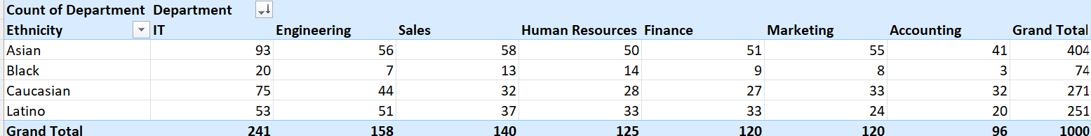
Task 9
Here “IT” department has the most diverse people followed by “Engineering”, “Sales”, “Human Resources”, “Finance”, “Marketing” and “Accounting” where “Accounting ” has the least amount of diversity.

