Slide 1
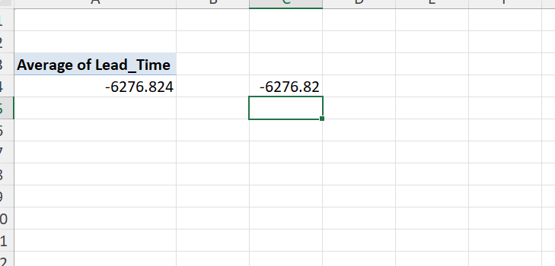
1.
To fid the average lead time, first we changed the date format to dd-mm-yyyy and then calculated the lead time by deducting completion date-work date then find the average.

Slide 2
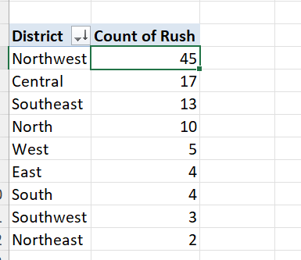
2.
The Northwest district has the highest number of rush jobs.

Slide 3
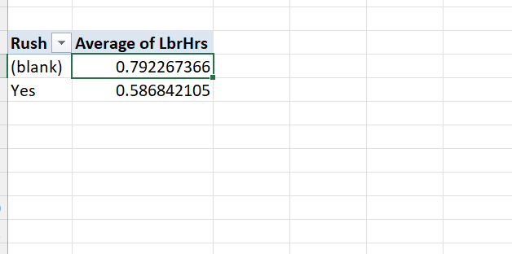
3.
As can be seen from the analysis the average labour hours is more for non –rush jobs than the rush jobs.

Slide 4
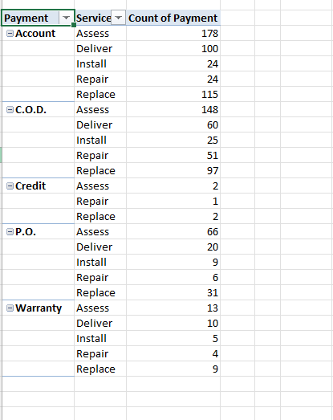
4.
The distribution of the Payment Types across different services are shown in the above snapshot. The different Payment modes like Account, COD, Credit, P.O. and Warranty and how they are differentiated into different services along with the count of the payment times.

Slide 5
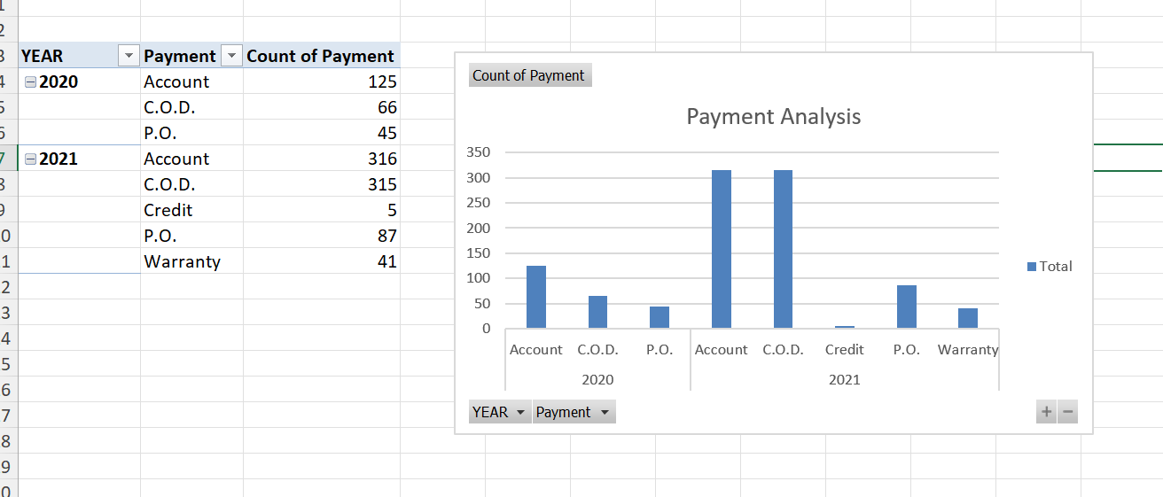
5.
To observe the trend of Payment w.r.t. time, we can see that all the payment mode has been increased in the year of 2021 corresponding to year 2020, C.O.D. being the highest mode.

Slide 6
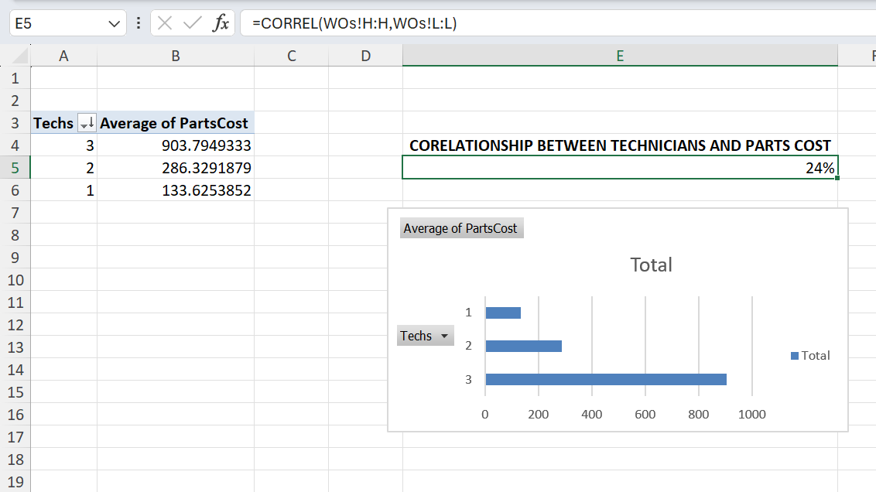
6.
When we look at the CORREL function we can see there is positive 24% proportionality between No of the technicians and the parts cost. Also, via pivot chart analysis and grom the graph it is quite evident that there is a relationship between the two.

Slide 7
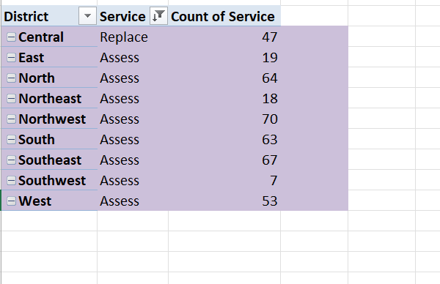
7.
The above data shows the most common type of service(highest service in number) requested in each district.

Slide 8
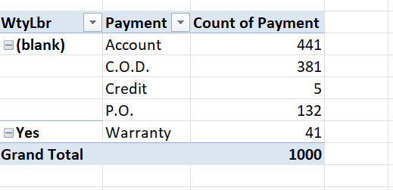
8.
There is a distribution of Payment types for Work orders with Warranty Labour(WtyLbr) compared to those without.

Slide 9
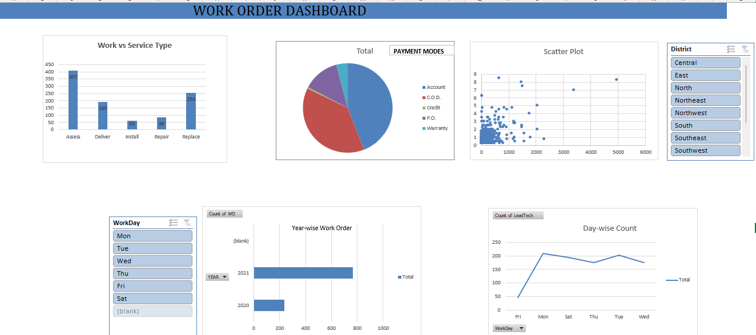
9.

