Slide 1

EXCEL REASSESMENT
Srijoni Sengupta

Slide 2
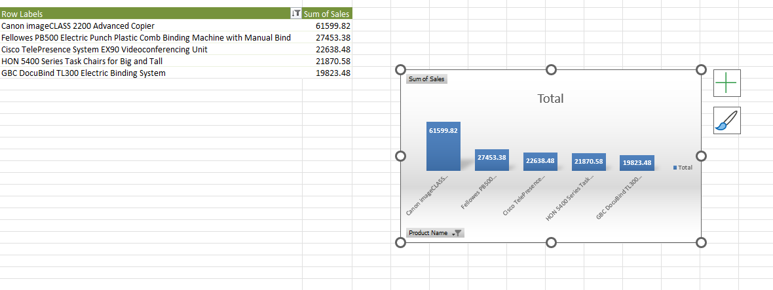
CASE Study:
1
STEPS→ PIVOT TABLE→Product Name on Axis(Categories) & Sum of Sales(Values)→ Descending sort
on Sales→ Value Filter(Top 5)
Canon image CLASS 2200 Advanced Copier has highest sales

Slide 3
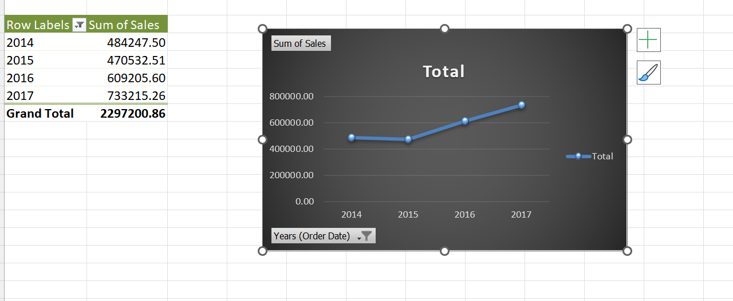
2.
STEPS→ PIVOT TABLE→ Years(Order Date) on Axis(Categories) & Sum of Sales(Values)
From year 2014 to 2015 there is a slight decrease in sales then in year 2016 there is a noticeable increase
in the sales then also in year 2017 there is slight increase in sales.
Yes in the year 2016 there is a noticeable increase in sales

Slide 4
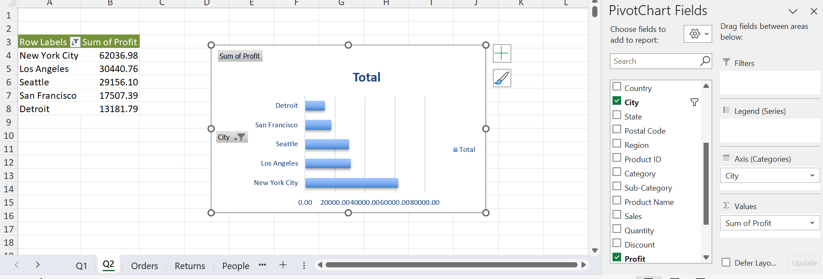
3.
STEPS→ PIVOT TABLE→ City on Axis(Categories) & Sum of Profit (Values)→Descending Sort on Sum of Profit
→Value Filter (Top 5)
New York City has the highest profitability

Slide 5
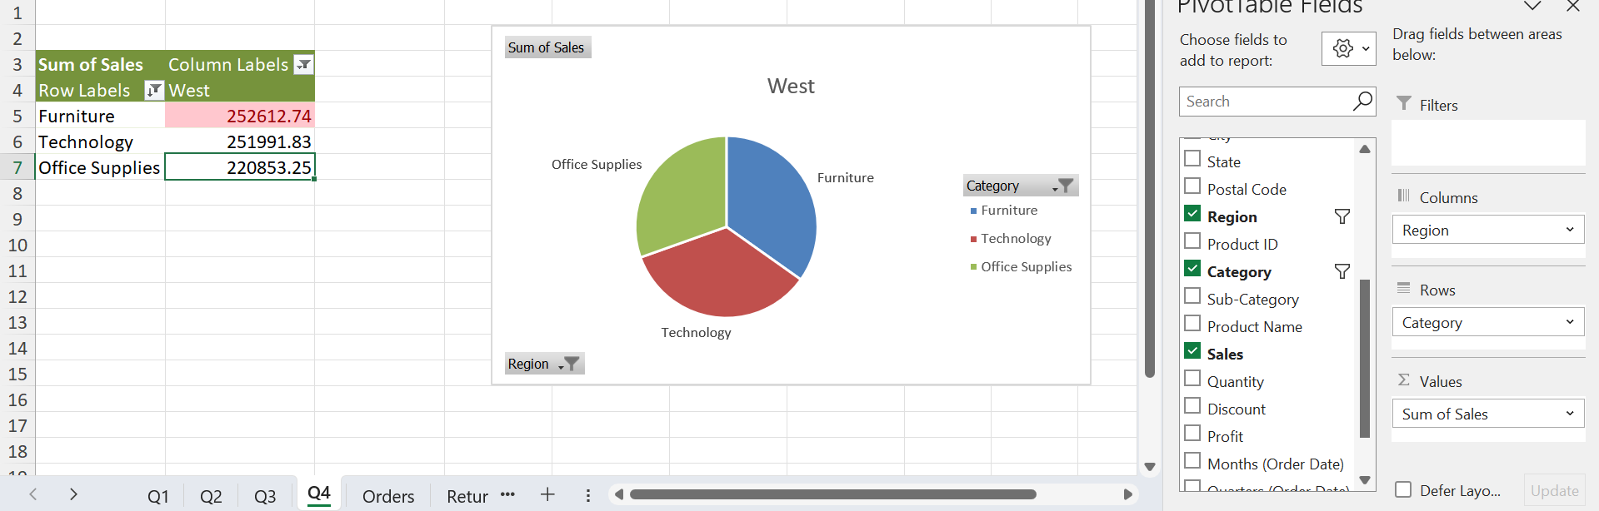
4.
STEPS→ PIVOT TABLE→ Category on Axis(Categories), Region on Legend(Series) & Sum of Sales (Values) →Filter on Region i.e. “West”→ Conditional Formatting to highlight the category that performed the best in west region
Furniture category performed the best in the West Region

Slide 6
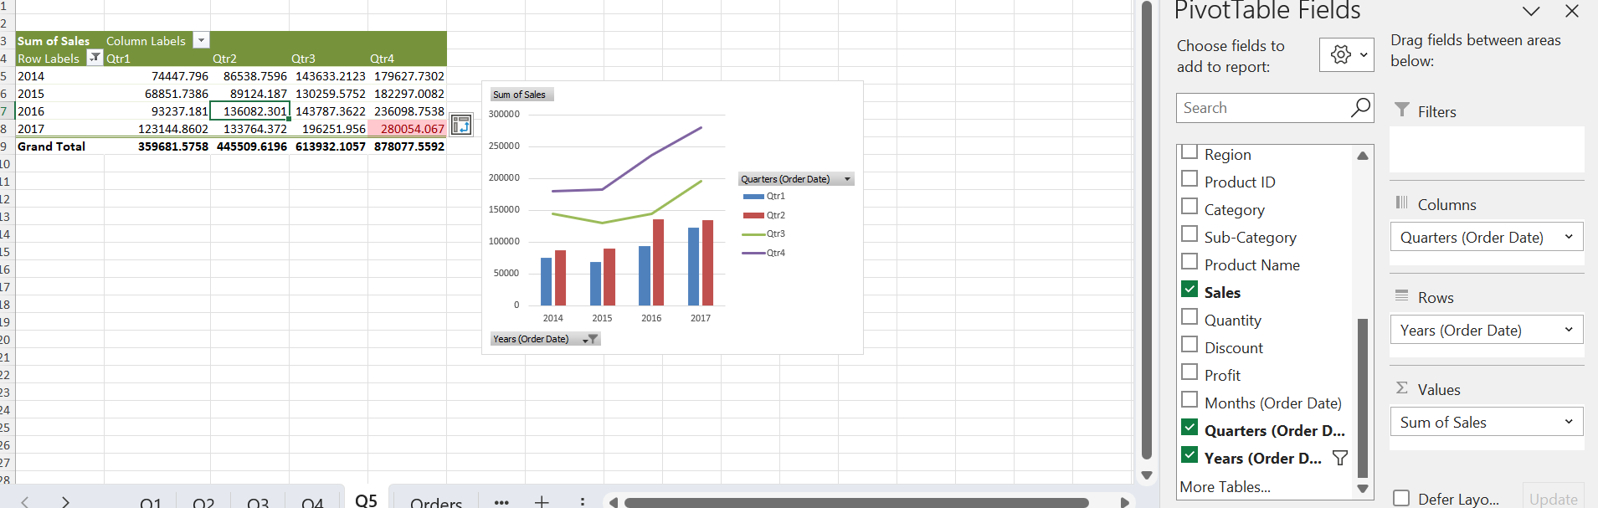
5.
STEPS→ PIVOT TABLE→ Years(Order Date) on Axis(Categories), Quarters(Order Date) on Legend(Series) & Sum of Sales (Values).
We get to find the Yearly analysis of sales and for each year there is quarter analysis as well.
We can see 4th Quarter of the year 2017 has shown highest sales.

Slide 7
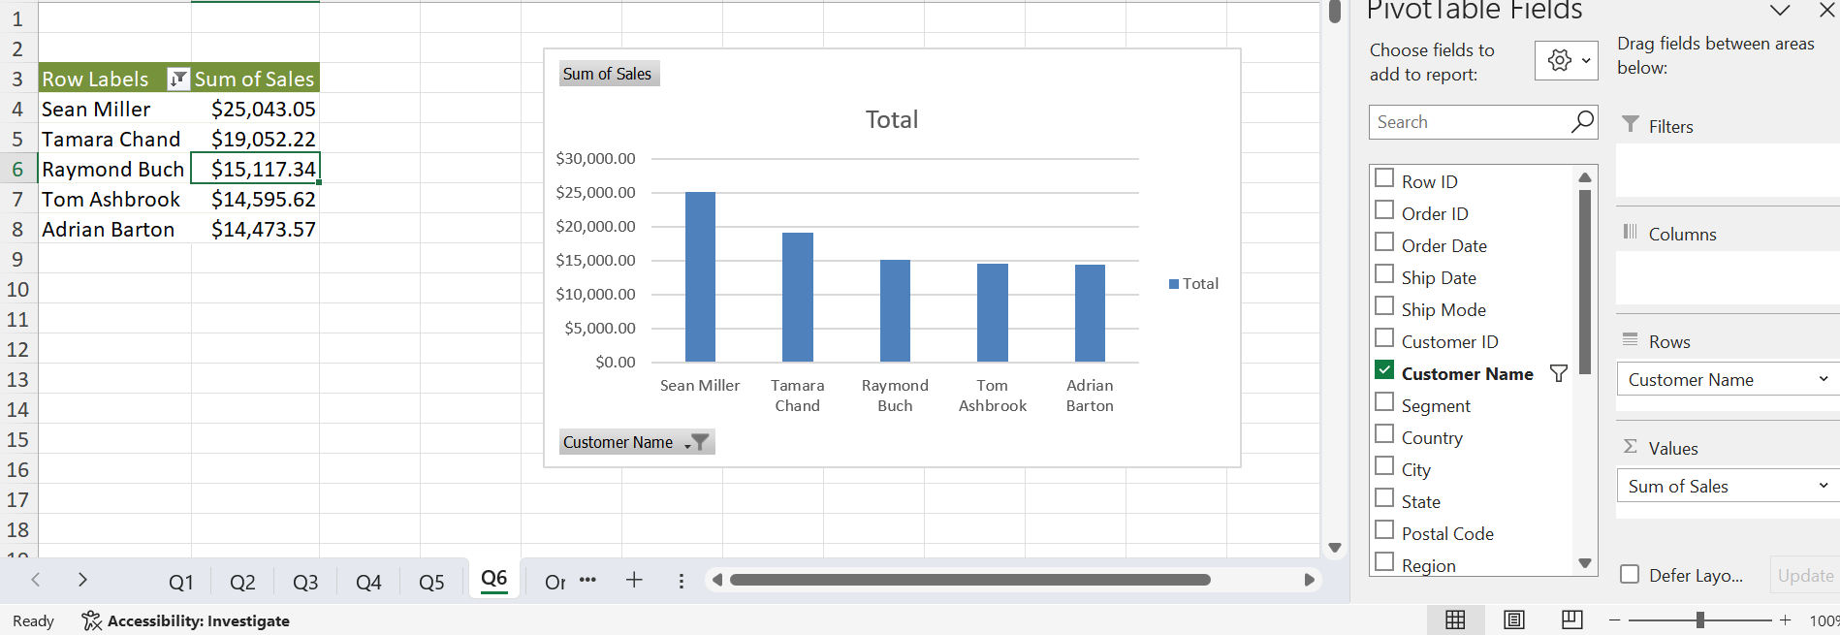
6.
STEPS→ PIVOT TABLE→ Customer Name on Axis(Categories), Sum of Sales (Values).→ Sort the data on descending order based on sales→ Value Filter Top 5
Sean Miller is the top customer and $25043.05 is the total Sales

Slide 8
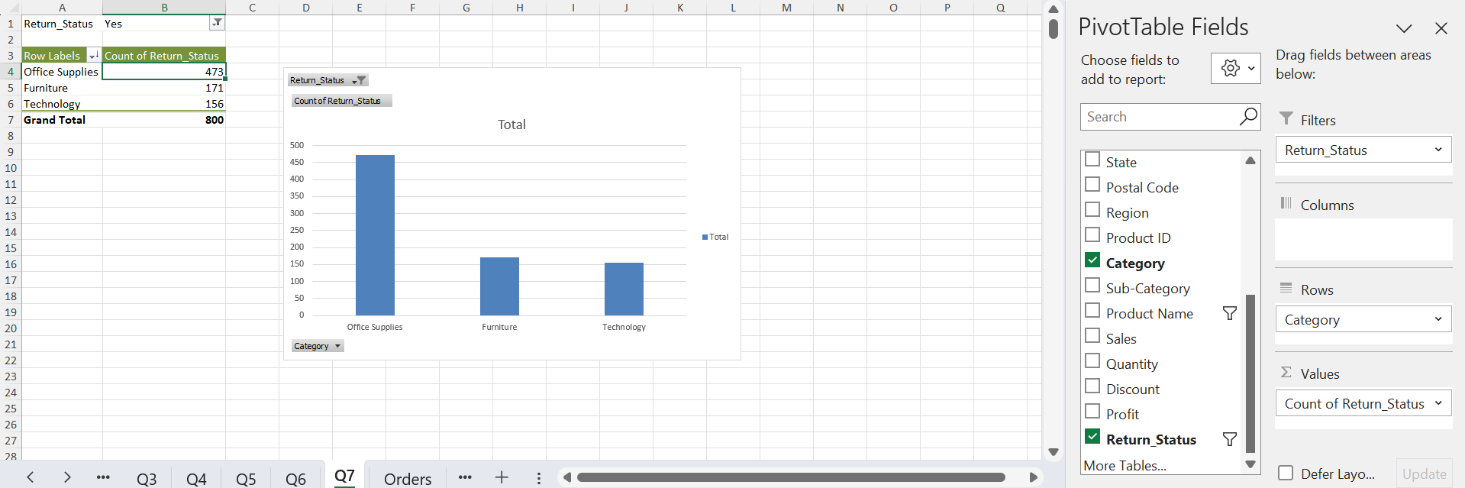
7.
STEPS→ First make a column on orders table with reference to returns sheet using Xlookup to find the return status of each order → PIVOT TABLE→ Category on Axis(Categories), Count of Return Status (Values) Filters of Return Status is YES→ Sort the data on descending order based on sales.
Office Supplies has the highest product return category. It might be because of the time taken in the order date and the shipping date, quality.

Slide 9
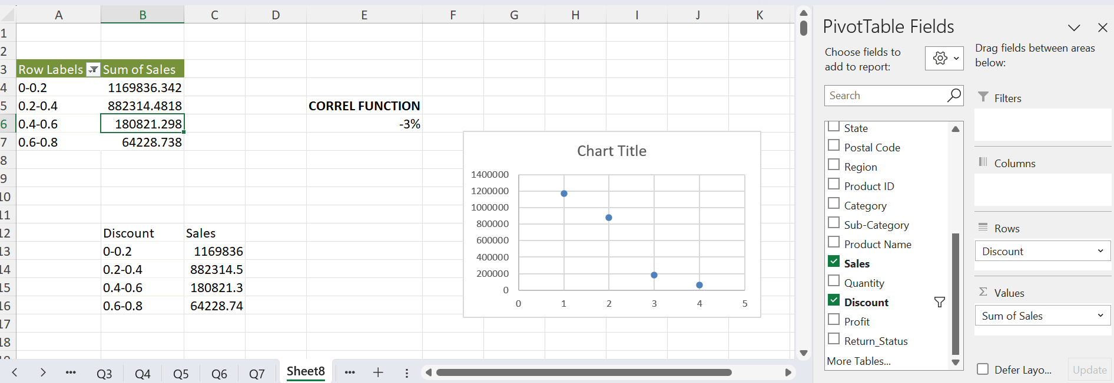
8.
STEPS→ → PIVOT TABLE→ Discount on Rows, Sum of Sales(Values). Grouped the data with an interval of 0.2 Used the correl function to find the relationship between 2 attributes, i.e. is negative 3% which shows that it is inversely proportional. Which increase in discount there is a negative impact on sales. Then did a scatter plot to show relationship between the 2 attributes
There is , i.e. is negative 3% which shows that it is inversely proportional. Which increase in discount there is a negative impact on sales.

Slide 10
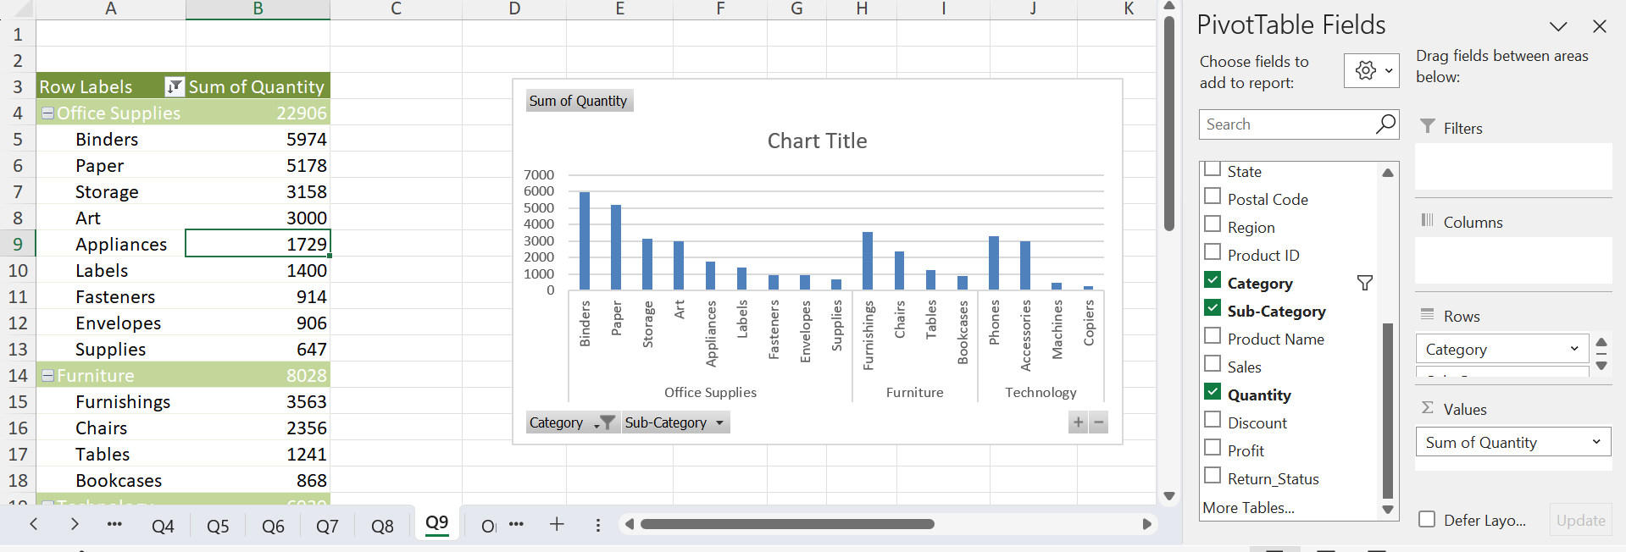
9.
STEPS→ → PIVOT TABLE→ Category and Sub category on Rows, Sum of Quantity (Values). Sort the data on descending order
Office Supplies, Binder is the most popular
Furniture, Furnishings is the most popular
Phones in Technology.
Furniture, Furnishings is the most popular

Slide 11
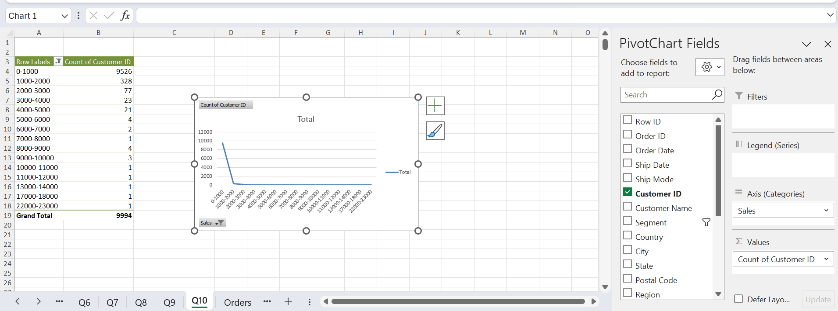
10.
STEPS→ → PIVOT TABLE→Sales on Axis(Category), Count of Customer_ID on Values. Grouped them by 1000, initial 0 and final value is 23000
So, here we are segregating the customer on the revenue they are generating. The 0-1000 (by sales amount) is the customer segment who generates the most revenue.

Slide 12
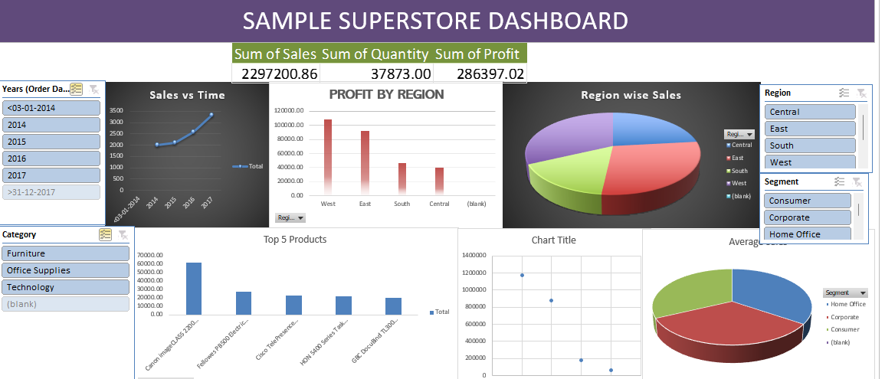
11. DASHBOARD

