Slide 1
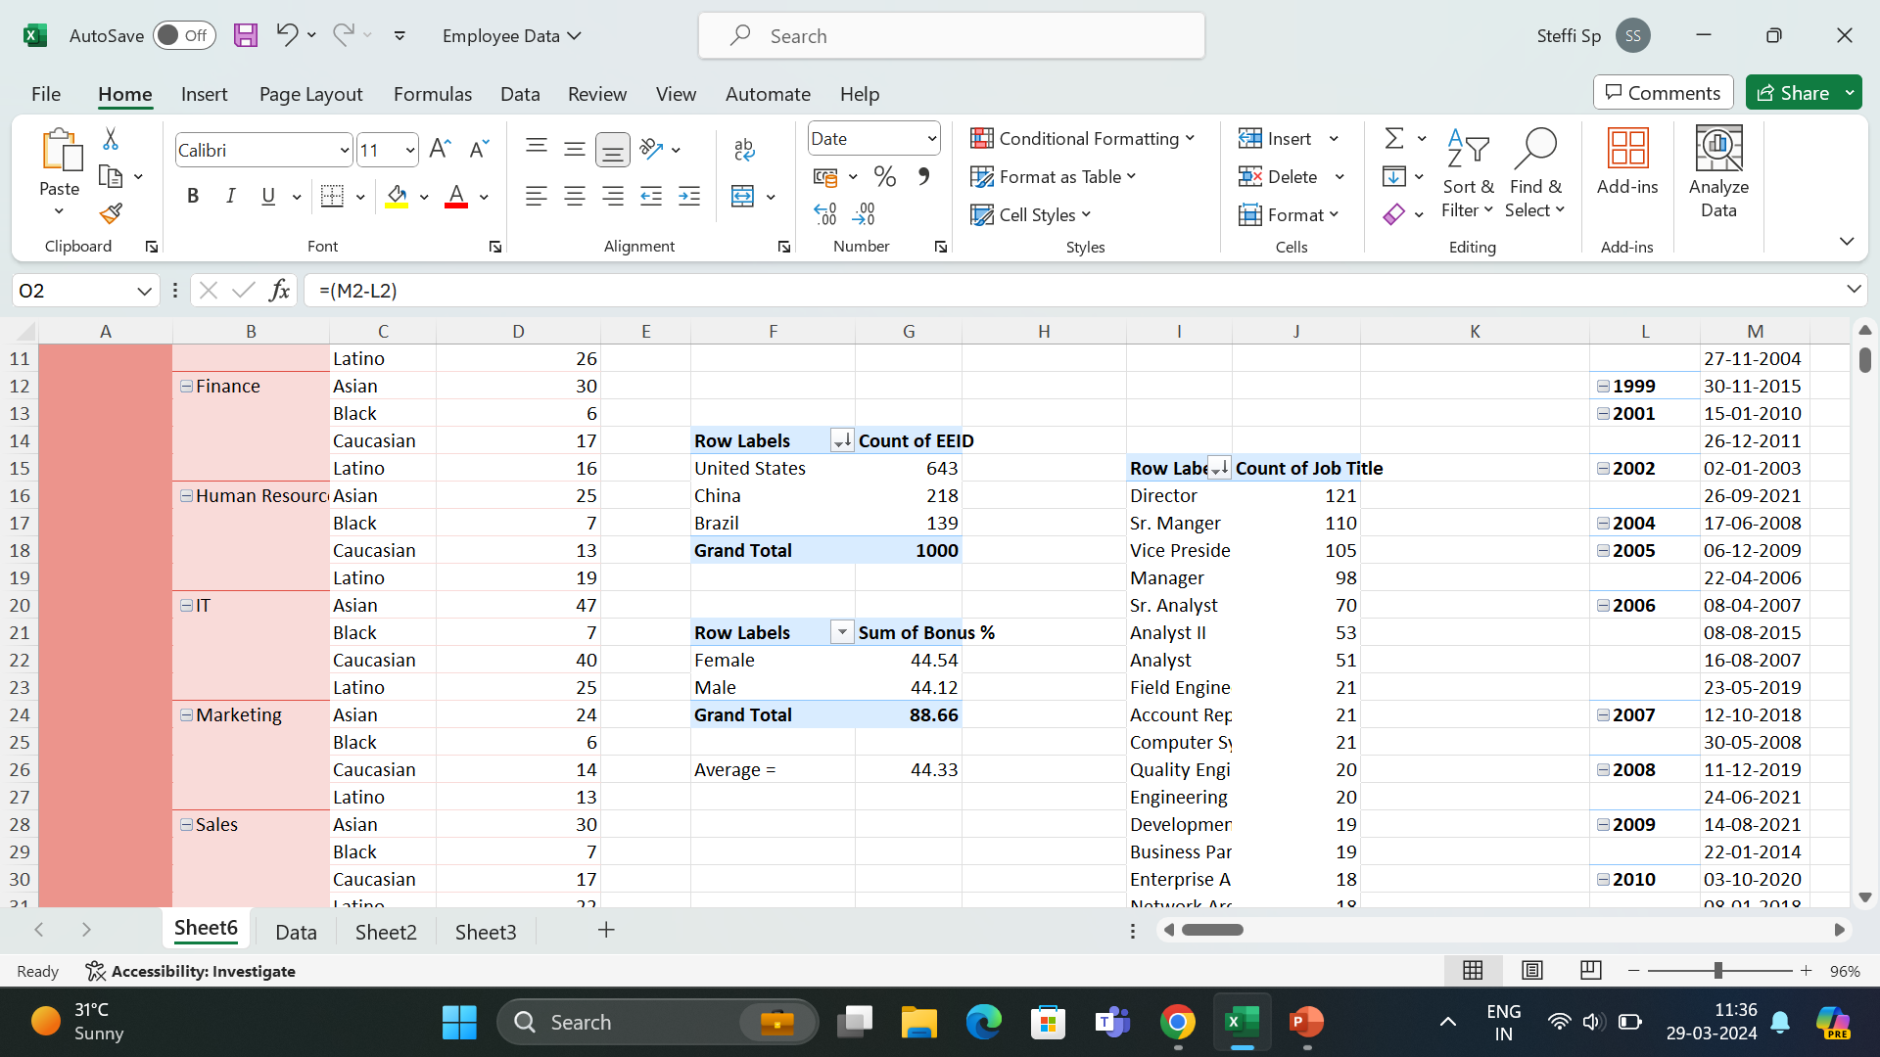
used pivot table
US HAS MORE NUMBER OF EMPLOYEES

Slide 2
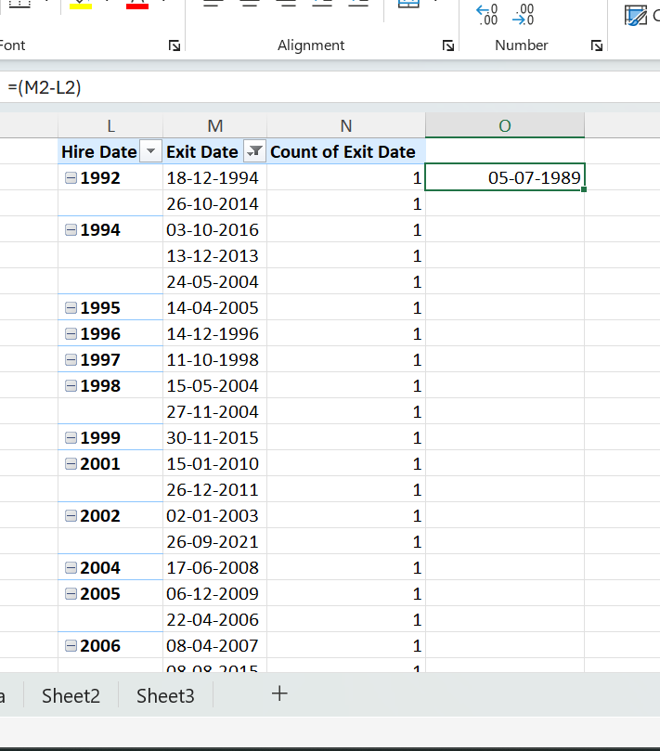
QUESTION 1
used pivot table
Showed the exit and hire date
Removed duplicates

Slide 3
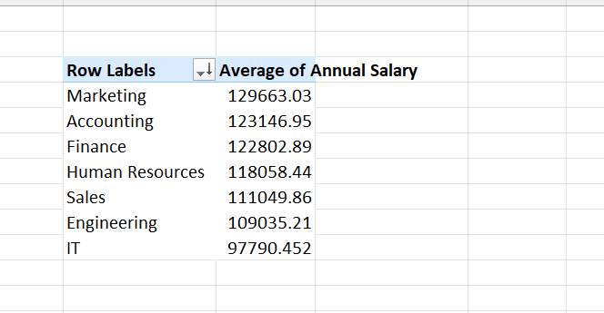
QUESTION 1
used pivot table
Showed dept and average salary
Marketing has highest salary
Lowest salary is in IT dept

Slide 4
QUESTION 1
used pivot table
Showed dept and average salary
Marketing has highest salary
Lowest salary is in IT dept

Slide 5
QUESTION 1
used pivot table
Female and male sum of bonus
Average of total bonus percentile

Slide 6
QUESTION 1
used pivot table
Director title is used a lot in the data

Slide 7
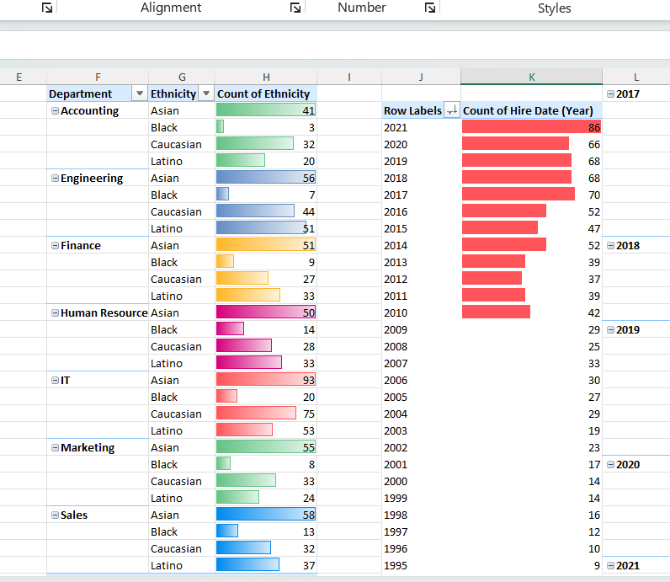
QUESTION 1
used pivot table
Table one shows the diversity of ethnicity in depts
HR and Sales have better distribution od ethnicity
Table two shows the last few years of increase in hires

Slide 8
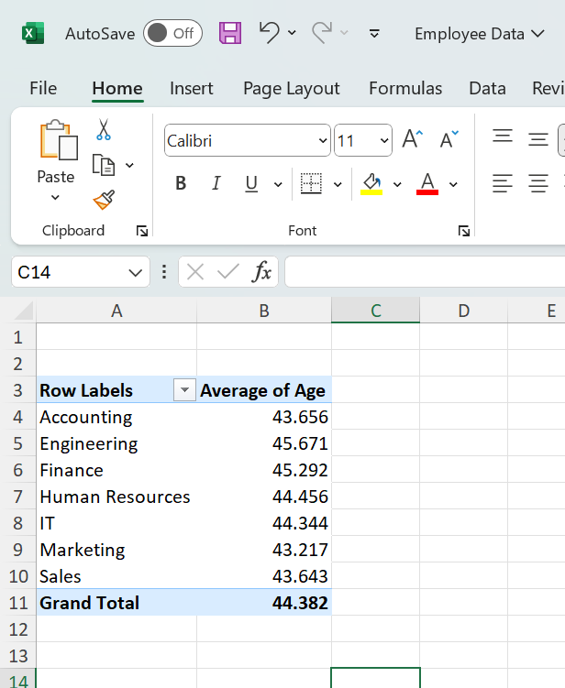
QUESTION 1
used pivot tableshows average age and dept

