Slide 1







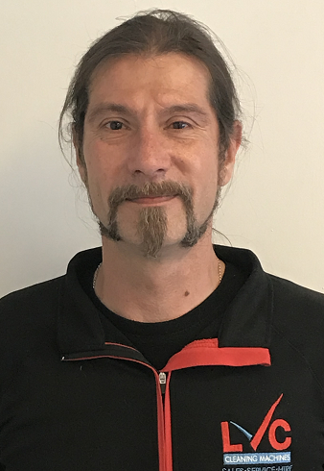

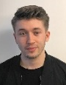
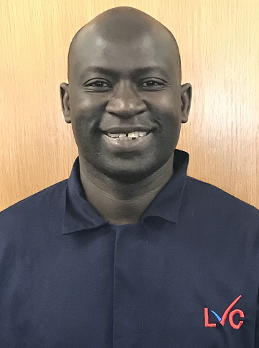
Managing Director
Sales Key Simon Tidder
Finance Director
Byron Rees
H&S/HR/Quality Coordinator Director
Britt Rees
General Manage
Sales Key Nick Rees
Operations Manager
Service Team
Otto Wolujevicz
SALES
HIRE DEPARTMENT
ACCOUNTS
Product & IT Support Manager
WORKSHOP
GOODS OUT
Stock Coordinator
GOODS in coordinator
SERVICE
Sales Manager
Simon Tidder
Hire Manager Jonathan Rees
Account Department Manager
Nipa Naik
Product Support Manager
Dean McBride
Workshop Manager
Matt Willet
Sales Order
Coordinator
Sanjeev Gill
Dispatch Coordinator
Glenn Walton
Goods In Department
Coordinator
Ariana Sultan
Goods In Department
Coordinator
Ariana Sultan
Service
Coordinator
Susanna
Service
Coordinator Assistant
Gowthami Veerappa
Senior Sales Consultant
I-team London
Sam Nurse
Accounts Assistant Gemma Janes
Accounts Payable Coordinator
Vijiyanthy Sivathasan
Delivery Driver &
Labour
assistant
Taqnny
Workshop Engineer
Luke Langlands
Senior Service Engineer
Ciaran McRae
Senior Service Engineer
Shane Wingfield
Senior Service Engineer
Peter Hunte
Sales Consultant & Marketing assistant
General Assistant
Basiry Kolley
Service Engineer
Hussain
Service Engineer
Chris Thomas

