Slide 1
HN23_FRF_EMB_07
MOCK 1
GROUP 1

Slide 2


INTRODUCTION
VU DUY PHUC
LE VAN HUNG
Leader
Member
NGUYEN HUU TRI
VU HAI DANG
Member
Member

Slide 3
TABLE OF CONTENTS
OVERVIEW OF FAT
FAT STRUCTURE
BOOT SECTOR
FILE ALLOCATION TABLES (FAT)
ROOT DIRECTORY
DATA AREA

Slide 4
WHAT IS THE FAT FILE?
The FAT file system (File Allocation Table) is heavily based on the file map model in terms of its on-disk layout
This file system was used on all versions of MS-DOS and PC-DOS, and o early versions of Windows
It is a reasonably simple, reasonably robust file system.
Three basic variants of the FAT file system:
Floppy disks and small hard disks usually use the 12-bit version, which was superseded by the 16-bit version as hard disks became bigger, This is turn was superseded by the 32-bit version as disks became bigger still.
Notes:
- FAT xuất hiện đầu tiên trong MS-DOS và đã được duy trì và mở rộng qua nhiều thế hệ hệ điều hành như Windows. Dù đã có sự xuất hiện của các hệ thống tệp mới, nhưng FAT vẫn tiếp tục tồn tại và được hỗ trợ trong nhiều tình huống sử dụng hiện đại.
- Nó được thiết kế để quản lý cách dữ liệu được tổ chức và lưu trữ trên ổ đĩa, cung cấp một cấu trúc đơn giản và hiệu quả cho việc truy cập dữ liệu.

Slide 5
FAT FILE OVERVIEW
Simple – and common – file system
Found on all Windows OS and many devices
+ FAT12: Developed 1977 (MS Disk BASIC)
+ FAT16: Developed 1987 (MS-DOS 3.31)
+ FAT32: Developed 1996 (Win95 OSR2)
Few data structures supported:
+ Cluster: Basic storage unit for files
+ Directory: Lists file name, starting cluster, and length
+ File Allocation Table: Contains cluster status and pointer to next cluster in chain
Notes:
Hệ thống tệp FAT sử dụng bảng phân chia (FAT) để theo dõi cụm dữ liệu trên đĩa. Bảng này chứa thông tin về vị trí vật lý của các khối dữ liệu trên đĩa và quyết định cách chúng được sắp xếp và kết nối với nhau.

Slide 6
FAT12/16 AND FAT32 LAYOUT COMPARED
FAT12 and FAT16
Reserved
Area
FAT
Area
Root
Directory
Data
Area
Boot
Sector
Number of FAT *
Size of FAT
Number of root
Directory entries
Number of sectors in file system
FAT32
Reserved
Area
FAT
Area
Root
Directory
Data
Area
Boot
Sector
Number of FAT *
Size of FAT
Root Directory
Starting Location
Number of sectors in
File system

Slide 7
BOOT SECTOR
First sector of a FAT system is the boot sector
Contains most of the information with which to determine
- The file system type
- Size and location of data structures
Boot sector format is different for FAT12/16 and FAT32

Slide 8
Bytes | Purpose
0-2 | Assembly code instructions to jump to boot code (mandatory in bootable partition)
3-10 | OEM name in ASCII
11-12 | Bytes per sector (512, 1024, 2048, or 4096)
13 | Sectors per cluster (Must be a power of 2 and cluster size mustbe <=32KB)
14-15 | Size of reserved area, in sectors
16 | Number of FATs (usually 2)
17-18 | Maximum number of files in the root directory (FAT12/16; 0 for FAT32)

Slide 9
Bytes | Purpose
19-20 | Number of sectors in the file system; if 2 B is not large enough, set to 0 and use 4 B value in bytes 32-35 below
21 | Media type (0xf0=removable disk, 0xf8=fixed disk)
22-23 | Size of each FAT, in sectors, for FAT12/16; 0 for FAT32
24-25 | Sectors per track in storage device
26-27 | Number of heads in storage device
28-31 | Number of sectors before the start partition
32-35 | Number of sectors in the file system; this field will be 0 if the 2B field above (bytes 19-20) is non-zero

Slide 10
Bytes | Purpose
36-37 | Physical drive number
38 | Extended Boot Record Signature
39-42 | Volume Serial Number
43-53 | Volume Label
54-61 | File system identifier
62-509 | The remainder of the bootstrap program
510-511 | Boot sector 'signature'

Slide 11
ROOT DIRECTORY
Contains file names and metadata
Located immediately after FAT(s) in FAT12/16 or in a location specified in the FAT32 boot sector
Supports names or long file names.
New entries are added to the directory using a first-available or next-available strategy.
First-available: Finds first unallocated entry in the directory.
Next-available: Finds next available entry from the last allocated entry; at end of directory chain, start again at beginning.

Slide 12
ROOT DIRECTORY ENTRIES
The Root Directory is a series of entries describing files
Each entry is 32 bytes and contains
single short filename (SFN),
attributes,
Date and times,
start cluster,
size,
and other metadata.
Additional 32B entries contain the file's long filename (LFN)

Slide 13
Bytes | Purpose
0-7 | File name(ASCII)
8-10 | Filename extension(ASCII)
11 | File attributes(see File Attribute table)
12-21 | Reserved
22-23 | Time created or last updated
24-25 | Date created or last updated
26-27 | Starting cluster number for file
28-31 | File size in bytes

Slide 14
File Attributes
Flag Value | Description
0000 0001 (0x01) | Read-only
0000 0010 (0x02) | Hidden file
0000 0100 (0x04) | System file
0000 1000 (0x08) | Volume label
0000 1111 (0x0f) | Long file name
0001 0000 (0x10) | Directory
0010 0000 (0x20) | Archive

Slide 15
FILE ALLOCATION TABLE
FAT table entries are packed so that two cluster entries occupy three bytes with the following general format:
yz Zx XY
Where
xyz is the one pointer entry
XYZ is the second pointer entry
Primary FAT starts at sector 1, byte 0x200
The starting cluster in the directory is also a pointer into the FATs linking to the next cluster in the file

Slide 16

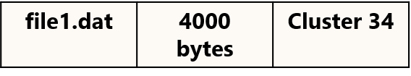
CLUSTER CHAIN
Directory Entry Structures
Clusters
FAT Struture
Cluster 34
Cluster 35

Slide 17
DATA AREA
The FAT works off logical data sector values. For the FAT12 system, while determining the logical sector number from the physical sector number, the following two factors need to be taken into account.
• From the organization of the disk, it is seen that the first 33 sectors are predefined. The actual data sector that holds user data does not exist in these first 33 sectors and starts at sector number 33 (remember we start with 0).
• The entries in positions 0 and 1 of the FAT are reserved. Therefore, it is entry 2 of the FAT that actually contains the description for physical sector number 33.
→Therefore, physical sector number = 33 + FAT entry number - 2

Slide 18
File System Manager
Open File
Read Boot Sector
Update List
Read Entry & Display
invalid
= 0
Check Option
1 ≤ option ≤ entries
0: Back to parent
> entries
Exit = ?
= 1
Create/Delete File
End

Slide 19
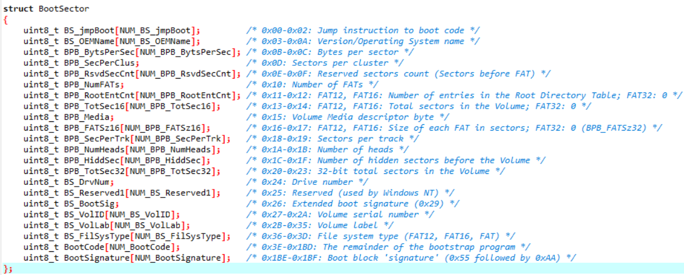
READ BOOT SECTOR

Slide 20
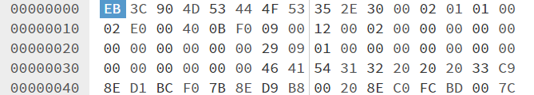
READ BOOT SECTOR
FAT12 allocates 12 bits per FAT entry
1 cluster = 1 sector
1 sector = 512 B
FAT = 9 sectors
This device has 2 880 sectors

Slide 21
SECTOR ASSIGNMENTS
Sector(s) | Address | Function
0 | 0x0000-0x01ff | Boot Sector
1-9 | 0x0200-0x13ff | File Allocation Table (primary)
10-18 | 0x1400-0x25ff | File Allocation Table (secondary)
19-32 | 0x2600-0x41ff | Root Directory
33-2879 | 0x4200-0x167fff | File storage space
NOTES:
Boot Sector is sector 0
There are two FATs, each 9 sectors
The Root Directory can contain 224 entries, each 32 bytes (14 sectors)
File storage starts at sector #33 (1+9+9+14), byte #0x4200

Slide 22
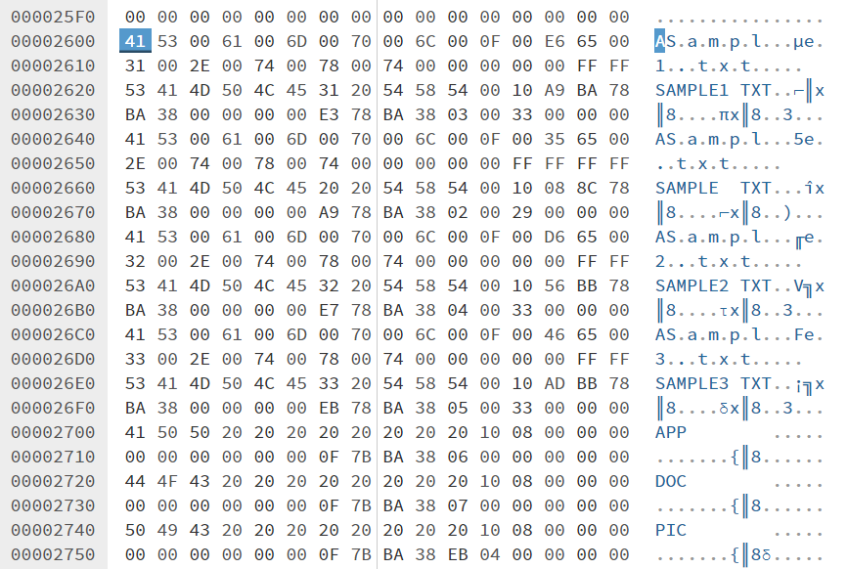
READ ROOT DIRECTORY

Slide 23
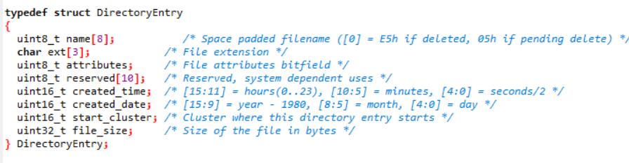
Address
Read_Entry
Entry
ptr
Entry
Check Entry
Entry
Entry
Entry
Save entries into Array
Ptr to Array & Entry num

Slide 24
FIND NEXT CLUSTER
nCluster
Read_FAT
Check nCluster
n is odd
n is even
Process
Process
Next Cluster
Next Cluster

Slide 25
FIND NEXT CLUSTER
Example:
The Primary FAT starts at Sector 1, byte 0x200.
Suppose a file has a starting cluster of 0x04EC (1260).
The file starts on the media at cluster #1260
The FAT entry pointing to the next cluster is in the FAT at byte (1260*1.5) = 1890(0x762)
Since the FAT starts at 0x200, the FAT entry for this file is at 0x962
1st cluster is 0x4EC(1260). FAT entry starts at high-order nibble of 0x962 = 0x4ED (1261)
2nd cluster is 0x4ED(1261). FAT entry starts at low-order nibble of 0x963 = 0xFFF(end of list)

Slide 26
DISPLAY LIST (ROOT & FOLDER)
Address
Read_Info from Array
Check First CLuster
Display data
Check Next Cluster
End

Slide 27
CREATE FILE
Calculate the number of entries to save the file name, N entries
Calculate the number of clusters to store file content, M clusters Determine the location to add (RDET or SDET)
Check if there is enough memory to store N entries?
FAT: check enough empty clusters to store files? nameList of clusters that store file content
Add N entries to the corresponding RDET/SDET
FAT: update the status of clusters that store volume contentbelieveDATA: writes file content to corresponding clusters

Slide 28
CREATE FOLDER
Calculate the number of entries to store in the folder name, N entries
Number of clusters to store SDET table, 1 cluster
Determine the location to add (RDET or SDET)
Check if there is enough memory to store N entries?
FAT: check enough empty clusters to store SDET? cluster. clustersave SDET
Add N entries to the corresponding RDET/SDET
Main entry attribute field: Turn on the Directory bit
FAT: update the status of clusters storing SDET (EOF)
DATA: write SDET table
Create 2 entries “.” and “..” in the first 2 entries in SDET

Slide 29
DELETE FILE
Based on RDET/SDET find file entries
- First sector + size
- Cancel these entries
FAT: find clusters containing file content
- Set the cluster status to FREE

Slide 30
REFERENCES
https://www.tavi.co.uk/phobos/fat.html
https://www.eit.lth.se/fileadmin/eit/courses/eitn50/Literature/fat12_description.pdf
https://en.wikipedia.org/wiki/Design_of_the_FAT_file_system

Slide 31
THANK FOR WATCHING!

