Slide 1
DATA ANALYST · DEMO TEACHING ROUND
SELECT skill
FROM analyst
JOIN mindset
ON curiosity;
SQL for Real Analysis:
Joins, CASE WHEN & Window Functions
A beginner-friendly, hands-on session: from first-principles intuition to
writing and interpreting real queries on one shared dataset.
Duration: 45–60 min | Tools: SQL · Sample Dataset

Slide 2
What Is SQL?
Structured Query Language — the standard way to store, retrieve, and manage data in a database
Why SQL?
-- Instead of scrolling millions of Excel rows...
SELECT * FROM Employee
WHERE Department = 'HR' AND Salary > 50000;
-- → answer in milliseconds
It's the standard language nearly every database (MySQL, Postgres, SQL Server…) understands.
You describe WHAT you want — the database figures out how to fetch it, fast.
5 Types of SQL Commands
Type
Full Name
Commands
Purpose
DDL
Data Definition Language
CREATE, ALTER, DROP, TRUNCATE
Build / change table structure
DML
Data Manipulation Language
INSERT, UPDATE, DELETE
Add / edit / remove data
DQL
Data Query Language
SELECT
Ask questions — read data (today's focus)
DCL
Data Control Language
GRANT, REVOKE
Control who can do what
TCL
Transaction Control Language
COMMIT, ROLLBACK
Save or undo a batch of changes
What Is SQL?
1

Slide 3
Session Roadmap
Same dataset throughout — so every new concept builds on one shared mental model
01
Meet the Dataset
employees + sales — the two tables we'll use for every demo
02
JOINS
Combining tables: INNER, LEFT, RIGHT, FULL
03
CASE WHEN + Aggregation
If/else logic that powers real business summaries
04
Window Functions
Ranking, LEAD/LAG, running totals — without collapsing rows
05
Recap & Key Takeaways
When to reach for each tool
SQL for Real Analysis
2

Slide 4
Meet the Dataset
One employees table + one sales table — used for every demo in this session
employees
sales
emp_id
INT (PK)
sale_id
INT (PK)
emp_name
VARCHAR
emp_id
INT (FK)
department
VARCHAR
region
VARCHAR
salary
NUMERIC
sale_amount
NUMERIC
join_date
DATE
sale_date
DATE
10 employees across Sales, Marketing, Engineering, HR
14 sale records. On purpose: 2 employees (HR) have no sales, and
one sale references an emp_id that doesn't exist — perfect for JOIN demos.
SQL for Real Analysis
3

Slide 5
SECTION A
A
JOINS
Combining two tables into one meaningful result

Slide 6
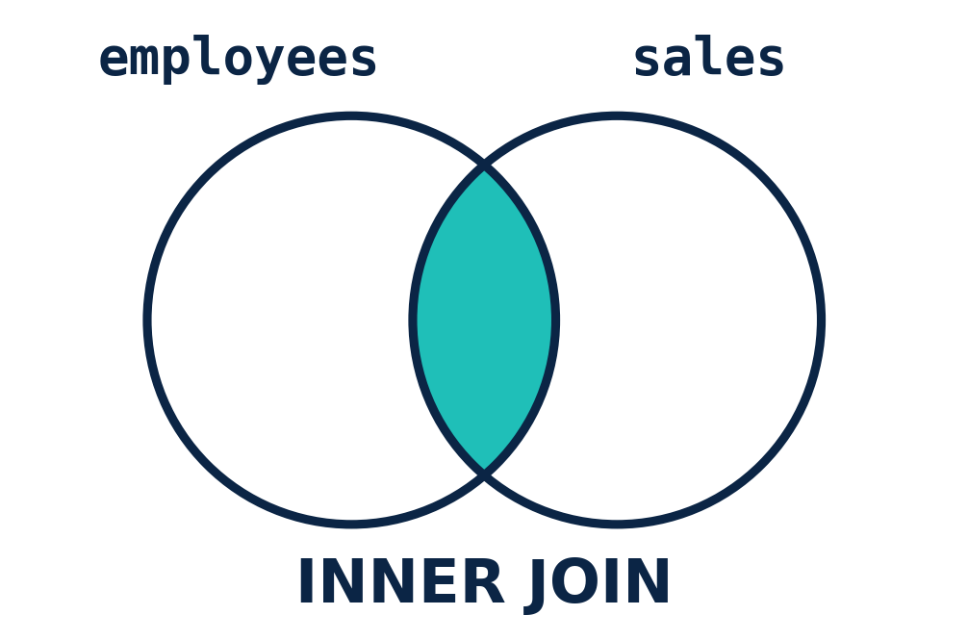
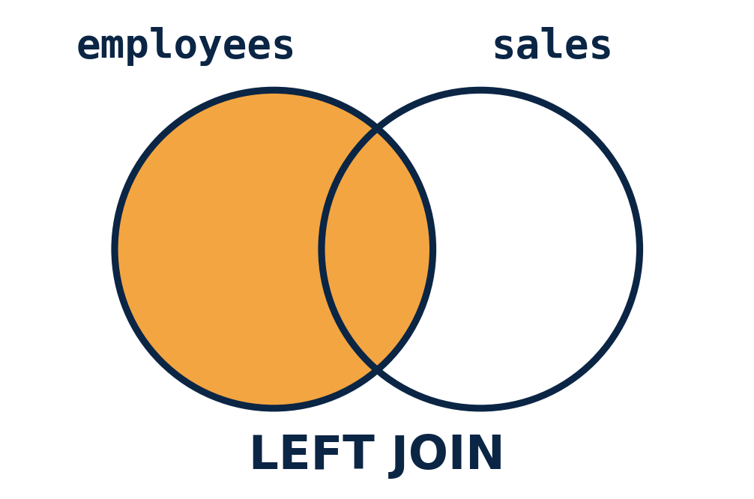
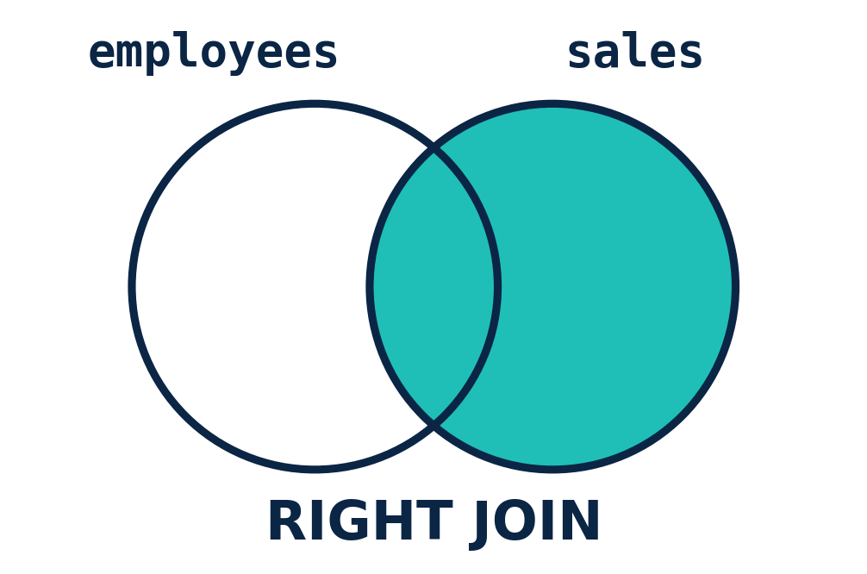
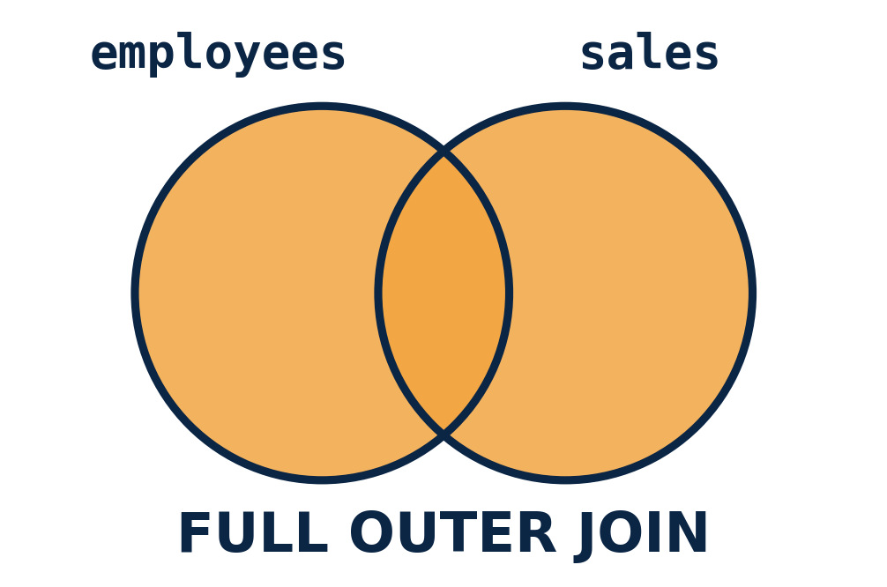
Why Do We Need JOINS?
Real-world data is normalized into separate tables — JOINS let you ask questions that span both
The problem, without JOINs
employees lives in one table, sales in another — that's normal, healthy database design (no duplicated data).
But a manager doesn't ask for tables — they ask a question that needs BOTH: “What did each employee sell?”
The benefit
JOINS stitch related tables together on a shared key (emp_id) — no data duplication, no manual copy-paste.
Different join types answer different real questions — that's the whole reason four types exist.
Use case: “Show me every employee AND their total sales, including staff who haven’t sold anything yet.”
Section A · Joins
4

Slide 7
Joins: The Intuition
A JOIN links rows from two tables using a shared key — here, emp_id
employees
sales
INNER JOIN
Only the overlap — rows that match in BOTH tables
LEFT JOIN
emp_id
match
Everything on the left + matches from the right (NULLs if no match)
RIGHT JOIN
Mirror of LEFT — everything on the right + left matches
FULL OUTER JOIN
Everything from both sides, matched or not
Section A · Joins
5

Slide 8
Join Syntax at a Glance
Same shape every time: pick the join type, then say what the keys must match on
SELECT e.emp_name, s.region, s.sale_amount
FROM employees e
<JOIN_TYPE> JOIN sales s ON e.emp_id = s.emp_id;
INNER JOIN
LEFT JOIN
RIGHT JOIN
FULL OUTER JOIN
Keep matches only
Keep all of employees
Keep all of sales
Keep everything, both sides
Section A · Joins
6

Slide 9
Live Demo: Finding Employees With No Sales
A classic real-world ask — solved with a LEFT JOIN + IS NULL filter
Result
SELECT e.emp_name, e.department
FROM employees e
LEFT JOIN sales s
ON e.emp_id = s.emp_id
WHERE s.sale_id IS NULL;
emp_name | department
Ishaan Gupta | HR
Meera Pillai | HR
How to interpret this:
LEFT JOIN keeps every employee row, filling in NULL for sales columns when there's no match.
Filtering WHERE s.sale_id IS NULL isolates exactly the rows that had no match — i.e., no sales.
Business takeaway: HR has two employees with zero recorded sales — worth flagging to a manager.
Section A · Joins
7

Slide 10
SECTION B
B
CASE WHEN + Aggregation
Turning if/else logic into business summaries

Slide 11
Why Do We Need CASE WHEN?
Raw numbers don't mean anything to a business user — CASE WHEN turns values into labels people act on
$102,000
→
CASE WHEN
salary >= 90000
→
“High Earner”
Raw value
If / else logic
Business label
The benefit
Result once aggregated — a summary you can act on:
Turns raw numbers into categories stakeholders instantly understand — no separate spreadsheet step.
Combined with aggregation, it becomes a summary a manager can act on in seconds.
Use case: customer tiers, risk flags, age brackets, salary bands — any time a number needs to become a decision.
Section B · CASE WHEN + Aggregation
8

Slide 12
CASE WHEN: The Intuition
It's just if / else logic — evaluated for every row, top to bottom, first match wins
Row-level result
CASE
WHEN salary >= 90000 THEN 'High'
WHEN salary >= 60000 THEN 'Medium'
ELSE 'Entry'
END AS salary_band
emp_name | salary | salary_band
Vikram Singh | 102000 | High
Neha Verma | 71000 | Medium
Kavya Iyer | 48000 | Entry
Why this matters for analysts:
Conditions are checked top-to-bottom — put the most specific condition first.
By itself, CASE WHEN labels each row. Its real power shows up once we aggregate by that label — next slide.
Section B · CASE WHEN + Aggregation
9

Slide 13
Live Demo: Conditional Aggregation
"Pivot-style" summary — count High/Mid/Entry earners side by side, per department
SELECT department,
COUNT(CASE WHEN salary >= 90000 THEN 1 END) AS high_earners,
COUNT(CASE WHEN salary >= 60000 AND salary < 90000 THEN 1 END) AS mid_earners,
COUNT(CASE WHEN salary < 60000 THEN 1 END) AS entry_earners,
ROUND(AVG(salary), 0) AS avg_salary
FROM employees
GROUP BY department;
department | high_earners | mid_earners | entry_earners | avg_salary
Engineering | 1 | 2 | 0 | 95,000
Marketing | 0 | 1 | 1 | 64,500
Sales | 0 | 1 | 2 | 55,000
HR | 0 | 0 | 2 | 50,500
Interpretation: Engineering skews High/Medium; HR and Sales lean Entry-level — a one-glance view a manager can act on.
Section B · CASE WHEN + Aggregation
10

Slide 14
SECTION C
C
Window Functions
Calculating across related rows — without collapsing them

Slide 15
Why Do We Need Window Functions?
Some questions need row-level detail AND group context at the same time — GROUP BY forces you to pick one
The problem, with only GROUP BY
Rank without losing rows (RANK)
GROUP BY can tell you the department average — but it erases every individual employee row to do it.
“Who is #1 in each department?” or “what's the running total over time?” simply can't be answered after rows collapse.
The benefit
Window functions calculate ACROSS a group of rows while keeping every row visible — ranking, comparisons, and running totals in one pass.
No self-joins, no subqueries just to compare a row to its neighbors or its peer group.
Track cumulative change (running total)
Use case: leaderboards, top-N per category, month-over-month change, running totals — all without collapsing the detail.
Section C · Window Functions
11

Slide 16
Window Functions: The Intuition
GROUP BY collapses rows into a summary. A window function keeps every row AND adds context.
GROUP BY department
AVG(salary) OVER (PARTITION BY department)
department | avg_salary
Engineering | 95,000
Sales | 55,000
emp_name | dept | salary | dept_avg
Vikram Singh | Eng | 102000 | 95,000
Arjun Rao | Eng | 95000 | 95,000
Priya Nair | Eng | 88000 | 95,000
Rows collapse — individual employees disappear.
Every employee row survives — now compare each person to their peer group.
Section C · Window Functions
12

Slide 17
Ranking Within Groups
RANK, DENSE_RANK, ROW_NUMBER — same idea, different tie-breaking rules
RANK() OVER (PARTITION BY department ORDER BY salary DESC) AS rnk,
DENSE_RANK() OVER (PARTITION BY department ORDER BY salary DESC) AS dense_rnk,
ROW_NUMBER() OVER (PARTITION BY department ORDER BY salary DESC) AS row_num
emp_name | department | salary | rnk | dense_rnk | row_num
Vikram Singh | Engineering | 102,000 | 1 | 1 | 1
Arjun Rao | Engineering | 95,000 | 2 | 2 | 2
Priya Nair | Engineering | 88,000 | 3 | 3 | 3
Rohan Mehta | Sales | 62,000 | 1 | 1 | 1
Aditi Sharma | Sales | 55,000 | 2 | 2 | 2
Tip when teaching live: temporarily set two salaries equal in your own dataset and re-run this query — RANK visibly skips a number right after the tie, while DENSE_RANK doesn't. That's the one distinction learners always ask about.
Section C · Window Functions
13

Slide 18
Live Demo: LEAD / LAG & Running Totals
Row-to-row comparisons and cumulative sums — no self-join required
SELECT emp_id, sale_date, sale_amount,
LAG(sale_amount) OVER (PARTITION BY emp_id ORDER BY sale_date) AS prev_sale,
SUM(sale_amount) OVER (PARTITION BY emp_id ORDER BY sale_date
ROWS BETWEEN UNBOUNDED PRECEDING AND CURRENT ROW) AS running_total
FROM sales;
emp_id | sale_date | sale_amount | prev_sale | running_total
1 | 2024-01-05 | 12,000 | NULL | 12,000
1 | 2024-02-10 | 15,000 | 12,000 | 27,000
1 | 2024-03-08 | 9,000 | 15,000 | 36,000
Interpretation:
prev_sale lets us see change month-over-month without a manual self-join.
running_total shows cumulative performance over time — the basis of a growth chart.
Section C · Window Functions
14

Slide 19
Recap: Which Tool, When?
Three tools, three distinct jobs — all queryable on the same dataset
JOINS
CASE WHEN + Agg.
Window Functions
Job:
Job:
Job:
Combine rows from 2+ tables
Add if/else business logic, then summarize
Compare rows without collapsing them
Ask it answers:
Ask it answers:
Ask it answers:
"Show me employee AND their sales together."
"How many High vs Entry earners per dept?"
"Who's #1 in each department? What's the running total?"
Recap
15

Slide 20
Thank You
Questions & Hands-On Practice
-- Try it yourself:
-- dql_demo.sql has the full runnable script
Thank You
16

