Slide 1


Slide 2

Day 8: Agenda
Introduction to SVM (Support Vector Machine)
The Concept of Margin and Support Vectors
Kernel Trick for Non-Linear Data
Introduction to K-Nearest Neighbors (KNN)
How KNN Makes Predictions Based on Nearest Neighbors
Distance Metrics: Euclidean, Manhattan, and Others
Choosing the Value of K
Hands-On Practical Example: Classification and Regression

Slide 3
SVM and KNN
Both Support Vector Machines (SVM) and K-Nearest Neighbors (KNN) are supervised learning algorithms.
SVM (Support Vector Machine):
SVM is a supervised learning algorithm that can be used for both classification and regression tasks. It works by finding the hyperplane that best separates data into different classes, based on labeled training data.
KNN (K-Nearest Neighbors):
KNN is also a supervised learning algorithm. It classifies new data points based on the majority class of their nearest neighbors in the labeled training set. The algorithm requires labeled data during training to make predictions.
In summary, both SVM and KNN fall under supervised learning because they require labeled data for training and prediction.
For further details on the definitions of supervised learning and the distinctions between various algorithms, you can refer to reputable sources like:

Slide 4
KNN vs Kmeans
K-Means Example (Clustering):
Imagine you have a set of points representing customer income and age. You want to group these customers into 3 segments.
K-Means will:
  Choose 3 random centroids (groups).
  Assign customers to the nearest centroid based on their income and age.
  Recalculate centroids based on the assigned customers and repeat until the clusters are stable.
KNN Example (Classification):
Imagine you have a dataset of flowers with labels (rose, daisy) and features (petal length, petal width).
When a new flower is introduced:
  KNN finds the nearest labeled flowers (e.g., the 3 closest flowers).
  It checks how many of the nearest neighbors are roses and how many are daisies.
  The flower is classified as the majority class (e.g., if 2 out of 3 nearest neighbors are roses, the new flower is classified as a rose).

Slide 5
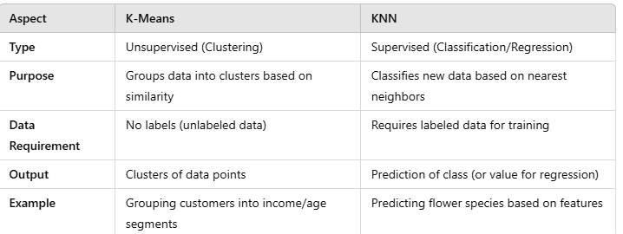
KNN vs Kmeans

Slide 6
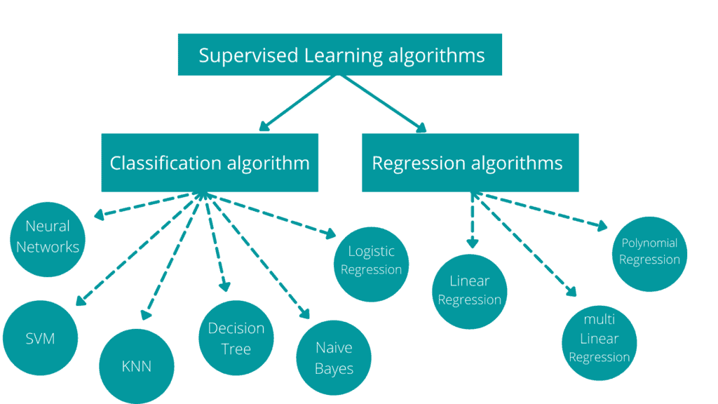
Support Vector Machine (SVM)

Slide 7
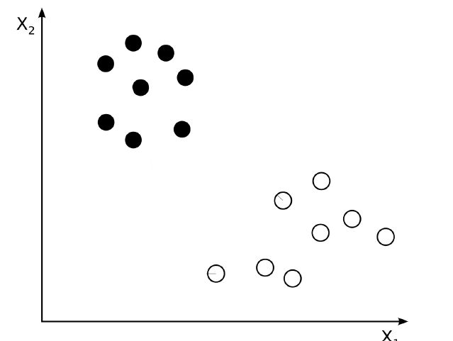
Support Vector Machine (SVM)
A Classification Problem
  Linearly separable
SVM is a supervised machine learning algorithm used for classification and regression tasks.
The goal is to find the best hyperplane that separates classes with the maximum margin.
It uses support vectors (critical data points) to define the decision boundary.
Works well for both linearly and non-linearly separable data with the help of kernels.

Slide 8
Support Vector Machine (SVM)
SVM is a machine learning algorithm used for classification and regression.
It aims to find an optimal hyperplane to separate data into distinct classes or make regression predictions.
It's effective in high-dimensional spaces, handles non-linearity through kernel functions, and is less prone to overfitting.
Classification:
SVM separates data effectively, even in high dimensions.
It's robust against overfitting.
The kernel trick allows it to handle non-linear data.
Regression:
SVM can be used for regression by minimizing ε-insensitive loss.
It's robust and can capture non-linear relationships using kernel functions.

Slide 9
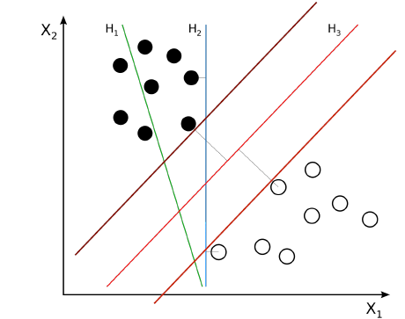
Separating Hyper-planes
There are many hyperplanes that might classify the data.
One reasonable choice as the best hyperplane is the one that represents
the largest separation, or margin, between the two classes. So, we choose
the hyperplane so that the distance from it to the nearest data point on each side is maximized.
If such a hyperplane exists, it is known as the maximum-margin hyperplane
A hyperplane is the decision boundary that separates classes.
The hyperplane's position is determined by support vectors (closest data points).
The goal is to maximize the distance (margin) between the hyperplane and the support vectors.

Slide 10
Separating Hyper-planes

Slide 11
Margin in SVM
Definition: The margin in Support Vector Machine (SVM) is the gap between the decision boundary (hyperplane) and the nearest data points from different classes.
Significance:
  A larger margin indicates a more confident and robust classification.
  It allows better generalization to unseen data.
Support Vectors:
  Support vectors are the data points closest to the decision boundary.
  They influence the position of the hyperplane and the margin.

Slide 12
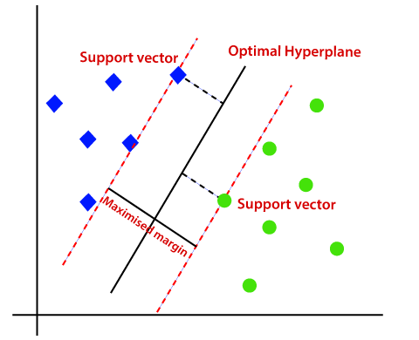
Margin in SVM
Margin: Distance between the decision boundary and the nearest points.
Support Vectors: Data points that define the boundary.
Goal: Maximize the margin for better classification

Slide 13
Margin in SVM
Imagine sorting mail into "spam" and "not spam" categories based on words' frequency. SVM draws a line (or hyperplane) to separate these two groups effectively.

Slide 14
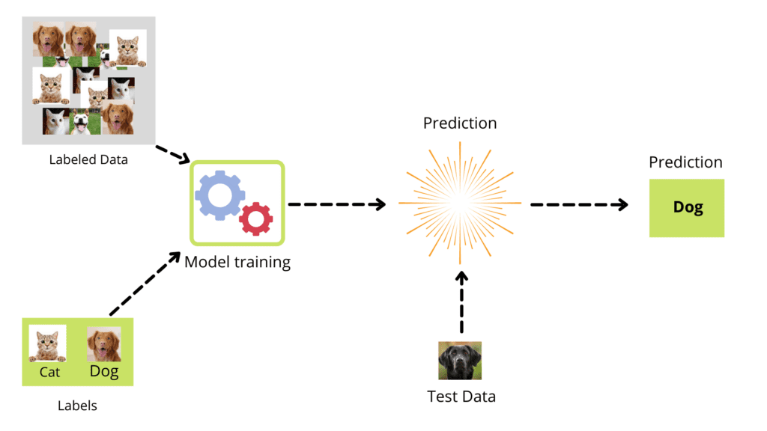
Support Vector Machine (SVM)

Slide 15
Hard Vs Soft Margin
If the data is linearly separable
  we can select two parallel hyperplanes that separate the two classes of data, so that the distance between them is as large as possible.
  The region bounded by these two hyperplanes is called the "margin", and
  the maximum-margin hyperplane is the hyperplane that lies halfway between them.
When data are NOT linearly separable
  Hinge loss function: adds a penalty for crossing over the margin
  Penalty is proportional to the distance from the margin
Hard Margin:
Assumes perfect separation of classes.
Works only for linearly separable data.
Sensitive to outliers.
Soft Margin:
Allows some misclassification.
Balances between maximizing the margin and minimizing misclassification.
Works for noisy and real-world data.

Slide 16
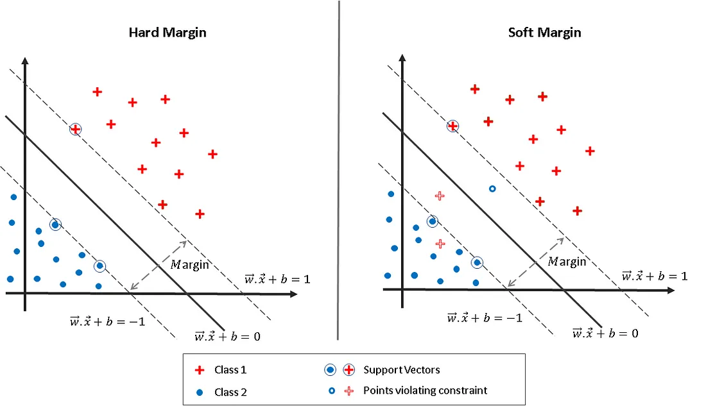
Hard Vs Soft Margin

Slide 17
Data That is Not Linearly Separable
Not all datasets can be separated by a straight line in the original space.SVM uses kernels to transform the data into a higher dimension, making it linearly separable. Kernels allow SVM to handle complex, curved boundaries.
Graph with Overlaps use Hinge loss.
Notes:
Note:- Use Jupyter file for this question - SVM classifier - Breast Cancer Dataset (In-built).ipynb

Slide 18
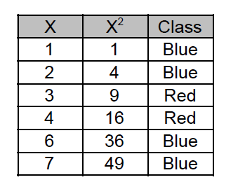
Kernel Trick
As it can be seen from the figure that initial data is not linearly separable. The given distribution is expressed as:
X Class
1 Blue
2 Blue
3 Red
4 Red
6 Blue
7 Blue
The given data is in 1 dimension but can be transformed into higher dimension using a kernel trick. Let
a new dimension be formed using squaring the variable x. We will get a two-dimensional distribution of
given data which is linearly separable and can be classified using a line.

Slide 19
Kernel Function
Kernel functions are mathematical functions used in SVM to transform input data into a higher-dimensional feature space.
Linear kernels simply compute the dot product between data points in the input space.
Polynomial kernels capture polynomial relationships, allowing SVM to model curved decision boundaries.
Radial basis function (RBF) kernels create flexible, non-linear decision boundaries, suitable for complex data distributions.
Kernels enable SVM to work effectively in high-dimensional spaces, simplifying classification by projecting data into spaces where classes are more separable.

Slide 20
Handling Non-Linear Data
Non-linear data refers to data with intricate, non-linear relationships between features and classes.
The kernel trick is a technique to address non-linearity, often used with SVM, transforming data into higher-dimensional spaces.
Linear classifiers, like SVM, struggle with non-linear data.
The kernel trick avoids the need to explicitly map data to higher dimensions, saving computational resources.
This technique enhances SVM's versatility by allowing it to establish non-linear decision boundaries for complex data distributions in classification tasks.

Slide 21
Hands-on: SVM Classified
Write a code for an ML model that incorporates an SVM classifier on the Breast Cancer dataset. Visualize the result using PCA.
Notes:
Note:- Use Jupyter file for this question - SVM classifier - Breast Cancer Dataset (In-built).ipynb

Slide 22
Kernel Trick
Data classification can be done linear and nonlinear functions as shown in the following figure. The first
figure is a rare case and most real-life situations we face a classification problem which is not linearly
separable.
As we know, a support vector machine uses hyper planes to separate data points in the space but with
nonlinear data SVM finds it difficult to generate hyperplanes. The solution of this problem is kernel trick.
Kernel function (Kernel trick) maps the original nonlinear separable data into the higher dimensions
which helps to find the suitable hyperplane which separates the data points. It can be also understood
as the function which maps a low dimensional space into higher dimensional space for making linear
separable data points.

Slide 23
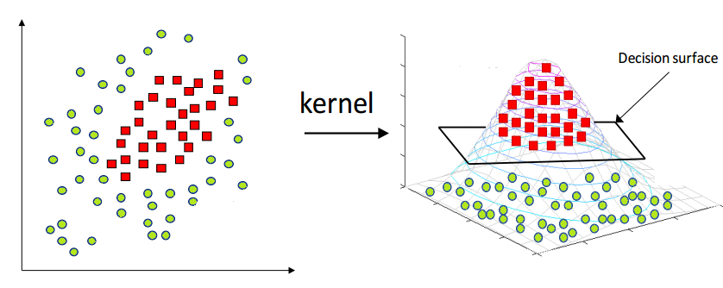
Kernel Trick

Slide 24
Kernel SVM
“A complex pattern-classification problem, cast in a high-dimensional space nonlinearly, is more likely to be linearly separable than in a lowdimensional space, provided that the space is not densely populated” -- T. Cover

Slide 25
Pros & Cons of SVM
Advantages of SVM
- SVM model works well with high dimensional data.
- SVM model equally works well with linear and nonlinear separable data.
- Training model is relatively simple and easy.
Disadvantages of SVM
- Selection of the right kernel and parameters can be computationally expensive.

Slide 26
K-Nearest Neighbors (KNN)
KNN is a simple algorithm that classifies data based on the K nearest points to a given data point. It doesn’t build a model; instead, it uses all the data to make predictions.
  Instance-based learning: No model training, predictions use existing data.
  Classifies based on the majority of K closest neighbors.
  Works for classification and regression.
Example: Imagine you're trying to decide if a fruit is an apple, or an orange based on its color and size. Look at the 3 closest fruits to the one you’re testing. If most of them are apples, you classify the fruit as an apple.

Slide 27
K-Nearest Neighbors (KNN)
K-Nearest Neighbors (KNN) is a versatile supervised learning algorithm for both classification and regression tasks. It operates based on the following principles:
Classification:
Assigns a data point to a class by considering the majority class among its k-nearest neighbors, where "k" is a user-defined parameter.
Assumes that similar data points in feature space belong to the same class.
KNN's simplicity makes it an excellent choice for certain classification problems.

Slide 28
K-Nearest Neighbors (KNN)
Regression:
Predicts a data point's value by averaging the target values of its k-nearest neighbors.
Suitable for making predictions involving continuous or numeric outcomes.
Like in classification, the choice of "k" significantly influences the model's predictive performance.
In both cases, selecting an appropriate "k" value and distance metric is crucial for achieving accurate results.

Slide 29
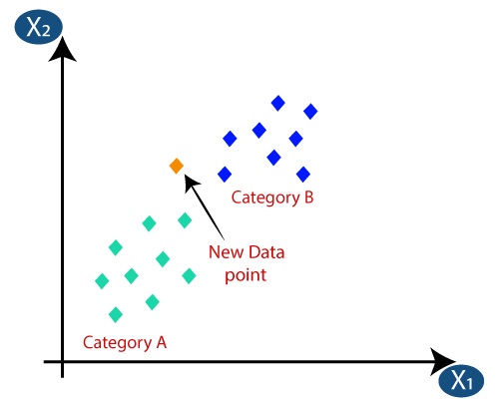
K-Nearest Neighbors (KNN)

Slide 30
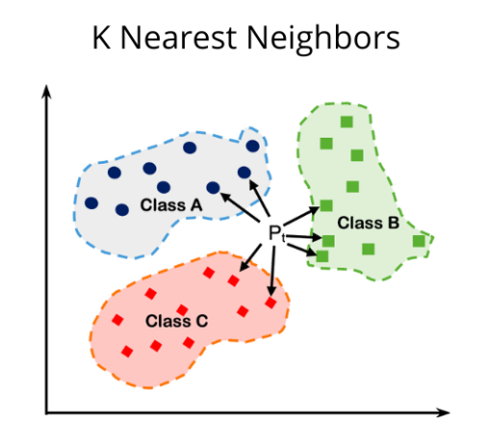
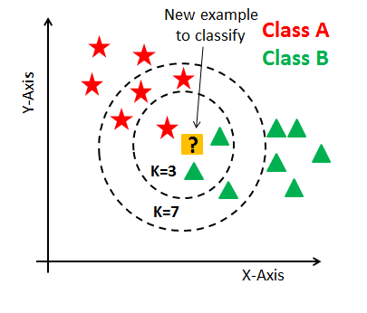
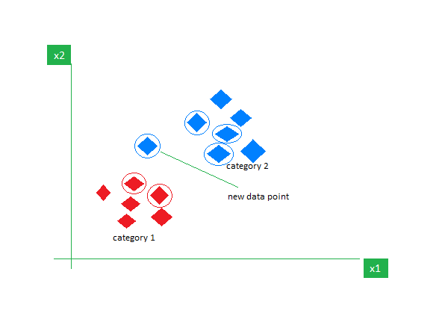
K-Nearest Neighbors (KNN)

Slide 31
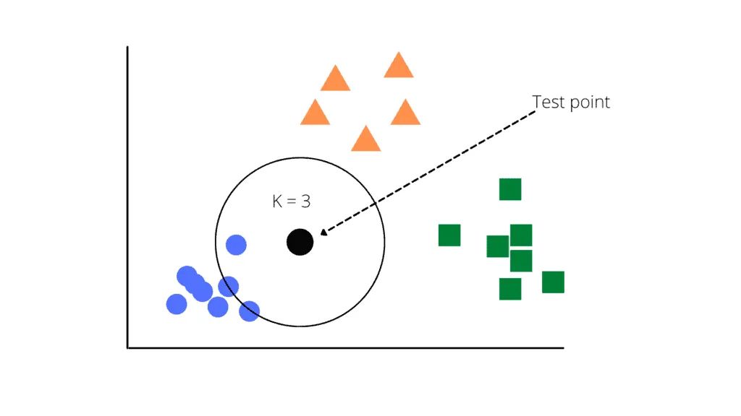
K-Nearest Neighbors (KNN)
Source

Slide 32
KNN Algorithm Steps
Select the Number of Neighbors (k): Choose the value of k, the number of nearest neighbors to consider.
Calculate Distances: Compute the distance between the data point to classify and all other data points.
Identify Nearest Neighbors: Choose the k data points with the shortest distances as the nearest neighbors.
Majority Voting (Classification): In classification, predict the class based on the majority class of the nearest neighbors.
Average (Regression): In regression, predict the target value by averaging the values of the nearest neighbors.

Slide 33
Role of Nearest Neighbors
Influence Predictions: Nearest neighbors impact a data point's prediction.
Local Insights: They reveal nearby data characteristics.
Weighted Voting: Proximity-based weighting may apply.
K Value Matters: Choice of k influences prediction sensitivity.

Slide 34
Distance Metrics
Measure Similarity: Quantify the dissimilarity between data points.
Euclidean Distance: Straight-line distance in space.
Manhattan Distance: Sum of absolute differences.
Minkowski Distance: Generalized metric based on parameter p.
Distance metrics gauge data similarity and are essential for clustering and classification algorithms.

Slide 35
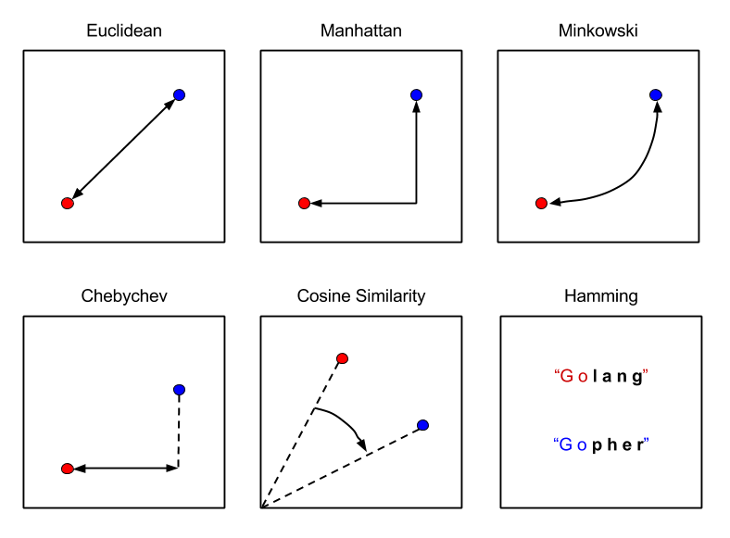
Distance Metrics

Slide 36
Selecting the Value of K
The number of nearest neighbors (K) is crucial.
Small K:
    Low bias, high variance.
    Prone to overfitting.
Large K:
    High bias, low variance.
    Smoother but may underfit.
Optimal K: Found through cross-validation.
Impact: K affects bias and variance.
Trade-offs: Balance is needed for a well-generalized model.

Slide 37
K-Nearest Neighbors (KNN)
Imagine you have a dataset of different flowers, each described by their petal length and width. You also have labels indicating whether each flower is a rose or a daisy. Now, you encounter a new flower and want to determine its type. This is where KNN comes into play. Now, In this flower example, KNN looks at the flower’s nearest neighbors to decide its type. Let’s say we set K = 3, meaning we’ll consider the three closest neighbors to make our prediction. To determine the type of the new flower using KNN, here’s what we’ll do:
Measure the distance: Calculate the distance between the new flower and all the flowers in the dataset. In our case, we can use the Euclidean distance, which is like measuring the straight-line distance between two points. The distance is computed based on the petal length and width.
Find the K nearest neighbors: Identify the K flowers with the shortest distances to the new flower. These are the K nearest neighbors. For instance, if K = 3, we select the three flowers that are closest to our new flower.
Majority voting: Among the K nearest neighbors, count how many are roses and how many are daisies. Whichever type has the majority becomes our prediction for the new flower. For example, if two neighbors are roses and one is a daisy, we predict that the new flower is a rose.

Slide 38
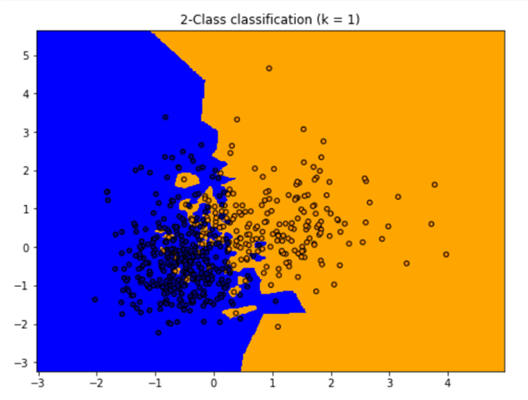
Overfitting and Underfitting in KNN
Definition of Overfitting:
Overfitting occurs when a model becomes overly complex and captures noise or irrelevant details from the training data, failing to generalize to unseen data.
KNN and Overfitting:
When 𝐾 is very small (e.g., 𝐾=1), the model focuses too closely on individual training samples.
This creates a complex decision boundary that memorizes training data, reducing accuracy on new data.
Example:
  With 𝐾=1K=1, the decision boundary becomes highly irregular, closely following the training points.
  This results in high accuracy for the training set but poor performance on test data.

Slide 39
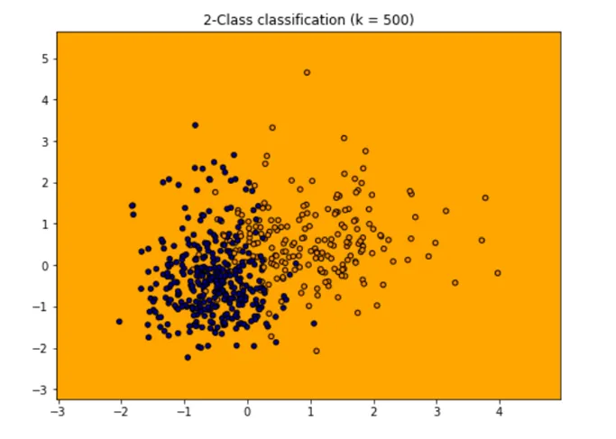
Challenges of KNN with Large Datasets
Definition of Underfitting:
  Underfitting happens when a model is too simple and fails to capture the underlying patterns in the data, leading to poor performance on both training and test sets.
KNN and Underfitting:
  When 𝐾K is set to a very large value (e.g., equal to the total number of training samples), the model becomes overly generalized.
  The decision boundary becomes too smooth, ignoring local variations and intricate patterns in the data.
Example:
  If 𝐾K is set to the total number of training samples, the model predicts the same class for all data points based on the majority class in the entire dataset.
  This results in poor classification accuracy as the model oversimplifies the data.
Notes:
Large dataset: KNN is a lazy learning technique because in training phase KNN doing nothing, so training is fast but on time of prediction it becomes slow as large dataset comes. Let’s take an example imagine you have a dataset in which 1 lakh rows and 500 columns, in this case on prediction time your model has calculate euclidean distance from 1 lakh points in 500 dimentional dataset, due to which lots of time consume and no one likes to take much more time during prediction.
Curse of Dimensionality: The curse of dimensionality refers to the phenomenon where the feature space becomes increasingly sparse as the number of dimensions (features) grows. In high-dimensional spaces, the notion of proximity or similarity becomes less meaningful. This can negatively impact the performance of KNN, as the algorithm relies on the assumption that similar instances are close to each other. In large datasets with high-dimensional feature spaces, the accuracy and effectiveness of KNN may decrease.
Irrelevant or Outlier Features: In large datasets, it’s common to encounter features that are irrelevant or noisy, meaning they do not contribute much to the underlying patterns or have inconsistent or misleading information. KNN considers all features equally in the distance calculation, which can lead to the inclusion of irrelevant or noisy features in the decision-making process. This can result in suboptimal predictions and decreased performance.
Imbalanced dataset: In an imbalanced dataset, the majority class typically has significantly more samples than the minority class. Since KNN relies on the nearest neighbors for classification, a large number of neighbors from the majority class can overpower the neighbors from the minority class. As a result, the majority class tends to dominate the decision-making process, leading to a bias towards the majority class in the predictions.

Slide 40
Challenges of KNN with Large Datasets
Large Datasets:
  KNN has fast training but slow predictions.
  Example: Predicting with a dataset of 1 lakh rows and 500 columns requires calculating distances for every point, consuming significant time.
Curse of Dimensionality:
  In high-dimensional spaces, features become sparse, making proximity less meaningful.
  This reduces KNN's accuracy and effectiveness in high-dimensional datasets.
Irrelevant or Outlier Features:
  KNN equally considers all features during distance calculations.
  Noisy or irrelevant features can mislead predictions and lower performance.
Imbalanced Datasets:
  KNN tends to favor majority classes in imbalanced datasets.
  Neighbors from the majority class dominate, causing bias in predictions.
Notes:
Large dataset: KNN is a lazy learning technique because in training phase KNN doing nothing, so training is fast but on time of prediction it becomes slow as large dataset comes. Let’s take an example imagine you have a dataset in which 1 lakh rows and 500 columns, in this case on prediction time your model has calculate euclidean distance from 1 lakh points in 500 dimentional dataset, due to which lots of time consume and no one likes to take much more time during prediction.
Curse of Dimensionality: The curse of dimensionality refers to the phenomenon where the feature space becomes increasingly sparse as the number of dimensions (features) grows. In high-dimensional spaces, the notion of proximity or similarity becomes less meaningful. This can negatively impact the performance of KNN, as the algorithm relies on the assumption that similar instances are close to each other. In large datasets with high-dimensional feature spaces, the accuracy and effectiveness of KNN may decrease.
Irrelevant or Outlier Features: In large datasets, it’s common to encounter features that are irrelevant or noisy, meaning they do not contribute much to the underlying patterns or have inconsistent or misleading information. KNN considers all features equally in the distance calculation, which can lead to the inclusion of irrelevant or noisy features in the decision-making process. This can result in suboptimal predictions and decreased performance.
Imbalanced dataset: In an imbalanced dataset, the majority class typically has significantly more samples than the minority class. Since KNN relies on the nearest neighbors for classification, a large number of neighbors from the majority class can overpower the neighbors from the minority class. As a result, the majority class tends to dominate the decision-making process, leading to a bias towards the majority class in the predictions.

Slide 41
KNN is called black box model
No Explicit Rules or Parameters:
  KNN doesn’t learn explicit rules or parameters from training data.
  Predictions are made based on the similarity to neighboring instances, making the model's inner workings harder to interpret.
No Feature Importance:
  KNN treats all features equally during distance calculations.
  It doesn’t provide insights into which features are more or less influential in predictions.
No Model Summary or Explanation:
  Unlike decision trees or linear regression, KNN lacks a concise summary or explanation of its behavior or reasoning process.
Notes:
https://medium.com/@sachinsoni600517/k-nearest-neighbours-introduction-to-machine-learning-algorithms-9dbc9d9fb3b2
Lack of Explicit Rules or Parameters: KNN does not learn explicit rules or parameters from the training data like other models such as decision trees or linear regression. Instead, it stores the training instances in memory and makes predictions based on the similarity to neighboring instances. This lack of explicit rules or parameters makes it difficult to understand the inner workings of the model.
No Feature Importance or Coefficients: KNN does not provide feature importance or coefficients that indicate the influence of each feature on the prediction. Since KNN considers all features equally in the distance calculation, it does not offer insights into which features contribute more or less to the final decision.
Lack of Model Summary or Explanation: KNN does not provide a concise summary or explanation of the model’s behavior. Unlike models such as decision trees or linear regression, which can be summarized by inspecting the learned rules or coefficients, KNN does not offer a straightforward way to summarize its behavior or reasoning.

Slide 42
Hands-on: KNN Classifier
Implement the K-Nearest Neighbors (KNN) algorithm for classification using the Iris dataset, along with visualizing and interpreting the results. Choose the value of K.
Notes:
Note:- Use Jupyter file for this question - KNN Classifier - Iris Dataset.ipynb

Slide 43
Hands-on: ML Classification model
Take any dataset iris/ Titanic, Implement all Classification models and choose the best suit model
Start from Logistic, Decision tree, RF, Boostings, SVM and KNN
Notes:
Note:- Use Jupyter file for this question - KNN Classifier - Iris Dataset.ipynb

Slide 44
Questions ?

Slide 45
Thank You !

