Slide 1
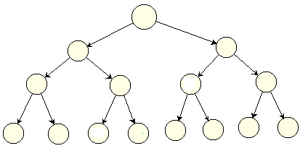
Trees-Part 3 Balanced BST & Heaps

Slide 2
Learning outcomes of this part
LO4.8: Define balanced BST and explain simple balancing algorithm
LO4.9: Define AVL Tree and explain by examples the insertion and deletion operations in it.
LO4.10: Define heap and explain its’ application.

Slide 3
Introduction
BST advantages:
Adding, searching, removing operations have complexity of O(tree’s height). It is less than O(number of items).
Data in the tree are always in-order.
BST disadvantages
Tree’s height depends mainly on order of data added. It means that the BST’s height can not be predicted.
If a BST is degraded, almost of data are at one direction, operations on it have complexity of O(number of nodes)
Perhaps, we like a complete BST in which its height is low. How can we make it?

Slide 4
Contents
1- Introduction to balanced binary search tree
2- Create a balanced BST
3- The DSW algorithm demonstration. ⬅ Assignment
4- Self-balanced BST/AVL Trees
5- Heaps and their uses.
Your work: Implement the demo. in these slides.

Slide 5
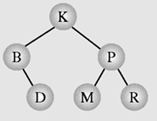
1- Introduction to Balanced BSTs
Definitions:
Perfect Binary Tree is a BT in which all non-terminal nodes have both their children, and all leaves are at the same level → Shortest tree, all path lengths from the root to leaves are the same. ← Ideal case
A binary tree is height-balanced or balanced if the difference in height of both sub-trees of any node in the tree is either zero or one.

Slide 6
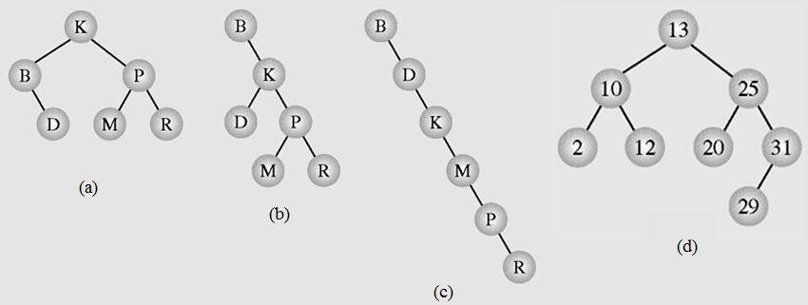
1- Introduction to Balanced BSTs…
Given following BSTs, which of them are not balanced?

Slide 7
1- Introduction to Balanced BSTs…
Characteristics of a balanced BST
Advantages:
Its height is small → Search operation is faster and predictable.
In the worst case, the complexity of the search operation in a tree is O(height).
Disadvantages
Cost of balancing the tree: memory, time

Slide 8
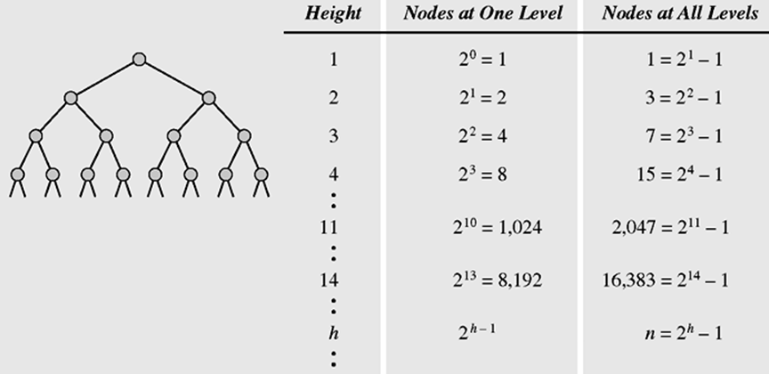
1- Introduction to Balanced BSTs…
Characteristics of a balanced BST
Perfect BST is balanced.
Properties of Perfect BSTs

Slide 9
2- Create a Balanced BST
Two cases:
1- The BST is empty, input is an array:
➔ Order of values in the array which will be added must be considered appropriately.
2- The BST is given but it is not balanced
➔ A balancing algorithm must be implemented.

Slide 10
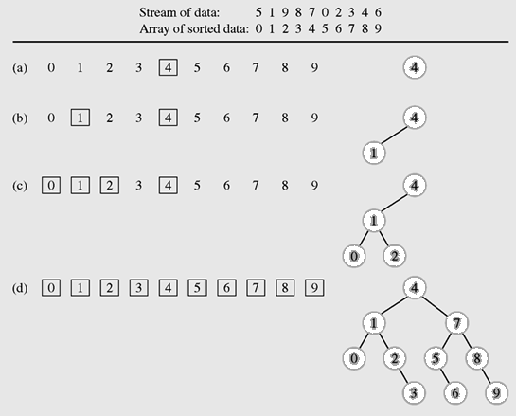
2- Create a Balanced BST…
Create a balanced BST from an array
Sort array → O(n²) if basic sorting is used.
(2) Loop adding the middle element of each group to the tree
O(n* O(height))
O(nlog₂(n))
Summary:
O(n²) Adding principle

Slide 11

2- Create a Balanced BST…
Create a balanced BST from an array
Recursive Algorithm: Add the middle from position i to j of the ordered array a[] to the tree.
void addMid (int i, int j, int a[]){
if (i<=j){
int mid= (i+j)/2;
tree.add (a[mid]);
addMid (i, mid-1, a);
addMid (mid+1, j, a);
}
}
void add (int a[], int n){
addMid (0, n-1, a);
}
}

Slide 12
2- Create a Balanced BST…
Balance a BST: DSW Algorithm
Basic simple Algorithm
Step 1: Traverse the tree for copying nodes’ data to an array → O(n) → Extra memory block is needed (memory x 2)
Step 2: Clearing the given tree → System-level cost
Step 3: Sorting the array ➔O(n²) or O(nlogn).
Step 4: Create a new balanced BST using introduced basic simple algorithm
→ O(n²) or O(nlogn).

Slide 13
2- Create a Balanced BST…
Balance a BST: The DSW Algorithm
Colin Day, Quentin F. Stout, Bette L.Warren introduced this algorithm which will transform a BST to balanced BST based on rotations with NO EXTRA MEMORY BLOCK
There are two types of rotation, left and right, which are symmetrical to one another
Step 1: Creating a backbone using right rotations to transform a BST to right-degraded BST → O(n)
Step 2: Creating balanced tree using left rotations to transform it to balanced BST → O(n)
Summary: Complexity of O(n)

Slide 14
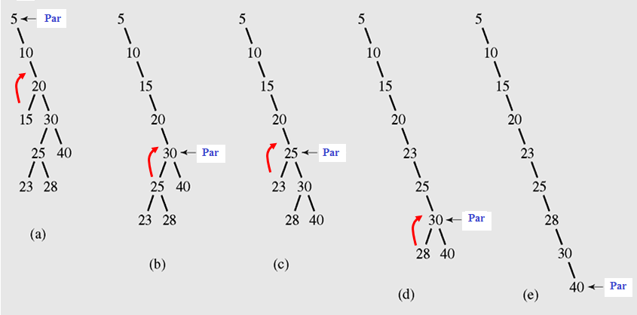
2- Create a Balanced BST…
Balance a BST: The DSW Algorithm
Step 1: Creating a backbone using right rotations
From the root, right rotating all left children to make the backbone (full right-degraded BST) → O(n)
Father node is the center of rotation

Slide 15
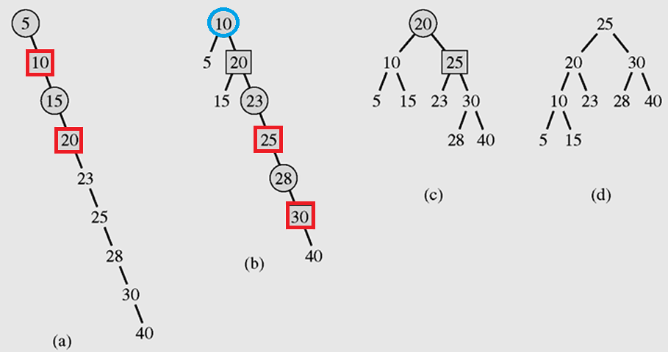
2- Create a Balanced BST…
Balance a BST: The DSW Algorithm
Step 2: Creating balanced BST using left rotations: O(n)
Perfect Balanced BST (height=3)having 7 nodes. The above tree has 2 extra nodes. Extra nodes are put to the left sub-tree.
Right child node is the center of rotation

Slide 16
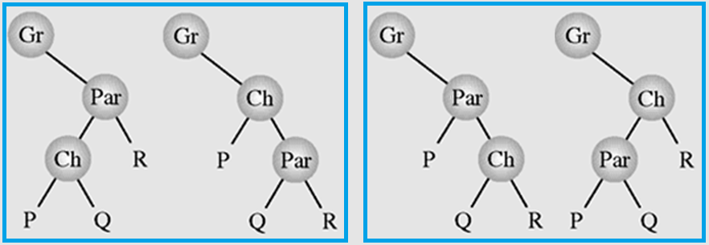
2- Create a Balanced BST…
The DSW Algorithm – Right/ Left Rotations
rotateRight (Gr, Par, Ch)
if Par is not the root of the tree // i.e., if Gr is not null
grandparent Gr of child Ch becomes Ch’s parent;
right subtree of Ch becomes left subtree of Ch’s parent Par;
node Ch acquires Par as its right child;
Update references
Right rotation
Left rotation

Slide 17
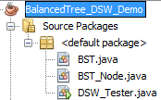
3- DSW Algorithm: Lab2- Demo.
BST_Node class: Class for a node in a BST. Data in a node must be Comparable
BST class: Class for a BST of comparable data in which the DSW algorithm is implemented.
DSW_Tester: Class for testing the DSW algorithm.

Slide 18
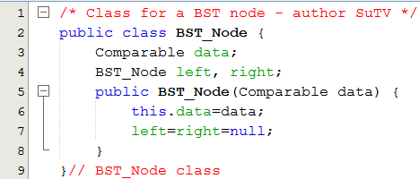
3- DSW Algorithm Demo.
BST_Node class

Slide 19
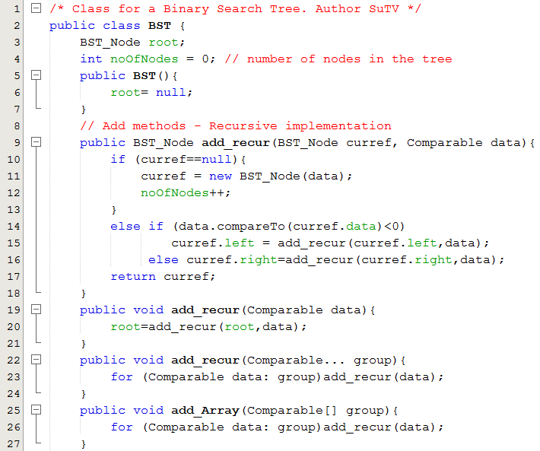
3- DSW Algorithm Demo.
BST class

Slide 20
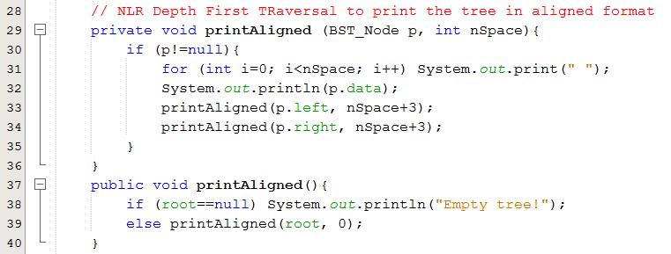

3- DSW Algorithm Demo.
BST class

Slide 21
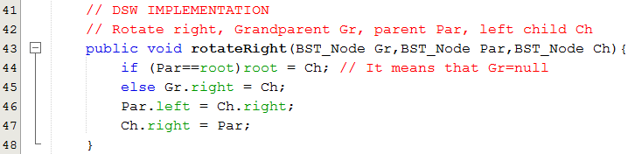
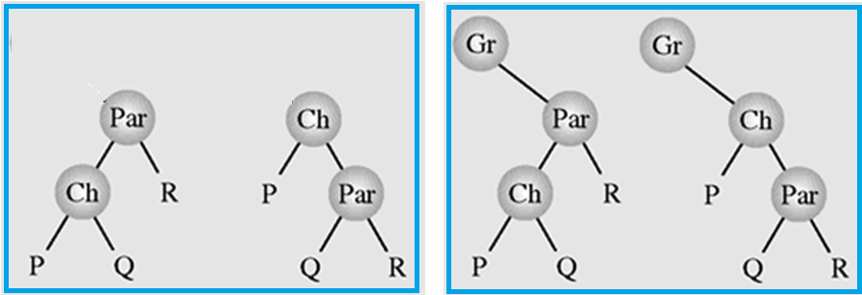
3- DSW Algorithm Demo.
BST class

Slide 22
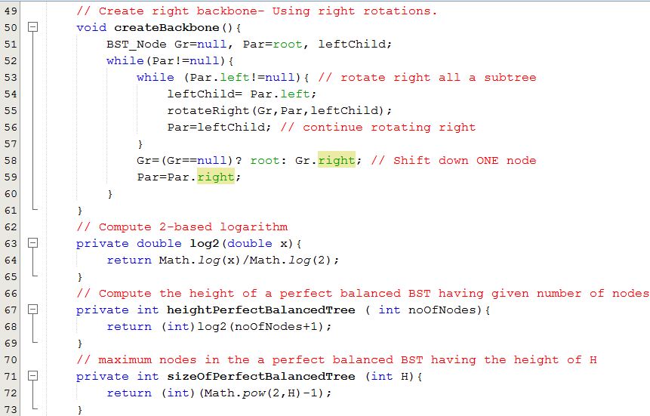
3- DSW Algorithm Demo.
BST class

Slide 23
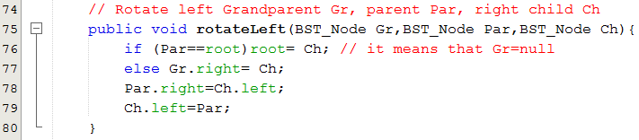
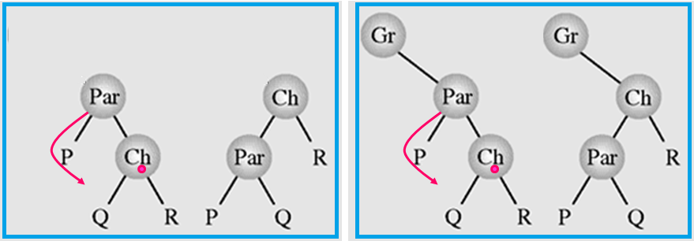
3- DSW Algorithm Demo.
BST class

Slide 24
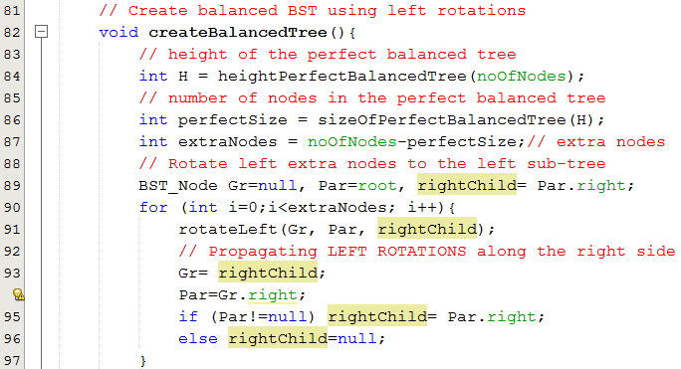
3- DSW Algorithm Demo.
BST class

Slide 25
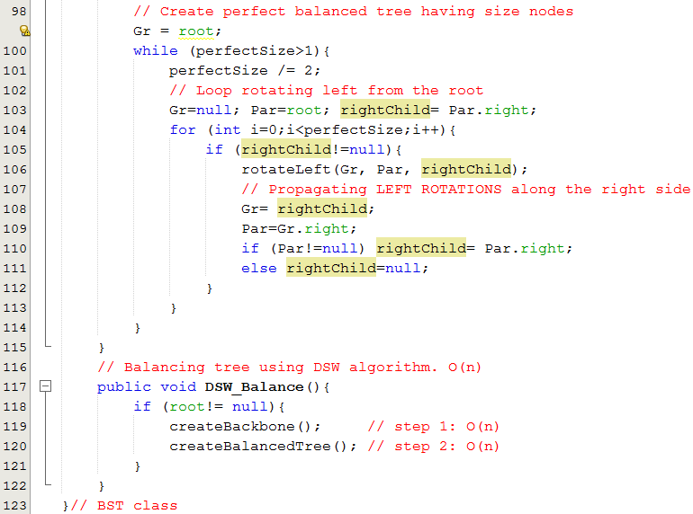
3- DSW Algorithm Demo.
BST class

Slide 26
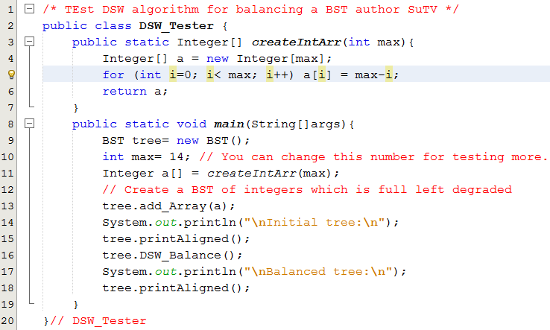
3- DSW Algorithm Demo...
DSW_Tester class

Slide 27
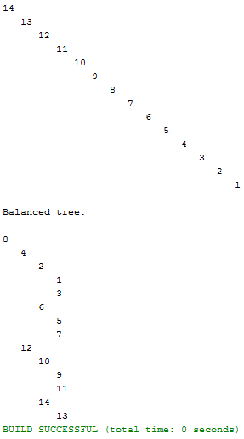
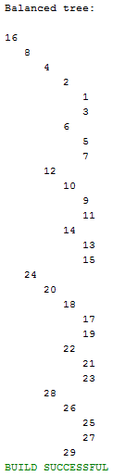
3- DSW Algorithm Demo...
DSW_Tester class
Result with max =14
Result with max =29

Slide 28
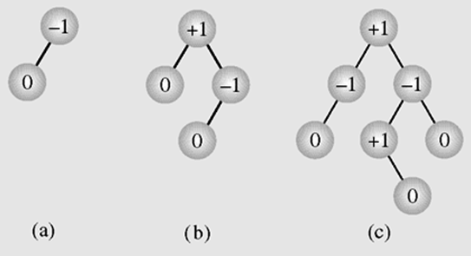
4- Self-Balanced BSTs/ AVL Trees
Two Soviet inventors, Georgy Adelson-Velsky and Evgenii Landis introduced a self-balancing BST in 1962.
An AVL tree is one in which the height of the left and right subtrees of every node differ by at most one. ➔ A balance state is the height of the right subtree minus the height of the left subtree → Memory cost

Slide 29
4- Self-Balanced BSTs/ AVL Trees…
Node
AVL Node structure
data
state
left
right
Check state of each node in these trees
State = Height of the right subtree - the height of the left subtree.
Add/remove operations may cause the tree un-balanced (State of some nodes may change). In this case, the tree needs re-balance using rotations.

Slide 30
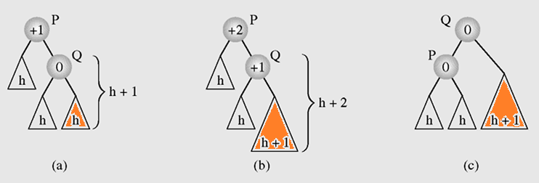
4- Self-Balanced BSTs/ AVL Trees…
Rebalancing after an add: Using a single rotation
Add x
Balancing a tree after insertion of a node in the right subtree of node Q

Slide 31
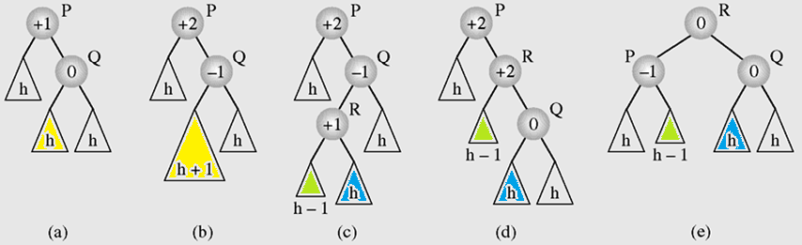
4- Self-Balanced BSTs/ AVL Trees…
Rebalancing after an add: Using double rotation
Balancing a tree after insertion of a node in the left subtree of node Q
Try use a single rotation for checking whether the tree is balanced or not?

Slide 32
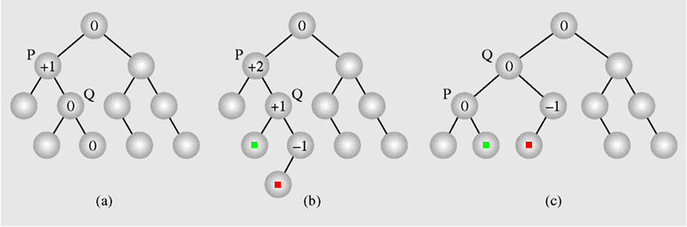
4- Self-Balanced BSTs/ AVL Trees…
Rebalancing after an add: Using a single rotation
An example of inserting a new node (b) in an AVL tree (a), which requires one rotation (c) to restore the height balance

Slide 33
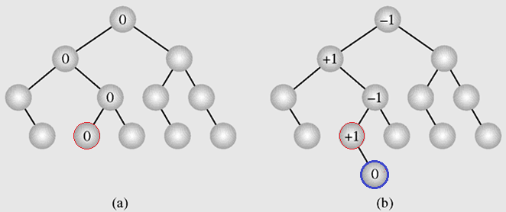
4- Self-Balanced BSTs/ AVL Trees…
Rebalancing: Rotations are required only when the tree is un-balanced
In an AVL tree (a) a new node is inserted
(b) requiring no height adjustments

Slide 34
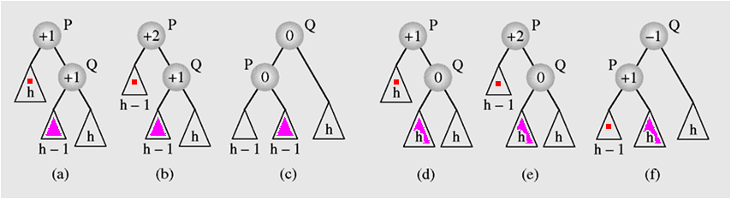
4- Self-Balanced BSTs/ AVL Trees…
Rebalancing after a deletion: Using a single rotation
Rebalancing an AVL tree after deleting a node

Slide 35
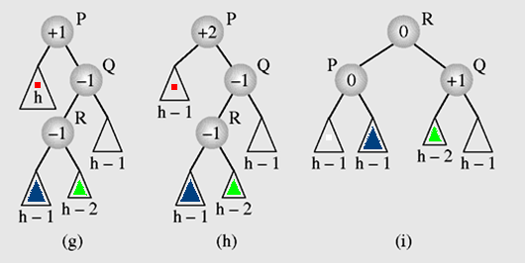
4- Self-Balanced BSTs/ AVL Trees…
Rebalancing after a deletion: Using a double rotation
Try use a single rotation for checking whether the tree is balanced or not?
Rebalancing an AVL tree after deleting a node

Slide 36
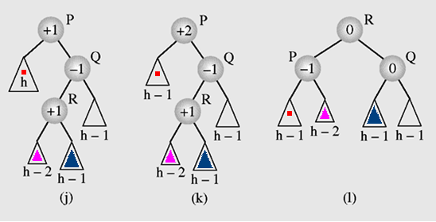
4- Self-Balanced BSTs/ AVL Trees…
Rebalancing after a deletion: Using a double rotation
Rebalancing an AVL tree after deleting a node

Slide 37
5- Heaps and Their Uses
Definitions
Heap is a collection whose items are layered.
Heap is a described as a special binary tree. Based on comparison values on father node and child node, heaps are divided into two types: Max heap and min heap.
Properties of a max heap:
The value of each node is greater than or equal to the values stored in each of its children
The tree is perfectly balanced, and the leaves in the last level are all in the leftmost positions
If “greater” in the first property is replaced with “less,” then the definition specifies a min heap

Slide 38
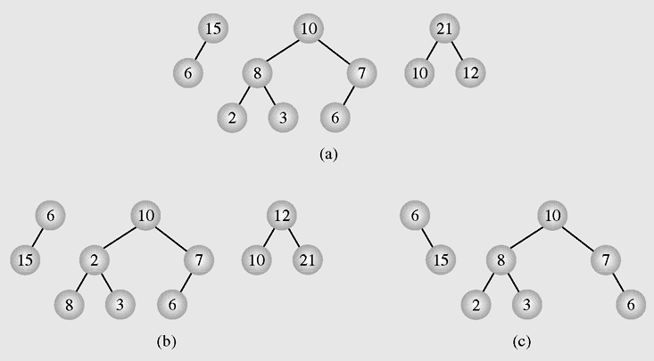
5- Heaps and Their Uses…
Some examples using view of max heaps
Violation:
6 should be left child of 7
Examples of (a) heaps and (b–c) non-heaps

Slide 39
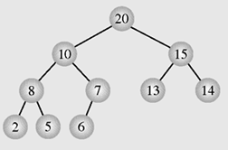
5- Heaps and Their Uses…
Heap in memory: A array-based binary tree.
Index | 0 | 1 | 2 | 3 | 4 | 5 | 6 | 7 | 8 | 9
Value | 20 | 10 | 15 | 8 | 7 | 13 | 14 | 2 | 5 | 6
- Item the index 0 is the tree’s root.
- Values are put to the tree based on layer in left-to-right direction
Values in the array are NOT in total order (thứ tự toàn phần ).
Values in a path are in partial order (thứ tự bộ phận/ riêng phần)

Slide 40
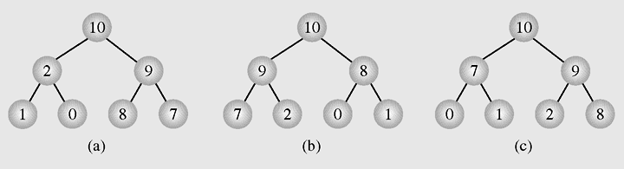
Heaps: Some heaps for a collection
We have some different max heaps with the same elements
Different heaps constructed with the same elements
[10 2 9 1 0 8 7], [10 9 8 7 2 0 1], [10 7 9 0 1 2 8]

Slide 41
5- Heaps and Their Uses…
Relations: Father index → Child index
Index | 0 | 1 | 2 | 3 | 4 | 5 | 6 | 7 | 8 | 9
Value | 20 | 10 | 15 | 8 | 7 | 1 | 14 | 2 | 5 | 6
Value | Father | Left | Right
20 | 0 | 1 | 2
10 | 1 | 3 | 4
15 | 2 | 5 | 6
8 | 3 | 7 | 8
7 | 4 | 9 | X
13 | 5 | x | X
14 | 6 | x | X
2 | 7 | x | X
5 | 8 | x | X
6 | 9 | x | x
Left = 2.Father +1
Right= 2.Father+2

Slide 42
5- Heaps and Their Uses…
Relations: Child index → Father index
(Left-1)/2 | Left | Father | Right | (Right-1)/2
(1-1)/2=0 | 1 | 0 | 2 | (2-1)/2=0
(3-1)/2=1 | 3 | 1 | 4 | (4-1)/2=1
(5-1)/2=2 | 5 | 2 | 6 | (6-1)/2=2
(7-1)/2=3 | 7 | 3 | 8 | (8-1)/2=3
(9-1)/2=4 | 9 | 4 | x
 | x | 5
 | x | 6
 | x | 7
 | x | 8
 | x | 9
Child index -1
Father index =
2

Slide 43
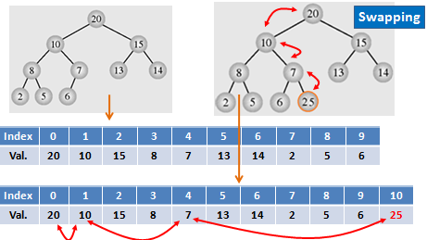
5- Heaps and Their Uses…
Restoring a heap after inserting new item with minimum swaps because it is a balanced tree.

Slide 44
5- Heaps and Their Uses…
1- A heap can be used as a priority queue
- With respect to max heap, the maximum value must be at the beginning of the queue where an item can be de-queued.
- When a new item is en-queued, add operation will destroy max heap property. A bottom-up transformation must be carried out to preserve this property.

Slide 45
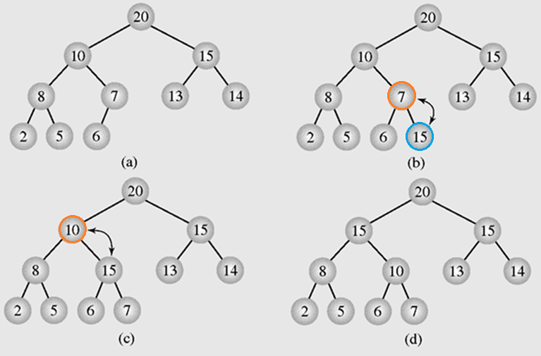
5- Heaps and Their Uses…
Heaps as Priority Queues: Enqueuing new element
Enqueuing an element, value 15, to a heap

Slide 46
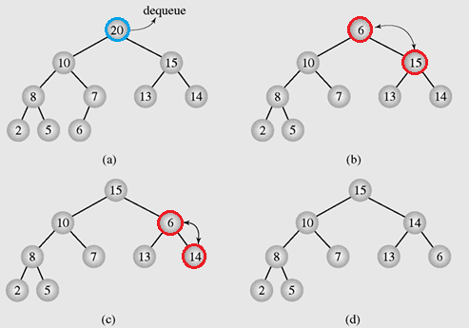
5- Heaps and Their Uses…
Heaps as Priority Queues: Dequeuing an element
Dequeuing an element from a heap

Slide 47
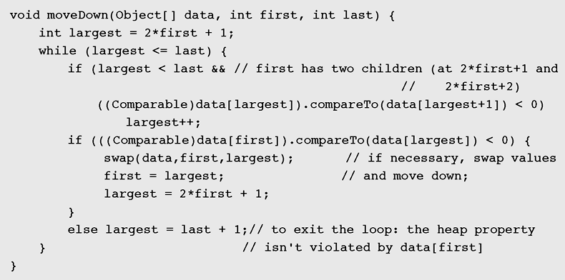
5- Heaps and Their Uses…
Implementation of an algorithm to move the root element (the index first, down a tree when it cause a violation of max heap
Left = 2Father +1; Right = 2Father + 2

Slide 48
5- Heaps and Their Uses…
2- It can be used as a tool for sorting
→ Heap sort.
Algorithm:
for (i= n-1 ; i>0; i--) {
tranform a[0] … a[i] to max heap;
swap a[0], a[i] → move the max value to the end of the group
}

Slide 49
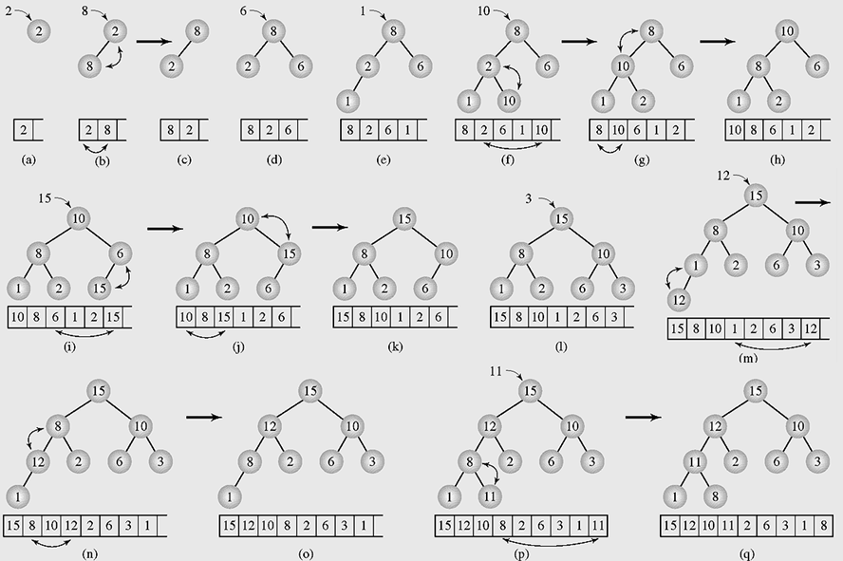
5- Heaps and Their Uses…
Organizing Arrays as Heaps with a top-down method

Slide 50
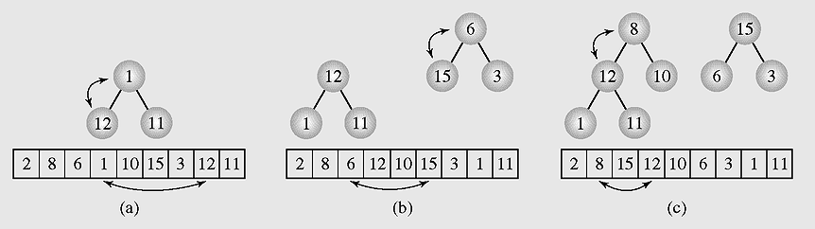
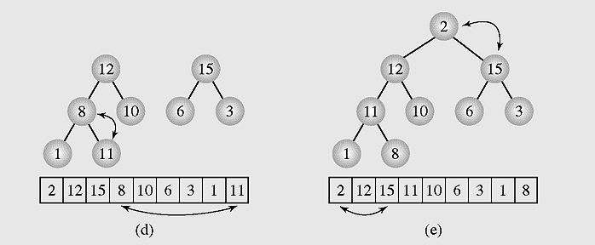
5- Heaps and Their Uses…
Transforming the array into a heap with a bottom-up method

Slide 51
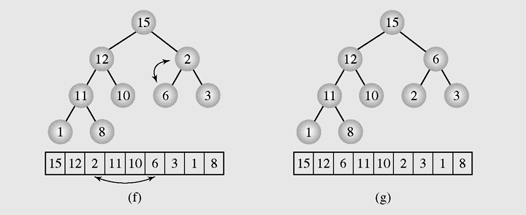
5- Heaps and Their Uses…
Transforming the array into a heap with a bottom-up method

Slide 52
Summary

LO4.8: Define balanced BST and explain simple balancing algorithm
LO4.9: Define AVL Tree and explain by examples the insertion and deletion operations in it.
LO4.10: Define heap and explain its’ application.



Slide 53
Summary- Viết vào vở
What is a complete binary tree?
What is a height-based balanced tree?
What are advantages of balanced tree?
What are disadvantages of balanced tree?
How to create a balanced BST from an array?
What is the main idea of the DSW algorithm when it is applied to balance a BST?
What is a self-balanced BST?
What is the cost of self-balanced tree?
What is a max heap?
What are applications of heaps?
Cây cân bằng hoàn toàn có 15 nút. Hỏi chiều cao của cây này?
Cây cân bằng hoàn toàn có 1023 nút. Hỏi chiều cao của cây này?
Cây cân bằng hoàn toàn có 511 nút. Hỏi chiều cao của cây này?
Cây cân bằng hoàn toàn có 611 nút. Hỏi chiều cao của cây này?

