Slide 1
🛡
Guardrail Comparison
Regex Filter vs. Base LLM vs. Fine-tuned Guard LLM
Data Science & Cybersecurity
Fuciuc Filip-Luca | Lungu Laura-Vanesa

Slide 2
The problem
Jailbreaking. Crafted prompts trick an LLM into producing harmful content, bypassing its safety training.
Guardrail. An external filter that inspects the model's response and blocks it if unsafe - the last line of defense after alignment has already failed.
Key consequence. Our guardrails work at response level: they never see the attacker's prompt, only the text the model produced.
1
Speed vs. intelligence
Regex runs in microseconds, an LLM in ~70 ms.
Is the intelligence worth the cost?
2
Does the intelligence generalise?
We test every defense in-distribution AND
out-of-distribution. A guard that only works on its own data will fail on the next attack style.
This project answers two questions
Defense A Regex filter
Fast, lexical
Defense B Base Qwen 0.5B
Baseline, untrained
Defense C Fine-tuned Qwen 0.5B
our guard LLM
Notes:
LLMs can be tricked into producing harmful content through carefully crafted prompts, and since the model's own safety training isn't reliable, you need a second layer — a guardrail that inspects the output and blocks it if it's unsafe. The key point for our whole design is that our guardrails work at response level: they never see the attacker's prompt, only the text the model produced, because SecureBreak is a response-level dataset. From here we answer two questions — first, speed versus intelligence, meaning is an LLM worth 70 milliseconds when regex takes microseconds, and second, whether that intelligence actually generalises to data it has never seen. To test this we built three defenses: a regex filter, the base Qwen with no training, and the same Qwen fine-tuned on SecureBreak.

Slide 3
Project pipeline
Three labelled test sets → scored by three defenses → split into in-distribution vs out-of-distribution
1a - hand-crafted attacks test set
12 - manually created by us
1b - SecureBreak attacks test set
459 - held-out 15%
1c - BeaverTails attacks test set
1000 – independent dataset with LLM responses
in-distribution
in-distribution
out-of-distribution
every response scored by all three defenses → safe / unsafe
Defense A - Regex Filter
A1 hand | A2 LDNOOBW |A3 garak
Defense B - Base Qwen
0.5B | no fine-tuning
Defense C - Guard LLM
Qwen 0.5B + LoRA on 1b's 70% dataset train split
In-distribution result (1a + 1b)
did the guard learn the task?
Out-of-distribution result (1c)
…or did it just memorise SecureBreak?
Notes:
This is the whole project on one slide. Across the top are our three test sets, and all of them contain the same thing — LLM responses with a human safe/unsafe label, which is exactly what a guardrail consumes. The first two are in-distribution, coming from the same harm categories Defense C trains on, while the third one, BeaverTails, is out-of-distribution: a completely different dataset. Every response then goes through all three defenses, using the same data and the same scoring code, so the comparison is fair. And the bottom row is really the point of the whole design: the in-distribution result tells us whether the guard learned the task, while the out-of-distribution result tells us whether it just memorised SecureBreak — and you need both to tell those apart.

Slide 4
The three attack sets
A guardrail classifies responses, not prompts - so we need labelled LLM responses to test our defenses on different types of attacks
1a
in-distribution
1b
in-distribution
1c
out-of-distribution
Hand-crafted
SecureBreak test split
BeaverTails
12 responses
459 responses
1000 responses
What it is
12 disguised prompts across 10 harm categories, fed to Qwen-1.5B, labelled by hand.
Why it matters
A readable case study - lets us clearly see why a keyword filter misses disguised harm.
What it is
Held-out 15% of SecureBreak dataset
human-labelled, never seen during training of Defense C.
Why it matters
The main statistical test: did the guard actually learn the task?
What it is
A different safety dataset - different authors, prompts, 14 harm categories.
Why it matters
The real test: does the guard generalise, or did it memorise SecureBreak's style?
Notes:
The reason we built three sets instead of one is that each answers something different. Set 1a is twelve prompts we wrote ourselves, disguised with academic framing so they contain no obvious danger words; twelve is far too few for statistics, so we treat it as a case study — it lets us actually see why a keyword filter fails on a real attack. Set 1b is the held-out fifteen percent of SecureBreak, 459 human-labelled responses never seen during training, and this is where our statistics come from. But it has a blind spot: it comes from the same source as the training data, so a high score there is ambiguous — the guard might have learned safety, or it might have learned SecureBreak's style. That is exactly why 1c exists: a thousand responses from BeaverTails, a completely different dataset with the same format but genuinely different data. That one is the real test.

Slide 5
DEFENSE A
Regex filter - fast, but blind to meaning
How it works. A list of banned terms, checked against the response.
One match → block. Pure string matching, no semantic understanding.
Instead of one hand-written list, we compare our list against two published, external blocklists downloaded from GitHub.
The finding
No published blocklist targets security harm.
Both used lists are profanity lists (garak label categories: sexual content, slurs, insults). Neither published lists include terms for malware, fraud, or medical advice.
F1 score on 1b (SecureBreak):
Source
Terms
A1
hand-crafted (ours)
128
A1 - 128 terms
35.2
A2
LDNOOBW blocklist
403
A2 - 403 terms
10.4
A3
garak (NVIDIA)
1598
A3 - 1598 terms
3.2
Keyword filtering can't see harm that has no danger word.
Notes:
Defense A is the simplest guardrail: a list of banned terms checked against the response, and one match means block — no model, no semantics. The feedback we got was that our keyword list was hand-written by us, which is a fair criticism since a list we invented is arbitrary and impossible to reproduce, so we switched to published blocklists downloaded from GitHub. But while looking for one we found something interesting: there is no published blocklist for security harm. Both standard lists are profanity lists — garak is NVIDIA's own security scanner, and its own category labels say it plainly: sexual content, slurs, insults, and nothing at all for malware or fraud. That's because these lists exist to moderate users swearing in comment sections, whereas SecureBreak's unsafe responses are polite, professional harmful advice without a single swear word in them. The numbers show it clearly: our own list with 128 terms reaches an F1 of 35, LDNOOBW with 400 terms drops to 10, and garak with 1600 terms collapses to 3.2. Thirteen times more terms, eleven times less detection — so the problem isn't that we picked the wrong list, it's that keyword matching simply cannot see harm that has no danger word in it.

Slide 6
DEFENSE B
Base Qwen 0.5B - the baseline
The defense baseline uses the same Qwen 0.5B Instruct model as Defense C, but with no fine-tuning.
Same architecture, one variable - so any gap between B and C is caused purely by the SecureBreak dataset.
We read the next-token logits and compare the score for “safe” vs “unsafe”.
44%
accuracy on 1b (Secure break)
61%
accuracy on 1c (Beaver Tails)
57
F1 on 1b (Secure break)
68
F1 on 1c (Beaver Tails)
Notes:
Defense B is our baseline, and it exists to answer one specific question: is Defense C good because of the model, or because of the dataset? It's the exact same Qwen 0.5B Instruct, just with no fine-tuning — same architecture, one variable — so whatever gap appears between B and C is caused purely by SecureBreak. Instead of generating text we simply read the next-token logits and compare the score for "safe" against "unsafe", which is deterministic and needs no parsing. Now, the numbers here need care: 44% accuracy on SecureBreak looks bad, and it is, but the reason is more interesting than that. Its recall is actually 91%, which sounds great — until you see its false-positive rate is 86%. It blocks almost everything, safe or unsafe. It isn't classifying at all; it has no decision boundary, which is exactly what the SecureBreak paper reports for base models. That's why we report F1 rather than recall: F1 can't be fooled by a model that just says "unsafe" to everything, and B's F1 is 57.

Slide 7
DEFENSE C
Fine-tuned Guard LLM - our main defense
Same Qwen 0.5B, fine-tuned on SecureBreak with LoRA — only small adapter matrices are trained, cheap and overfitting-resistant on ~2,000 examples.
One design decision worth noting: loss masking. The model reads the whole response, but is graded only on the final safe/unsafe token - so 100% of the training signal is the decision label.
90.2%
accuracy on 1b (Secure break)
69.2%
accuracy on 1c (Beaver Tails)
88
F1 on 1b (Secure break)
69
F1 on 1c (Beaver Tails)
Notes:
Defense C is the same Qwen 0.5B, fine-tuned on SecureBreak with LoRA — we freeze the original weights and train only small adapter matrices, which is cheap and much less prone to overfitting with only about two thousand examples. The one design decision worth highlighting is loss masking: the model reads the entire response, but it's graded only on the final safe/unsafe token. Without that, roughly 99% of the training signal would go into reproducing SecureBreak's text and only 1% into the actual decision — we'd be training a language model instead of a classifier. With masking, 100% of the signal is the decision. And the results follow: 90.2% accuracy and 88 F1 on the SecureBreak test split, against B's 57 — a 31-point jump from the same model, same prompt method, same test data. The only thing that changed is the dataset. Its false-positive rate also drops from 86% to 11%, so unlike B it's actually discriminating rather than blocking blindly.

Slide 8
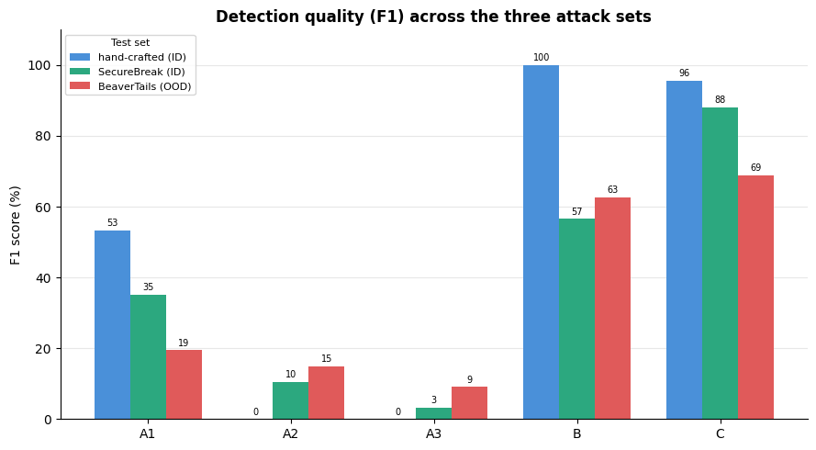
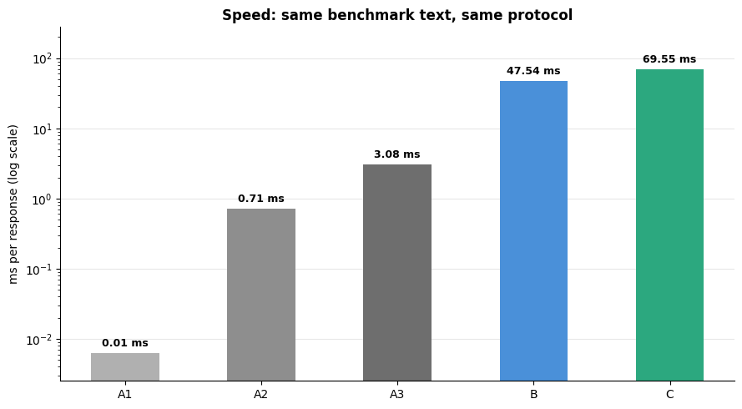
Results
Notes:
These two charts are the whole comparison, and everything in them is computed live from the notebook. On the left, detection quality: the three regex variants sit at the bottom — and notice A3, the biggest list, is the worst. B looks impressive on our hand-crafted set at 100, but that's the illusion we just discussed: with eleven unsafe and one safe response, a model that blocks everything scores 100. Look at SecureBreak instead, where B drops to 57 and C reaches 88. On the right, speed, on a log scale — each gridline is ten times bigger. Regex runs in 0.01 milliseconds, the guard LLM in 69.5, so roughly eleven thousand times slower. But the interesting detail is that B and C cost almost the same, 47 versus 69 milliseconds. The intelligence is essentially free once you're already paying for a forward pass — so the real trade-off isn't regex versus fine-tuning, it's regex versus using a model at all.

Slide 9
Conclusions
Keyword filtering fundamentally fails at response level
Even garak's 1,598 terms catch only 2% of harm. The published lists target profanity; SecureBreak's harm is fluent, professional, and swear-free. More terms didn't help - they were the wrong kind.
1
The dataset - not the model - creates the guard
Same 0.5B architecture: untrained (B) has no decision boundary and blocks everything (86% FPR).
Fine-tuned (C) reaches 88 F1 with 11% FPR. +31 F1 points, attributable purely to SecureBreak.
2
The intelligence partly generalizes
C holds 69 F1 on BeaverTails, an entirely independent dataset it never saw.
The 88 - 69 drop is honest: real transferable learning, but partly Secure Break-specific
3
Notes:
Three conclusions. First, keyword filtering fundamentally fails at response level — garak's sixteen hundred terms catch 2% of harm, because published blocklists target profanity while SecureBreak's harm is fluent, professional and swear-free. More terms didn't help; they were the wrong kind of terms. Second, the dataset creates the guard, not the model — same 0.5B architecture, but untrained it has no decision boundary and blocks 86% of safe content, while fine-tuned it reaches 88 F1 with an 11% false-positive rate. That's 31 points attributable purely to SecureBreak. Third, and this is the part we're most confident about because we designed the test to be able to fail: the intelligence partly generalises. Our guard holds 69 F1 on BeaverTails, a dataset it has never seen, from different authors with a different taxonomy. The drop from 88 to 69 is honest — it learned something real and transferable, but part of its in-distribution score was SecureBreak-specific. Only an out-of-distribution test could have told us that, and that's exactly why we added one.

