Slide 1

Machine-learning approach to start-up success
by L. Vilner

Slide 2
Table of contents
Seed: Introduction
A: Data sources
B: Data wrangling
C: Data story
D: Data models
Exit: Recommendations

Slide 3
Introduction
Forbes defines start-up as a company that is based on the “culture and mentality of innovating … to solve critical pain points”*.
Given the fluid definition of a start-up and the difficulty of tracking all of them down, it is hard to tell exactly how many start-ups there are globally or even in the US at any given moment.
Many start-ups will fail before truly taking off, while many start-ups will fail after getting a significant amount of funding. On the other hand, many start-ups will succeed even with little funding.
Even if not closing down, no company can exist in a start-up form forever. Driven by funding, start-ups will have to provide an exit for its shareholders. At that point, an acquisition or an IPO becomes inevitable.
* “What is a start-up” -- Forbes, December 16th 2013

Slide 4


Thesis:
If acquisition or IPO = success and
closing down = failure then:
Can we (as investors, for example) predict as early as possible which start-up will succeed and which one will fail?

Slide 5
Data source:
The database is broken down into three main datasets:
For the purpose of this study we will be focusing on the first two.
Crunchbase:
https://www.crunchbase.com/
Datasets used in the project were downloaded on December 4th 2015 and were made available on github. Data in the sets has the cut-off date as of Q2 2014.
Use of this data is governed by the CrunchBase Terms of Service and Licensing Policy
Companies
Relevant information for each specific start-up
Data points:
Company name/ company ID
Status (operating, closed, IPO, acquired)
Homepage url
Sector
Country/state/region/city
Total funding obtained
Total number of funding rounds
Date founded
Date of first funding round
Date of last funding round
Investments
Breakdown of funding rounds for each start-up
Data points:
Company name/company ID
Sector
Country/state/region/city
Investor name
Investor sector
Investor country/state/region/city
Funding round type (e.g. Series A)
Date of funding round
Amount raised in the round
* This dataset has multiple lines for each start-up to account for each investor in each funding round
Acquisitions
Information on acquisitions by start-ups and of start-ups
Data points:
Company name/company ID
Sector
Country/state/region/city
Bidder name/bidder ID
Bidder sector
Bidder country/state/region/city
Date acquired
Price/currency

Slide 6
Data wrangling
Company duplicates
Missing values
Converting date variables from string to date format
Merging datasets

Slide 7
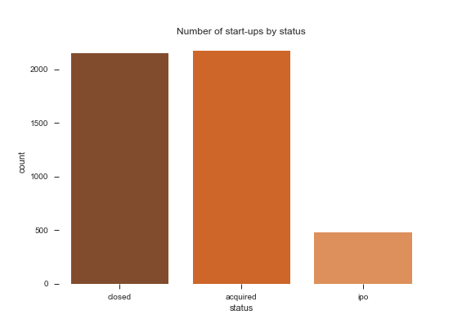
Data story
It is often said that only 1% of all ideas succeed.
However, Crunchbase data paints a different story. It shows that more than 50% of companies with at least one funding round succeed.
*Assuming that there is no selection bias within Crunchbase data
our office

Slide 8
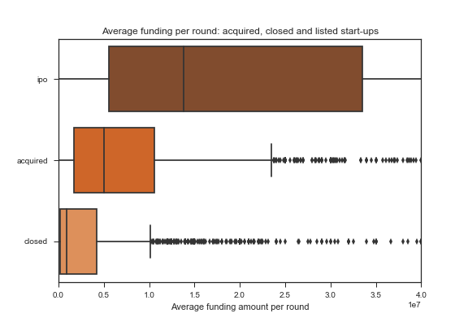
Data story
The data also reveals some differences between successful and unsuccessful companies.
On average, the latter were involved in fewer funding rounds and received less funding per round.*
*This is to be expected: funding amount generally grows in each subsequent funding round.
our office
 | Listed | Acquired | Closed
Average num. of funding rounds | 2.6 | 1.9 | 1.4

Slide 9
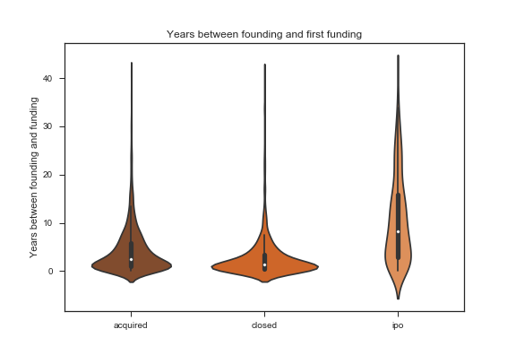
Data story
Finally, unsuccessful start-ups seem to rush to get their first funding, while successful start-ups wait longer.
But even if there does appear to be a difference between start-ups early on, can we actually predict whether a start-up will fail or succeed?
our office
 | Listed | Acquired | Closed
Median number of years until first funding | 8.4 | 2.5 | 1.3

Slide 10
Testing data models Prior to testing different models to predict start-up success, the following features were selected. Each row was represented by a start-up. The response variable was binary: 0 for unsuccessful/closed companies; 1 for successful/listed or acquired companies
Investor information
Transformed to make it readable by the model (explained in the next slide)
Start-up sector, country, state, region, city
Converted to dummy variables
Total funding raised
Normalized
Number of funding rounds
Year founded
Normalized
Days between founding and first funding
Normalized
Plus, average funding per round

Slide 11
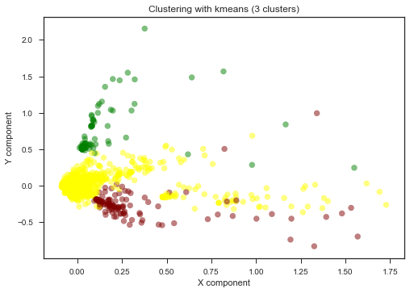
Testing data models Investor information was transformed by turning each investor into a separate column. The values in the resulting dataset represented the number of funding rounds a specific investor participated in for a specific company. Because investor data amounted to more than 4500 columns, to avoid the curse of dimensionality (and to speed up the model), PCA was used to reduce dimensionality to 600 principal components.
The first two components are clustered through kmeans here:

Slide 12
Selecting the final data model Logistic Regression and Random Forest were trained/ cross-validated on 40% of the data and validated using 30% of the data. The combined 70% were used for re-training, with the remaining 30% used for final testing. Based on results provided here, LR was selected as the final prediction model, with accuracy in the testing phase = 0.693
Training/cross-validation -> Validation -> Re-training -> Testing
Logistic Regression
Accuracy: 0.672
Sensitivity: 0.850
Specificity: 0.412
Random Forest
Accuracy: 0.638
Sensitivity: 0.925
Specificity: 0.219
Baseline accuracy: 0.594

Slide 13
Recommendations
Overall observation: Even with such supposedly unpredictable event as start-up success, we were still able to generate some predictive power. This is a strong result in itself and warrants further exploration.
Timing of prediction: While this model can be used as early as Series A funding round to identify potential successful and unsuccessful candidates, the more funding rounds a company has gone through, the more information there is for the model.
More granular analysis: Investors are encouraged to consider individual features, such as days/years before the company got its first funding, selection of investors in each round, or average amount of funding per round, to raise concerns about a potential investment.
Acquisition of further data: It would be ideal to invest into acquisition of further start-up data, e.g. information on founders, start-up financial information, or start-up PR and marketing information, to generate more features for the model and, subsequently, improve its performance.
our office

Slide 14
Follow-up to the study:
Features:
Use the most updated Crunchbase data – ideally, real-time data – for the model
Utilize the acquisitions dataset to generate further features
Invest into acquisition of additional, early-stage start-up data
Explore variable importance to determine what really matters for success.
Model:
Test other models (aside from RF and LR), or a combination of different models
Predict not only success/failure but additional company statuses (IPO/acquisition). The latter might be of interest not just to investors, but to the advisory community as well.

Slide 15
our office
Thank you!

