Slide 1
Aviation Accidents
Lacy SoRelle, Jonathan McDermott, Lalitha Vijayaraghavan, Guy Thompson

Slide 2
Data Sources
Kaggle –
www.planecrashinfo.com – For Webscraping
worldbankdata- For total flight departures data

Slide 3
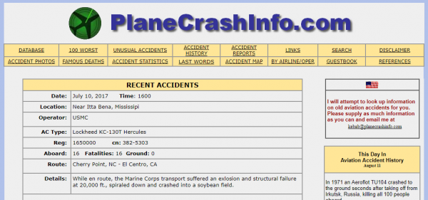
Webscraping :
The data from Kaggle is from 1908-2009 , so we decided to get the recent data from planecrashinfo.com .
The structure of the webpage made it easier for webscraping. The first site is the landing page. You find recent plane crashes and incidents there:
http://www.planecrashinfo.com

Slide 4
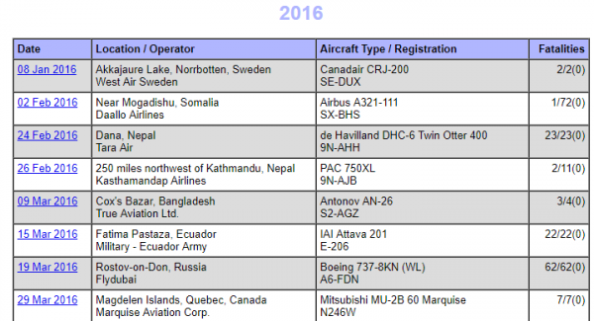
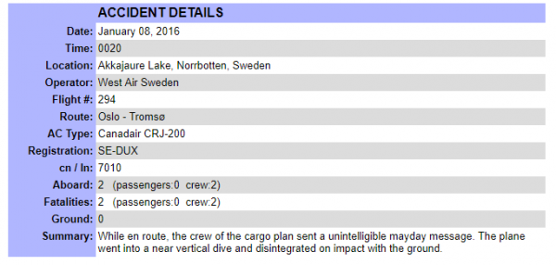
If you enter the second page, you can find data on all plane crashes happening in 2016:
http://www.planecrashinfo.com/2016/2016
By adding a -1 to the URL, you access the first entry in the table and get detailed information on that:
http://www.planecrashinfo.com/2016/2016-1
4

Slide 5
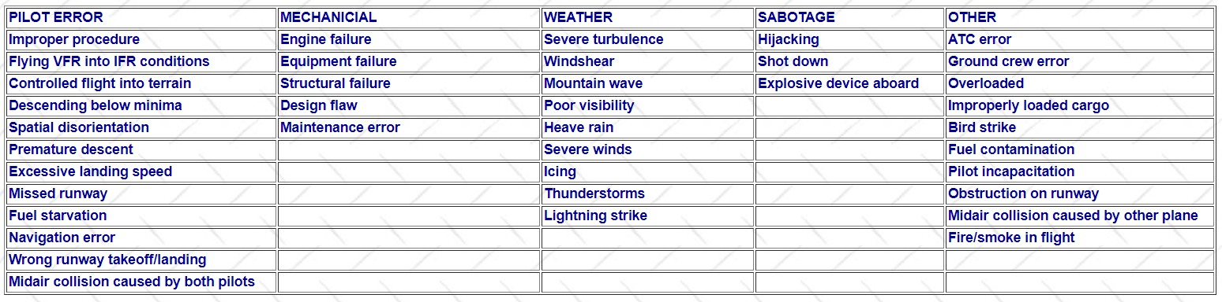
We used the table below as reference to look for key words in the summary field and analyze and classify the causes of the accidents.
We used Open Cage API to get the latitude and longitude of the crash location:
https://api.opencagedata.com/geocode/v1/json

