Slide 1

CU-EduLink
L Vinay Kumar Reddy
(Dept. of Computer Science.)
Christ University
Thangavignesh T
(Dept. of Computer Science.)
Christ University
MISSION
CHRIST is a nurturing ground for an individual’s holistic development to make effective contribution to the society in a dynamic environment
VISION
Excellence and Service
CORE VALUES
Faith in God | Moral Uprightness Love of Fellow Beings
Social Responsibility | Pursuit of Excellence

Slide 2
CHRIST
Deemed to be University
AGENDA
Progress made
Methodology and approach
Challenges and solutions
Alignment with Initial proposal
Excellence and Service

Slide 3
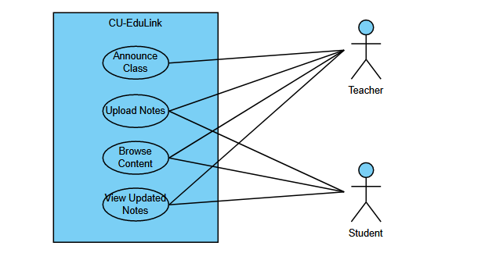
CHRIST
Deemed to be University
Progress Made
Topic Selection: An interactive platform for teachers and students to share notes.
Created a problem statement and made a PPT on the same.
Created a Use case Diagram.
Excellence and Service

Slide 4
CHRIST
Deemed to be University
Methodology and approach
Requirements:
System Design:
Wireframing and Mockups:
Development:
Iterative Development:
Testing:
Deployment:
User Training and Onboarding:
Excellence and Service

Slide 5
CHRIST
Deemed to be University
Challenges and solutions
User Engagement:
Challenge: Encouraging consistent user engagement can be challenging, as students and teachers may face competing priorities.
Solution: Implement gamification elements, such as badges or rewards, to motivate users. Regularly update content and features to maintain interest.
Excellence and Service

Slide 6
CHRIST
Deemed to be University
Challenges and solutions
Technical Issues:
Challenge: Users may encounter technical issues, such as slow loading times or difficulty accessing certain features.
Solution: Conduct thorough testing, invest in a reliable hosting infrastructure, and provide responsive customer support to address technical issues promptly.
Excellence and Service

Slide 7
CHRIST
Deemed to be University
Challenges and solutions
Adoption Barriers:
Challenge: Convincing both teachers and students to adopt the platform may face resistance.
Solution: Offer comprehensive onboarding materials, training sessions, and incentives. Highlight the platform's benefits in terms of enhanced collaboration and learning.
Excellence and Service

Slide 8
CHRIST
Deemed to be University
Challenges and solutions
Integration with Existing Systems:
Challenge: Integrating EduLink with existing educational systems or tools used by institutions can be complex.
Solution: Work closely with IT departments, utilize standardized APIs, and provide clear documentation for seamless integration. Offer support during the transition period.
Excellence and Service

Slide 9
CHRIST
Deemed to be University
Alignment with Initial proposal
Developing a website.
The website can be integrated with the college website and library for easier access for students.
Making it available to only Christ Students.
Credentials can be generated by Admin and given to Students.
Excellence and Service

Slide 10
CHRIST
Deemed to be University
Thank You
Excellence and Service

