Slide 1

中外家庭教育差异
合作：刘文博
王聪

Slide 2
中美家庭文化背景的不同
01
02
03
教育方式的不同
教育结果的不同

Slide 3
文化背景
简要说明
经济条件比较差
中国经济条件比较差,社会养老保障不健全,家长对孩子的教育从个人养老或个人的荣誉角度考虑比较多,把孩子当成自己的私有财产来看待,要求孩子知恩图报,因而在教养的方式和方法上就充分体现出这一点。
China's economic conditions are relatively poor, the social pension security is not sound, parents of children's education from the perspective of personal pension or personal honor more consideration, the child as their own private property to treat, ask the child to repay, so in the way and method of upbringing is fully reflected in this point
中国自古就有着重视教育的优良传统 , 由于社会的变迁,特别是封建小农意识长期的影响,文化价值观上多是比较内敛和保守的。中国人往往把一生的幸福寄托在某一些职业上,选择面窄。中国父母认为学业成绩好,找到好的工作,求得一生安稳,是一个人最好的人生出路 ,中国父母的教育目的是成才。
China has a fine tradition of attaching great importance to education since ancient times. Due to the social changes, especially the long-term influence of feudal smallholder consciousness, the cultural values of China are mostly reserved and conservative.Chinese people tend to pin their lifelong happiness on certain professions, with narrow choices.Chinese parents believe that academic performance is good, find a good job, secure life, is a person's best way out of life, Chinese parents' education is to become.
受封建小农意识长期的影响
父母的教育目的
社会养老保障不健全

Slide 4
文化背景
生产力先进
简要说明
生存压力小 ，用人机制健全
美国生产力先进 , 商品经济发达 , 就业机会多 , 生存压力小 , 用人机制健全 , 劳动力流通自由, 跳槽机会多,是能力社会。所以美国人择业观念开放 , 职业选择面宽,社会养老保障健全 , 父母不认为养儿就是为了防老 , 自己老了可以进养老院 , 无后顾之忧。
The United States has advanced productivity, developed commodity economy, more employment opportunities, less pressure for survival, a sound employment mechanism, free labor circulation, and more job-hopping opportunities.Therefore, americans have an open concept in choosing jobs, wide range of career choices, and sound social endowment security. Parents do not think that raising children is to prevent their aging, and they can enter a nursing home when they are old without worries.
美国父母认为 , 把孩子培养到十八岁 , 并成为一个独立自主 , 有责任心和同情心的人就算尽到了自己的义务 , 完成了养育孩子的任务，孩子将来的路如何走 , 全靠他自己去奋斗, 至于将来能否光宗耀祖升官发财 , 父母考虑得并不多。
American parents believe that the children at the age of 18, and become an independent, has the sense of responsibility and compassion, even if is doing its duty, completed the task of raising children, the children of the way how to go in the future, all by himself to strive, as for can uphold the promoting to a higher position in the future, parents think there are not many.
能力社会
父母思想开明

Slide 5
中国家庭教育方式
01
生活方面（包办孩子的生活）
On the life to the child's basic necessities of life package does instead, does not let the child touch the housework side
Options
02
这种包办横向涉及孩子的方方面面 , 纵向延伸到孩子长大成人。于是出现了小学生还要家长接送 , 中学生还要家长洗衣服 , 大学新生入学还要家长护送。其次，不少家长怕孩子吃亏或学坏， 于是限制孩子与外界的接触 , 一旦孩子与小朋友或同学之间发生争执或不愉快的事情 , 多数家长采取袒护自己孩子而指责其他孩子的办法。
This arrangement involves all aspects of the child horizontally, and extends vertically to the child growing up into an adult.So there are primary school students also parents pick up, middle school students also parents wash clothes, college freshmen even parents escort.Secondly, many parents are afraid of the children suffer losses or learn bad, so limit the children and the outside world, once the children and children or classmates dispute or unpleasant things, most parents take to protect their children and blame other children.
经济方面（放任自由）
Chinese parents adopt a laissez-faire approach
Options
不少家长对孩子的要求百依百顺 , 有求必应 , 连经济拮据的家庭 , 家长也要勒紧裤 带省下钱来满足孩子的需求。不少小学生都拥有手机，数码相机等高档消费品 , 这无形中助长了他们奢华浪费的习惯。
Not a few parents are obedient to the requirement of the child, have everything to ask for, connect the family of money straitened, the parent also wants to tighten pants to take save money to satisfy the need of the child.Many primary school students own mobile phones, digital cameras and other high-end consumer goods, which has virtually encouraged their habits of luxury and waste.
03
学习方面（非常严厉）
severe
Options
与生活，经济，社交上的纵容相比 , 家长对孩子的学习却要求很高 , 甚至达到一种苛刻的程度。
Compared with the connivance in life, economy and social life, parents are demanding to their children's study, even to a demanding degree.

Slide 6
西方家庭教育方式
01
生活方面（放手而不放任）
It is better to let go than to let go
Options
放手就是从孩子生下来父母就设法给他们自我锻炼的机会和条件 , 让他们在各种环境中得到充分锻炼。父母除了照管孩子的安全外 , 其他生活上的事都让孩子自主选择。让他们从小就有存放个人衣服，玩具和学习用品的地方 , 自己收拾整理房间 , 布置属于他们自己的小天地 , 父母决不替孩子包办 , 顶多在一旁提醒参谋。
Letting go is when a child is born and the parents try to give them opportunities and conditions to exercise themselves sufficiently in various environments.Parents let their children choose for themselves everything in life except the safety of their children.Let them have the place that puts individual clothes, toy and study things as a child, oneself tidy up tidy a room, decorate the small world that belongs to their own, the parents does not pack for the child absolutely, at most in one side remind staff.
02
经济方面（家富而不奢）
A rich family is no extravagance
Options
家庭在他们18岁之后，就不在提供经济支持，靠他们自己打工或者贷款维持自己的生活，贷款会在工作之后慢慢还清。
Families no longer provide financial support after they turn 18. They work for themselves or take out loans to support themselves.
03
学习方面（严教而不袒）
Strict education without being exposed
Options
他们的观点是孩子对感兴趣的 知识自然会努力去学 , 为什么要强制他们去做本不愿做的事情呢。人生道路要让孩子自己去走。
Their view is that children naturally strive to learn what they are interested in, so why force them to do what they would not otherwise do.Let your child walk the path of life.

Slide 7
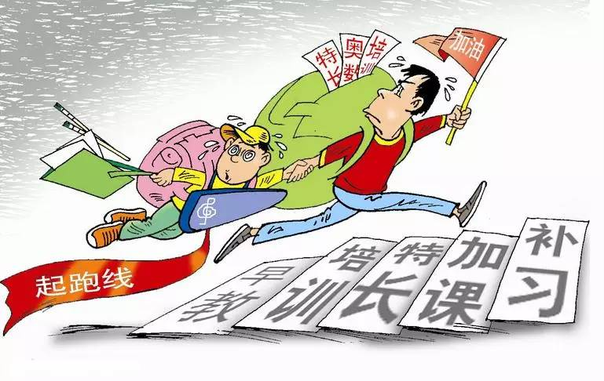
中国教育虽然在学业上不亚于美国 , 但中国孩子普遍表现出独立生活能力比较差, 自立意识不强 , 缺乏适应环境和应变的能力 , 这些问题与中国倾向于学历教育有很大关联 , 父母希望孩子躲在学校这座象牙塔里寒窗苦读,不让孩子在风云变幻的社会里摸爬滚打。
Chinese education while in school as much as the United States, but with poor Chinese children generally show the ability to live independently, independent consciousness is not strong, and lack the ability to adapt to the environment and the strain, these problems with the Chinese tendency Yu Xueli is greatly related education, parents want their children to hide the ivory tower, cold window study hard at school don't let the child of seasoning in the changeable society.

Slide 8
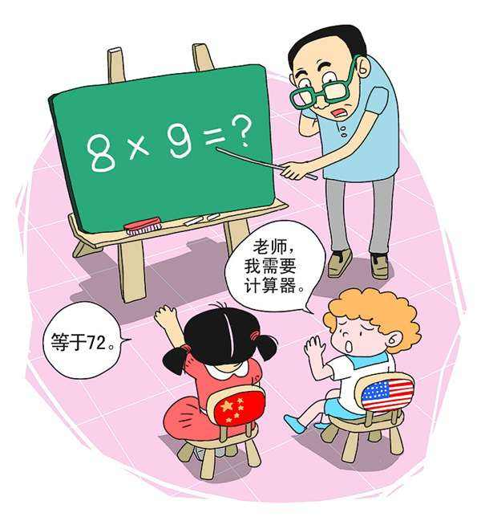
美国的儿童，少年从小就表现出较强的自立能力 ，创新能力 , 他们性格倾向积极 , 能与人和谐相处 , 敢想敢做 , 具有创新精神, 社会活动能力强 , 有作为社会成员独立存在的信心和勇气。因为他们18岁开始不依靠家庭 , 多数打工补贴自身的消费需用 , 所以具有适应市场经济的头脑。
American children and teenagers have shown strong self-reliance and innovation ability since childhood. They tend to be positive, get along well with others, dare to think and do, have innovative spirit, strong ability of social activities, and have the confidence and courage to exist independently as social members.Since they do not rely on their families at the age of 18, most of them work to supplement their own consumption needs, so they have the mind to adapt to the market economy

Slide 9

刘文博
王聪

