Slide 1
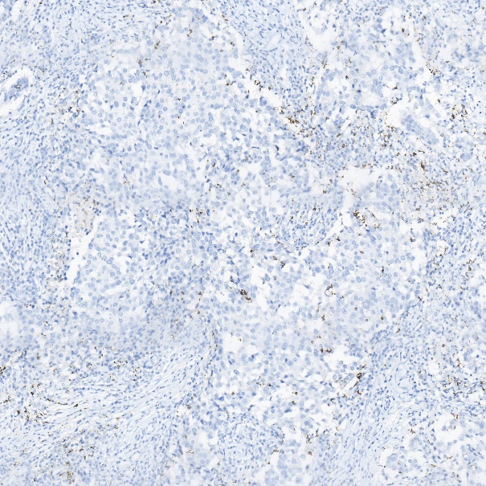
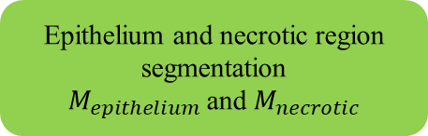
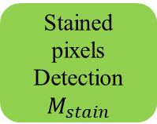
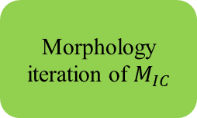
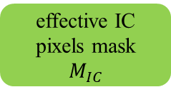
RGB to HSV color conversion
Stained pixels
Detection
$$M_{stain}$$
Morphology iteration of $M_{IC}$
WSI image patch
IC score
effective IC pixels mask
$$M_{IC}$$
Epithelium and necrotic region segmentation
$M_{epithelium}$ and $M_{necrotic}$
Reference image dataset
Deep learning model: Linknet

