Slide 1
LWPsix

Slide 2
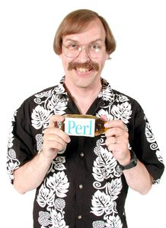
http://www.spidereyeballs.com/os5/images/small/os5_r23_1542.jpg
In Perl 6, we decided it would be better to fix the language than to fix the user.
- Larry Wall

Slide 3
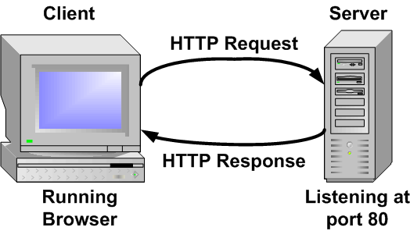
HTTP
http://www.cs.uregina.ca/Links/class-info/215/deng_webpage/Picts/Request_Response.gif

Slide 4
HTTP Request
GET / HTTP/1.1 |  | <request>
Host: | google.com | <required headers>
Connection: close | close
User-Agent: | Web-sniffer/1.0.37 (+http://web-sniffer.net/) | <optional headers>
Accept-Encoding: | Gzip
Accept-Charset: | ISO-8859-1,UTF-8;q=0.7,*;q=0.7
Cache-Control: | no-cache
Accept-Language: | de,en;q=0.7,en-us;q=0.3
Referrer: | http://web-sniffer.net/
 |  | <empty line>

Slide 5
HTTP Response
HTTP/1.1 200 OK |  | <status line>
Date: | Thu, 20 May 2004 21:12:58 GMT | <general headers>
Connection: | close
Server: | Apache/1.3.27
Accept-Ranges: | bytes | <response headers>
Content-Type: | text/html
Content-Length: | 170 | <entity headers>
Last-Modified: | Tue, 18 May 2004 12:32:56 GMT
 |  | <empty line>
<!DOCTYPE … |  | <message body>

Slide 6
Project Goals
Inspired by LWP for Perl 5…
High-level implementation of HTTP
Common web use cases simply and straightforwardly
Subclassers provide complex behavior

Slide 7
Justification
Why not Perl 5’s LWP?
LWP::Simple for Perl 6
Extensible design over cover-all functionality

Slide 8
Project Requirements
GET and POST requests
Transparent handling of redirects
Automatic reassembly of chunked results
Support for HTTP/1.0
Support for HTTPS and HTTP proxies
Connection persistence with keepalive
Cookie handling
Basic and Digest authentication

Slide 9
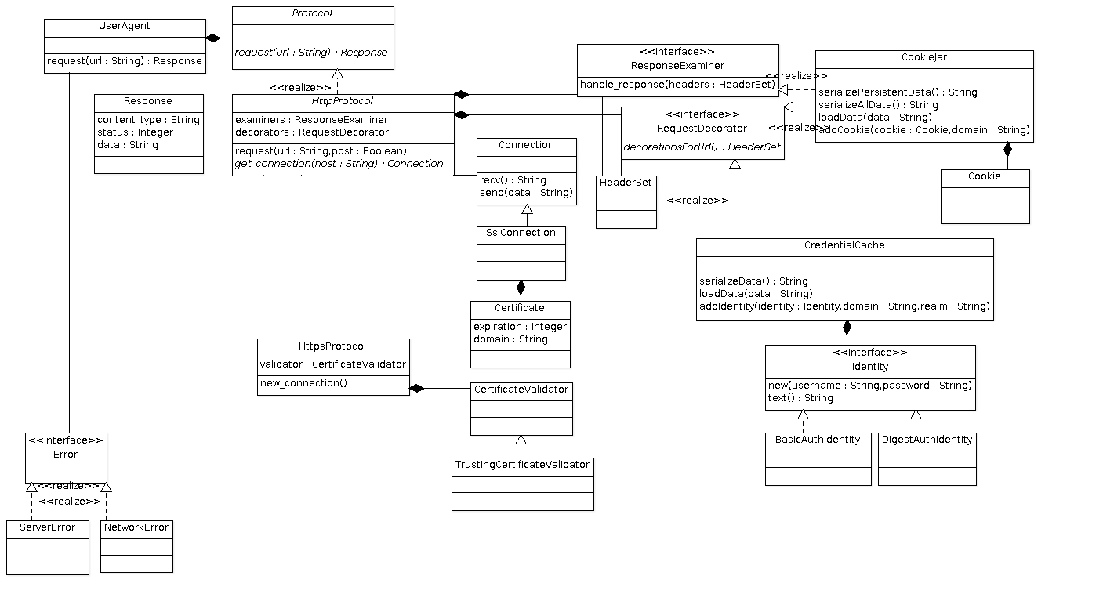
Project Design

Slide 10
Modules

Slide 11
UserAgent
Background
Boil down user interaction to bare essentials while allowing for more complex behaviors to be possible

Slide 12
UserAgent
Functionality
new(…)
builds %protocols according to params
default settings for keep-alive and proxy
request(…)
flexible, determines protocol and passes request

Slide 13
UserAgent
Extensibility
Protocols
HttpProtocol: ConcreteConnection
HttpsProtocol: SslConnection, CertificateValidator
…

Slide 14
Headers
HeaderSet: contains all headers from the server’s response
RequestDecorator, ResponseExaminer: interfaces defining functions acting on the headers
Identity, BasicAuthIdentity, DigestAuthIdentity: store credentials with desired level of security
IdentityMaker: factory class that facilitates easy creation of identities
CredentialCache: Holds Identities
Cookie, CookieJar: Holding persistent information

Slide 15
HttpsProtocol
Background
IO::Socket::INET provides TCP-level sockets
Code an SSL layer on top of these basic TCP sockets.

Slide 16
HttpsProtocol functionality
HttpsProtocol: Parallel to HttpProtocol with two key differences:
Owns a HTTPS::CertificateValidator, which knows how to determine whether an SSL certificate from a server is valid, and an HTTPS::SslConnectionNegotiator, which performs the complicated three-way handshake necessary to initiate an SSL connection. At this point, these are up to a subclasser of the library to provide; if they are not provided in the constructor, the library defaults to a HTTPS::TrustingCertificateValidator, which accepts any certificate as valid, and an HTTPS::SimpleSslConnectionNegotiator, a skeleton class which outlines the handshake steps necessary but fails upon the first (Client “Hello”).
Opens an HTTPS::SslConnection for a given host, which invokes the negotiator and instead of using the socket’s send and receive methods directly, encrypts and decrypts communications based on the key and algorithm established by the negotiation.

Slide 17
HttpsProtocol functionality
Breakdown of the most important interactions:
SslConnection owns a SslConnectionNegotiator, which provides public access to the Certificate obtained in the negotiation
SimpleSslConnectionNegotiator suggests a further breakdown of methods: .exchangeHellos(), .acceptCertificate(), .establishKey
SslConnectionNegotiator must implement negotiate() (returns 0 upon success) and .getCertificate()
Certificate owns a public CertificateValidator validator and must provide public access to the key and algorithm agreed upon during negotiation via .getKey() and .getAlgorithm()
CertificateValidator must implement .validate(), which returns a Boolean

Slide 18
HttpsProtocol functionality
Crypto support: While the library does not implement the necessary cryptography for an SSL layer, it provides some useful code for subclassers:
Uses NativeCall, a Perl6 module capable of invoking methods from a C shared library (.so)
Provides the code for a proof-of-concept simplecrypto.so library for testing and a shell script to build it, containing three important functions (skeletal):
char* extractKey(char* rawCert), which Certificate uses to get the important key information (cipher suite and key) from a raw certificate; no crypto yet; returns algorithm TLS_NULL_WITH_NULL_NULL, i.e. no encryption
char* encrypt(char* buf, char* key, int algorithm), which SslConnection uses to encrypt a message before sending; currently stubbed out & returns buf
char* decrypt(char* buf, char* key, int algorithm) , which SslConnection uses to decrypt a message it receives; currently stubbed out & returns buf

Slide 19
HttpsProtocol
Extensibility
Framework for validation – certificates, encryption & decryption, negotiation process
Perl 6 SSL protocol support

Slide 20
Core Features
GET requests
Support for HTTP/1.0
Support for HTTPS and HTTP proxies
Connection persistence with keepalive
Cookie handling
Basic and Digest authentication

Slide 21
Challenges
Lack of documentation
Compiler issues
Ease-of-use and coders as users
Overengineering
Unfortunate events

Slide 22
Demo

Slide 23
page_fetch.pm6
use v6;
use LWPsix::UserAgent;
my $ua = LWPsix::UserAgent.new;
my $host = prompt "URL: ";
my $response = $ua.request($host);
my $fh = open("output.html", :w);
unless $fh.defined {
die "Could not export response from server!";
}
$fh.say($response.data);
$fh.close;

Slide 24
Demo Trace
UserAgent
new()
request()
HttpProtocol
request()
ConcreteConnection
send()
recv()
Response
new()

