Slide 1
CNT4007C: Theory and Fundamentals of Computer Networks
Network Structures
Content derived from various sources including Tomsho et al., Guide to Networking Essentials,
Kurose and Ross, Computer Networking: A Top-Down Approach

Slide 2
Overview of Network Topologies
Common Network Topologies in LANs.
Signal Propagation in LANs.
Robustness of Network Topologies.
Network Devices and Media.
Network Structures of the Internet

Slide 3
Network Topology
Computer networks can have a variety of structures.
The selection of the structure of the network is based on several criteria:
Cost of infrastructure: how expensive is it to connect the sites.
Bandwidth/Latency determines how much data can be transported and how long will it take to send messages between sites.
Reliability determines if a network link fails, how will it affect the exchange of messages between all sites in the network.
Network topologies can be depicted as graphs whose nodes represent sites and edges represent direct communication links.

Slide 4
Network Topology Examples
Ring
D
A
Star
D
A
C
E
B
C
B
Tree
A
Bus
B
C
D
E
G
F
E
F
G
H
E
H
E

Slide 5

Network Topologies Examples (cont.)
Mesh
E
D
A
C
B
Given n nodes in network,
then the number of edges in a mesh network is:

Slide 6

Hybrid Fiber-Coaxial (HFC) Access Network
Neighborhood
Fiber node
fiber
cable
coaxial cable
Head node
individual homes
Neighborhood
Fiber node
fiber
cable
coaxial cable
Cable modem divides HFC network into two channels for uploading and downloading data.

Slide 7



Signal Propagation in Bus Networks (Ethernet 10Base2)
listening host
sending host
listening host
terminator
terminator
listening host
listening host
Sender generates signal and puts it on the wire.
Signal propagates in both directions.
Other hosts listen-in on signal.
Terminator “consumes” the signal.

Slide 8
Network Failure in a Bus Network (Ethernet 10Base2)
no terminator
no terminator
cable broke
Signal bounces if in terminators are attached or if network cable is broken.
Bouncing signal generates noise.

Slide 9
Signal Propagation in Ring Networks (Token Ring)
sending host
listening host
Sender generates signal and waits for token.
Sender “appends” signal to token.
Signal propagates in physical ring from host to host.
Recipient “consumes” the signal and sends token.

Slide 10
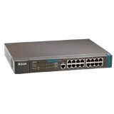
Logical Network Topology - Ring
Physical Topology:
hub connects hosts in a star topology
10 Base-T Ethernet
Logical Topology:
hub receives signal from a host
hub transmits signal in a specific order
order determines logical topology

Slide 11
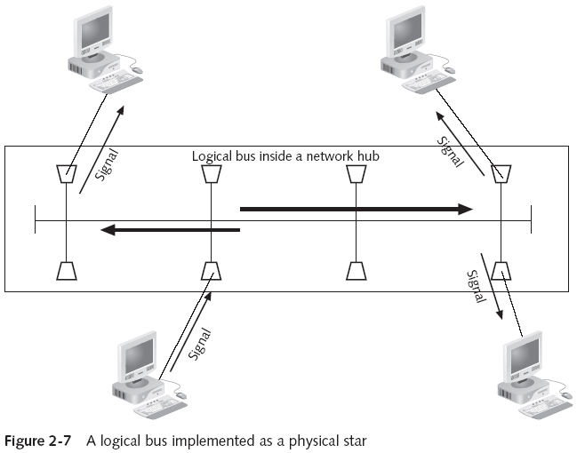
A Logical Bus Implemented as a Physical Star

Slide 12
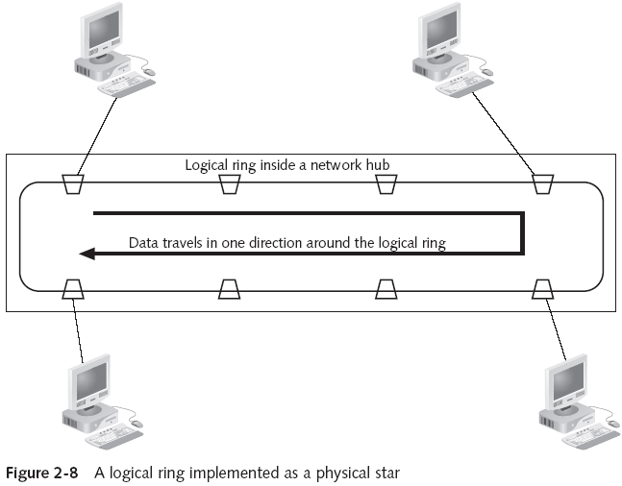
A Logical Ring Implemented as a Physical Star

Slide 13
Robustness of Network Topologies
Ring Topology
less robust because a cable break or a network card failure shuts down the entire network
Bus Topology
less robust because a cable break shuts down the entire network
Star Topology
more robust because a cable break only disconnects one host from the network
failure of hub, switch, router at center of network shuts down the network

Slide 14
Network Devices
Patch Panel
serves as junction points between cables coming from switch/hub and wall
no signal strengthening or filtering
Hubs
distribute signal across multiple connected ports
regenerates signal to original signal level (signal strengthening)
filters any noise
Switches
Same as hub plus
determines port of recipient instead of broadcasting the signal to all ports
reduces overall traffic on network compared to hub by directing the signal

Slide 15
Network Devices (cont.)
Routers
strengthen and filter signals
connect different networks to build larger networks
routing tables in each router determines the flow of network traffic
operates at higher level of the OSI model than switches allowing heterogeneous networks to be connected

Slide 16
Data Transport in Hubs
Hub is a plug-and-play device.
requires no manual configuration
Frames sent across the network may collide with each other.
No frame buffering.
host B
host D
host C
Hub
segment
host A
When host A sends a frame to host B
no other host may send or a collision
will occur.

Slide 17
Data Transport in Switches
Switch is a plug-and-play, self-learning device.
requires no manual configuration
stores & forwards Ethernet frames using physical address in the frame
identifies the destination port by observing traffic flow
host B
host D
host C
Switch
segment
host A
Host A and B and host C and D
can exchange messages without
interference.

Slide 18
Self-Learning Switches
Switch sets up a table to forward frames to destination host.
host B
host D
host C
1
Switch
4
2
MAC address | interface | TTL
A | 3 | 60
C | 2 | 60
3
segment
host A
Frame
A | B | ….
Source
Destination

Slide 19
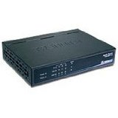
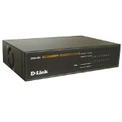
Sample Network
Router
Hub
Switch
Hub

Slide 20
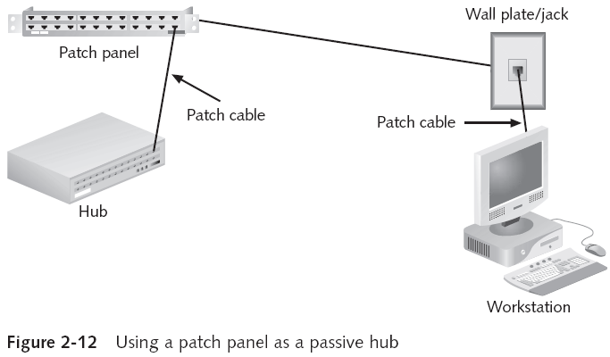
Connecting Hosts to Network
Figure 2-12: Guide to Networking Essentials, 5th Edition, Tomsho et al.

Slide 21
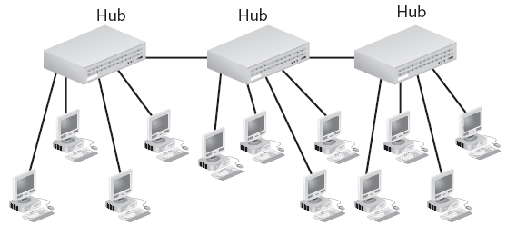
Combination Star Topology
bus backbone
Figure 2-12 Guide to Networking Essentials, 5th Edition, Tomsho et al.

Slide 22
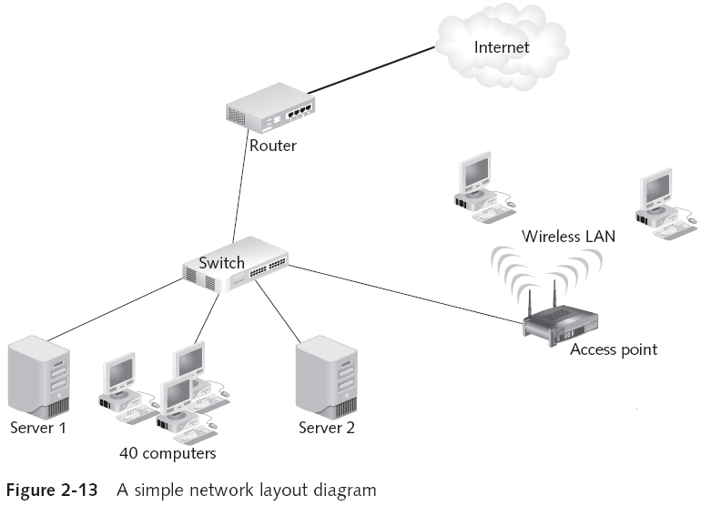
Complex Local Area Network
Figure 2-13 Guide to Networking Essentials, 5th Edition, Tomsho et al.

Slide 23
Complex Local Area Networks (Ethernet)
Small business configured network using
Ethernet switches
Routers
Modem for WAN connection
Ethernet:
10 Mbs, 100 Mbps, 1 Gbps, 10 Gbps Ethernet
in a modern configuration, host connects to an Ethernet swith
Switch
Router

Slide 24
Selecting a Topology
Most new network designs come down to only one choice: How fast should the network be?
The physical topology will certainly be a star, and the logical topology is almost always switching
Ethernet switches are typically used on a LAN, but you might consider other logical topologies for other reasons:
Use of legacy equipment
Network size
Cost restrictions
Difficulty to run cables

Slide 25
Creating the Layout
Network must be documented
Useful questions before drawing the diagram
How many client computers will be attached?
How many servers will be attached?
Will there be a connection to the Internet?
How will the building’s physical architecture influence decisions, such as whether to use a wired or wireless topology, or both?
Which topology or topologies will you use?
Network diagram must be kept up to date
https://creately.com/

Slide 26
Creating the Layout (continued)

Slide 27
Network Structure of the Internet
Internet is a connection of many small networks into larger networks.
Networks may use different network protocols for routing traffic.
TCP/IP protocol run by almost all personal computers
Phone companies operate ATM networks.
Mainframes use SNA network.
Interconnection of networks supports communication between hosts at different locations regardless of network type and protocol.

Slide 28

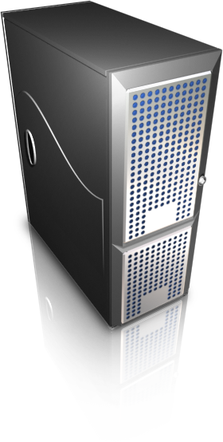
Internet Illustration
Mobile network
Global ISP
Home network
Regional ISP
Institutional network

Slide 29
Connecting Heterogeneous Networks
mainframes
ATM network
SNA network
PCs connecting to
an Ethernet
FDDI ring
wireless
Ethernet
laptop computers using
802.11 to connect to a network
Notes:
SNA – IBM – Systems Network Architecture

