Slide 1
AI CLASS · CAPSTONE
Discerning the Synthetic
Can a neural network tell real photos from AI-generated images —
even from generators it has never seen?
R
F
F
R
F
R
F
R
F
R
Real vs. AI-generated — the classification game
Liev Wurtzel · July 2026
Notes:
The project in one line: can a CNN distinguish real from AI images, and does it generalize to generators it never trained on? That last part is where it gets interesting.

Slide 2
THE PROBLEM
Telling real from AI is getting harder
Modern generators — Stable Diffusion, Midjourney, DALL·E — make images most people can't flag by eye.
New generators appear constantly. A detector is only useful if it works on ones it was never trained on.
So: does a CNN trained to catch one generator's fakes generalize to the rest?
REAL PHOTO
captured by a camera
AI-GENERATED
diffusion / GAN model
the model must decide
Notes:
Set up the stakes: fakes are convincing, new generators keep appearing, so generalization to unseen generators is the whole game.

Slide 3
ACT 1 · A DETECTOR THAT WORKS
Train on one generator, and it nails it
95%
Dataset — CIFAKE: 60k real (CIFAR-10) + 60k fakes from Stable Diffusion 1.4, at 32×32.
Model — a convolutional neural network, trained from scratch.
Held-out test accuracy:
accuracy on held-out CIFAKE
Stable Diffusion 1.4 · a single generator
Looks solved — right?
Notes:
A from-scratch CNN hits 95% on CIFAKE. It looks like a solved problem — which sets up the twist on the next slide.

Slide 4
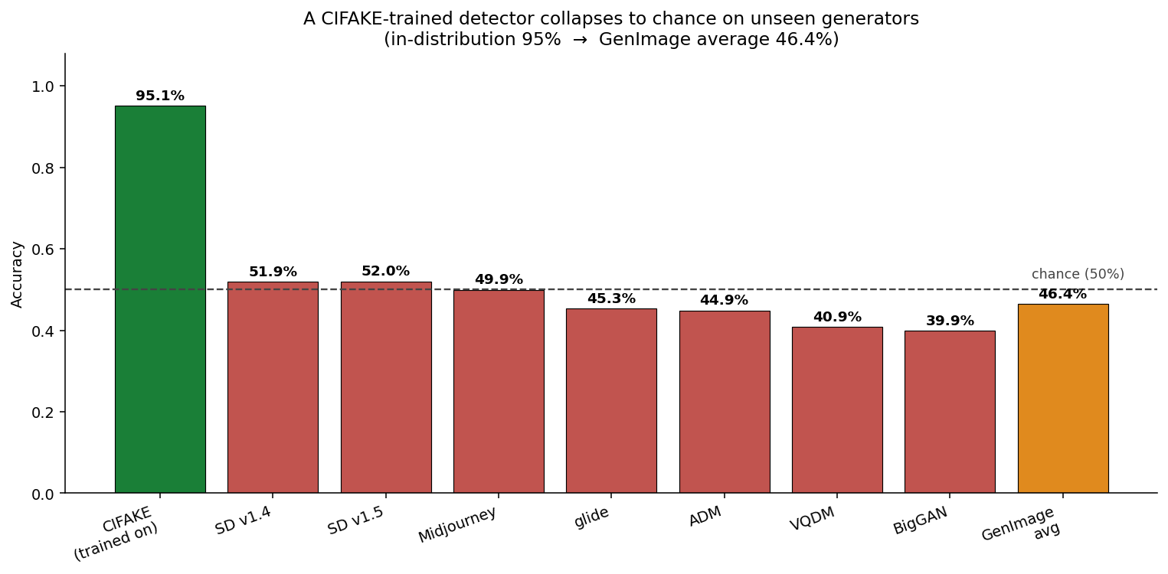
ACT 1 · THE TWIST
…until it meets a different generator
95% → 46%
On 7 unseen generators, accuracy falls to chance (~50%) or below.
It learned SD-1.4's fingerprint — not “AI-ness.”
The CIFAKE-trained detector, tested on each GenImage generator it never saw.
Notes:
The reveal: 95% in-distribution drops to ~46% average on unseen generators — at or below chance. It memorized one generator's fingerprint, not a general notion of 'AI-generated.'

Slide 5
ACT 2 · A STRONGER MODEL
Scaling up: train across many generators
DATASET
GenImage — 8 generators + real photos, at full 224px (not 32×32).
79%
TRAINED ON
ResNet50V2 transfer learning · 3 generators: SD 1.4, glide, BigGAN (★).
average accuracy across all 8 generators
TESTED ON
up from 46% for the single-generator model
All 8 generators' held-out sets — including 5 it never trained on.
Next: how it does generator by generator →
Notes:
Set up Act 2 before the graph: GenImage is a much bigger, higher-resolution dataset spanning 8 generators. I trained a ResNet50V2 on three of them and tested on all eight — including five it never saw. Headline: 79% average accuracy, up from 46% for the CIFAKE model. The next slide breaks that down generator by generator.

Slide 6
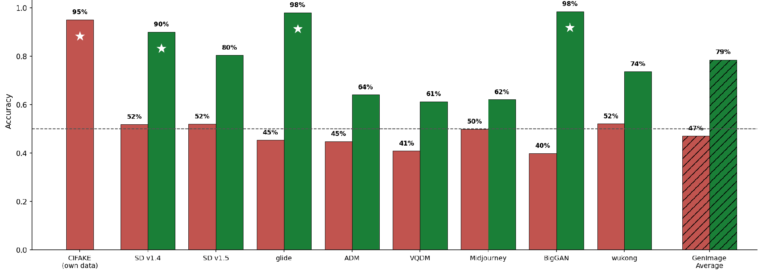
ACT 2 · TRAIN ACROSS GENERATORS
More generators → better generalization
■ single-generator model ■ multi-generator model ★ trained on this generator - - - 50% chance
Notes:
The payoff figure. Every green bar (new model) beats its red bar (old model). Stars mark the three generators it trained on — near-ceiling there. The real story is the unstarred greens: still well above the red model and above chance, though they dip on ADM, VQDM, Midjourney, which it never saw. Improved generalization, not solved.

Slide 7
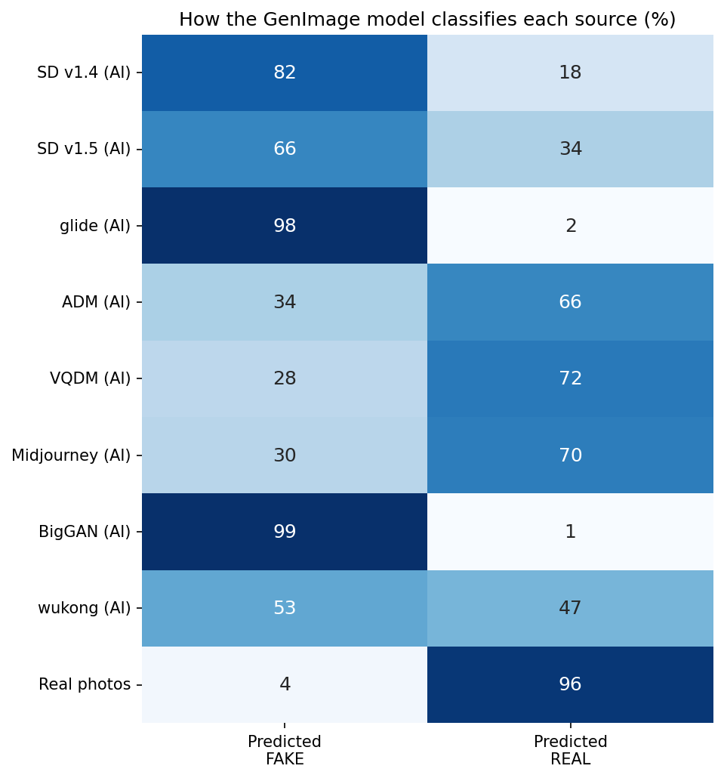
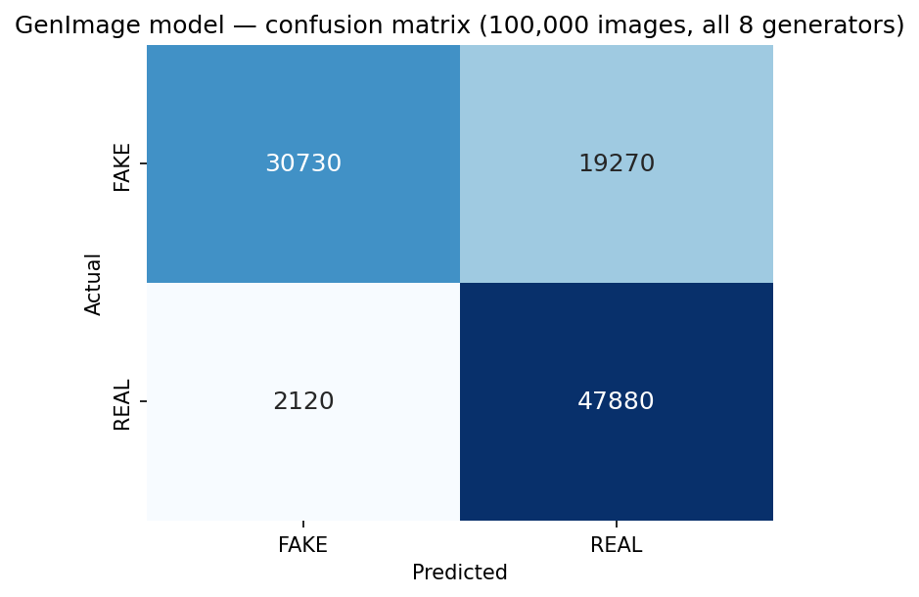
ACT 3 · HOW IT FAILS
It doesn't guess — it defaults to “real”
Cautious model: 96% correct on real photos, but it catches only ~61% of fakes.
All 100k validation images: actual vs. predicted.
Per generator — unseen fakes (ADM, VQDM, Midjourney) are called “real” ~70% of the time.
Notes:
The failure is systematic, not random. It's a cautious model: almost never false-alarms on reals (96% right), but misses ~39% of fakes — and the misses concentrate on generators it never trained on, which it waves through as 'real.'

Slide 8
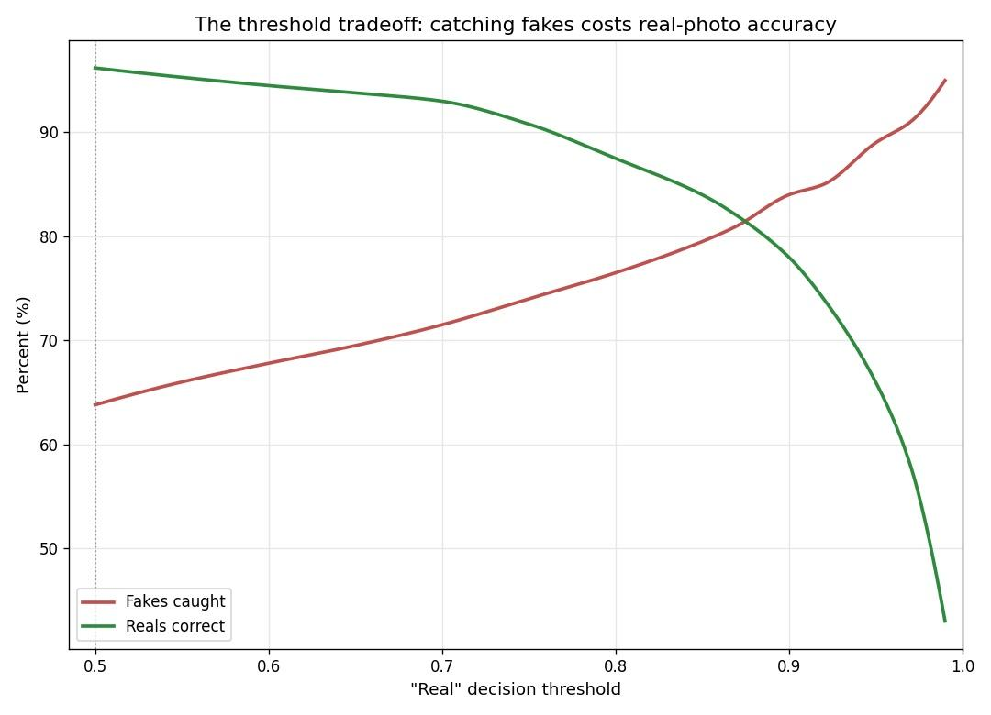
THE LEVER
One knob: the decision threshold
The tradeoff
Because missed fakes get labeled “real,” raising the bar for “real” catches more of them — at a cost to real-photo accuracy.
threshold 0.50 64% fakes · 96% reals · 80% overall
threshold 0.80 77% fakes · 88% reals · 82% overall
Tuning picks which errors you make — it doesn't fix generalization.
Notes:
Because misses default to 'real,' we can move the threshold to trade real-accuracy for fake-catching. 0.80 is a defensible operating point. But honesty: this only picks which errors we make; the deep fix is still generalization.

Slide 9
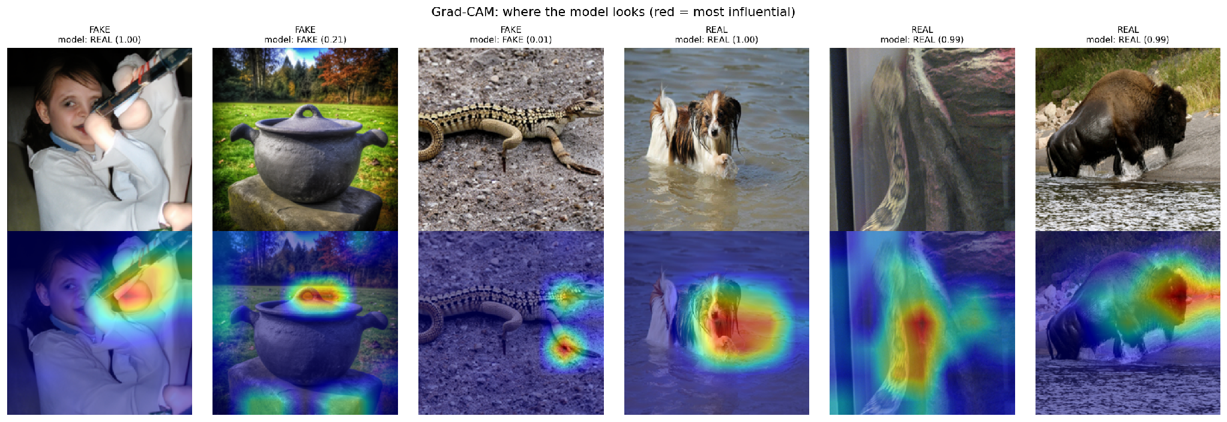
INTERPRETABILITY
What is the model looking at?
Grad-CAM highlights the pixels that drove each prediction (red = most influential).
It attends to the rendered subject, not the background — reading generation artifacts in the object itself. (First panel is a missed fake: confidently called real.)
Notes:
Grad-CAM shows the model looks at the subject itself, not the background — reading artifacts in how the object was rendered. A nice contrast with the low-res CIFAKE literature, which found background cues.

Slide 10
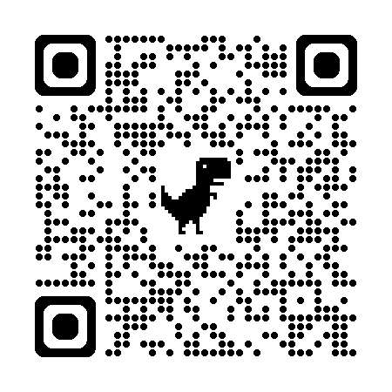
LIVE DEMO
Human vs. Model — let's play
Play it in your browser
lwurtzel.github.io/Discerning-the-Synthetic
Same twenty images — can you beat the model?
SCAN TO PLAY
Notes:
Live demo: open the site or have the class scan the QR, play a quick round, and compare to the model. Keep it to a minute or two.

Slide 11
LESSONS LEARNED
What we learned
1
Detectors are brittle
A model trained on one generator collapses to chance on generators it never saw.
2
The failure is systematic
Training across generators helps — and the mistakes aren't random: unseen fakes get called “real.”
3
Generalization is the real challenge
Thresholds trade off which errors you make; they don't teach the model new fingerprints.
Code, models & figures: github.com/LWurtzel/Discerning-the-Synthetic
Notes:
Three takeaways: brittleness, systematic failure toward 'real,' and generalization as the real frontier.

Slide 12
FUTURE DIRECTIONS
Where this goes next
The no-limits version — more data, more generators, a real tool:
1
Close the gap
Fine-tune on more generators and add newer ones — SDXL, DALL·E 3, Flux — so unseen-generator accuracy climbs.
2
Stress-test robustness
Does compression, resizing, or a small adversarial tweak break the detector? The real world is messy.
3
Calibrate & ship
Better-calibrated confidence, then package it as a browser extension people could actually use.
Notes:
Framed as the professor's 'money and a year off' prompt: close the generalization gap with more and newer generators, stress-test robustness against real-world image manipulations, and calibrate and ship it as a usable tool.

Slide 13
Thank you
Questions?
R
F
F
R
F
R
F
R
F
R
github.com/LWurtzel/Discerning-the-Synthetic
Notes:
Close and invite questions — you have 2 minutes of Q&A.

