Slide 1

Flink Streaming
Marton Balassi
Flink committer
data Artisans
@MartonBalassi

Slide 2

Stream processing

Slide 3
Stream
Infinite sequence of data arriving in a continuous fashion.

Slide 4
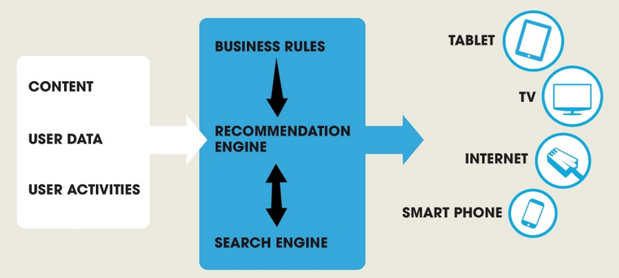
An example streaming use case
Recommender system
Based on historic item ratings
And on the activity of the user
Provide recommendations
To tens of millions of users
From millions of items
With a 100 msec latency guarantee
Figure courtesy of Gravity R&D, used with permission.

Slide 5
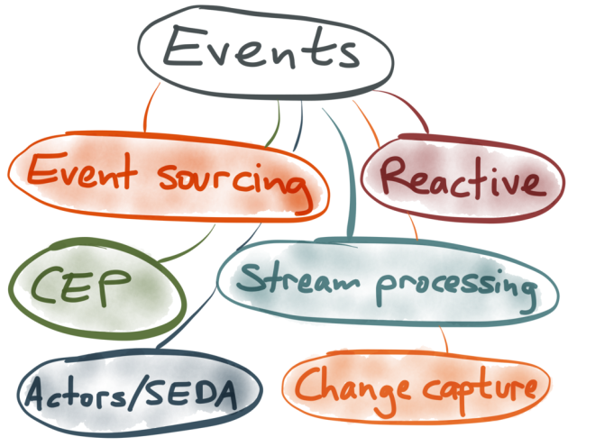
Many buzzwords, similar concepts
Figure courtesy of Martin Kleppmann, used with permission.

Slide 6
Streaming systems
Apache Storm
True streaming, low latency - lower throughput
Low level API (Bolts, Spouts) + Trident
Spark Streaming
Stream processing on top of batch system, high throughput - higher latency
Functional API (DStreams), restricted by batch runtime
Flink Streaming
True streaming with adjustable latency-throughput trade-off
Rich functional API exploiting streaming runtime; e.g. rich windowing semantics
Apache Samza
True streaming built on top of Apache Kafka, state is first class citizen
Slightly different stream notion, low level API

Slide 7
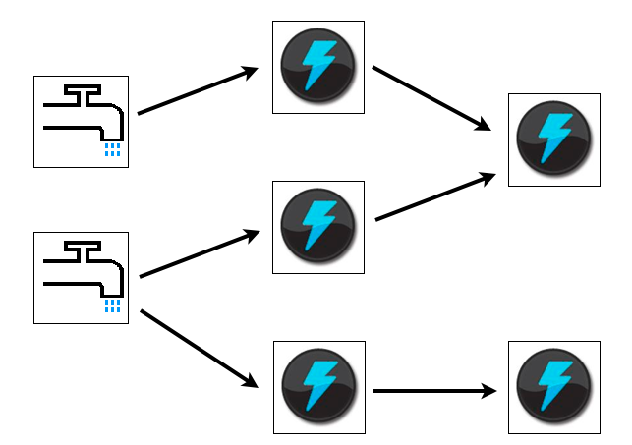
Streaming systems
Apache Storm
True streaming, low latency - lower throughput
Low level API (Bolts, Spouts) + Trident
Figure courtesy of Apache Storm, source: http://storm.apache.org/images/topology.png

Slide 8
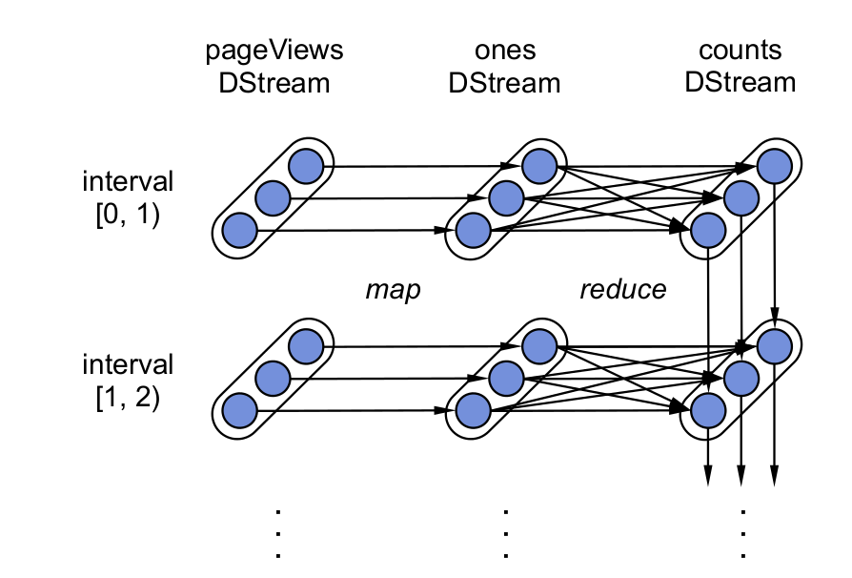
Streaming systems
Spark Streaming
Stream processing on top of batch system, high throughput - higher latency
Functional API (DStreams), restricted by batch runtime
Figure courtesy of Matei Zaharia, source: http://cs.berkeley.edu/~matei/papers/2013/sosp_spark_streaming.pdf, page 6

Slide 9
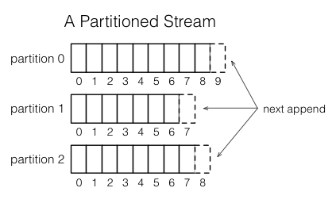
Streaming systems
Apache Samza
True streaming built on top of Apache Kafka, state is first class citizen
Slightly different stream notion, low level API
Figure courtesy of Apache Samza, source: http://samza.apache.org/img/0.8/learn/documentation/introduction/stream.png

Slide 10
Streaming systems
Apache Storm
True streaming, low latency - lower throughput
Low level API (Bolts, Spouts) + Trident
Spark Streaming
Stream processing on top of batch system, high throughput - higher latency
Functional API (DStreams), restricted by batch runtime
Flink Streaming
True streaming with adjustable latency-throughput trade-off
Rich functional API exploiting streaming runtime; e.g. rich windowing semantics
Apache Samza
True streaming built on top of Apache Kafka, state is first class citizen
Slightly different stream notion, low level API

Slide 11
Streaming in Flink
Python API
(upcoming)
Graph API
Apache
MRQL
Scala API
Java API
Common API
Embedded
environment
(Java collections)
Flink Optimizer
Flink Stream Builder
Flink Local Runtime
Local
Environment
(for debugging)
Remote environment
(Regular cluster execution)
Apache Tez
Single node execution
Standalone or YARN cluster
Data
storage
Files
HDFS
S3
JDBC
HBase
Kafka
Rabbit MQ
Flume
…

Slide 12
Using Flink Streaming

Slide 13
Example: StockPrices
Reading from multiple inputs
Merge stock data from various sources
Window aggregations
Compute simple statistics over windows of data
Data driven windows
Define arbitrary windowing semantics
Combining with a Twitter stream
Enrich your analytics with social media feeds
Streaming joins
Join multiple data streams
Detailed explanation and source code on our blog
http://flink.apache.org/news/2015/02/09/streaming-example.html

Slide 14
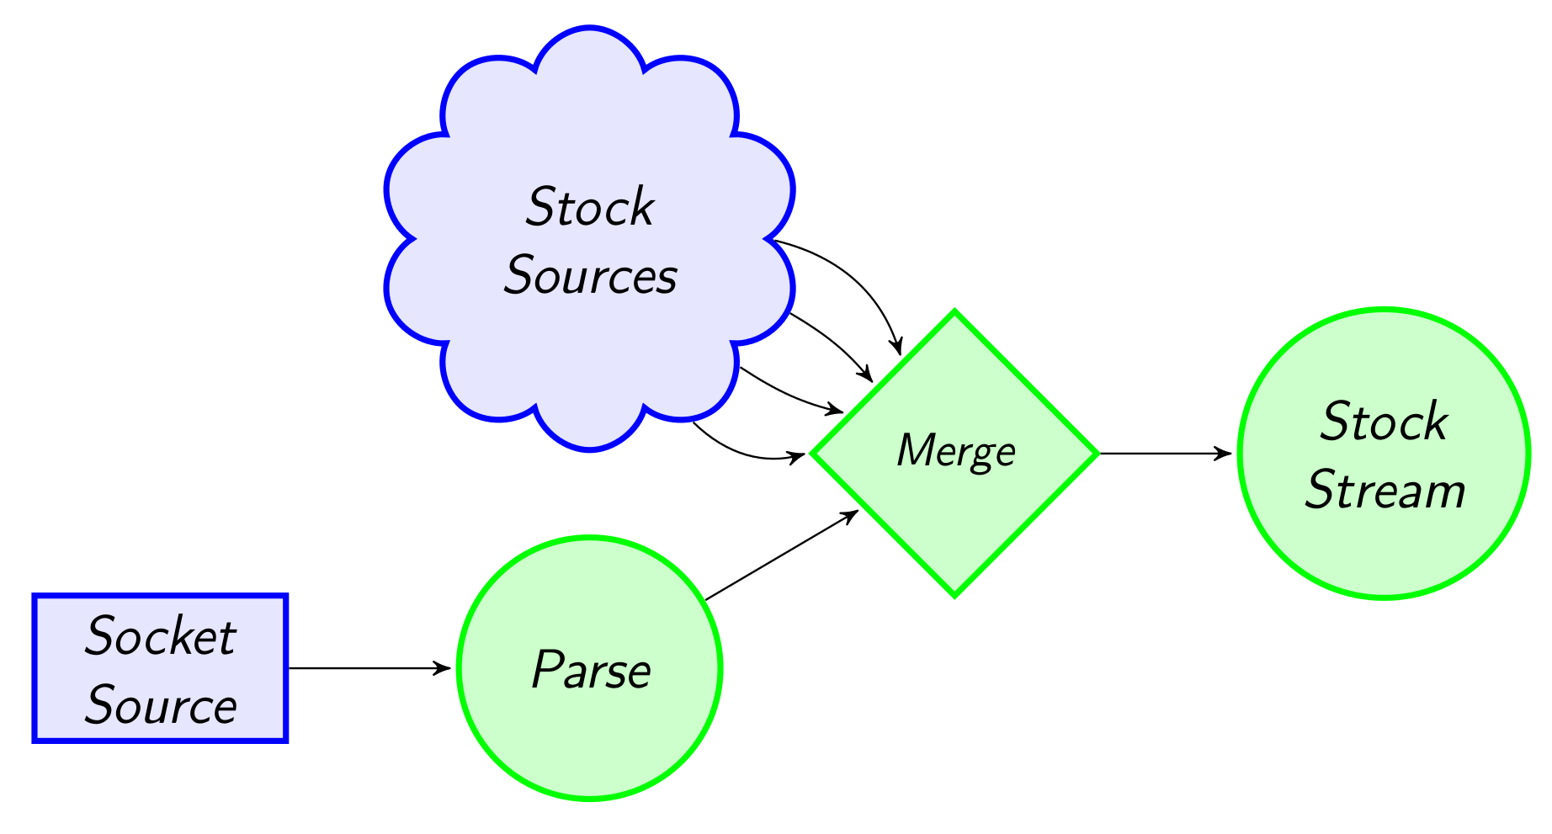
Example: Reading from multiple inputs
(3)
StockPrice(SPX, 2113.9)
StockPrice(FTSE, 6931.7)
(4)
StockPrice(SPX, 2113.9)
StockPrice(FTSE, 6931.7)
StockPrice(HDP, 23.8)
StockPrice(HDP, 26.6)
(1)
"HDP, 23.8"
"HDP, 26.6"
(2)
case class StockPrice(symbol : String, price : Double)
val env = StreamExecutionEnvironment.getExecutionEnvironment
val socketStockStream = env.socketTextStream("localhost", 9999)
.map(x => { val split = x.split(",")
StockPrice(split(0), split(1).toDouble) })
val SPX_Stream = env.addSource(generateStock("SPX")(10) _)
val FTSE_Stream = env.addSource(generateStock("FTSE")(20) _)
val stockStream = socketStockStream.merge(SPX_Stream, FTSE_STREAM)
(1)
(2)
(3)
(4)

Slide 15
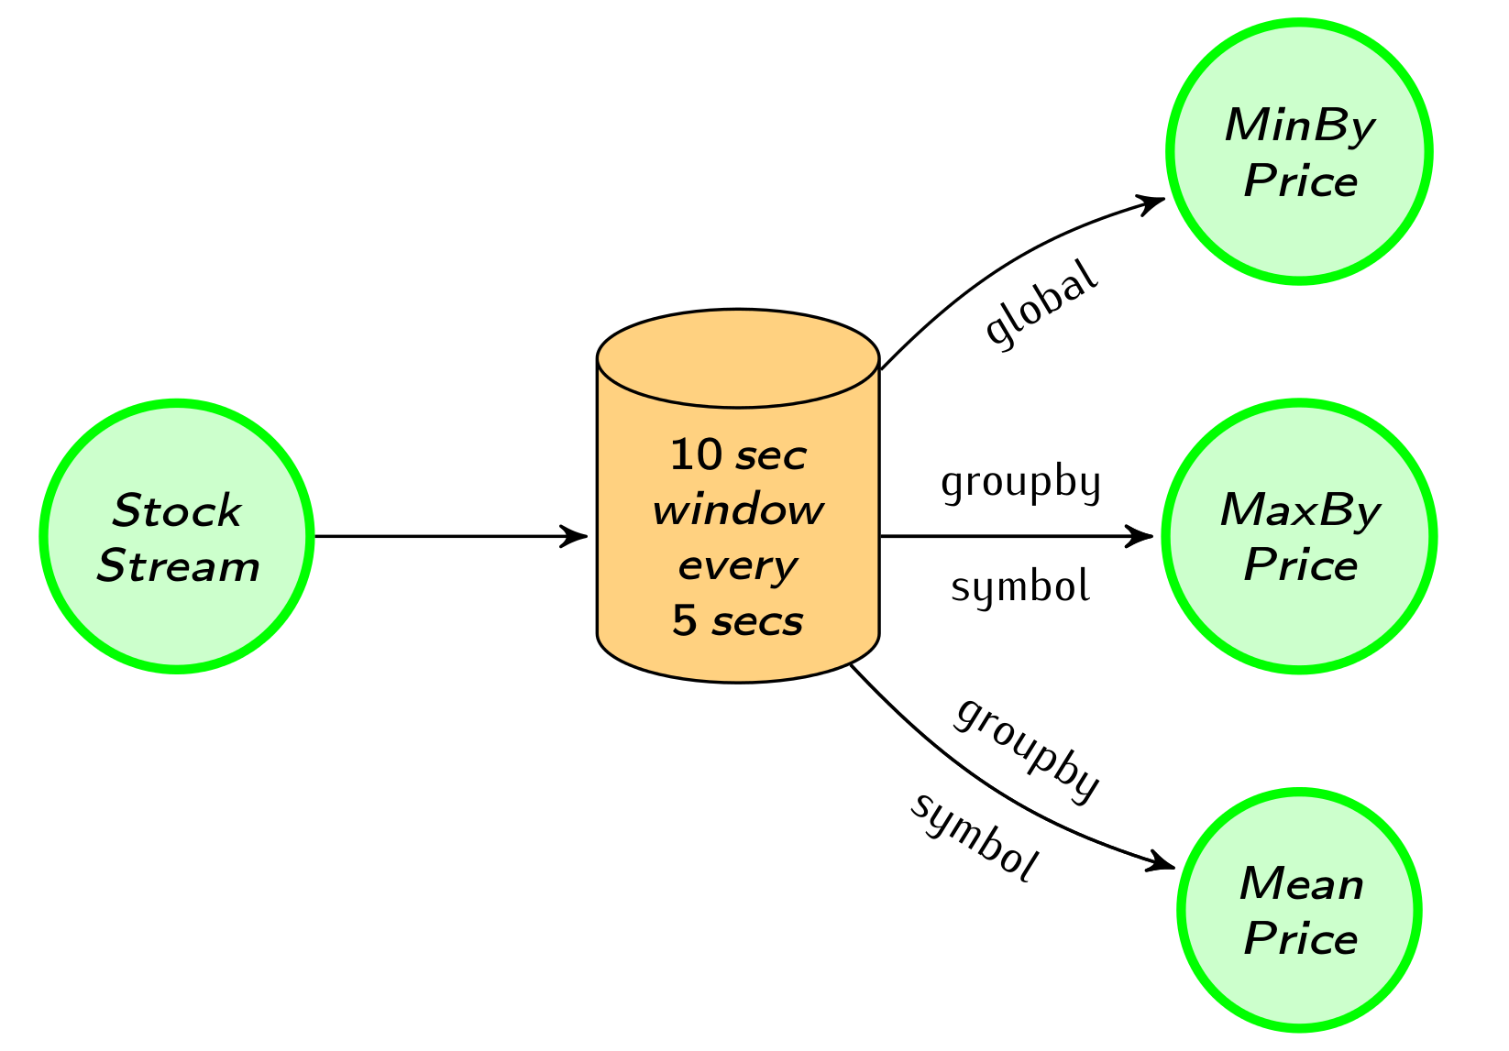
Example: Window aggregations
(2)
StockPrice(HDP, 23.8)
StockPrice(SPX, 2113.9)
StockPrice(FTSE, 6931.7)
StockPrice(HDP, 23.8)
StockPrice(HDP, 26.6)
(1)
StockPrice(SPX, 2113.9)
StockPrice(FTSE, 6931.7)
StockPrice(HDP, 26.6)
(3)
StockPrice(SPX, 2113.9)
StockPrice(FTSE, 6931.7)
StockPrice(HDP, 25.2)
(4)
val windowedStream = stockStream
.window(Time.of(10, SECONDS)).every(Time.of(5, SECONDS))
val lowest = windowedStream.minBy("price")
val maxByStock = windowedStream.groupBy("symbol").maxBy("price")
val rollingMean = windowedStream.groupBy("symbol").mapWindow(mean _)
(1)
(2)
(3)
(4)

Slide 16
Windowing
Trigger policy
When to trigger the computation on current window
Eviction policy
When data points should leave the window
Defines window width/size
E.g., count-based policy
evict when #elements > n
start a new window every n-th element
Built-in: Count, Time, Delta policies

Slide 17
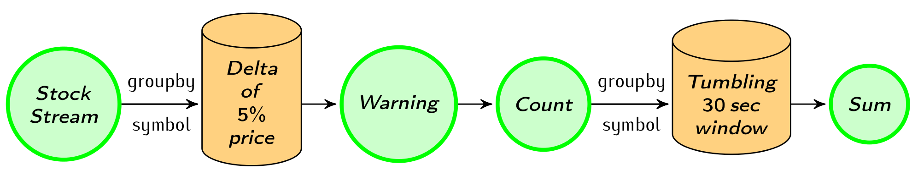
Example: Data-driven windows
StockPrice(SPX, 2113.9)
StockPrice(FTSE, 6931.7)
StockPrice(HDP, 23.8)
StockPrice(HDP, 26.6)
(1)
(3)
(2)
(4)
StockPrice(HDP, 23.8)
StockPrice(HDP, 26.6)
Count(HDP, 1)
case class Count(symbol : String, count : Int)
val priceWarnings = stockStream.groupBy("symbol") .window(Delta.of(0.05, priceChange, defaultPrice)) .mapWindow(sendWarning _)
val warningsPerStock = priceWarnings.map(Count(_, 1)) .groupBy("symbol")
.window(Time.of(30, SECONDS))
.sum("count")
(1)
(2)
(3)
(4)

Slide 18
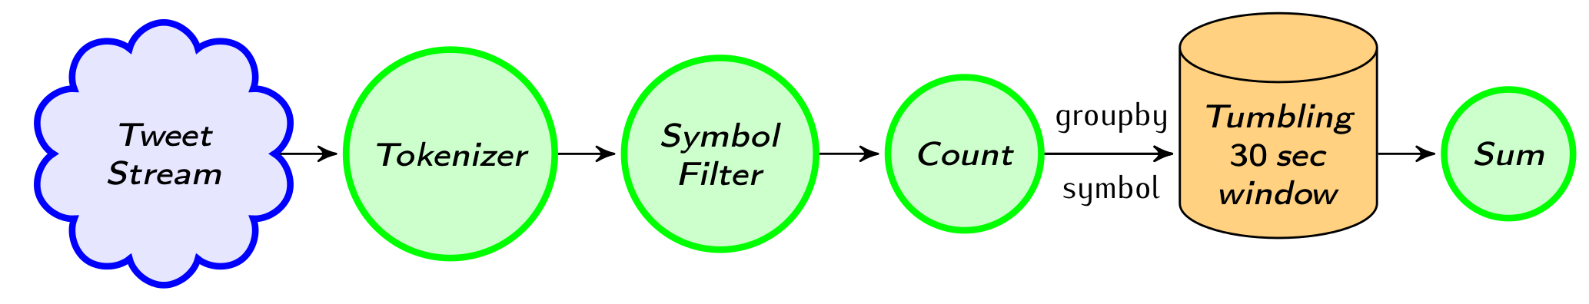
Example: Combining with a Twitter stream
"hdp is on the rise!"
"I wish I bought more YHOO and HDP stocks"
(4)
(2)
(3)
(1)
Count(HDP, 2)
Count(YHOO, 1)
(1)
val tweetStream = env.addSource(generateTweets _)
val mentionedSymbols = tweetStream.flatMap(tweet => tweet.split(" ")) .map(_.toUpperCase())
.filter(symbols.contains(_))
val tweetsPerStock = mentionedSymbols.map(Count(_, 1)) .groupBy("symbol")
.window(Time.of(30, SECONDS))
.sum("count")
(2)
(3)
(4)

Slide 19
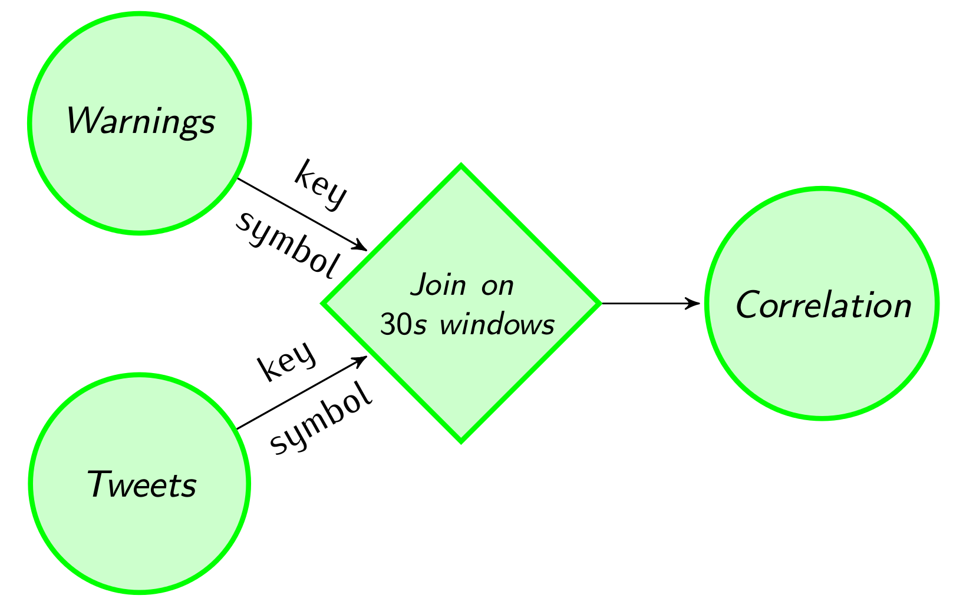
Example: Streaming joins
Count(HDP, 1)
(1)
(2)
0.5
Count(HDP, 2)
Count(YHOO, 1)
(1,2)
val tweetsAndWarning = warningsPerStock.join(tweetsPerStock) .onWindow(30, SECONDS)
.where("symbol")
.equalTo("symbol"){ (c1, c2) => (c1.count, c2.count) }
val rollingCorrelation = tweetsAndWarning
.window(Time.of(30, SECONDS))
.mapWindow(computeCorrelation _)
(1)
(2)

Slide 20
Overview of the API
Data stream sources
File system
Message queue connectors
Arbitrary source functionality
Stream transformations
Basic transformations: Map, Reduce, Filter, Aggregations…
Binary stream transformations: CoMap, CoReduce…
Windowing semantics: Policy based flexible windowing (Time, Count, Delta…)
Temporal binary stream operators: Joins, Crosses…
Iterative stream transformations
Data stream outputs
For the details please refer to the programming guide:
http://flink.apache.org/docs/latest/streaming_guide.html

Slide 21
Internals

Slide 22
Streaming in Flink
Python API
(upcoming)
Graph API
Apache
MRQL
Scala API
Java API
Common API
Embedded
environment
(Java collections)
Flink Optimizer
Flink Stream Builder
Flink Local Runtime
Local
Environment
(for debugging)
Remote environment
(Regular cluster execution)
Apache Tez
Single node execution
Standalone or YARN cluster
Data
storage
Files
HDFS
S3
JDBC
HBase
Kafka
Rabbit MQ
Flume
…

Slide 23

Programming model
Data abstraction: Data Stream
Program
Data Stream A
X
Data Stream B
Y
Data Stream C
Operator X
Operator Y
Parallel Execution
A (1)
X
B (1)
Y
C (1)
A (2)
X
B (2)
Y
C (2)

Slide 24
Fault tolerance
At-least-once semantics
All the records are processed, but maybe multiple times
Source level in-memory replication
Record acknowledgments
In case of failure the records are replayed from the sources
Storm supports this approach
Currently in alpha version

Slide 25
Fault tolerance
Exactly once semantics
User state is a first class citizen
Checkpoint triggers emitted from sources in line with the data
When an operator sees a checkpoint it asyncronously checkpoints its state
Upstream recovery from last checkpoint
Spark and Samza supports this approach
Final goal, current challenge

Slide 26
Roadmap
Fault tolerance – 2015 Q1-2
Lambda architecture – 2015 Q2
Runtime Optimisations - 2015 Q2
Full Scala interoperability – 2015 Q2
Integration with other frameworks
SAMOA – 2015 Q1
Zeppelin – 2015 ?
Machine learning Pipelines library – 2015 Q3
Streaming graph processing library – 2015 Q3

Slide 27
Performance

Slide 28
Flink Streaming performance
Current measurements are outdated
Last measurements showed twice the throughput of Storm
In a recent specific telecom use case throughput was higher than Spark Streaming’s
New blogpost on performance measures is coming soon!

Slide 29
Closing

Slide 30
Summary
Flink combines true streaming runtime with expressive high-level APIs for a next-gen stream processing solution
Flexible windowing semantics
Iterative processing support opens new horizons in online machine learning
Competitive performance
We are just getting started!

Slide 31
flink.apache.org @ApacheFlink

Slide 32
Appendix

Slide 33
Basic transformations
Rich set of functional transformations:
Map, FlatMap, Reduce, GroupReduce, Filter, Project…
Aggregations by field name or position
Sum, Min, Max, MinBy, MaxBy, Count…
Source
Map
Reduce
Merge
Sum
Sink
Source
FlatMap

Slide 34
Binary stream transformations
Apply shared transformations on streams of different types.
Shared state between transformations
CoMap, CoFlatMap, CoReduce…
public interface CoMapFunction<IN1, IN2, OUT> {
public OUT map1(IN1 value);
public OUT map2(IN2 value);
}

Slide 35

Iterative stream processing
Feedback stream
T
R
Output stream
Step function
def iterate[R](
stepFunction: DataStream[T] => (DataStream[T], DataStream[R]),
maxWaitTimeMillis: Long = 0 ): DataStream[R]

Slide 36
Operator chaining
Filter
Map
Reduce
Map -> Filter
Reduce
F-1
M-1
R-1
M-1
F-1
R-1
F-2
M-2
R-2
M-2
F-2
R-2
Reduce
R-1
Reduce
R-1
R-2
R-2

Slide 37
Processing graph with chaining
Forward
Shuffle

Slide 38
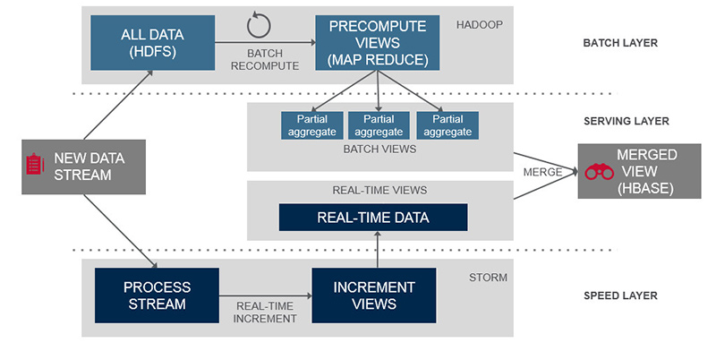
Lambda architecture
In other systems
Source: https://www.mapr.com/developercentral/lambda-architecture

Slide 39
Lambda architecture
In Apache Flink
One System
One API
One cluster

Slide 40
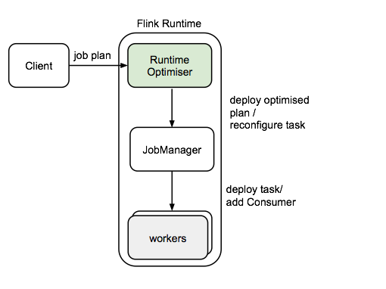
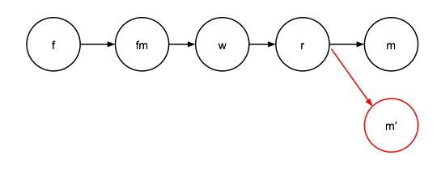
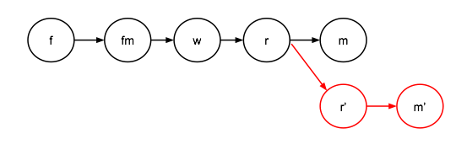
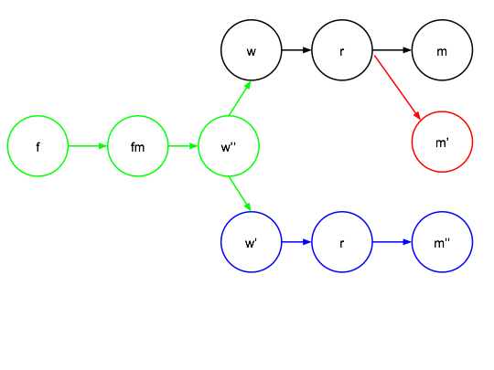
Query Optimisations
Reusing Intermediate Results Between Operators
Reuse
Containment
Derivability

Slide 41
Scala Interoperability
Seamlessly integrate Flink streaming programs into scala pipelines
Scala streams implicitly converted to DataStreams
In the future the output streams will be converted back to Scala streams
fibs.window(Count of 4).reduce((x,y)=>x+y).print
def fibs():Stream[Int] = {0 #:: fibs.getExecutionEnvironment.scanLeft(1)(_ + _)}

Slide 42
Machine Learning Pipelines
Measures
Classification
Evaluation
ETL
Sampling
Clustering
Mixing periodic ML batch components
with streaming components

Slide 43
Streaming graphs
time
Streaming new edges
Keeping only the fresh state
Continuous graph analytics

