Slide 1

Real-time Stream Processing with Apache Flink
Marton Balassi – data Artisans Gyula Fora - SICS
Flink committers
mbalassi@apache.org / gyfora@apache.org

Slide 2
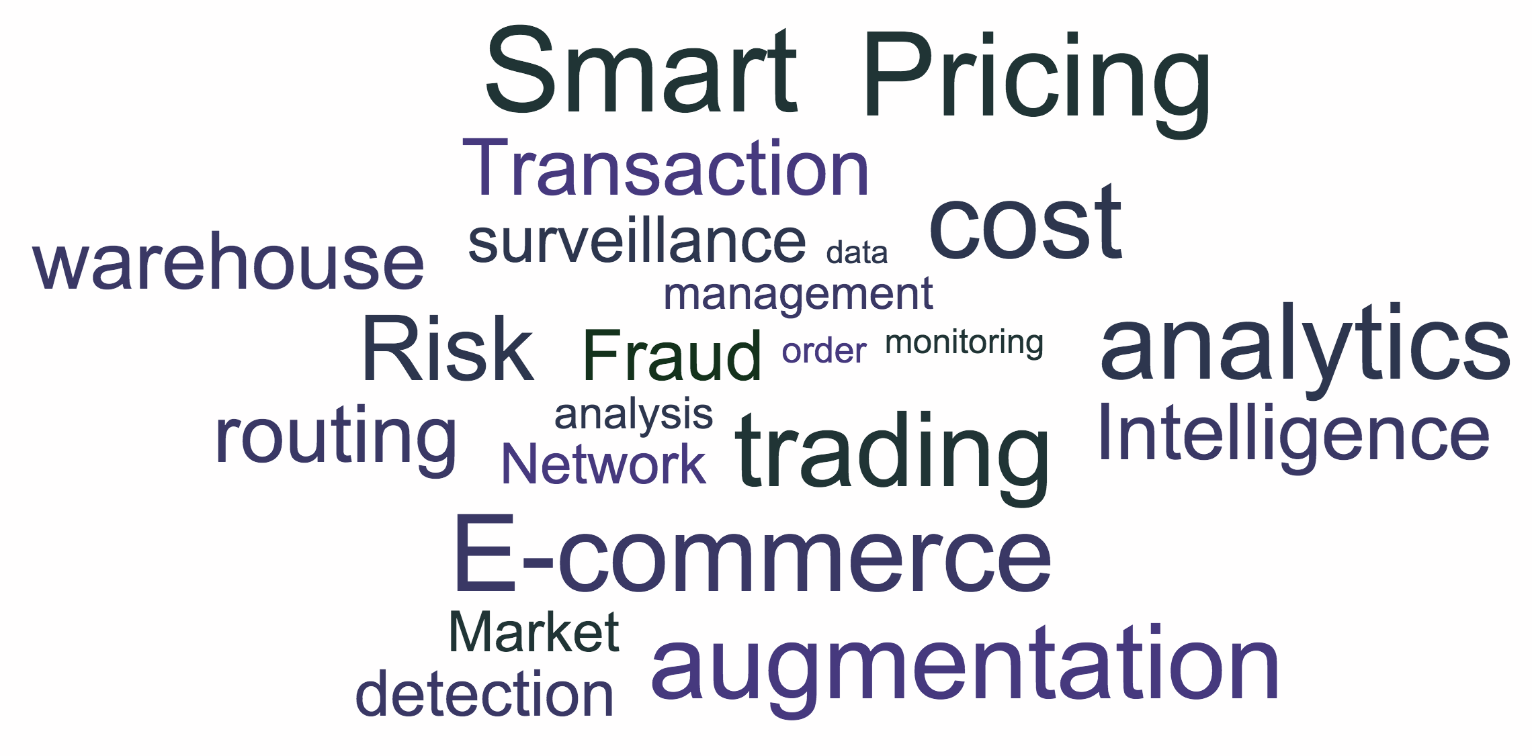
Stream Processing
Data stream: Infinite sequence of data arriving in a continuous fashion.
Stream processing: Analyzing and acting on real-time streaming data, using continuous queries

Slide 3
Streaming landscape
Apache Storm
True streaming, low latency - lower throughput
Low level API (Bolts, Spouts) + Trident
Spark Streaming
Stream processing on top of batch system, high throughput - higher latency
Functional API (DStreams), restricted by batch runtime
Apache Flink
True streaming with adjustable latency-throughput trade-off
Rich functional API exploiting streaming runtime; e.g. rich windowing semantics
Slightly different stream notion, low level API
True streaming built on top of Apache Kafka, state is first class citizen
Apache Samza

Slide 4
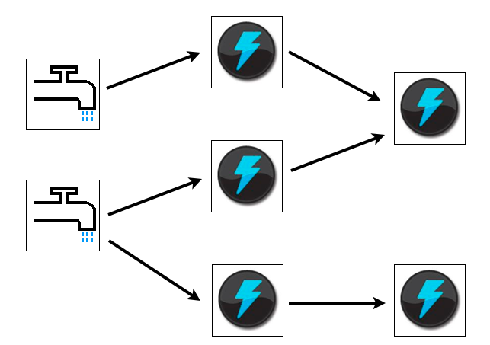
Apache Storm
True streaming, low latency - lower throughput
Low level API (Bolts, Spouts) + Trident
At-least-once processing guarantees
Issues
Costly fault tolerance
Serialization
Low level API

Slide 5
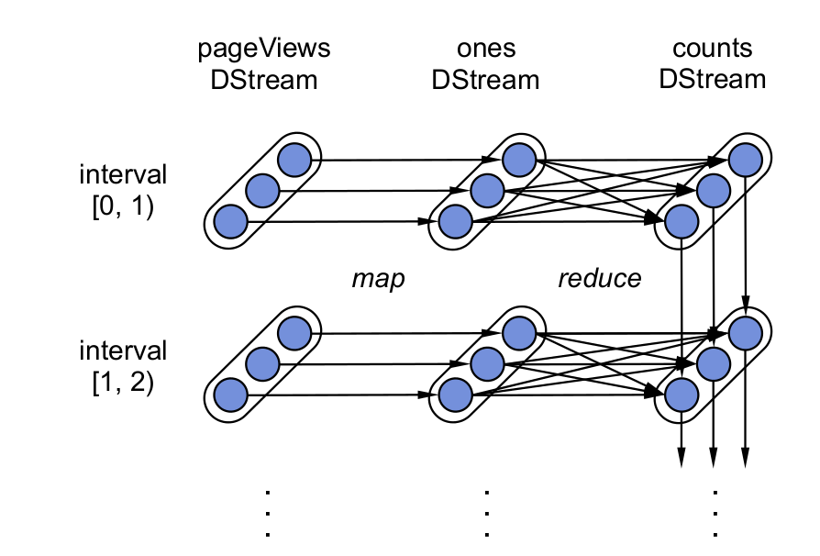
Spark Streaming
Stream processing emulated on a batch system
High throughput - higher latency
Functional API (DStreams)
Exactly-once processing guarantees
Issues
Restricted streaming semantics
Windowing
High latency

Slide 6
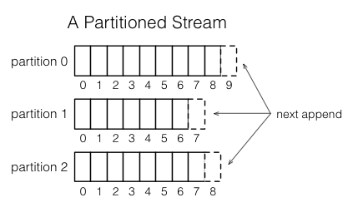
Apache Samza
True streaming built on top of Apache Kafka
Slightly different stream notion, low level API
At-least-once processing guarantees with state
Issues
High disk IO
Low level API

Slide 7
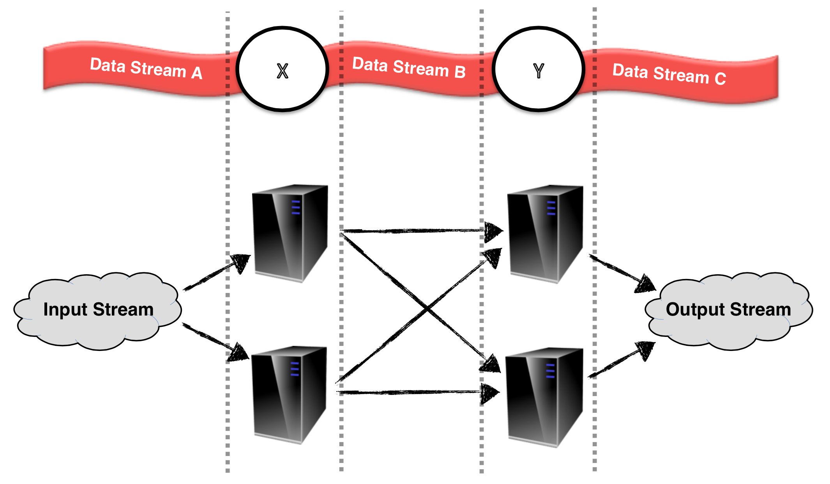
Apache Flink
True streaming with adjustable latency and throughput
Rich functional API exploiting streaming runtime
Flexible windowing semantics
Exactly-once processing guarantees with (small) state
Issues
Limited state size
HA issue

Slide 8

Apache Flink

Slide 9
What is Flink
A "use-case complete" framework to unify batch and stream processing
Event logs
ETL
Relational
Graph analysis
Machine learning
Streaming analysis
Historic data

Slide 10



What is Flink
An engine that puts equal emphasis to streaming and batch
Real-time data
streams
Flink
ETL, Graphs, Machine Learning Relational, …
Low latency windowing, aggregations, ...
Event logs
Kafka, RabbitMQ, ...
Historic data
HDFS, JDBC, ...

Slide 11
Flink stack
*current Flink master + few PRs
Gelly
Flink ML
SAMOA
Python
Table
Dataflow
Dataflow
Hadoop M/R
DataSet (Java/Scala)
DataStream (Java/Scala)
Batch Optimizer
Streaming Optimizer
Flink Runtime
Local
Remote
Yarn
Tez
Embedded

Slide 12
Flink Streaming

Slide 13
Overview of the API
Src
Map
Reduce
Data stream sources
File system
Message queue connectors
Arbitrary source functionality
Stream transformations
Basic transformations: Map, Reduce, Filter, Aggregations…
Binary stream transformations: CoMap, CoReduce…
Windowing semantics: Policy based flexible windowing (Time, Count, Delta…)
Temporal binary stream operators: Joins, Crosses…
Native support for iterations
Data stream outputs
For the details please refer to the programming guide:
http://flink.apache.org/docs/latest/streaming_guide.html
Merge
Sum
Sink
Src
Filter
Notes:
3 main components to the system: Connectors(sources), Operators(trafos), Sinks (outputs)
The source interface is as general as it gets + preimplemented connectors
Rich set of operators, designed for true streaming analytics (long-standing, stateful, windowing)
Sinks are very general, same as sources. Simple interfaces + pre-implemented

Slide 14
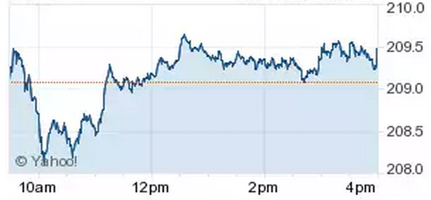
Use-case: Financial analytics
Reading from multiple inputs
Merge stock data from various sources
Window aggregations
Compute simple statistics over windows of data
Data driven windows
Define arbitrary windowing semantics
Combine with sentiment analysis
Enrich your analytics with social media feeds (Twitter)
Streaming joins
Join multiple data streams
Detailed explanation and source code on our blog
http://flink.apache.org/news/2015/02/09/streaming-example.html
Notes:
-The goal is to showcase the main features of the api on a “real world” example
-Use-case: Analyze streams of stock market data, which consists of (Stock symbol, Stock price) pairs
-Sentiment analysis: Combine the market information with information aquired from social media feeds (in this case the nr of times the stock symbol was mentioned in the twitter stream)
-Use stream joins for this ^

Slide 15
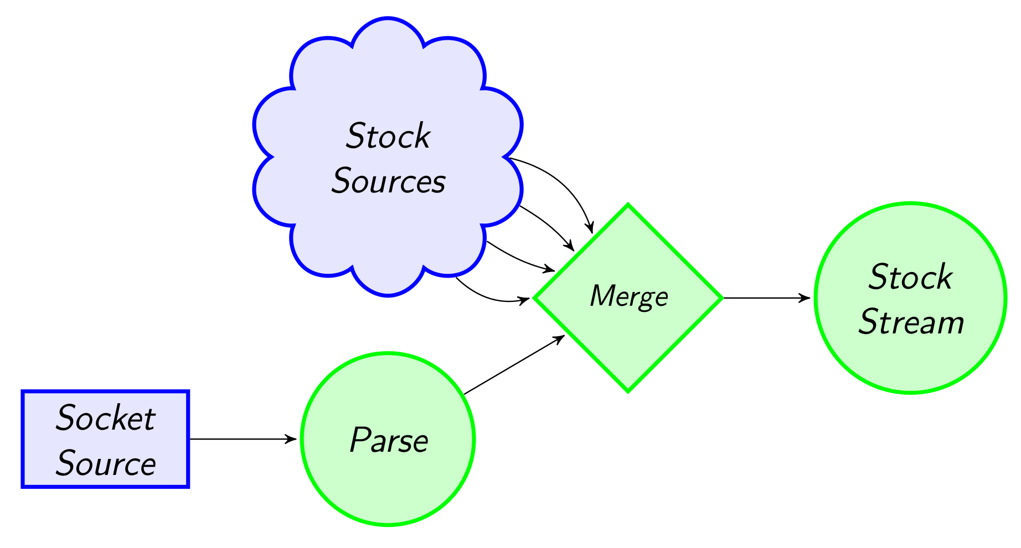
Reading from multiple inputs
StockPrice(SPX, 2113.9)
(3)
StockPrice(FTSE, 6931.7)
(4)
StockPrice(SPX, 2113.9)
StockPrice(FTSE, 6931.7)
StockPrice(HDP, 23.8)
StockPrice(HDP, 26.6)
(1)
"HDP, 23.8"
"HDP, 26.6"
(2)
case class StockPrice(symbol : String, price : Double)
val env = StreamExecutionEnvironment.getExecutionEnvironment
val socketStockStream = env.socketTextStream("localhost", 9999)
.map(x => { val split = x.split(",")
StockPrice(split(0), split(1).toDouble) })
val SPX_Stream = env.addSource(generateStock("SPX")(10) _)
val FTSE_Stream = env.addSource(generateStock("FTSE")(20) _)
val stockStream = socketStockStream.merge(SPX_Stream, FTSE_STREAM)
(1)
(2)
(3)
(4)
Notes:
- As a first step we need to connect to our data streams, and parse our inputs
Here we use a simple socket stream and convert it to a case-class
-> Could have used kafka or any other message queue + or more advanced stock representation

Slide 16
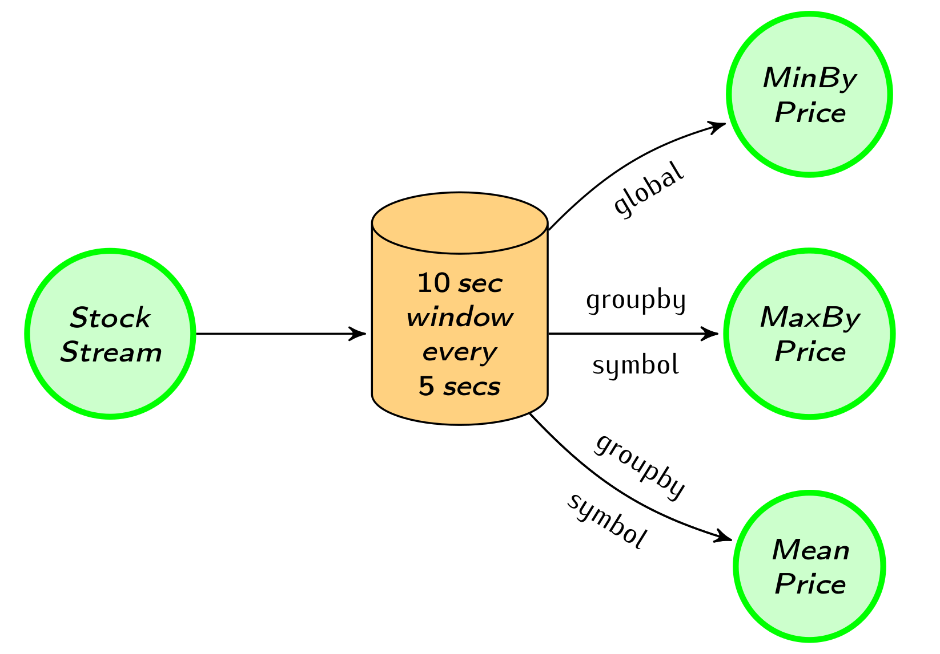
Window aggregations
(2)
StockPrice(HDP, 23.8)
StockPrice(SPX, 2113.9)
StockPrice(FTSE, 6931.7)
StockPrice(HDP, 23.8)
StockPrice(HDP, 26.6)
(1)
StockPrice(SPX, 2113.9)
StockPrice(FTSE, 6931.7)
StockPrice(HDP, 26.6)
(3)
StockPrice(SPX, 2113.9)
StockPrice(FTSE, 6931.7)
StockPrice(HDP, 25.2)
(4)
val windowedStream = stockStream
.window(Time.of(10, SECONDS)).every(Time.of(5, SECONDS))
val lowest = windowedStream.minBy("price")
val maxByStock = windowedStream.groupBy("symbol").maxBy("price")
val rollingMean = windowedStream.groupBy("symbol").mapWindow(mean _)
(1)
(2)
(3)
(4)
Notes:
Talk about policy based windowing -> eviction(window size), trigger (slide size)
Window operations: reduce, mapWindow
Grouped vs non-grouped windowing

Slide 17
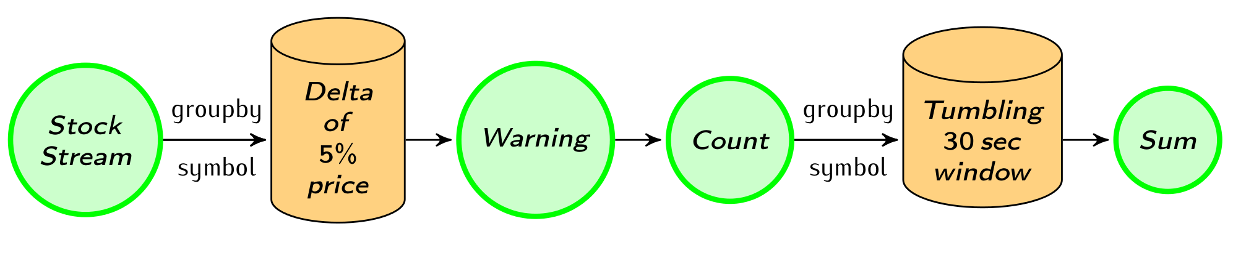
Data-driven windows
StockPrice(SPX, 2113.9)
StockPrice(FTSE, 6931.7)
StockPrice(HDP, 23.8)
StockPrice(HDP, 26.6)
(1)
(3)
(2)
(4)
StockPrice(HDP, 23.8)
StockPrice(HDP, 26.6)
Count(HDP, 1)
case class Count(symbol : String, count : Int)
val priceWarnings = stockStream.groupBy("symbol")
.window(Delta.of(0.05, priceChange, defaultPrice))
.mapWindow(sendWarning _)
val warningsPerStock = priceWarnings.map(Count(_, 1)) .groupBy("symbol")
.window(Time.of(30, SECONDS))
.sum("count")
(1)
(2)
(3)
(4)
Notes:
Flexible windowing -> awesome features
Delta policy
Case-class Count for convenience
Mention other cool use-cases: detecting user sessions

Slide 18
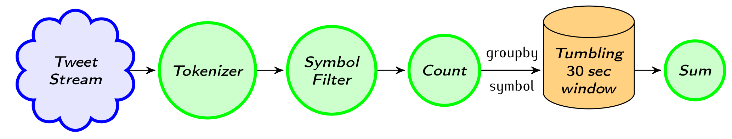
Combining with a Twitter stream
"hdp is on the rise!"
"I wish I bought more YHOO and HDP stocks"
(4)
(2)
(3)
(1)
Count(HDP, 2)
Count(YHOO, 1)
(1)
val tweetStream = env.addSource(generateTweets _)
val mentionedSymbols = tweetStream.flatMap(tweet => tweet.split(" "))
.map(_.toUpperCase())
.filter(symbols.contains(_))
val tweetsPerStock = mentionedSymbols.map(Count(_, 1)).groupBy("symbol")
.window(Time.of(30, SECONDS))
.sum("count")
(2)
(3)
(4)
Notes:
Simple windowed word count on the filtered tweet stream for each symbol

Slide 19
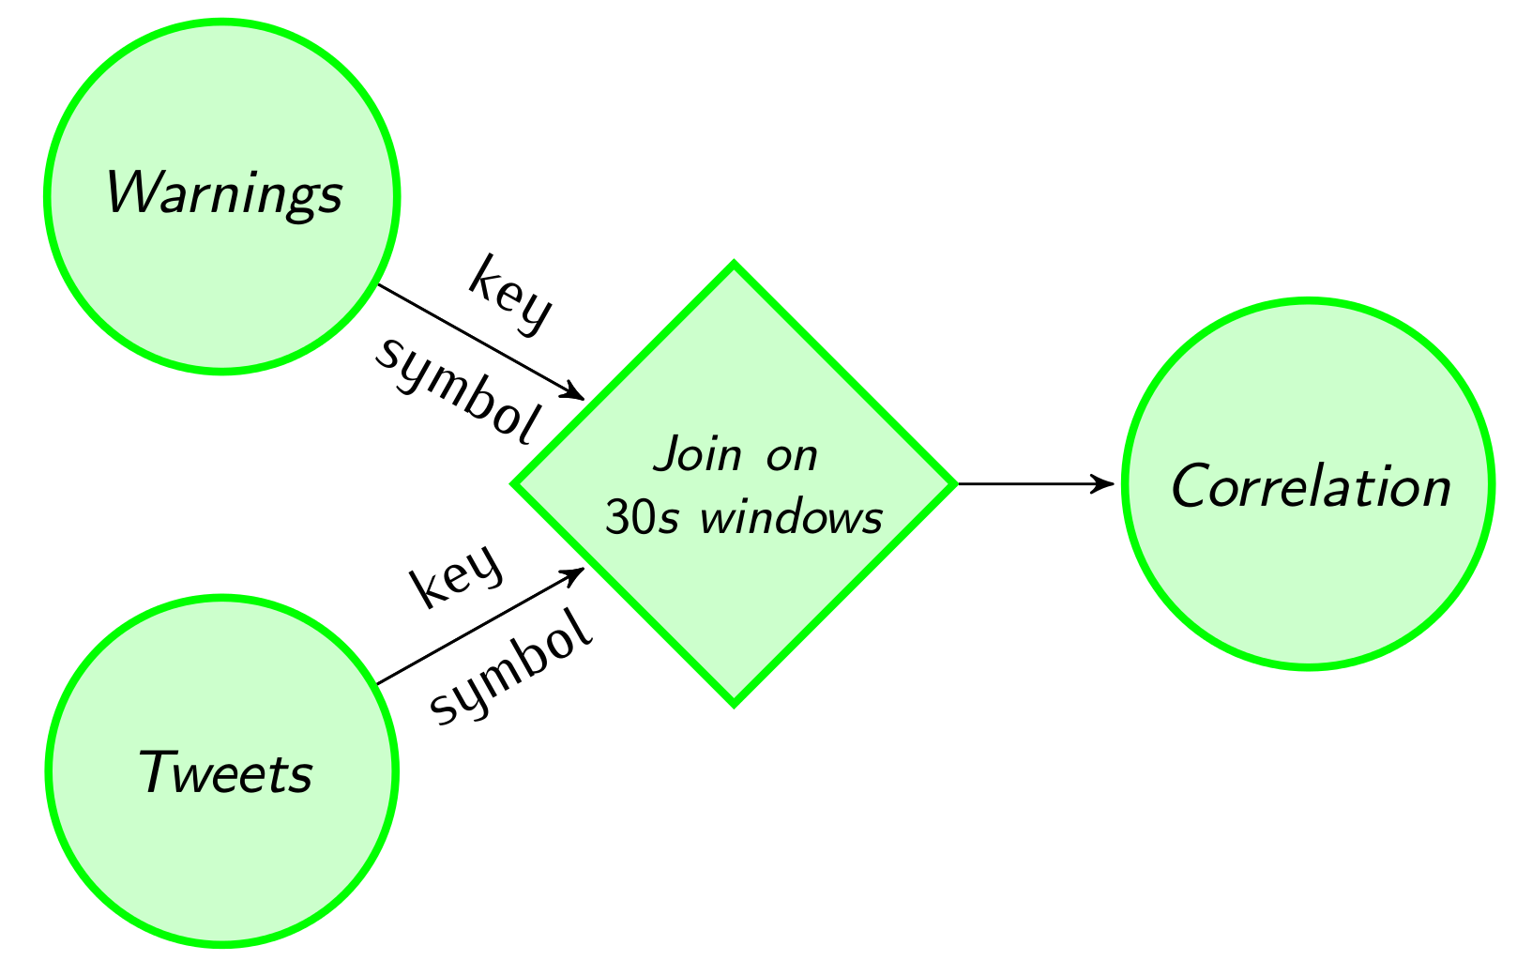
Streaming joins
Count(HDP, 1)
(1)
(2)
0.5
Count(HDP, 2)
Count(YHOO, 1)
(1,2)
val tweetsAndWarning = warningsPerStock.join(tweetsPerStock)
.onWindow(30, SECONDS)
.where("symbol")
.equalTo("symbol"){ (c1, c2) => (c1.count, c2.count) }
val rollingCorrelation = tweetsAndWarning
.window(Time.of(30, SECONDS))
.mapWindow(computeCorrelation _)
(1)
(2)

Slide 20
Fault tolerance
Exactly once semantics
Asynchronous barrier snapshotting
Checkpoint barriers streamed from the sources
Operator state checkpointing + source backup
Pluggable backend for state management
SM
State manager
Job manager
Operator
Snapshot barrier
Event channel
Data channel
Checkpoint
JM
SM
1
2
3
JM
1

Slide 21
Performance
Performance optimizations
Effective serialization due to strongly typed topologies
Operator chaining (thread sharing/no serialization)
Different automatic query optimizations
Competitive performance
~ 1.5m events / sec / core
As a comparison Storm promises ~ 1m tuples / sec / node

Slide 22
Roadmap
Persistent, high-throughput state backend
Job manager high availability
Application libraries
General statistics over streams
Pattern matching
Machine learning pipelines library
Streaming graph processing library
Integration with other frameworks
Zeppelin (Notebook)
SAMOA (Online ML)

Slide 23
Summary
Flink is a use-case complete framework to unify batch and stream processing
True streaming runtime with high-level APIs
Flexible, data-driven windowing semantics
Competitive performance
We are just getting started!

Slide 24

Flink Community
Unique git contributors

Slide 25
flink.apache.org @ApacheFlink

