Slide 1

Quality Assurance (QA)
and Testing

Slide 2
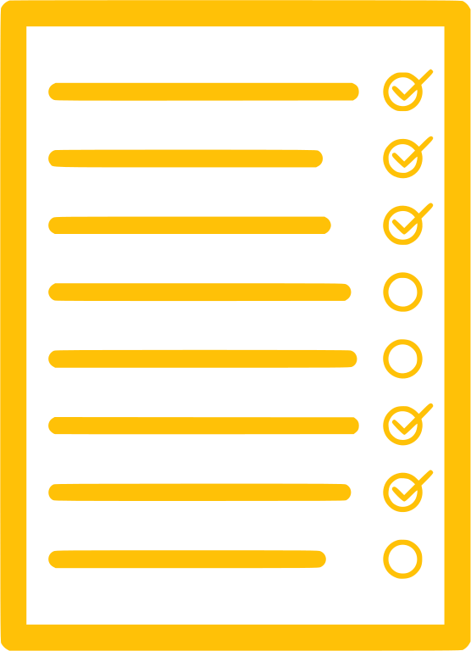
What is Testing?
Why?
EXPLAIN
Software testing is a process of evaluating a system to find bugs (or defects).
It is done to check if the system satisfies its requirements.
Assure customers that the product works.
Defects from not testing, give a bad reputation to the development company.
Defects detected earlier have lower cost to fix!
It’s much more expensive to fix a bug after release, than before.
The process of designing tests gives a different view of the requirements.
Writing tests is a good way to understand the requirements.
Many PNC graduates become full-time professional QA engineers!
Notes:
2min

Slide 3
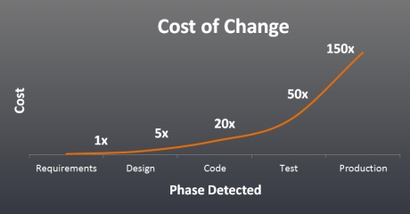

Slide 4
Types of Test
EXPLAIN
There are many kinds - Manual Testing, Automation Testing, Unit Testing, Performance Testing, Load Testing, A/B Testing, Beta Testing, Regression Testing, Smoke Testing, Monkey Testing, Usability Testing, Security Testing, Mutation Testing, UAT Testing… etc…
For a full list see https://artoftesting.com/software-testing-tutorial
Many of these are types of Automated test. These are tests run automatically using testing tools such as Selenium, PHPUnit, JMeter and many others.
Notes:
2min
Mutation Testing – Checking s/w quality by intentionally mutating the source code.
Monkey Testing - Testing performed with random inputs and without any test cases.
UAT Testing – Testing carried out by the end-user before releasing to production.

Slide 5
Manual Testing
EXPLAIN
A Manual Test is one done directly by a human.
Examples:
Click on a button. Does it do what you expected?
Fill in a web form. Check whether the data was saved in the database.
Enter bad data. Check whether we get the error message we expect.

Slide 6
Structure of a Test Plan
EXPLAIN
Test Name What am I testing? | Steps to do test If I do… | What output do I expect? The computer should do…
Login page should log me in | Enter correct username and password, and press Enter | Page should refresh, and display an icon to show I am logged in
… | … | …

Slide 7
Exercise (30min)
ACTIVITY
Think about the Acceptance Criteria (AC) you wrote earlier.
Write some tests for each AC. Try to write more than one test per AC.
Share your example with the group.
Example AC: “The login feature should log the user in, and handle errors.”
What am I testing? | Steps to do test | What output do I expect?
Login page should log me in | Enter correct username and password, and press Enter | Page should refresh, and display an icon to show I am logged in
Incorrect password should not let me in | Enter correct username, and incorrect password | Page should show an ‘incorrect password’ error after 3 seconds
Usability | Press Enter with fields left empty | Page should display error without submitting form to backend

Slide 8
How do we write a test?
EXPLAIN
Functional Testing
Think of each function - forms, buttons, processes, etc. How can we test each one?
Good User / Bad User, Good Data / Bad Data. How can we break the system?
Non-Functional Testing
Think of the non-interactive parts. Does the menu bar draw correctly? Does the website run fast enough? Does it crash? Are there console or log errors? Are there any security issues, like injection attacks?
Use Case / User Story Testing
Think of each user story - does the software do everything it needs to do for this?
Remember: one User Story can represent many Functions.
Development Task-based Testing
Each subtask in JIRA should be tested before it can be “Done”.

Slide 9
Exercise – Individual (15min + 5min)
ACTIVITY
Write an example User Story test, a Functional test, and a Non-functional test for one of your group’s other stories. Share your example with your group.
What am I testing? | Steps to do test | What output do I expect?
“As a customer, I want to see details of a show” (user story) | From main page, select a show, and check the details | Details should match the ones in the database. Page should show name, description, image, and link to buy tickets.
Logout button (functional) | Login as a user. Check that I am logged in. Click logout. Click through to some other pages on the site. | I expect to be logged out on all pages I visit.
Menu bar (non-functional) | Load each page on the site and look at the menu bar | The bar should be the same on each page, and the links on them should be useful.

Slide 10
Software Engineering
Advanced
Topics

Slide 11
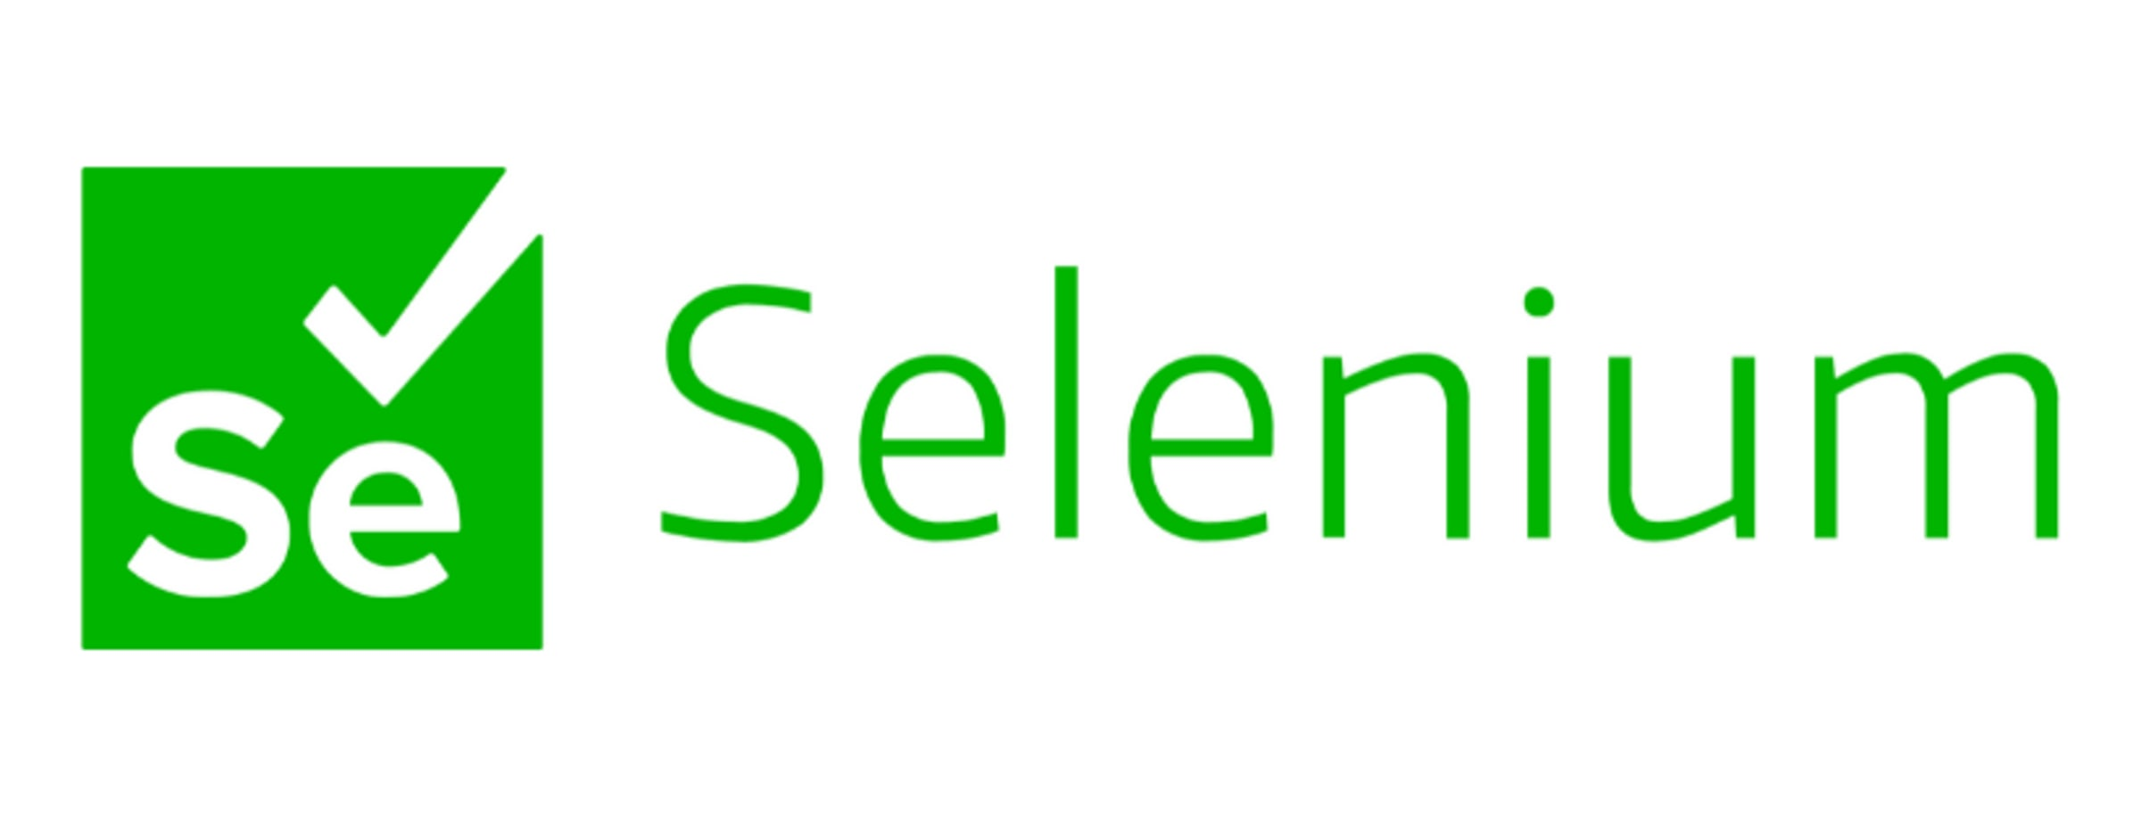
Automated Testing
EXPLAIN
Selenium is a popular, well-established web testing tool
Playwright is newer but becoming more popular
These let you record interactions with a webpage and make assertions (checks) about the results
Go to a URL. Click the “Submit” button. Does the result contain the string “Success message”?
By recording these tests, we can replay them every time we merge new code!
https://www.selenium.dev/

Slide 12
Automated Testing Demo
DEMO

Slide 13
Automated Testing
EXPLAIN
https://www.selenium.dev/
Automated tests are optional for the VC project, but you are encouraged to download and experiment in your own time.

Slide 14
Unit Testing
EXPLAIN
A unit of code is the smallest piece of code that can be isolated in a system. This is usually a function.
A unit test is a piece of code - usually written in the same language - that tests the unit independently of the rest of the system. It is a form of white box testing.
Because these usually involve small pieces of code and don’t require a full deployment, you can automatically and quickly run them as part of the build process.

Slide 15
Unit Testing in PHP (from tsh.io/blog/php-unit-testing)
EXPLAIN
<?php
class Product
{
private string $name;
private int $quantity;
public function __construct(string $name, int $quantity) {}
public function increaseQuantity(int $quantity): void
{
$this->quantity += $quantity;
}
public function getQuantity(): int
{
return $this->quantity;
}
}
Constructor body deleted to make space on the slide

Slide 16
Unit Testing in PHP (from tsh.io/blog/php-unit-testing)
EXPLAIN
<?php
use PHPUnit\Framework\TestCase;
class ProductTest extends TestCase
{
public function testIncreaseQuantityInProduct(): void
{
$chocolate = new Product("Chocolate", 2);
$chocolate->increaseQuantity(2);
self::assertSame(4, $chocolate->getQuantity());
}
}
“Assert” means “check”, or “test”.
It will return PASS or FAIL.

Slide 17
Unit Testing in Laravel
EXPLAIN
Advanced topic: optional for the VC project
See https://laravel.com/docs/10.x/testing for details

Slide 18
Exercise: start the test plan for your project
ACTIVITY
Create a spreadsheet (Excel, LibreOffice, Google Sheets, your team’s choice)
Make sections/tabs for user story, functional, and non-functional tests
Work with your team to make sure that all new features are tested!
Good luck!

