Slide 1
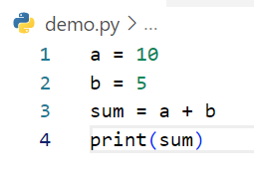
Write step following code below
Step | a | b | sum | output
1 | 10
2 | 10 | 5
3 | 10 | 5 | 15
4 | 10 | 5 | 15 | 15
Example

Slide 2
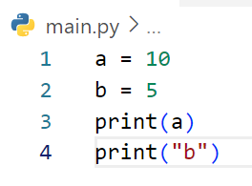
Write step following code below
Step | a | b | output
1 | 10
2 | 10 | 5
3 | 10 | 5 | 10
4 | 10 | 5 | b

Slide 3
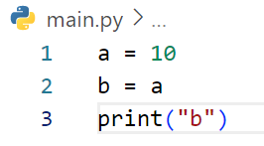
Write step following code below
Step | a | b | output
1 | 10
2 | 10 | 10
3 | 10 | 10 | b

Slide 4
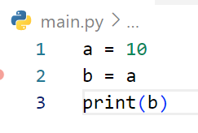
Write step following code below
Step | a | b | output
1 | 10
2 | 10 | 10
3 | 10 | 10 | 10

Slide 5
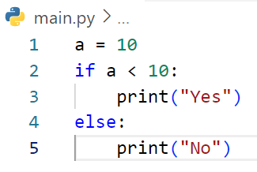
Write step following code below
Step | a | a < 10 | output
1 | 10
2 | 10 | False
3 | 10
4 | 10 |  | No

Slide 6
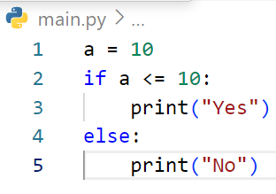
Write step following code below
Step | a | a <= 10 | output
1 | 10
2 | 10 | True
3 | 10 |  | Yes

Slide 7
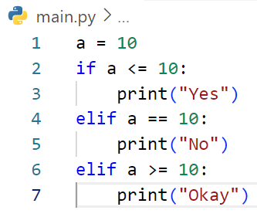
Write step following code below
Step | a | a <= 10 | a == 10 | a >= 10 | output
1 | 10
2 | 10 | True
3 | 10 |  |  |  | Yes

Slide 8
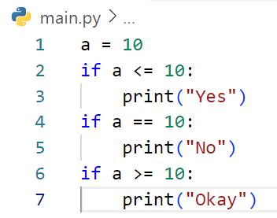
Write step following code below
Step | a | a <= 10 | a == 10 | a >= 10 | output
1 | 10
2 | 10 | True
3 | 10 |  |  |  | Yes
4 | 10 |  | True
5 | 10 |  |  |  | No
6 | 10 |  |  | True
7 | 10 |  |  |  | okay

Slide 9
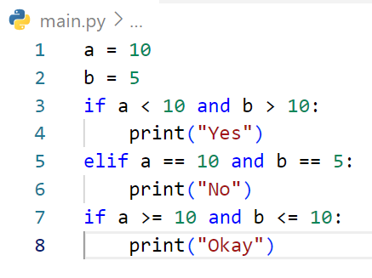
Write step following code below
Step | a | b | a < 10 and b > 10 | a == 10 and b == 5 | a >= 10 and b <= 10 | output
1 | 10
2 | 10 | 5
3 | 10 | 5 | False
4 | 10 | 5
5 | 10 | 5 |  | True
6 | 10 | 5 |  |  |  | No
7 | 10 | 5 |  |  | True
8 | 10 | 5 |  |  |  | Okay

Slide 10
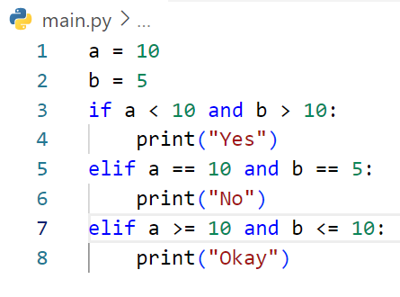
Write step following code below
Step | a | b | a < 10 And b >10 | a == 10 And b ==5 | a >= 10 and b <= 10 | output
1 | 10
2 | 10 | 5
3 | 10 | 5 | False
4 | 10 | 5
5 | 10 | 5 |  | True
6 | 10 | 5 |  |  |  | No

Slide 11
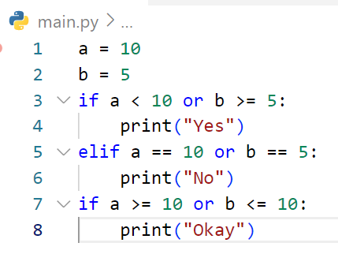
Write step following code below
Step | a | b | a < 10 and b >=5 | a == 10 or b == 5 | a >= 10 or b <= 10 | output
1 | 10
2 | 10 | 5
3 | 10 | 5 | True
4 | 10 | 5 |  |  |  | Yes
5 | 10 | 5
6 | 10 | 5
7 | 10 | 5 | True
8 | 10 | 5 |  |  |  | Okay

Slide 12
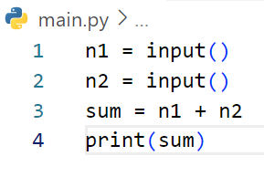
Write step following code below
Step | n1 | n2 | sum | output
1 | 3
2 | 3 | 5
3 | 3 | 5 | 35
4 | 3 | 5 | 35 | 35
# If user enter first : 3 and second 5

Slide 13
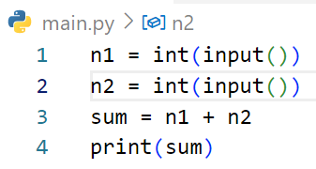
Write step following code below
Step | n1 | n2 | sum | output
1 | 3
2 | 3 | 5
3 | 3 | 5 | 8
4 | 3 | 5 | 8 | 8
# If user enter first : 3 and second 5

Slide 14
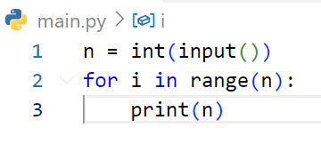
Write step following code below
Step | n | i | output
1 | 3
2 | 3 | 0
3 | 3 |  | 3
4 | 3 | 1
5 | 3 |  | 3
6 | 3 | 2
7 | 3 |  | 3
# If user enter : 3

Slide 15
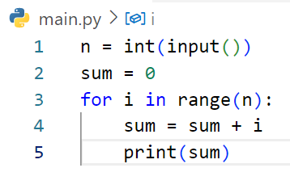
Write step following code below
Step | i | n | sum | output
1 |  | 3
2 |  | 3 | 0
3 | 0 | 3 | 0
4 | 0 | 3 | 0
5 | 0 | 3 | 0 | 0
6 | 1 | 3 | 0
7 | 1 | 3 | 1
8 | 1 | 3 | 1 | 1
9 | 2 | 3 | 1
10 | 2 | 3 | 3
11 | 2 | 3 | 3 | 3
# If user enter : 3

Slide 16
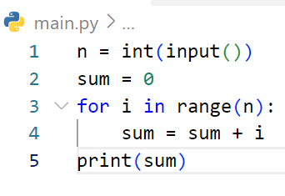
Write step following code below
Step | i | n | sum | output
1 |  | 2
2 |  | 2 | 0
3 | 0 | 2 | 0
4 | 0 | 2 | 0
5 | 1 | 2 | 0
6 | 1 | 2 | 1
7 | 1 | 2 | 1 | 1
# If user enter : 2

Slide 17
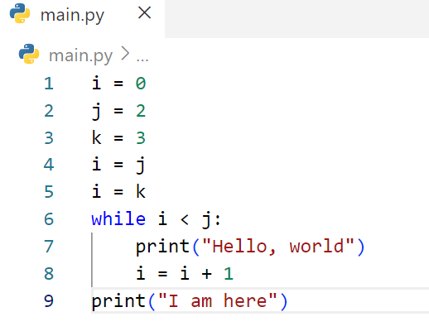
Write step following code below
Step | i | j | k | i < j | output
1 | 0
2 | 0 | 2
3 | 0 | 2 | 3
4 | 2 | 2 | 3
5 | 3 | 2 | 3
6 | 3 | 2 | 3 | False
7 | 3 | 2 | 3 |  | I am here

Slide 18
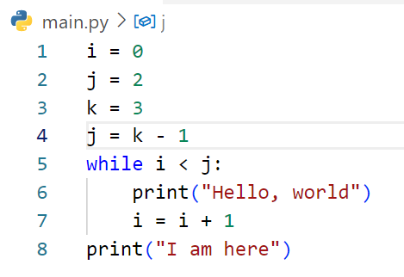
Write step following code below
Step | i | j | k | i < j | output
1 | 0
2 | 0 | 2
3 | 0 | 2 | 3
4 | 0 | 2 | 3
5 | 0 | 2 | 3 | True
6 | 0 | 2 | 3 |  | Hello, world
7 | 1 | 2 | 3
8 | 1 | 2 | 3 | True
9 | 1 | 2 | 3 |  | Hello, world
10 | 2 | 2 | 3
11 | 2 | 2 | 3 | False
12 | 2 | 2 | 3 |  | I am here

Slide 19
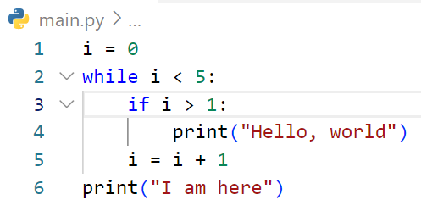
Step | i | i < 5 | i > 1 | output
1 | 0
2 | 0 | True
3 | 0 |  | False
4 | 1
5 | 1 | True
6 | 1 |  | False
7 | 2
8 | 2 | True
9 | 2 |  | True
10 | 2 |  |  | Hello, world
11 | 3
12 | 3 | True
13 | 3 |  | True
14 | 3 |  |  | Hello, world
15 | 4
16 | 4 | True
17 | 4 |  | True
18 | 4 |  |  | Hello, world
19 | 5
20 | 5 | False
21 | 5 |  |  | I am here
Write step following code below

Slide 20
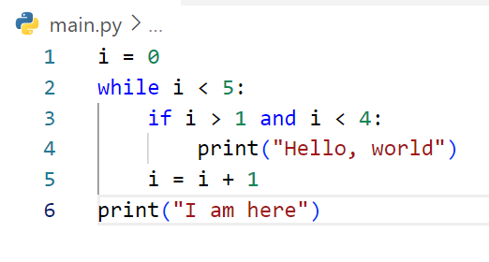
Step | i | i > 5 | i > 4 and i < 4 | output
1 | 0
2 | 0 | True
3 | 0 |  | False
4 | 1
5 | 1 | True
6 | 1 |  | False
7 | 2
8 | 2 | True
9 | 2 |  | True
10 | 2 |  |  | Hello, world
11 | 3
12 | 3 | True
13 | 3 |  | True
14 | 3 |  |  | Hello, world
15 | 4
16 | 4 | True
17 | 4 |  | False
18 | 5
19 | 5 | False
20 | 5 |  |  | I am here
Write step following code below

Slide 21
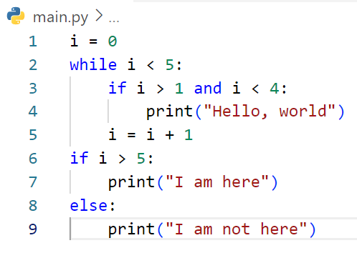
Step | i | i < 5 | i > 1 and I < 4 | i > 5 | output
1 | 0
2 | 0 | True
3 | 0 |  | False
4 | 1
5 | 1 | True
6 | 1 |  | False
7 | 2
8 | 2 | True
9 | 2 |  | True
10 | 2 |  |  |  | Hello world
11 | 3
12 | 3 | True
13 | 3 |  | True
14 | 3 |  |  |  | Hello world
15 | 4
16 | 4 | True
17 | 4 |  | False
18 | 5
19 | 5 | False
20 | 5 |  |  | False
21 | 5 |  |  |  | I am not here
Write step following code below

Slide 22
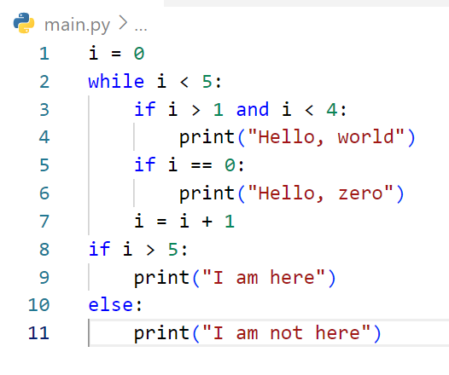
Step | i | i < 5 | i > 1 and I < 4 | I == 0 | i > 5 | output
1 | 0
2 | 0 | True
3 | 0 |  | False
4 | 0 |  |  | True
5 | 0 |  |  |  |  | Hello,zero
6 | 1
7 | 1 | True
8 | 1 |  | False
9 | 1 |  |  | False
10 | 2
11 | 2 | True
12 | 2 |  | True
13 | 2 |  |  |  |  | Hello,world
14 | 2 |  |  | False
15 | 3
16 | 3 | True
17 | 3 |  | True
18 | 3 |  |  |  |  | Hello,world
19 | 3 |  |  | False
20 | 4
21 | 4 | True
22 | 4 |  | False
23 | 4 |  |  | False
24 | 5
25 | 5 | False
26 |  |  |  |  | False
27 |  |  |  |  |  | I am not here
Write step following code below

Slide 23
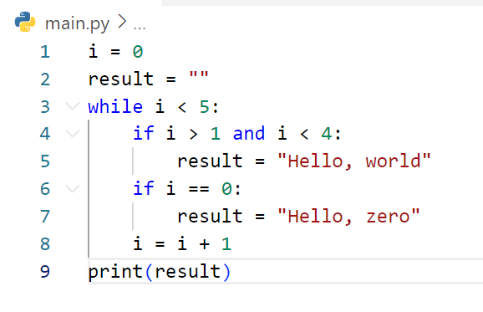
Step | i | i < 5 | i > 1 and i <4 | i == 0 | result | output
1 | 0
2 | 0
3 | 0 | True
4 | 0 |  | False
5 | 0 |  |  | True
6 | 0 |  |  |  | Hello, zero
7 | 1
8 | 1 | True
9 | 1 |  | False
10 | 1 |  |  | False
11 | 2
12 | 2 | True
13 | 2 |  | True
14 | 2 |  |  |  | Hello, world
15 | 2 |  |  | False
15 | 3
16 | 3 | True
17 | 3 |  | True
18 | 3 |  |  |  | Hello,world
19 | 3 |  |  | False
20 | 4
21 | 4 | True
22 | 4 |  | False
23 | 4 |  |  | False
24 | 5
25 | 5 | False
26 | 5 |  |  |  |  | Hello,word
Write step following code below

Slide 24
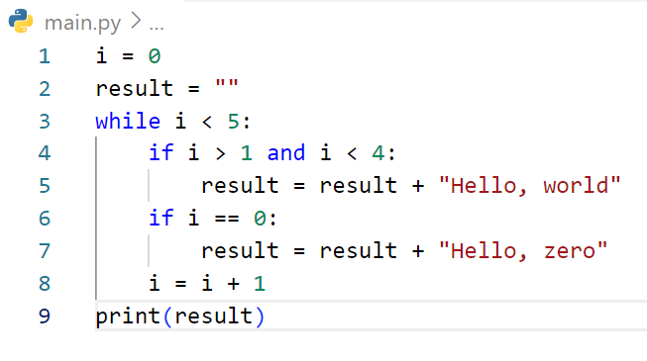
Step | i | i < 5 | i > 1 and i <4 | i == 0 | result | output
1 | 0
2 | 0
3 | 0 | True
4 | 0 |  | False
5 | 0 |  |  | True
6 | 0 |  |  |  | Hello, zero
7 | 1
8 | 1 | True
9 | 1 |  | False
10 | 1 |  |  | False
11 | 2
12 | 2 | True
13 | 2 |  | True
14 | 2 |  |  |  | Hello, zero Hello, world
15 | 2 |  |  | False
15 | 3
16 | 3 | True
17 | 3 |  | True
18 | 3 |  |  |  | Hello, zero Hello, world Hello,world
19 | 3 |  |  | False
20 | 4
21 | 4 | True
22 | 4 |  | False
23 | 4 |  |  | False
24 | 5
25 | 5 | False
26 | 5 |  |  |  |  | Hello, zero Hello, world Hello,world
Write step following code below

Slide 25
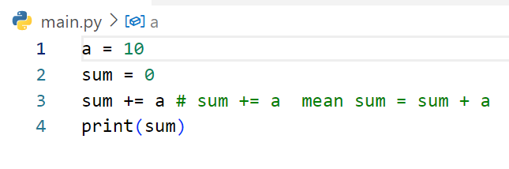
Write step following code below
Step | a | sum | output
1 | 10
2 | 10 | 0
3 | 10 | 10
4 | 10 | 10 | 10

Slide 26
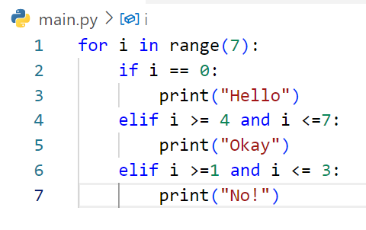
Step | i | i == 0 | i >= 4 and i <= 7 | i >= 1 and i <= 3 | output
1 | 0
2 | 0 | True
3 | 0 |  |  |  | Hello
4 | 1
5 | 1 | False
6 | 1 |  | False
7 | 1 |  |  | True
8 | 1 |  |  |  | No!
9 | 2
10 | 2 | False
11 | 2 |  | False
12 | 2 |  |  | True
13 | 2 |  |  |  | No!
14 | 3
15 | 3 | False
16 | 3 |  | False
17 | 3 |  |  | True
18 | 3 |  |  |  | No!
19 | 4
20 | 4 | False
21 | 4 |  | True
22 | 4 |  |  |  | Okay
23 | 5
24 | 5 | False
25 | 5 |  | True
26 | 5 |  |  |  | Okay
27 | 6
28 | 6 | False
29 | 6 |  | True
30 | 6 |  |  |  | Okay
Write step following code below

Slide 27
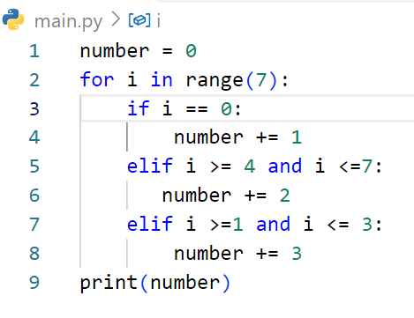
Step | i | number | i == 0 | i >= 4 and i <= 7 | i >= 1 and i <=3 | output
1 |  | 0
2 | 0 | 0
3 | 0 |  | True
4 | 0 | 1
5 | 1
6 | 1 |  | False
7 | 1 |  |  | False
8 | 1 |  |  |  | True
9 | 1 | 4
10 | 2
11 | 2 |  | False
12 | 2 |  |  | False
13 | 2 |  |  |  | True
14 | 2 | 7
15 | 3
16 | 3 |  | False
17 | 3 |  |  | False
18 | 3 |  |  |  | True
19 | 3 | 10
20 | 4
21 | 4 |  | False
22 | 4 |  |  | True
23 | 4 | 12
24 | 5
25 | 5 |  | False
26 | 5 |  |  | True
27 | 5 | 14
28 | 6
29 | 6 |  | False
30 | 6 |  |  | True
31 | 6 | 16
32 | 6 |  |  |  |  | 16
Write step following code below

